Slide 1
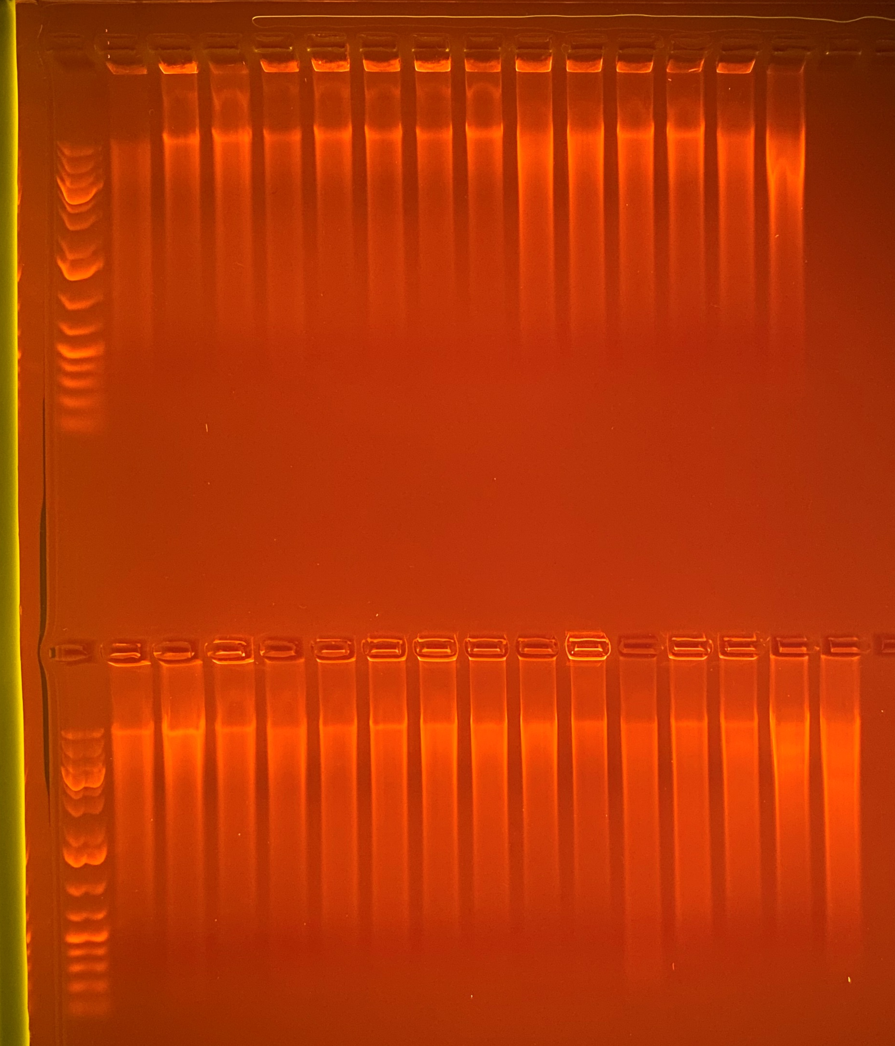
1 kb
Plus
Gene
Ruler
30.5
80.4
48.8
39.0
111.5
44.7
54.4
46.7
80.8
81.4
67.2
71.0
74.7
119
769
770
772
784
785
863
869
870
393
400
404
406
416
434
20000
5000
1500
500
75
Average Qubit Assay Value (DNA ng/l) given above sample number
1 kb
Plus
Gene
Ruler
63.0
120
53.4
61.5
60.9
84.5
81.6
76.9
59.8
62.1
53.9
69.0
68.6
152
121
451
472
483
751
762
781
788
789
790
795
801
839
840
861
866
20000
5000
1500
500
75

