Slide 1
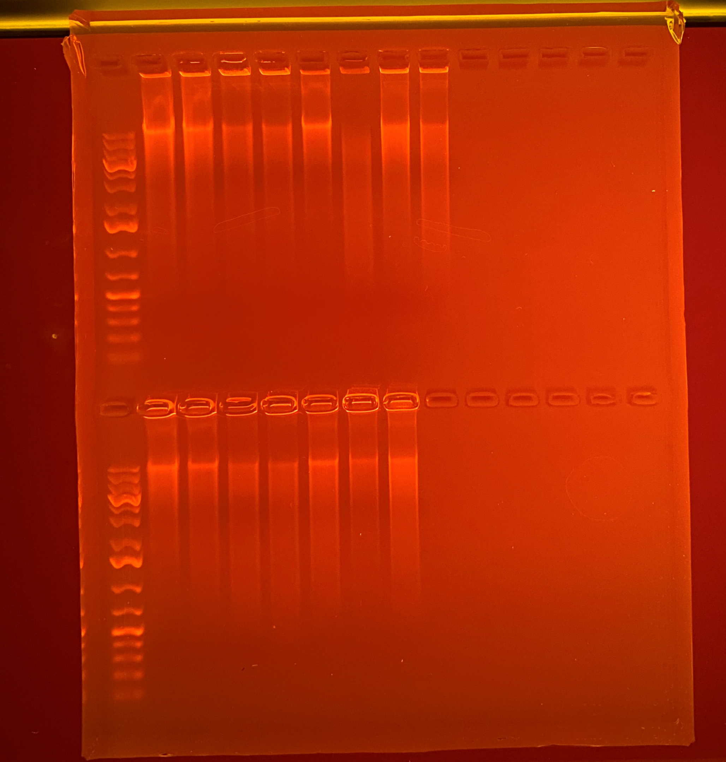
1 kb
Plus
Gene
Ruler
95.2
77.8
59.7
56.4
50.0
30.2
71.9
57.7
425
444
447
450
455
464
466
467
20000
5000
1500
500
Average Qubit Assay Value (DNA ng/l) given above sample number
75
1 kb
Plus
Gene
Ruler
55.9
50.8
46.3
55.6
50.8
53.4
66.0
470
488
776
777
780
838
887
20000
5000
1500
500
75

