Slide 1
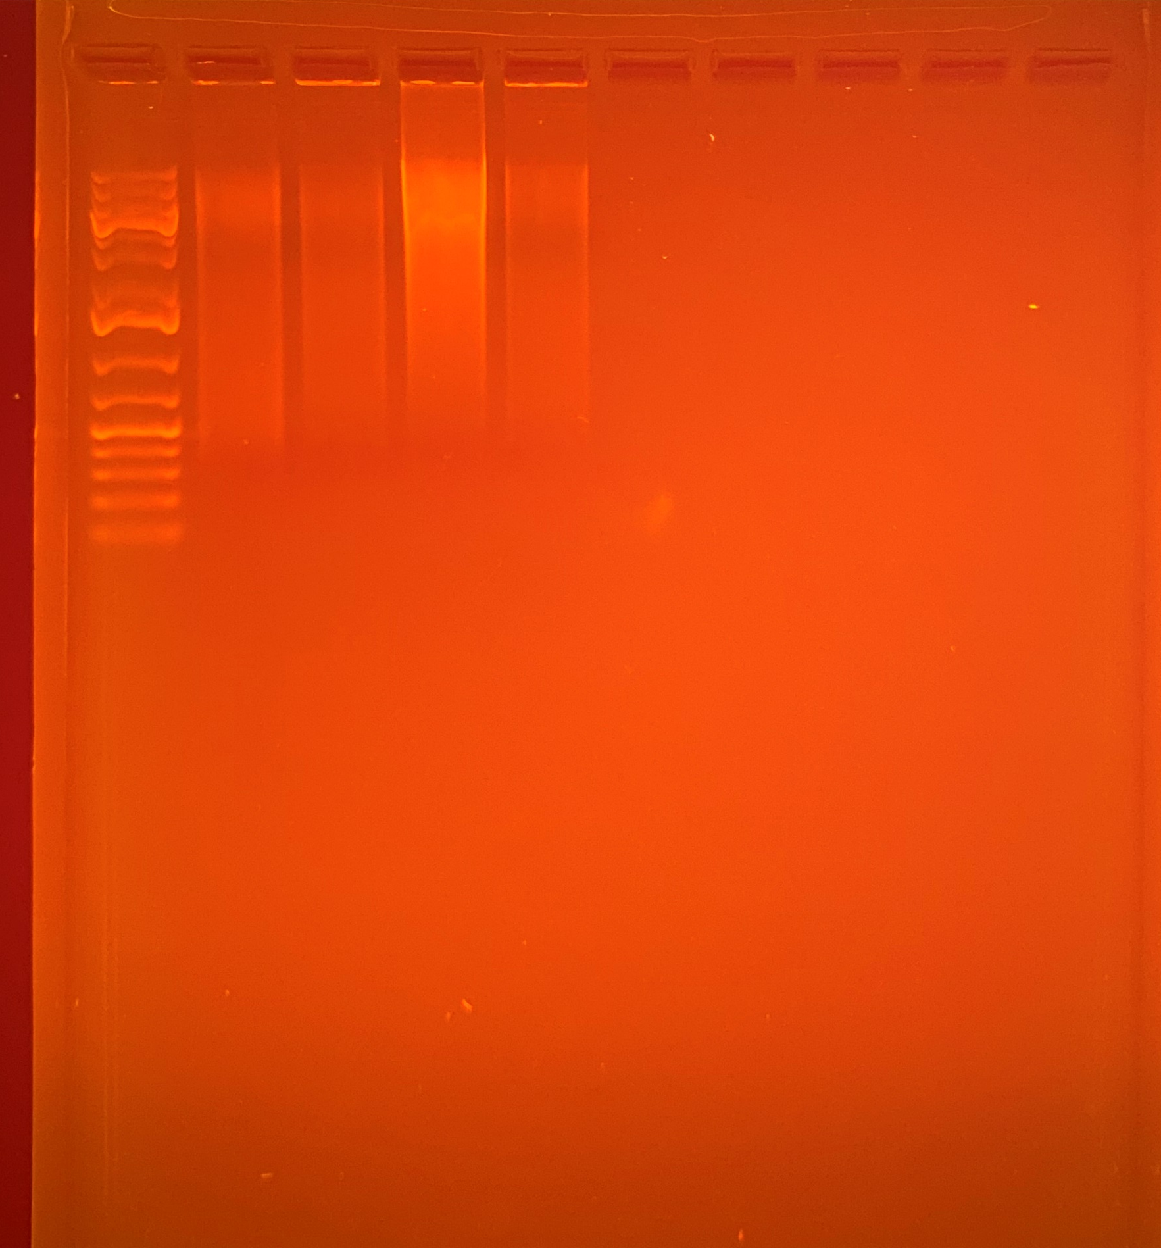
36.8
30.2
137
30.5
464
464
464-2
769
769-2
769
20000
5000
1500
500
75
Average Qubit Assay Value (DNA ng/l) given above sample number

