Slide 1

DevOps
Digital Transformation

Slide 2
Contents
Goals
Criticism
Cultural change
Deployment
Adoption

Slide 3


Goals
With goals FAST beats SMART

Slide 4

Criticism
While acknowledging that large companies such as Google and Facebook benefit from implementing DevOps, and that "there is no lack of appetite to experiment with DevOps practices" within "Fortune 500s and specifically financial services firms", Shannon-Solomon remarks that "there are few true change agents within enterprise IT willing to affect DevOps implementations."

Slide 5

Cultural change
Leadership + Change Management
Notes:
Consider talking about:
DevOps as a job title
Building a DevOps culture

Slide 6
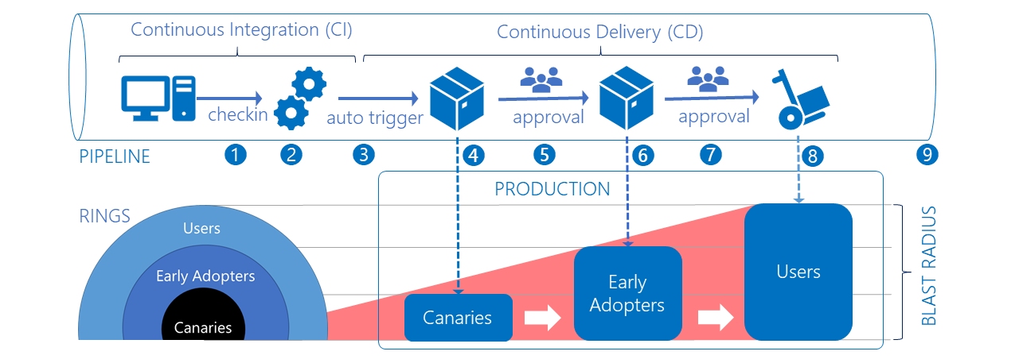
Deployment
Notes:
Consider talking about:
Architecturally significant requirements
Microservices
DevOps automation

Slide 7
Adoption of DevOps
The Best Practice is to Adopt a DevOps Model.
Automated deployment are prerequisite of DevOps, so architectures that makes automation easier are an inevitable result of DevOps adoption.
Adoption of DevOps is being driven by many factors including use of agile method.
One really driving factor to adoption of DevOps is missing the lack of good operators in economical terms.

Slide 8

DevOps Works cited
The state of DevOps Report 2020 released by Puppet reveals that internal platform for self-service and effective change management practice.

