Slide 1



Slide 2
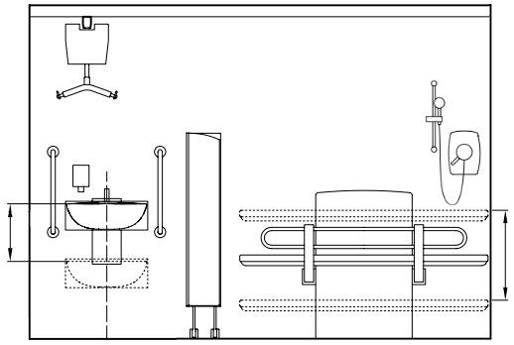
Hoist and ceiling track
Shower
Privacy screen
Adjustable height sink
Adjustable height
change table

