Slide 1

Quick summary

Slide 2
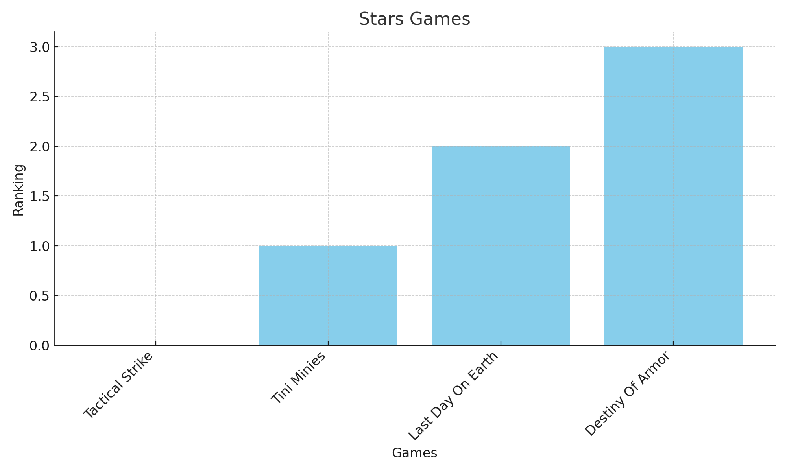
Stars Games

Slide 3
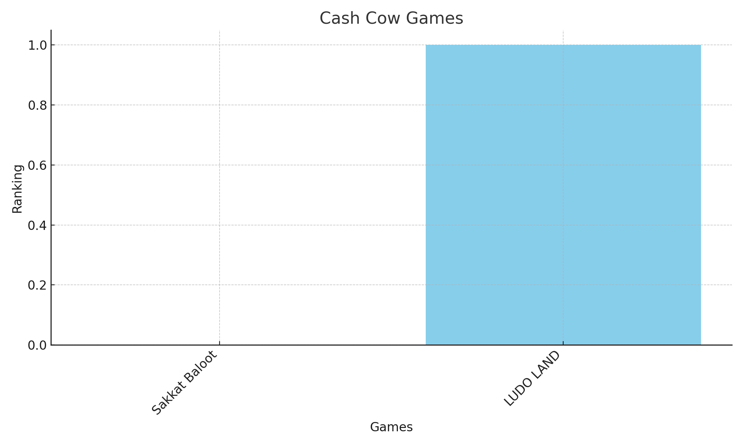
Cash Cow Games

Slide 4
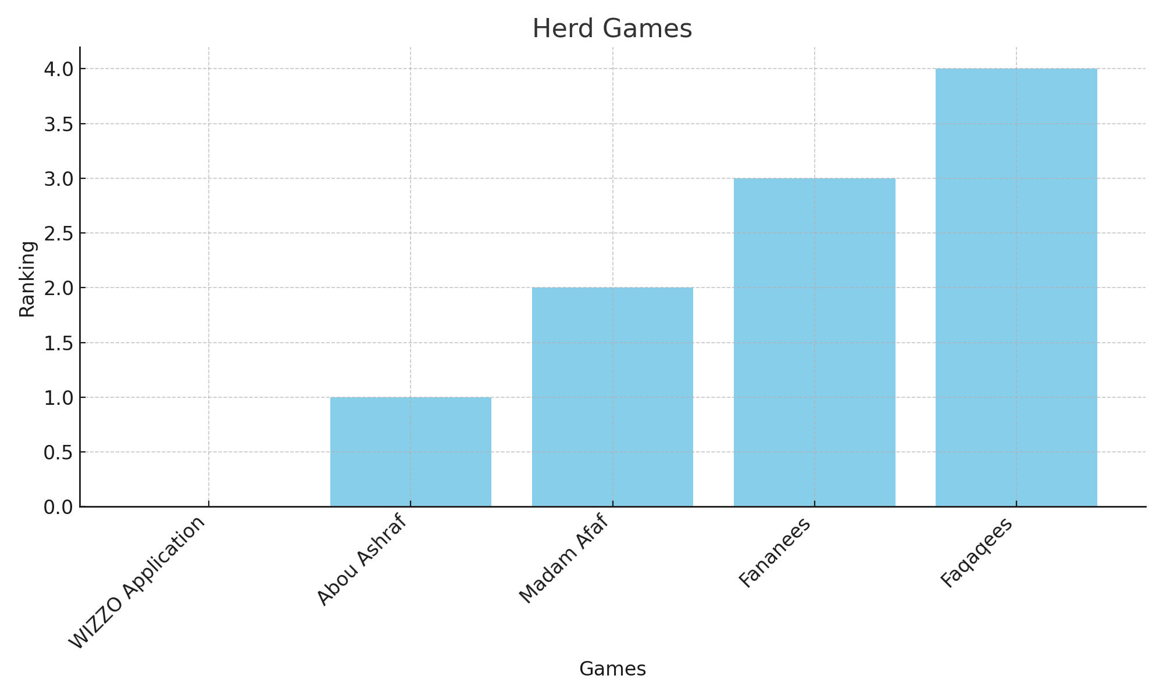
Herd Games

Slide 5
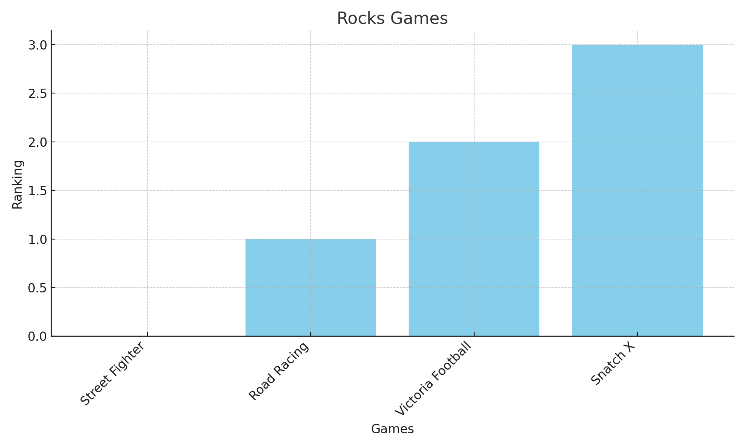
Rocks Games

Slide 6
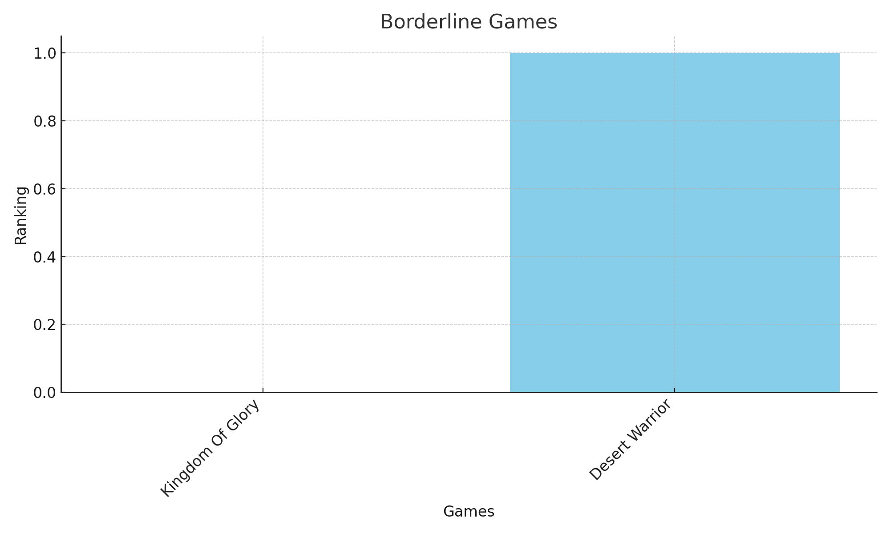
Borderline Games

