Slide 1
Real Estate ANALYSIS TEAM 4

Slide 2
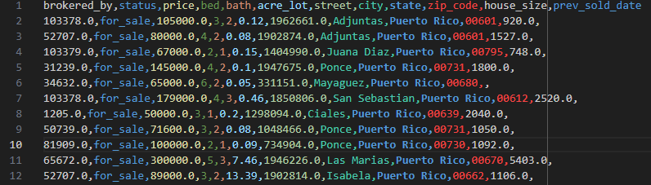
Dataset Overview
Source of Data:
Kaggle dataset scraped from realtor.com
"USA Real Estate Dataset" provides comprehensive information about real estate properties across the United States (and Puerto Rico and the Virgin Islands)
Sale data includes status, price, bedrooms, bathrooms, city, zip code, state, street, and house/lot size
Sold data includes information from November 2021 to April 2022

Slide 3
Cleaning the data
Dropped street data due to serialization
Performed .dropna() to filter out rows where data was missing
Focused only on 50 US states (dropped Puerto Rico, Virgin Islands, District of Columbia and Hawaii)

Slide 4
Real Estate Market Analysis OF AVERAGE PRICE OF HOMES IN DIFFERENT STATES

Slide 5
Intro
Objective: Determine the Average Price of Homes in the 50 different states and comparing it to the national average.
Focus: Property sales prices and their averages.
Key Questions:
What is the average price of houses sold in each state?
What is the national average value of houses sold in the USA?
How does each state’s average compare to the national average?

Slide 6
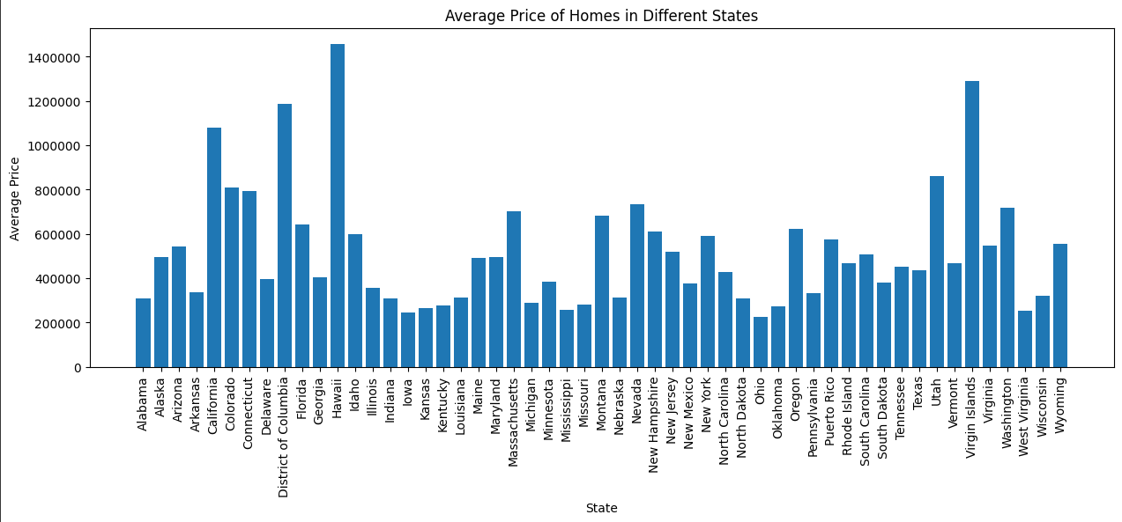
ANALYSIS OF THE AVERAGE VALUE OF HOUSES IN DIFFERENT STATES
Using the .mean() function and lambda formatting, we created a data frame with the 50 different states and the average value of the houses sold.
Created a bar graph using matplotlib to visualize the results

Slide 7
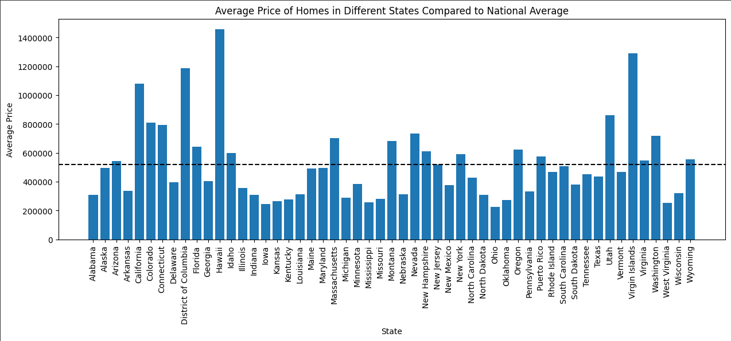
Comparing the state averages to the national average price of houses
Computed the sum thus finding the mean(national average price) of houses sold in the USA.
Represented the national average as a dotted line across the bar graph representing the average price of homes in different sates

Slide 8
Real Estate Market Analysis how does the number of bedrooms affect the price of homes

Slide 9
Intro
Objective: Determine how the number of bedrooms affects the price of houses.
Focus: Number of bedrooms and their correlation to the price of the house.
Key Questions:
What is the average price of houses with a specific number of bedrooms?
How does the number of bedrooms affect the price of houses?

Slide 10
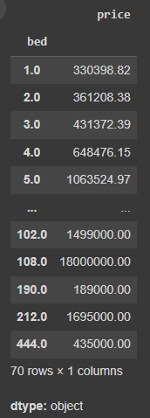
Initial Analysis of Number of bedrooms and its correlation to the price of homes
Used .mean() to find average price of houses based of number of bedrooms
Quickly realized, it didn’t make sense due to the different costs of living and prices of houses in different states
Decided to focus on individual states since the cost of living in each specific state
was more consistent.
Took out four states due to them being outliers(DC, Hawaii, Virgin Islands)

Slide 11
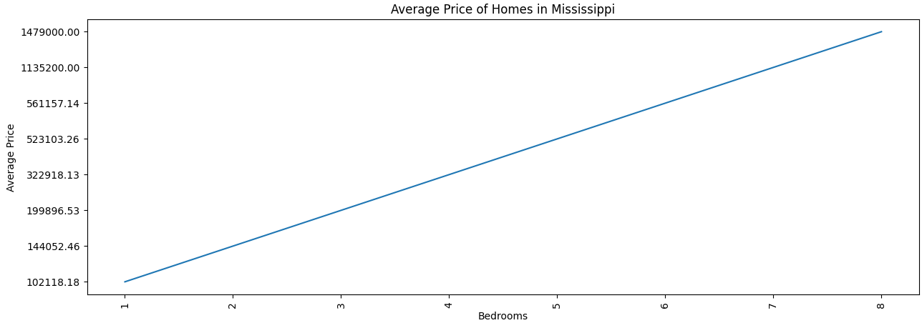
Analysis of Number of bedrooms and its correlation to the price of homes in specified states.
Nickson(Mississippi)
Filtered out the state of Mississippi and computed the average value of houses based on the number of
Bedrooms present in the house
Used matplotlib to visualize the perfect line graph that resulted. Displayed a positive relationship

Slide 12
Real Estate Market Analysis in Michigan and Midwest States (2021-2022)

Slide 13
Intro
Objective: Analyze real estate market trends in Michigan and the Midwest.
Focus: Property sales between 2021 and 2022.
Key Questions:
How did property sales compare in Michigan’s top 10 ZIP codes?
What are the sales trends across Midwest states?
Is there a correlation between population size and property sales?

Slide 14
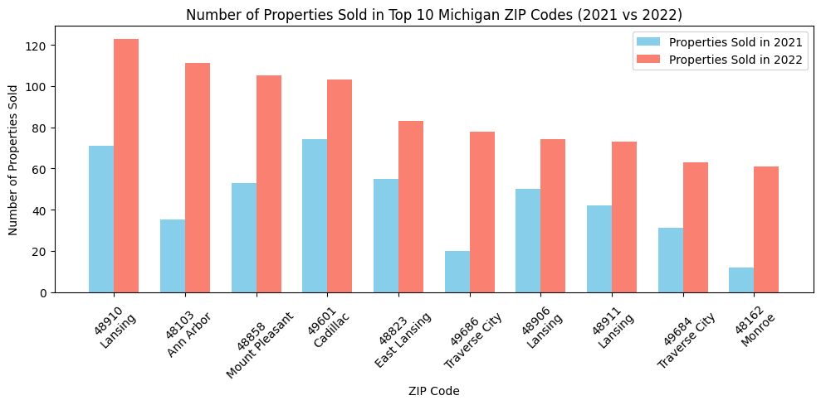
Initial Analysis of Top 10 Michigan ZIP Codes
Lansing appeared multiple times, leading to unreliable visualizations
Decision to pivot to city-based analysis for more accuracy
Didn’t like this output

Slide 15
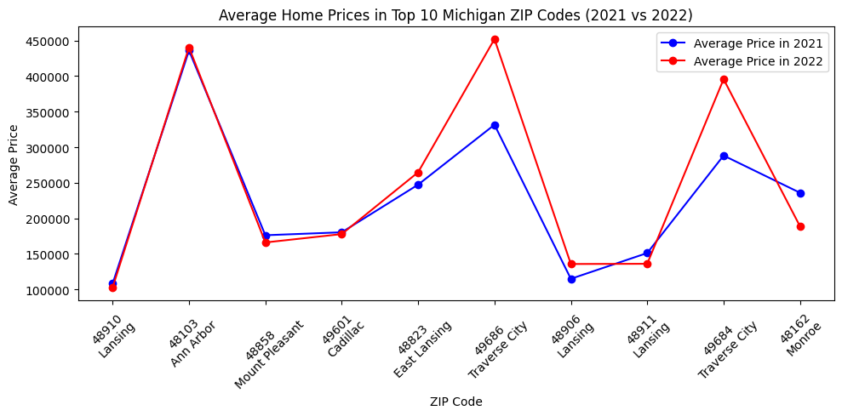
Initial Analysis of Top 10 Michigan ZIP Codes

Slide 16
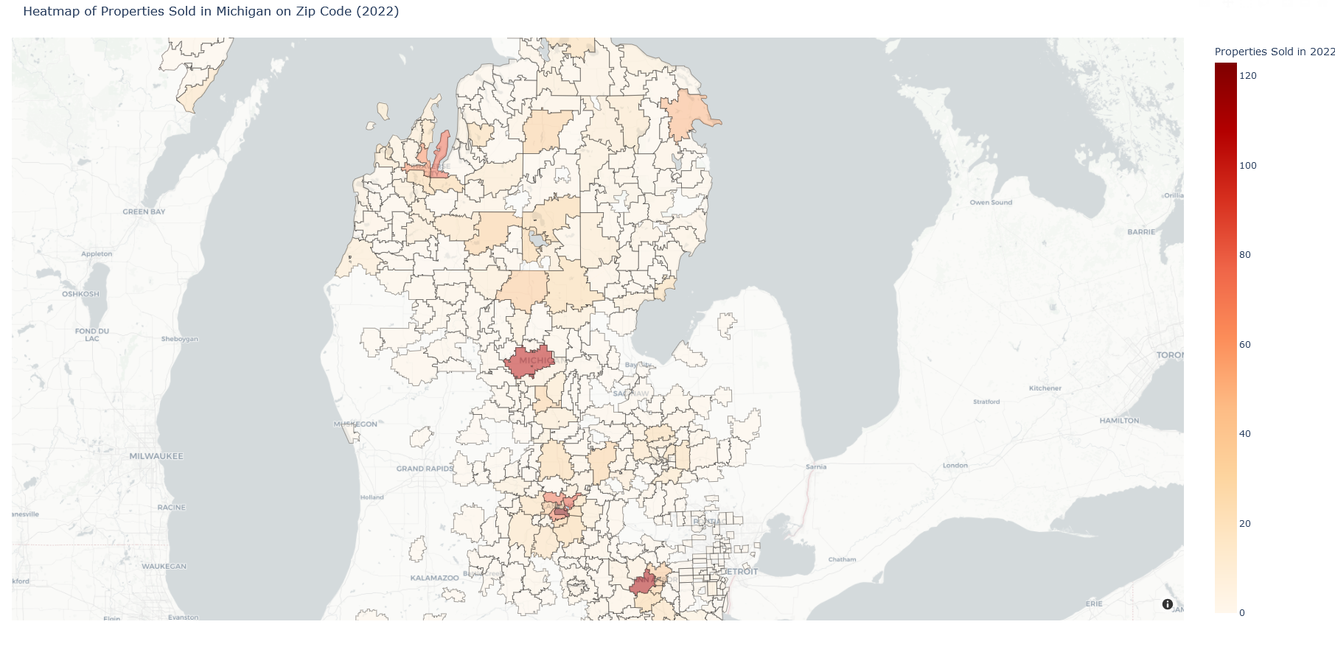
Zip code based heatmap
Mapped national shape file to state file for Michigan based on zip codes and location coordinates

Slide 17
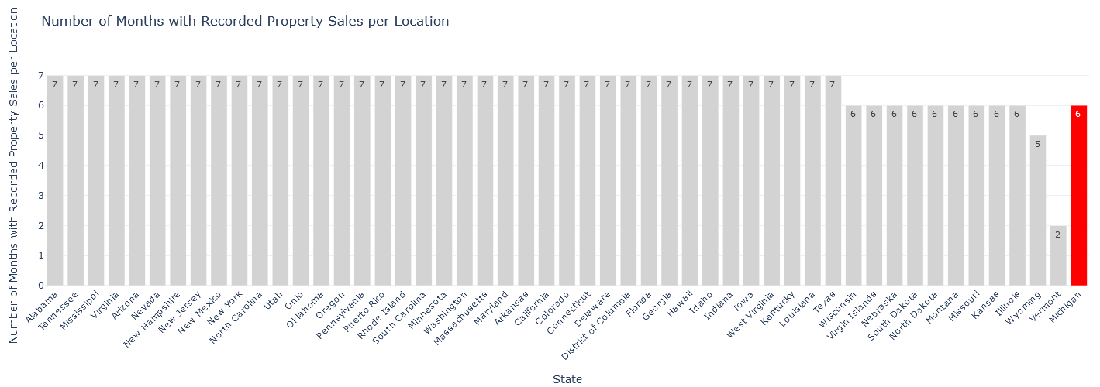
Focusing on sold data
Limited to 4Q 2021 and 1Q 2022

Slide 18
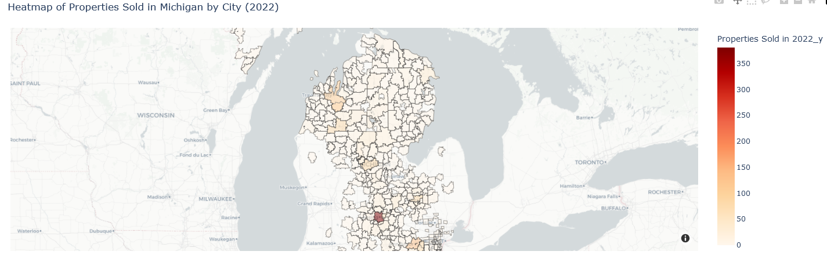
Pivot to city-based analysis
Shift to latitude and longitude data for city-level heatmaps
More accurate representation of property sales

Slide 19
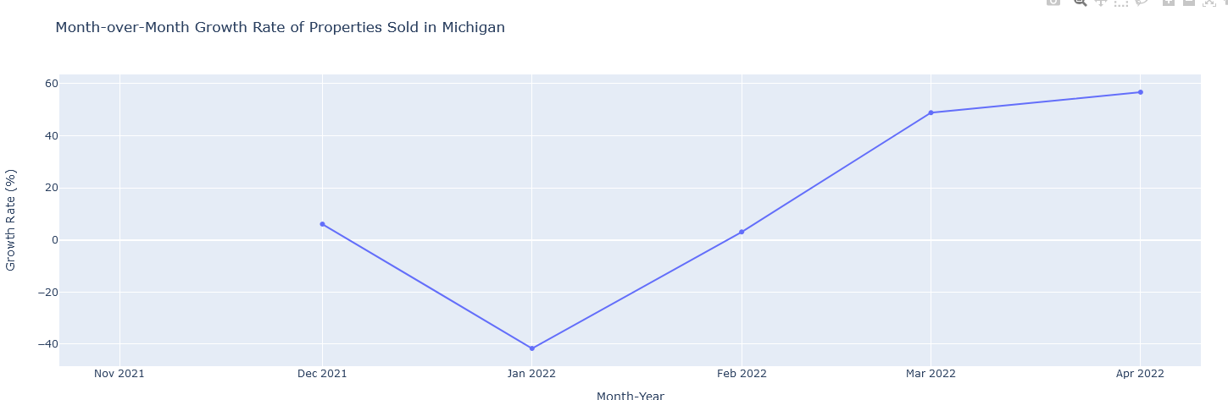
GROWTH RATE

Slide 20
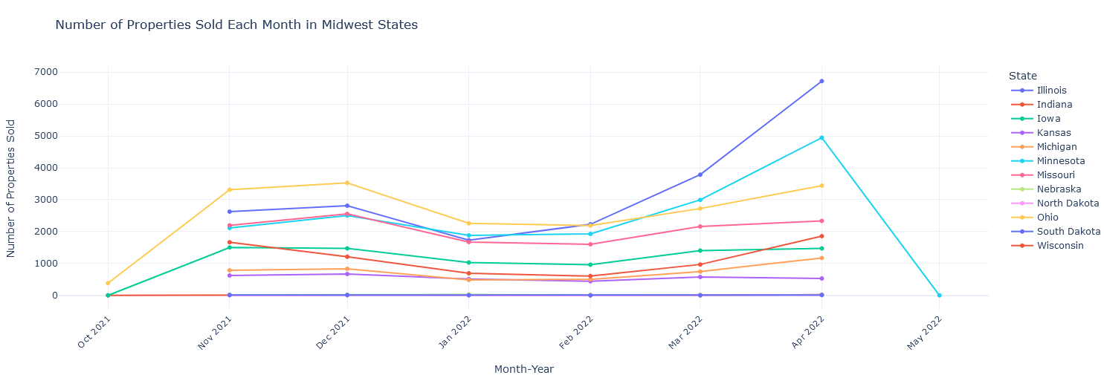
MIDWEST COMPARISON

Slide 21
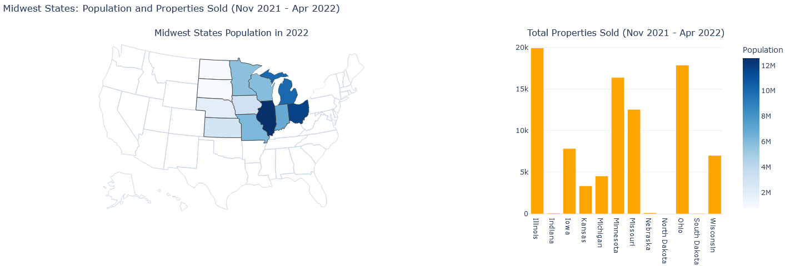
MIDWEST SALES BASED ON POPULATION

Slide 22
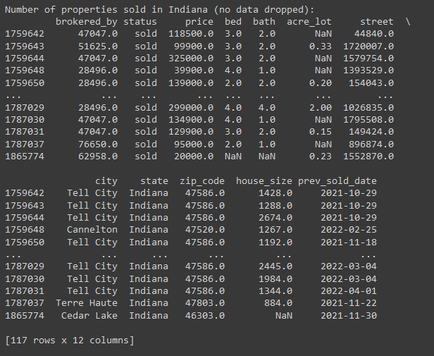
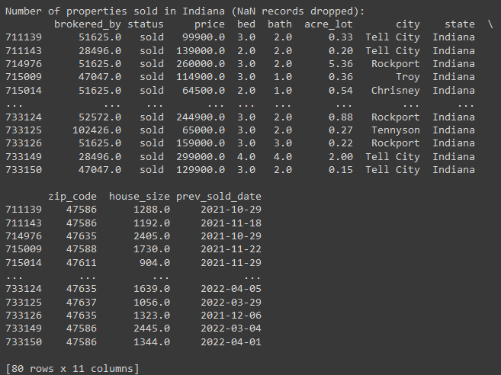
OUTLIERS?

Slide 23
Abandoned approaches
Attempted comparative analysis
Could not find datasets
Forecasting challenges
Only six months of data for Michigan
Impact of data cleaning
Reduced sampling size
Why was some data missing?

Slide 24

Thank you

