Slide 1
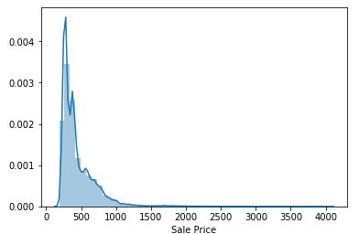
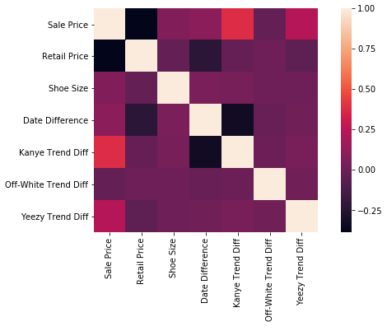
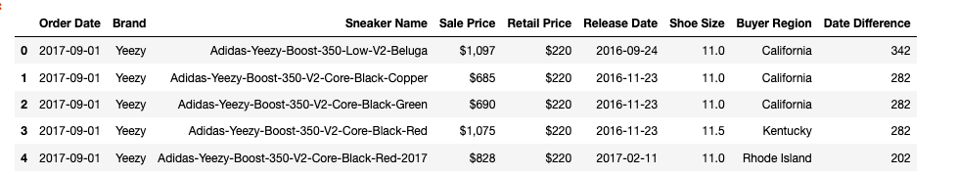
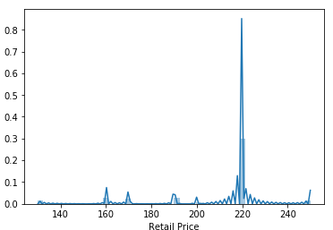
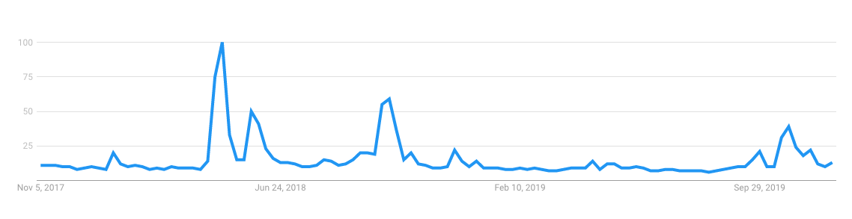
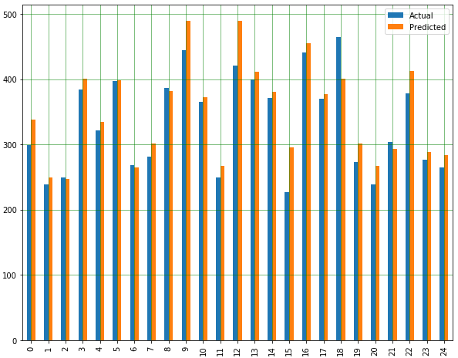
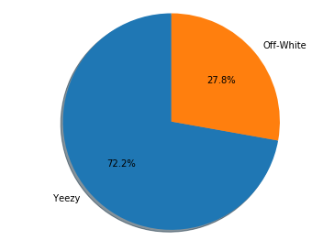
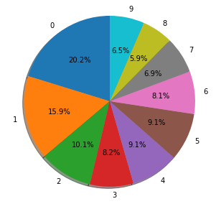
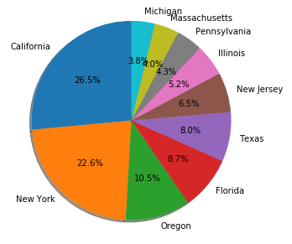


A Deep Dive into the Secondary Shoe Market Exchange StockX and an Analysis of Market Trends
David Neary and Anton Njavro
CS 591 Data science in e-commerce
Introduction
Exploratory Data Analysis
Prediction
Predictions via financial models
With the global sneaker market reaching a valuation of $58 billion in 2018 and with predicted CAGR of 7% in the next six years, a great number of platforms facilitating the secondary market model for sneakers have emerged. One of the largest being StockX, currently valued at around $1 billion. This high-level research project focused on using StockX data in order to get a better understanding of the secondary shoe market and to perform predictive analysis on listed transactions.
We proceeded to examine StockX data in more detail in order to obtain a better understanding of some of the underlying trends in the market. By simply calculating some basic statistics for resale prices and original prices, we’ve noted that resale is on average 114% greater than original prices. Geographically,is significant portion of the buyers come from California and New York, where such “streetwear” culture is most predominant. Regarding the Google Trends data, we have predominantly focused on data that had higher than average value. We have also created our unique features, such as date difference between release and sale.
Our initial prediction started by plotting out the correlation matrix of our data, which indicated relatively weak correlations among our features. Only meaningful correlations were found on “Yeezy” brand, and its correlation to “Kanye West” related Google Trends. We started by performing simple linear regression on dataset made out of only “Yeezy” shoe sales. Linear regression did not give promising results with only 0.37 variance explained and with RMSE of 115. We then proceeded to use a more advanced LGBM algorithm to tackle non-correlated data. That approach after careful feature engineering gave a promising result of 0.81 explained variance and RMSE of 61.
Classical prediction models from the financial world were also tested such as the typical runs analysis. Using a preliminary runs model calculating cumulative price movements we were able to lower the RMSE to 89 and bring the explained variance to .88. This result is particularly prominent as it does not utilize the second dataset, and relies on calculations soley achievable with StockX market data.
Data
Conclusions
The main dataset used throughout this research project was provided by StockX during its 2019 data contest. The main dataset consists of 99956 unique sales, each marked with 9 attributes. Besides StockX data we also utilized Google Trends data in order to follow popularity sentiments.
Interestingly the classical financial prediction models had similar predictive power as our advanced machine learning model. This suggests that the StockX market may be suited to be treated as a normal exchange, rather than an illiquid one. Implementation of more advanced asset price prediction models may be justified as a result.
The lack of significant simple correlations made this analysis particularly difficult. Future analysis using a runs model might implement more advanced features such as combining it with a classical linear regression using the available categorical data too. Our regression toolkits lacked the capabilities to automatically create dummy variables.
In addition we may try to extract other secondary data. Though google trends data was still useful, data such as site traffic, related tweet volume, and comparable model sales data, may help us refine our models and perform more accurate predictions.
Resale prices
StockX dataset example
Correlation matrix for “Yeezy” brand data
2017-2019 Kanye West Google Trends data
Original Price
Sample of LGBM solutions
Linear regression summary
Data distribution between brands
Percentage of date differences
Buyers sate percentage
LGBM summary
Notes:
I can write this out.
Some conlcusions:
Significant price difference
No significant correlations, especially between dates
Some impact of google trends
Future stuff: Find more data, more columns, more fancy ML models

