Slide 1
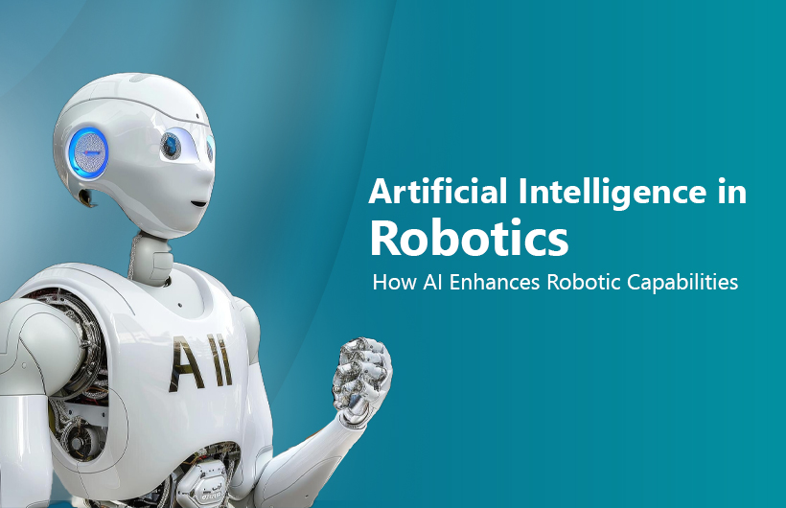
All resources and references used to create these slides can be found on the final "Resources" slide at the end of the presentation and in the BREO resource section.
LECTURER
Dr Massoud Khodadadzadeh
Massoud.Khodadadzadeh@beds.ac.uk
Tutor
Dr Umer Saeed
umer.saeed@beds.ac.uk
Case studies and demonstrations
CLASS CODE:
CIS006-2

Slide 2
AI in Robotics: Real-World Intelligent Robots
Robotics is one of the most visible applications of Artificial Intelligence.
Modern robots combine:
Sensors
Machine learning
Computer vision
Autonomous navigation
Human–robot interaction
In this session, we demonstrate three robots:
AgileX LIMO mobile robot
NAO humanoid robot
Unitree Go2 robotic dog
Unitree G1 humanoid robot
Each robot demonstrates different AI capabilities.
2

Slide 3
Why Robots Are Important in AI
Robots are physical systems that sense, think, and act.
Core AI technologies inside robots
Computer vision
Path planning
SLAM (Simultaneous Localization and Mapping)
Reinforcement learning
Speech recognition
Human-robot interaction
Robotics pipeline
Sensor → Perception → Decision → Action
Example:
Camera → Object detection → Decide movement → Motor control
3

Slide 4
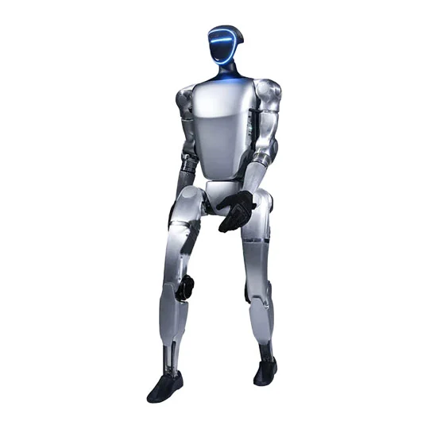
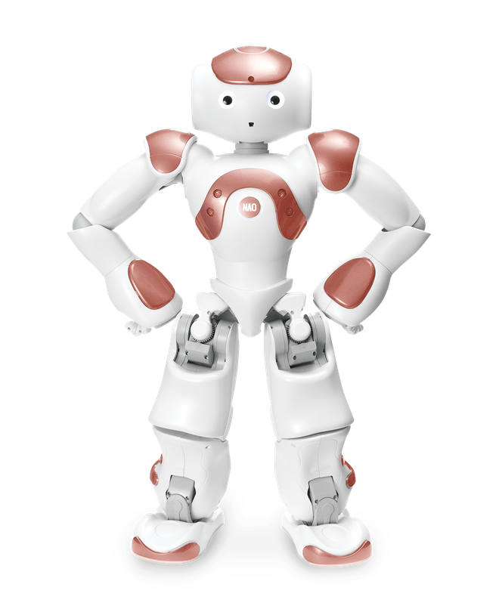
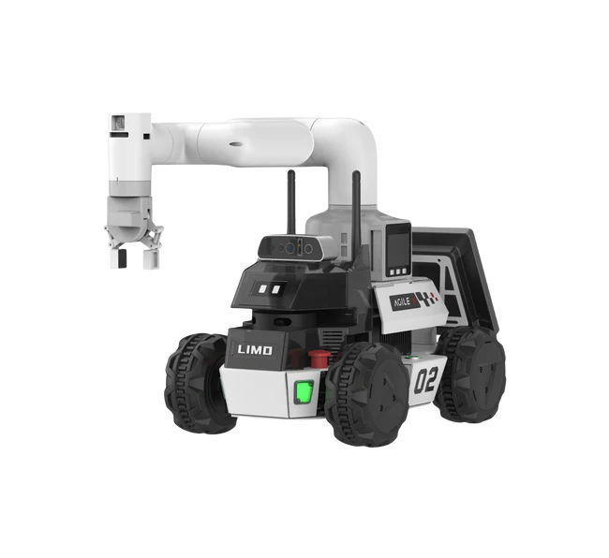
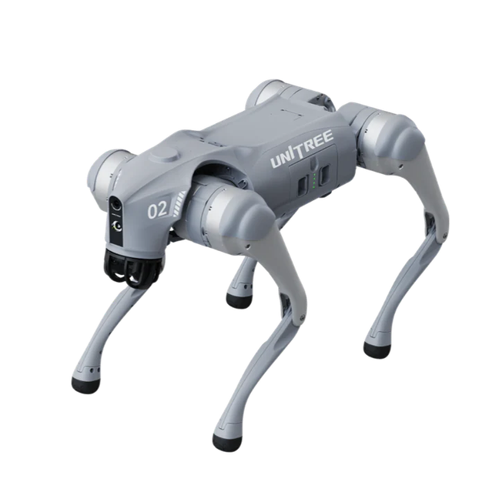
Types of Robots
Robots used in AI research can have different structures.
Common robot types
Mobile robots
autonomous navigation
mapping
Humanoid robots
human interaction
speech and gestures
Quadruped robots
terrain navigation
inspection tasks
4. Advanced humanoid robots
more complex humanoids with many joints
capable of dynamic movement and manipulation
The robots we demonstrate today represent all three.
4

Slide 5
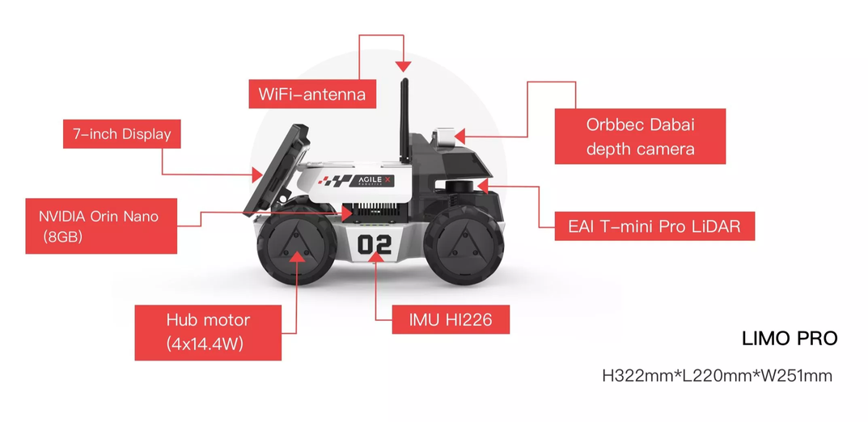
AgileX LIMO Robot
What is LIMO?
LIMO is a small research mobile robot platform designed for AI and robotics education.
It is widely used in universities for teaching:
autonomous navigation
SLAM
computer vision
ROS robotics programming
Key features
Weight: about 4.2 kg
Maximum speed: about 1 m/s
Runtime around 40 minutes
Compatible with ROS robotics framework
Sensors
Typical configuration includes:
LiDAR
depth camera
IMU
wheel encoders
These allow the robot to map its environment and navigate autonomously.
5

Slide 6
LIMO AI Capabilities
What AI can we run on LIMO?
Examples:
1. Autonomous navigation
SLAM
path planning
2. Object detection
camera + YOLO
3. Human following
4. Mapping the environment
6

Slide 7
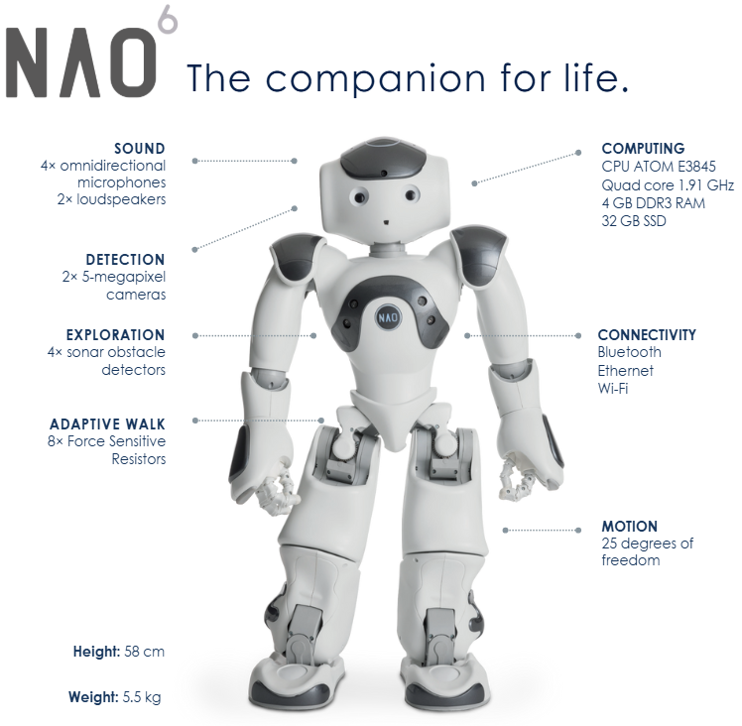
NAO Humanoid Robot
What is NAO?
NAO is a humanoid robot designed for education, research, and human-robot interaction.
Common uses:
teaching programming
social robotics
autism therapy
AI interaction research
Key characteristics
humanoid design
cameras for vision
microphones for speech recognition
speakers for speech output
multiple joints for movement
This allows the robot to interact naturally with people
7

Slide 8
AI Capabilities of NAO
NAO focuses on human-robot interaction.
AI applications
Speech recognition
Natural language interaction
Emotion recognition
Gesture control
Face recognition
Example tasks:
greeting students
answering questions
teaching programming
interacting with children
This robot demonstrates how AI
can interact socially with humans.
8

Slide 9
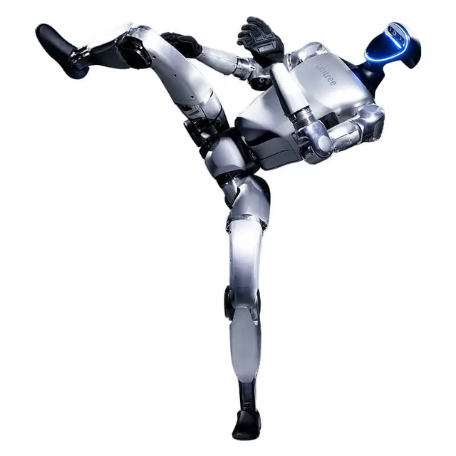
What is Unitree G1?
The Unitree G1 is a next-generation humanoid robot designed for AI research, human-robot interaction, and advanced locomotion. Unlike educational humanoids such as NAO, the G1 is designed to perform complex dynamic movements and manipulation tasks.
Typical uses include:
robotics research
reinforcement learning experiments
humanoid locomotion studies
manipulation tasks with robotic hands
Technical Characteristics
Key specifications:
Height: about 1.3 m
Weight: about 35 kg
Degrees of freedom: 23–43 joints depending on model
Arm payload: about 2–3 kg
Battery life: around 1–2 hours
Sensors include 3D LiDAR, depth cameras, microphones, and speakers.
High degrees of freedom allow the robot to perform human-like movements such as:
walking
running
jumping
manipulation
9

Slide 10
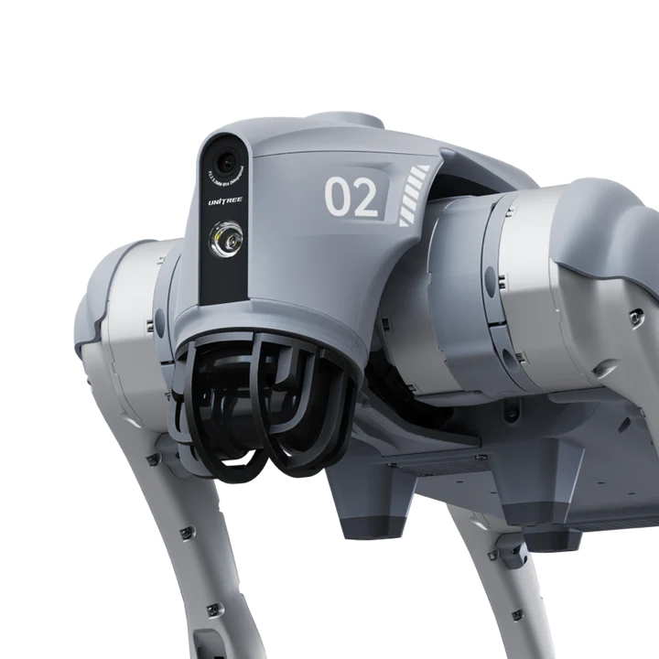
Unitree Go2 Robotic Dog
What is Go2?
Go2 is a quadruped robot, meaning it walks on four legs similar to an animal.
It is designed for:
research
inspection
AI development
search and rescue
Technical highlights
Speed up to 2.5 m/s
Payload up to about 10 kg
Equipped with 4D LiDAR for environment sensing
Onboard AI computing
10

Slide 11
AI Capabilities of Robot Dogs
Quadruped robots focus on mobility and autonomy.
AI technologies used
Reinforcement learning
Locomotion control
Obstacle avoidance
Autonomous exploration
3D mapping
Robot dogs can:
walk on rough terrain
climb slopes
inspect dangerous environments
They are used in:
industrial inspection
military robotics
disaster response
11

