Slide 1
sp-ptc1-2020

Slide 2
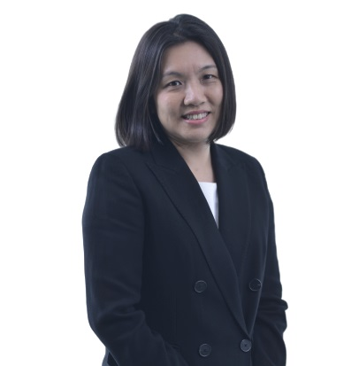
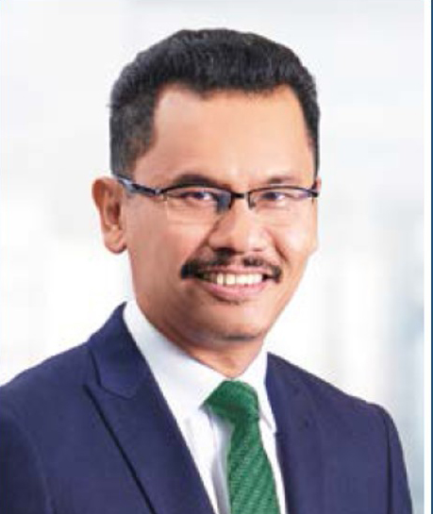
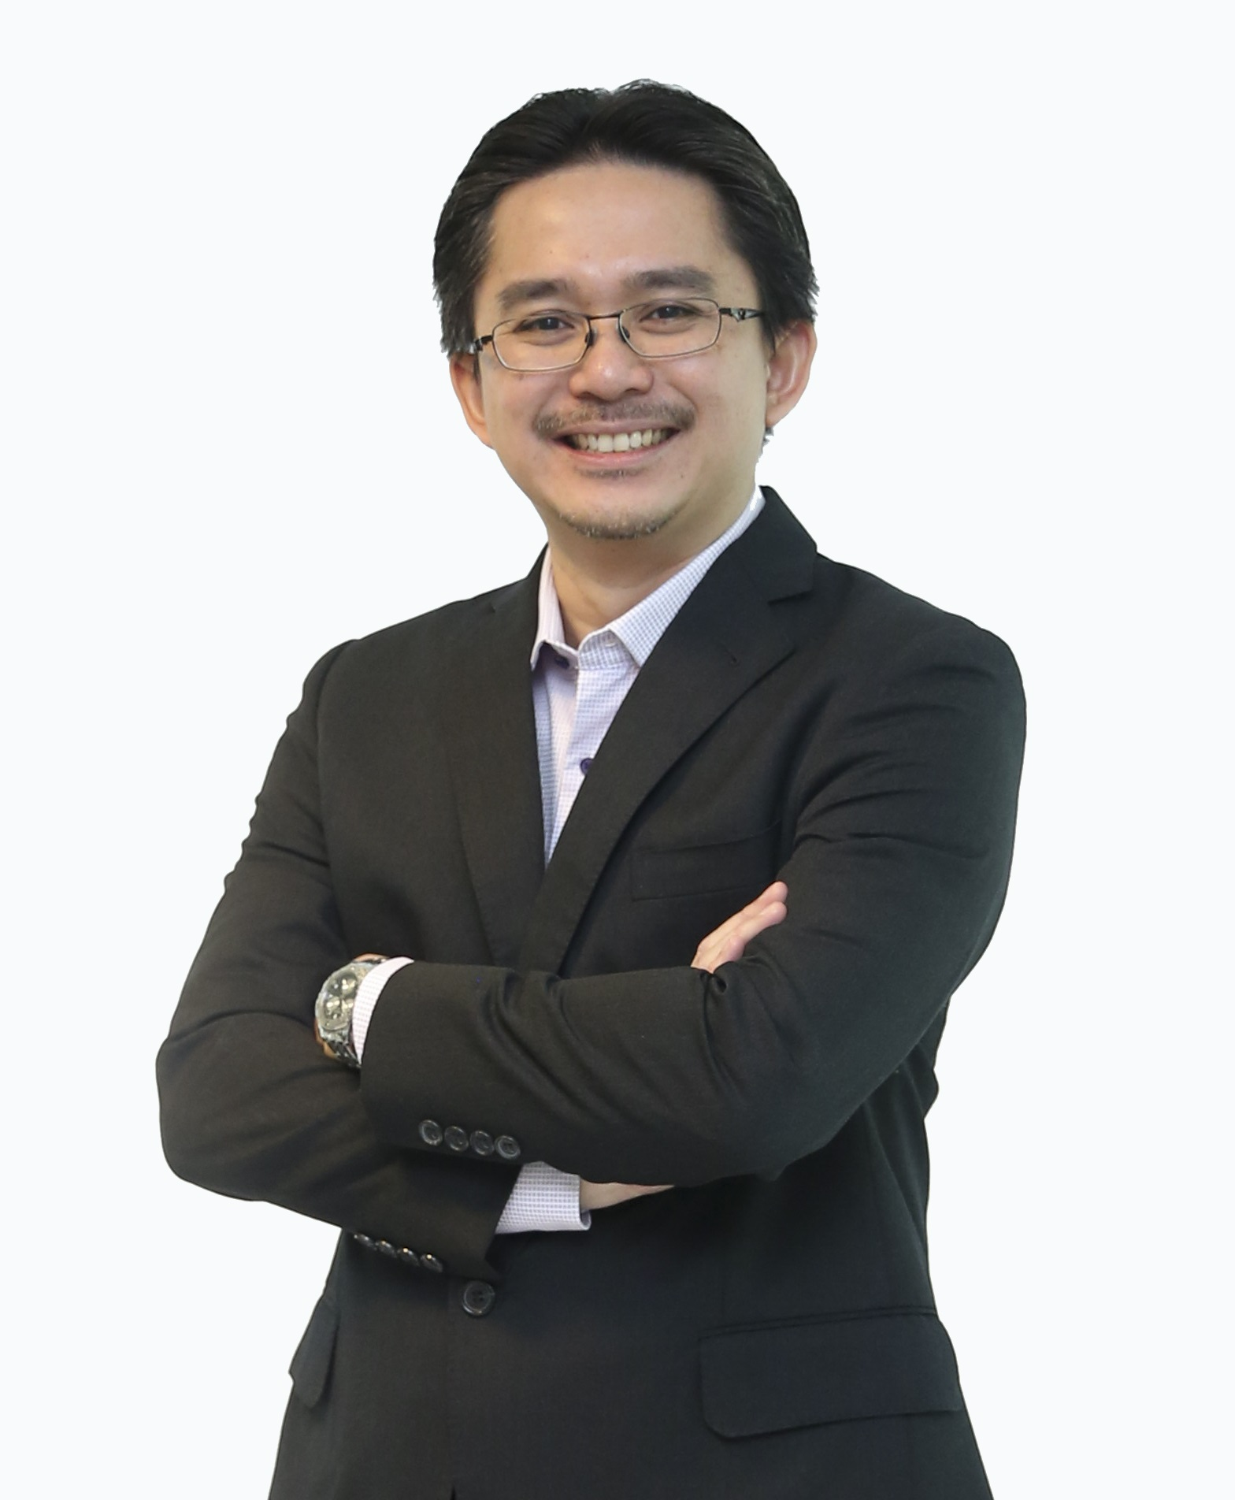
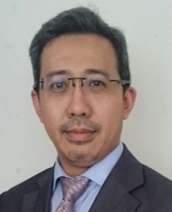
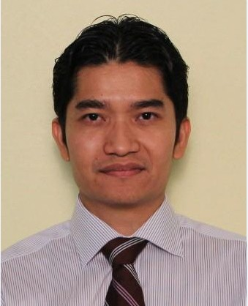
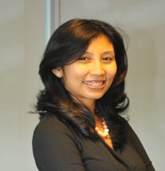
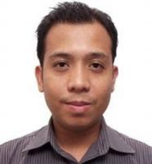
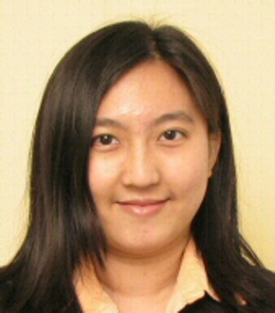
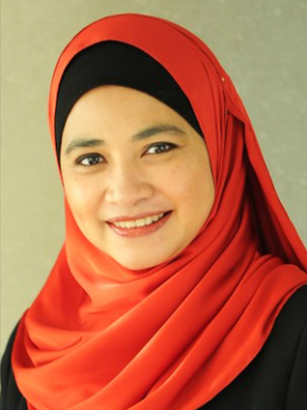
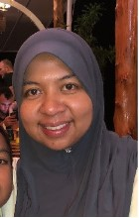
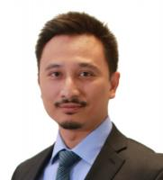
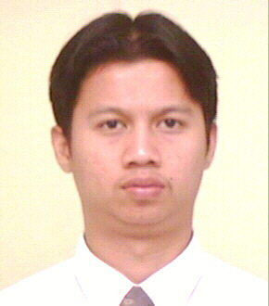
HEAD (CSP)
1st Line |  | 2nd Line |  | 3rd Line |  | 3rd Line
 | Lim Li Ping (G10, CT) Head (Commercial Malaysia), Commercial Malaysia, Commercial, Strategy & Commercial, PCSB, Upstream Business Retire: 03/02/2034, Age: 46 PPA: 1, 2, 2, 1, 2 |  | Abdul Aziz bin Othman (G12, CT) VP, Strategy & New Ventures, Strategy & Corporate Development, International Assets, PCSB, Upstream Business Retire: 06/08/2020, Age: 54 PPA: 2, 2, 1, 2, 1 |  | Abang Jimmy bin Abang Mordian (G10, CT) Head (Leadership & Capability Dev.), Leadership & Capability Development, Human Capital Development, Group Human Resource Management, PETRONAS Retire: 23/05/2036, Age: 43 PPA: 2, 2, 3S, 2, SDP |  | Muhammad Huzaini bin Ghazali (G09, CT) Director (Strategy & Commercial), Strategy & Corporate Development, International Assets, PCSB, Upstream Business Retire: 27/06/2031, Age: 43 PPA: 2, 3H, 2, 2, 1
 | Izwan bin Ismail (G11, CT) Head (Executive Assistant), Executive Assistant, President Special Assistant Unit, PETRONAS Retire: 25/08/2035, Age: 44 PPA: 1, 1, 2, 2, 2 |  | Hezlinn Fariss Idris (G11, CT) Chief Group Strat. & Transf. Officer, PETRONAS Lubricant International SB, Marketing, Downstream Corporate Office, PETRONAS Retire: 19/02/2033, Age: 47 PPA: 2, 2, 2, 1, 3H |  | Abdullah Ayman bin Awaluddin (G08, CT) Head (Venture Architect), Venture Architect, Venture Builder, Marketing, PDB, Downstream Business Retire: 30/07/2041, Age: 38 PPA: 2, 3H, 2, 1, 1 |  | Norzaileen binti Shamsul Kamar (G07, CT) Manager (LMT Planning & Performance), LMT Planning & Performance, Finance & Risk, LNG Marketing & Trading, PLSB, Gas & New Energy Retire: 29/10/2041, Age: 38 PPA: 2, 3H, 2, 2, 2
 | Jazlinawati binti Osman (G11, CT) Head (Transformation Office), Transformation Office, President Special Assistant Unit, PETRONAS Retire: 23/02/2034, Age: 46 PPA: 2, 1, 2, 2, 2 |  | Adiana Mastura binti Mohamed Idris (G09, CT) Head (Commercial MPM), Commercial MPM, Commercial, Strategy & Commercial, PETRONAS Upstream Retire: 30/08/2036, Age: 43 PPA: 2, 2, 3H, 2, 2 |  | Izmir bin Kamarudin (G09, CT) Head (BD - USA), Business Development, Strategy & Commercial, PCSB, Upstream Business Retire: 29/10/2029, Age: 45 PPA: 3H, 3H, 2, 3H, 2 |  | Muhammad Farid bin Hussin (G07, CT) Head (Commercial Optimization), Commercial Optimization, Gas & Power, PEGT, Gas & New Energy Retire: 07/06/2043, Age: 36 PPA: 2, 3H, 2, 3S, 3S
HEAD (CSP)

Slide 3
HEAD (Mer & Acq)
1st Line |  | 2nd Line |  | 3rd Line
 | Izwan bin Ismail (G11, CT) Head (Executive Assistant), Executive Assistant, President Special Assistant Unit, PETRONAS Retire: 25/08/2035, Age: 44 PPA: 1, 1, 2, 2, 2 |  | Sani Zuhairi bin Zainudin (G10, CT) Head (Business Development & Commercial), Business Development & Commercial, Strategy & Business Development, PETRONAS Gas & New Energy Retire: 10/10/2031, Age: 43 PPA: 2, 2, 2, 2, 2 |  | Mohd Faizal bin Mohamed Sulaiman (G08, CT) Head (Marketing – South East Asia), Marketing - South East Asia, Marketing & Trading, LNG Marketing & Trading, PLL, Gas & New Energy Retire: 26/04/2042, Age: 37 PPA: SDP, 3H, 1, 2, 2
 | Azrul bin Osman Rani (G12, CT) Managing Director/CEO, MD/CEO Office, Marketing, PDB, Downstream Business Retire: 13/11/2033, Age: 46 PPA: 2, 2, 1, 2, 1 |  | Ezran bin Mahadzir (G11, CT) Head (Energy & Gas Trading), Energy & Gas Trading, Gas & Power, PEGT, Gas & New Energy Retire: 24/04/2030, Age: 44 PPA: 2, 1, 1, 2, 2 |  | Abdullah Ayman bin Awaluddin (G08, CT) Head (Venture Architect), Venture Architect, Venture Builder, Marketing, PDB, Downstream Business Retire: 30/07/2041, Age: 38 PPA: 2, 3H, 2, 1, 1
 |  |  | Mazlin Erawati binti Ab Manan (G10, CT) Head (CEO Office), RC & Petrochemical, Project, PRPC, Downstream Business Retire: 17/01/2040, Age: 40 PPA: 2, 2, 2, 2, 2 |  | Nazri Idzlan bin Abdul Malek (G08, CT) Head, Strategic Planning & Buss Dev, Strategic Planning & Buss Development, Refining & Trading, Downstream Corporate Office, PETRONAS Retire: 21/12/2041, Age: 38 PPA: 3H, SDP, SDP, 3S, 3H
HEAD (Mer & Acq)

Slide 4
Head Basin
1st Line |  | 2nd Line |  | 3rd Line
 | Mohd Redhani bin Abdul Rahman (G12, CT) Head (Iraq), Iraq, International Assets, PCSB, Upstream Business Retire: 07/04/2035, Age: 44 PPA: 2, 1, 1, 2, 2 |  | Christian Brinzer (G08, OT) Head (Exploration), Mexico Ventures, International Ventures, Exploration, PCSB, Upstream Business Retire: 29/03/2033, Age: 46 PPA: 2, 3H, 2, 3H, - |  | Ahmad Shamsul Kamal bin Zakaria (G07, CT) Head (Suriname Ventures), Suriname Ventures, MECA & Americas Ventures, International Ventures, Exploration, PCSB, Upstream Business Retire: 02/01/2035, Age: 45 PPA: 3H, 2, 2, 2, 3H
 | Azli bin Abu Bakar (G09, CT) Head (Asia Pacific Basin), Asia Pacific Basin, Basin & Petroleum System, Exploration, PCSB, Upstream Business Retire: 16/11/2031, Age: 43 PPA: 3H, 3H, 2, 2, SDP |  | Ahmad Faisal bin Bakar (G07, CT) Head (Central Luconia), Central Luconia, Borneo Shallow Water & Onshore, Malaysia Ventures, Exploration, PCSB, Upstream Business Retire: 17/07/2038, Age: 41 PPA: 1, 2, 2, 3H, 1 |  | Muhamad Amar bin Amir (G05, OT) Manager (Geoscience), Myanmar Ventures, Asia Pacific Ventures, International Ventures, Exploration, PCSB, Upstream Business Retire: 17/07/2047, Age: 32 PPA: 2, 2, 2, 2, 2
 | Liau Min Hoe (G10, CT) Head (Myanmar), Myanmar, International Assets, PCSB, Upstream Business Retire: 04/03/2036, Age: 43 PPA: 3H, 3H, 2, 3H, 1 |  |  |  | Eadie Noor Fadzly bin Mohd Saleh (G07, CT) Head (Exploration), US Ventures, MECA & Americas Ventures, International Ventures, Exploration, PCSB, Upstream Business Retire: 22/09/2042, Age: 37 PPA: 1, 2, 2, 2, 2
 |  |  |  |  | Muhamad Danni Mulya bin Ramlan (G05, CT) Staff (Petroleum Geosciences), Americas Basin, Basin & Petroleum System, Exploration, PCSB, Upstream Business Retire: 03/09/2048, Age: 31 PPA: 2, 2, 2, 2, 2
Head Basin

Slide 5
Head International Ventures
1st Line |  | 2nd Line |  | 3rd Line
 | Liau Min Hoe (G10, CT) Head (Myanmar), Myanmar, International Assets, PCSB, Upstream Business Retire: 04/03/2036, Age: 43 PPA: 3H, 3H, 2, 3H, 1 |  | Christian Brinzer (G08, OT) Head (Exploration), Mexico Ventures, International Ventures, Exploration, PCSB, Upstream Business Retire: 29/03/2033, Age: 46 PPA: 2, 3H, 2, 3H, - |  | Harris Saifi bin Hakimi (G07, CT) Head (Internal Audit-Downstream), Internal Audit - Downstream, Group Internal Audit, PETRONAS Retire: 22/08/2039, Age: 40 PPA: 3H, 3H, 3H, 3H, 2
 | Ramlee bin Abdul Rahman (G10, OT) Head (Asia Pacific Ventures), Asia Pacific Ventures, International Ventures, Exploration, PCSB, Upstream Business Retire: 01/10/2021, Age: 53 PPA: 3H, 3S, 3H, 2, 3H |  | Eadie Noor Fadzly bin Mohd Saleh (G07, CT) Head (Exploration), US Ventures, MECA & Americas Ventures, International Ventures, Exploration, PCSB, Upstream Business Retire: 22/09/2042, Age: 37 PPA: 1, 2, 2, 2, 2 |  | Muhamad Amar bin Amir (G05, OT) Manager (Geoscience), Myanmar Ventures, Asia Pacific Ventures, International Ventures, Exploration, PCSB, Upstream Business Retire: 17/07/2047, Age: 32 PPA: 2, 2, 2, 2, 2
 | Ahmad Faisal bin Bakar (G07, CT) Head (Central Luconia), Central Luconia, Borneo Shallow Water & Onshore, Malaysia Ventures, Exploration, PCSB, Upstream Business Retire: 17/07/2038, Age: 41 PPA: 1, 2, 2, 3H, 1 |  | Meor Shahrin bin Mahmood (G09, CT) Manager (Gabon Ventures), Gabon Ventures, Africa Ventures, International Ventures, Exploration, PCSB, Upstream Business Retire: 19/07/2026, Age: 48 PPA: 3H, 3H, 3H, 3H, 3H |  | Puteri Nurlina binti Mokhtar (G06, BT) Staff (Petroleum Geosciences), Operations, Mexico Ventures, International Ventures, Exploration, PCSB, Upstream Business Retire: 25/02/2040, Age: 40 PPA: 3H, 3H, 3H, 3H, 3H
 |  |  |  |  | Yusma Bazleigh bin Mohd Yusoff (G06, BT) Staff (Petroleum Geociences), Operations, Mexico Ventures, International Ventures, Exploration, PCSB, Upstream Business Retire: 29/09/2044, Age: 35 PPA: 2, 3H, 3H, 2, 3H
Head International Ventures

Slide 6
Head Malaysia Ventures
1st Line |  | 2nd Line |  | 3rd Line
 | Liau Min Hoe (G10, CT) Head (Myanmar), Myanmar, International Assets, PCSB, Upstream Business Retire: 04/03/2036, Age: 43 PPA: 3H, 3H, 2, 3H, 1 |  | Christian Brinzer (G08, OT) Head (Exploration), Mexico Ventures, International Ventures, Exploration, PCSB, Upstream Business Retire: 29/03/2033, Age: 46 PPA: 2, 3H, 2, 3H, - |  | Harris Saifi bin Hakimi (G07, CT) Head (Internal Audit-Downstream), Internal Audit - Downstream, Group Internal Audit, PETRONAS Retire: 22/08/2039, Age: 40 PPA: 3H, 3H, 3H, 3H, 2
 | Ramlee bin Abdul Rahman (G10, OT) Head (Asia Pacific Ventures), Asia Pacific Ventures, International Ventures, Exploration, PCSB, Upstream Business Retire: 01/10/2021, Age: 53 PPA: 3H, 3S, 3H, 2, 3H |  | Eadie Noor Fadzly bin Mohd Saleh (G07, CT) Head (Exploration), US Ventures, MECA & Americas Ventures, International Ventures, Exploration, PCSB, Upstream Business Retire: 22/09/2042, Age: 37 PPA: 1, 2, 2, 2, 2 |  | Ali Andrea bin Hashim (G06, OT) Head (Exploration), Brazil Ventures, MECA & Americas Ventures, International Ventures, Exploration, PCSB, Upstream Business Retire: 30/11/2042, Age: 37 PPA: 2, 2, 2, 2, 2
 | Ahmad Faisal bin Bakar (G07, CT) Head (Central Luconia), Central Luconia, Borneo Shallow Water & Onshore, Malaysia Ventures, Exploration, PCSB, Upstream Business Retire: 17/07/2038, Age: 41 PPA: 1, 2, 2, 3H, 1 |  | Meor Shahrin bin Mahmood (G09, CT) Manager (Gabon Ventures), Gabon Ventures, Africa Ventures, International Ventures, Exploration, PCSB, Upstream Business Retire: 19/07/2026, Age: 48 PPA: 3H, 3H, 3H, 3H, 3H |  | Mohamad Faiz bin Rasli (G05, OT) Manager (Business Analysis), Business Development, Strategy & Commercial, PCSB, Upstream Business Retire: 22/05/2047, Age: 32 PPA: 2, 2, 3H, 2, 2
 |  |  |  |  | Mohd Hafizan bin Abdul Wahab (G06, OT) Staff (Petroleum Geosciences), Technical Assurance & Capability, Exploration, PCSB, Upstream Business Retire: 15/06/2046, Age: 33 PPA: 1, 2, 2, 2, 3H
Head Malaysia Ventures

Slide 7
Head Technical Assurance
1st Line |  | 2nd Line |  | 3rd Line
 | Mohd Redhani bin Abdul Rahman (G12, CT) Head (Iraq), Iraq, International Assets, PCSB, Upstream Business Retire: 07/04/2035, Age: 44 PPA: 2, 1, 1, 2, 2 |  | Azli bin Abu Bakar (G09, CT) Head (Asia Pacific Basin), Asia Pacific Basin, Basin & Petroleum System, Exploration, PCSB, Upstream Business Retire: 16/11/2031, Age: 43 PPA: 3H, 3H, 2, 2, SDP |  | Marc De Urreiztieta (G08, OT) Principal (Petroleum Geosciences), Technical Assurance, Technical Assurance & Capability, Exploration, PCSB, Upstream Business Retire: 06/08/2026, Age: 53 PPA: 3S, 3H, 2, 2, 3H
 | Liau Min Hoe (G10, CT) Head (Myanmar), Myanmar, International Assets, PCSB, Upstream Business Retire: 04/03/2036, Age: 43 PPA: 3H, 3H, 2, 3H, 1 |  | Christian Brinzer (G08, OT) Head (Exploration), Mexico Ventures, International Ventures, Exploration, PCSB, Upstream Business Retire: 29/03/2033, Age: 46 PPA: 2, 3H, 2, 3H, - |  | Brianne Gillian Tracey Alleyne (EXPAT, OT) Staff (Petroleum Geosciences), Asia Pacific Basin, Basin & Petroleum System, Exploration, PCSB, Upstream Business Retire: 15/08/2020, Age: 39 PPA: 3H, 2, 2, 3H, 3S
 | Suhaileen binti Shahar (G10, BT) Head (Basin & Petroleum System), Basin & Petroleum System, Exploration, PCSB, Upstream Business Retire: 13/05/2034, Age: 45 PPA: 3H, 1, 3H, 2, 2 |  | Sandeep Kumar Chandola (G10, OT) Custodian (Acquisition), Technical Assurance & Capability, Exploration, PCSB, Upstream Business Retire: 16/08/2025, Age: 54 PPA: 2, 2, 2, 2, 2 |  | Muhamad Amar bin Amir (G05, OT) Manager (Geoscience), Myanmar Ventures, Asia Pacific Ventures, International Ventures, Exploration, PCSB, Upstream Business Retire: 17/07/2047, Age: 32 PPA: 2, 2, 2, 2, 2
 |  |  |  |  | Ong Swee Keong (G07, BT) Principal (Petroleum Geosciences), Technical Assurance, Technical Assurance & Capability, Exploration, PCSB, Upstream Business Retire: 20/04/2041, Age: 38 PPA: 2, 3H, 2, 2, 2
Head Technical Assurance

Slide 8
End

