Slide 1
Title slide
Claire Allen-Platt and Nicolas Corona
Put picture of ohio

Slide 2
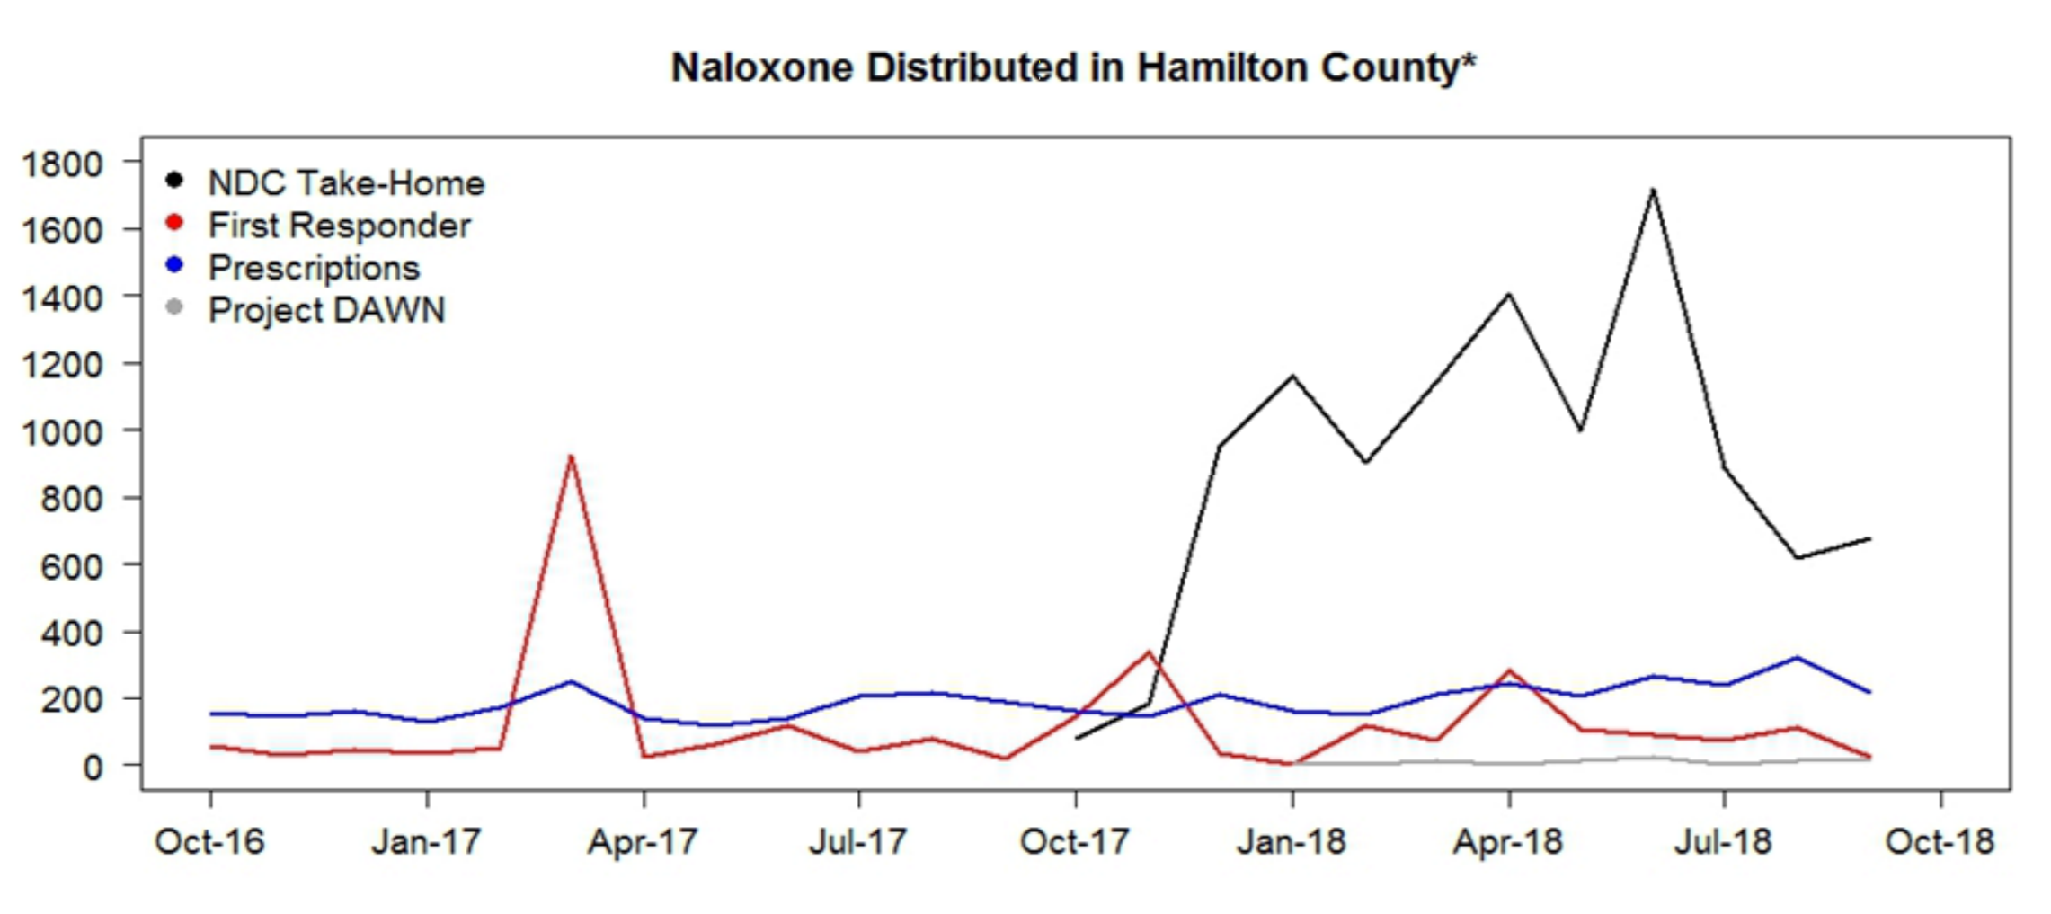
The Problem: fatal heroin overdoses in Ohio
Business as usual
Narcan (naloxone): intranasal or intramuscular treatment for opioid overdose
Cincinnati EMS regularly deploys personnel and resources to high-risk areas
Local nonprofits
distribute Narcan
and host Narcan
training sessions
Notes:
Problem:
Public health: 529 fatal opioid overdoses in 2017, driven by fentanyl
EMS resources: 3065 heroin-related responses in 2017
Mayor, regarding 2016: “first responders have gone to about 1,600 overdose runs this year so far, yielding a $1.6 million cost so far for EMS services.” Naloxone breaking the bank.
Business as usual

Slide 3
Our Proposed Data-driven Approach
Build a statistical model to predict the latent risk of heroin overdoses
Identify areas in Cincinnati that are high-risk for overdoses
Overdose deaths are hyper-local
Overdose patterns vary over time seasonally
Use the results to identify areas in which to focus the Narcan Distribution Collaborative’s take-home kit distribution and training programs
Notes:
Problem:
Public health: 529 fatal opioid overdoses in 2017, driven by fentanyl
EMS resources: 3065 heroin-related responses in 2017
Mayor, regarding 2016: “first responders have gone to about 1,600 overdose runs this year so far, yielding a $1.6 million cost so far for EMS services.” Naloxone breaking the bank.
Business as usual

Slide 4
The Data
Outcome of interest: EMS calls either caused explicitly in response to heroin overdoses or that led to the administration of Narcan
Cincinnati Open Data
Crime reports: drug-related crime
311 calls
Code violations
Abandoned homes, etc.
Police calls
Zoning / park boundaries
Census / ACS Data
Racial proportions
Gender distribution (MALE)
Age groups – by gender, too
Poverty / bachelor’s / unemployment

Slide 5
Exploratory analysis (spatial process)

Slide 6
Exploratory analysis

Slide 7
how does the model work in theory? features, spatial process, etc

Slide 8
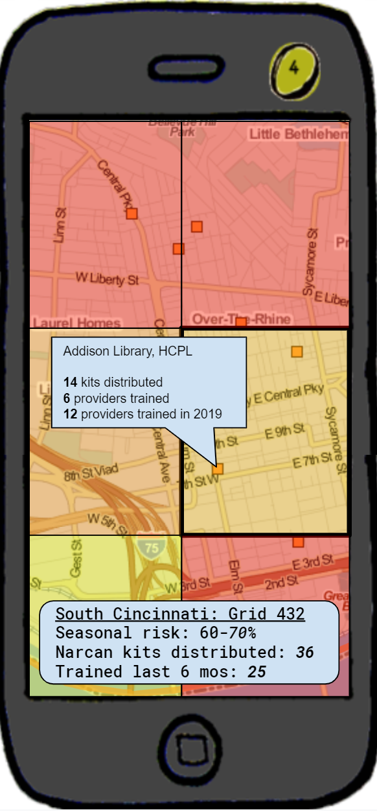
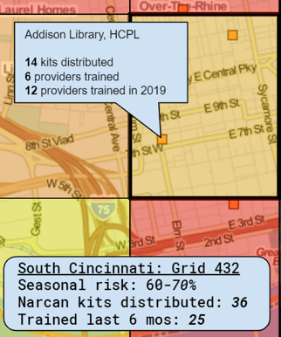
Narcan Distributor
Overlays color-coded risk data on navigable map
Displays risk assessment and distribution and training data by grid cell
Identifies prior distribution and training sites
Notes:
App called “Narcan Distributor” or “Narcan Mapper”
Functionalities
- Identify at-risk locations and map allocation of home-kits to the public near those locations.
- Identify areas without recent training - app recommends you set up shop for retraining.
- App recommends areas where NDC should set up stands for narcan distribution and training.
- App recommends buildings or locations where people should have narcan and narcan training in hotspot areas (parks, fast food restaurants, etc).
- App maps change in demand over time seasonally and recommends shifting focuses over time.

Slide 9
wireframe

Slide 10
Wireframe + conclusion

