Slide 1
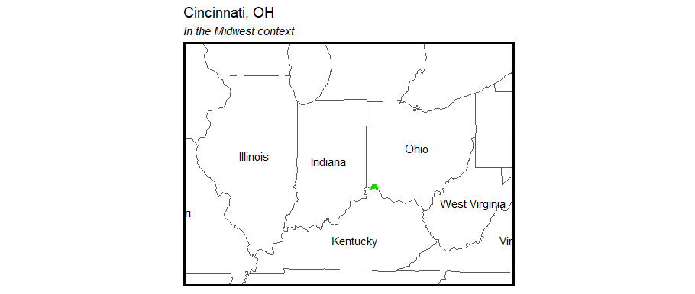
Opioid Overdoses in Cincinnati, Ohio
Claire Allen-Platt and Nicolas Corona

Slide 2
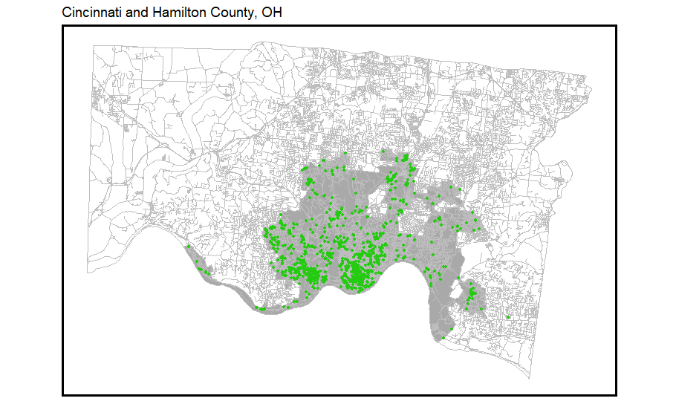
Problem
Midwest
In 2017, Ohio had the second highest opioid overdose rate in the US¹. Southwestern Ohio reported the highest overdose death rate².
The city of Cincinnati experienced a 50% rise in opioid overdoses since 2015³, with heroin overdoses declared an “epidemic”⁴
Cincinnati now distributes take-home kits of Narcan through the Narcan Distribution Collaborative (NDC) in 2017
Hamilton County, OH
Cincinnati
Locations of heroin overdose events
¹National Institute on Drug Abuse, 2019; ²Ohio Dept. of Health, 2017; ³Li et al., 2019; ⁴CincyInsights, 2019

Slide 3
Our Proposed Data-driven Approach
Build a statistical model to predict the latent risk of heroin overdoses
Identify areas in Cincinnati that are high-risk for overdoses
Overdose deaths are hyper-local
Overdose patterns vary over time seasonally
Use the results to identify areas in which to focus the Narcan Distribution Collaborative’s take-home kit distribution and training programs
Notes:
Problem:
Public health: 529 fatal opioid overdoses in 2017, driven by fentanyl
EMS resources: 3065 heroin-related responses in 2017
Mayor, regarding 2016: “first responders have gone to about 1,600 overdose runs this year so far, yielding a $1.6 million cost so far for EMS services.” Naloxone breaking the bank.
Business as usual

Slide 4
Data
Outcome of interest: EMS calls either caused explicitly in response to heroin overdoses or that led to the administration of Narcan
Cincinnati Open Data
Crime reports: drug-related crime
311 calls
Code violations
Abandoned homes, etc.
Police calls
Zoning / park boundaries
Census / ACS Data
Racial proportions
Gender distribution (MALE)
Age groups – by gender, too
Poverty / bachelor’s / unemployment

Slide 5
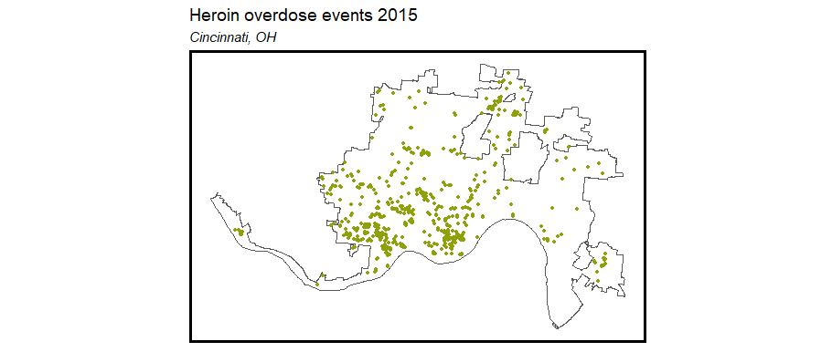
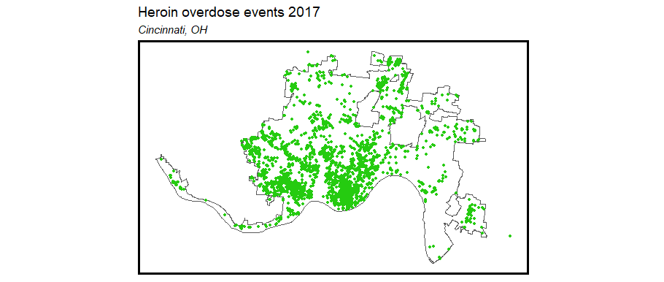
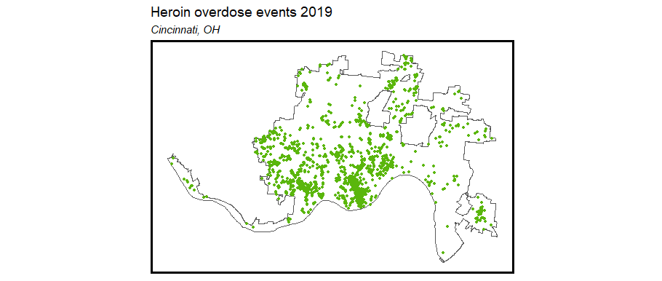
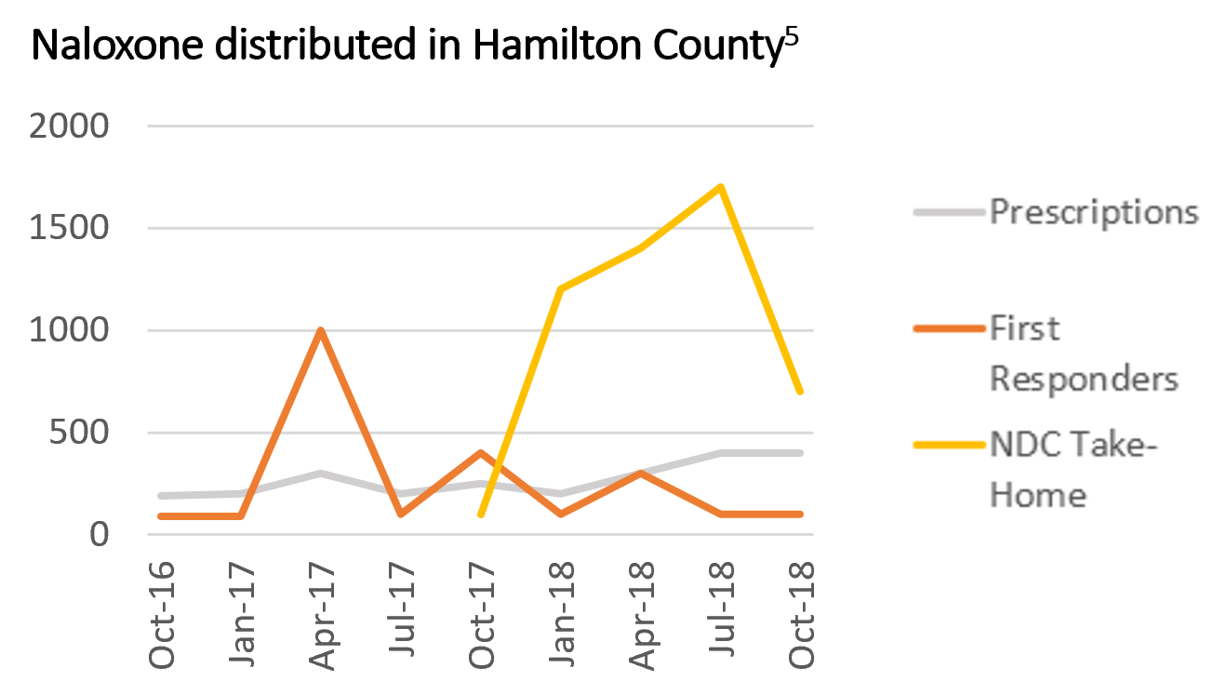
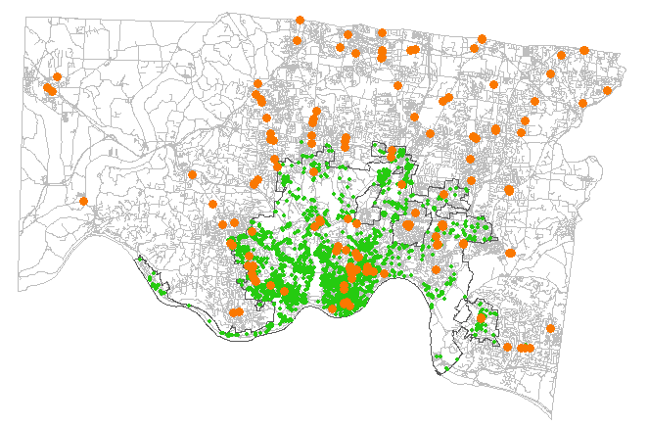
Exploratory Analysis
Heroin overdose events in Cincinnati spiked in 2016-2017 and have begun to decline
2015
2017
2019
Supply versus demand: heroin overdoses
vs. Naloxone distribution sites
Heroin overdose
Naloxone distribution site
⁵Ingram, 2018

Slide 6
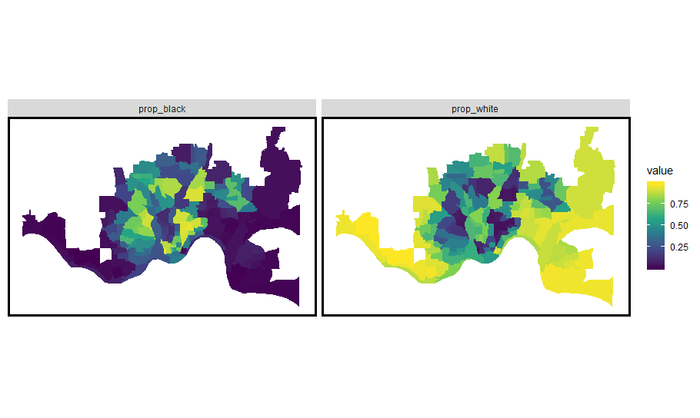
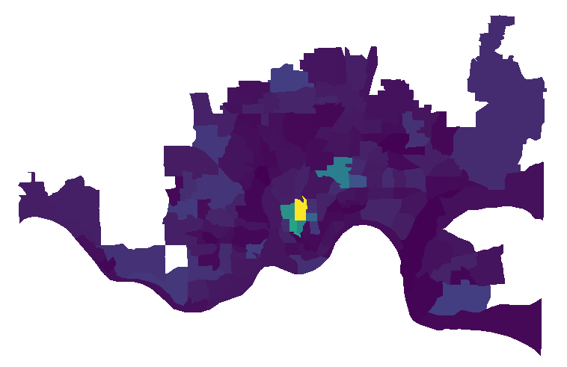
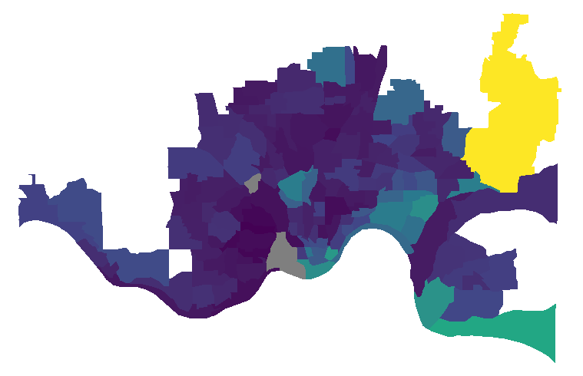
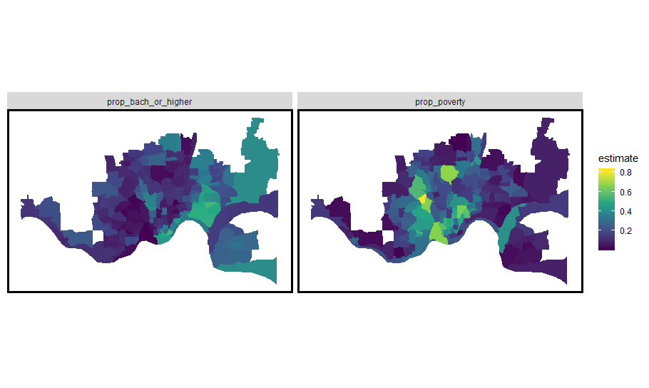
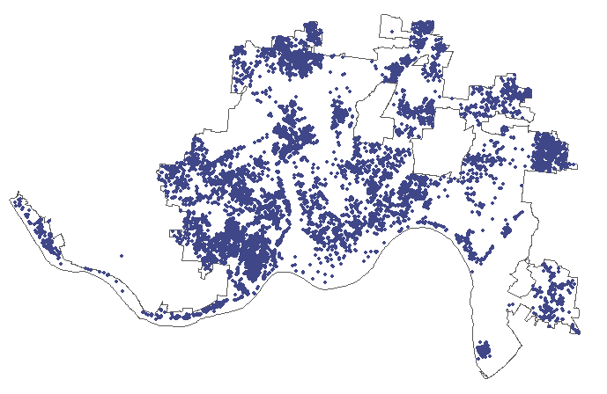
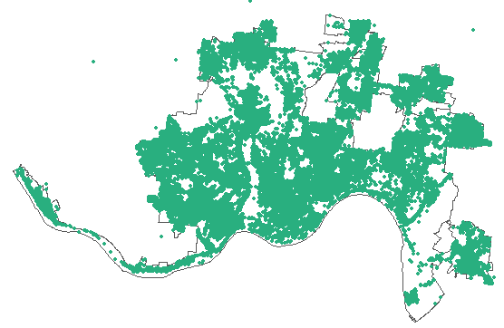
Exploratory Analysis
Proportion Black
Proportion White
Men aged 18-24
Heroin overdose events, 2017
Median home value
Proportion in poverty
Proportion with college degree
Abandoned vehicles
Trash complaints

Slide 7
Data
Poisson regression
Temporal and spatial components
Train on 2015 – 2018 data (through the parabola trend shape), test on 2019 data
Time-invariant covariates
Census tract data (ACS 2015)
Total population
Male population
Racial/ethnic makeup
Median household income
Poverty rate
Unemployment
Zoning (manufacturing, commercial, residential)
Number of fast food restaurants
Time-varying covariates
Distance from event to pharmacies, hospitals, EMT stations
Distance from event to Naloxone distribution
Crime
Weather/season and day of week

Slide 8
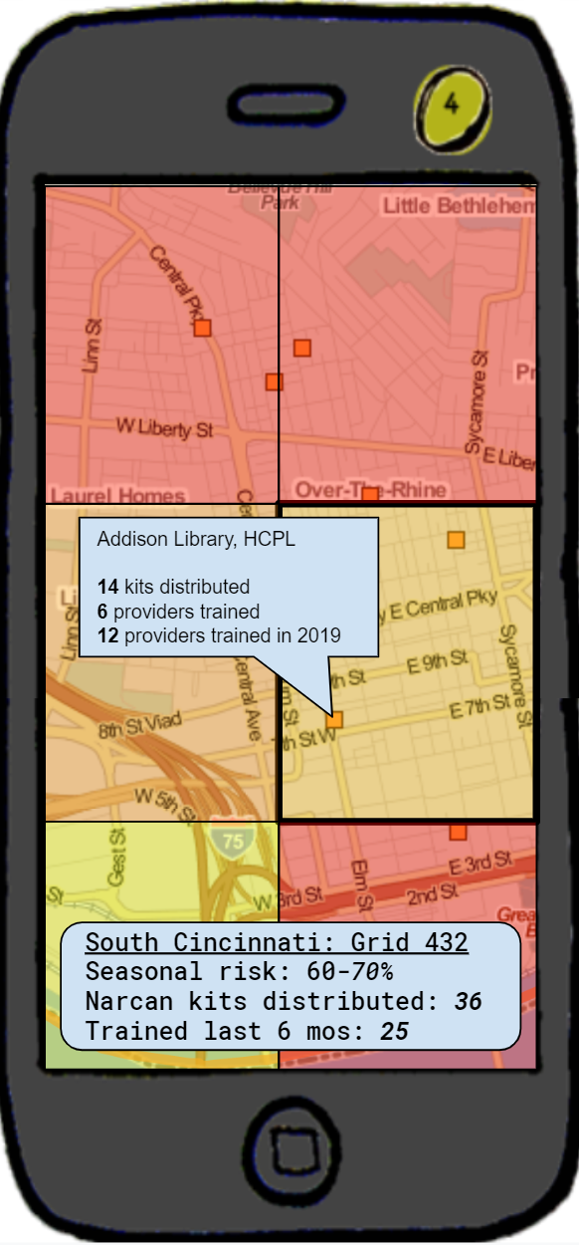
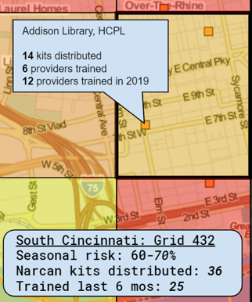
Narcan Distributor
Overlays color-coded risk data on navigable map
Displays risk assessment and distribution and training data by grid cell
Identifies prior distribution and training sites
Notes:
App called “Narcan Distributor” or “Narcan Mapper”
Functionalities
- Identify at-risk locations and map allocation of home-kits to the public near those locations.
- Identify areas without recent training - app recommends you set up shop for retraining.
- App recommends areas where NDC should set up stands for narcan distribution and training.
- App recommends buildings or locations where people should have narcan and narcan training in hotspot areas (parks, fast food restaurants, etc).
- App maps change in demand over time seasonally and recommends shifting focuses over time.

Slide 9
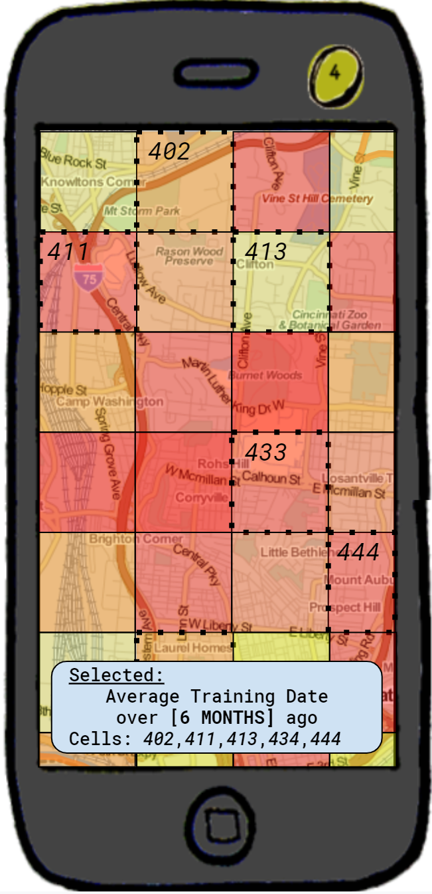
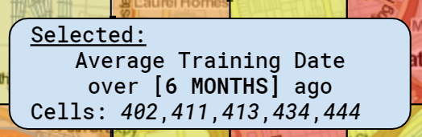
Narcan Distributor
Identifies locations with mismatches between risk, kit distribution, and Narcan training
Identifies areas without recent refresher training
Maps change in risk over time and shifts its recommendations accordingly
Recommends locations (parks, fast-food restaurants, libraries) for direct outreach

Slide 10
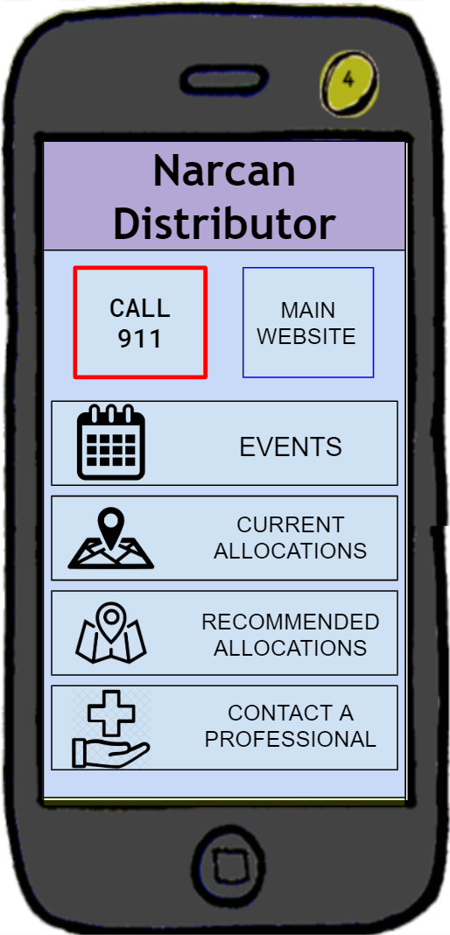
Notes:
In conclusion, the Narcan Distributor app will improve the NDC’s allocation of limited Narcan resources by using a predictive model for latent risk and providing targeted recommendations for future outreach in the city of Cincinnati.

Slide 11
Thank you!

Slide 12
References
Bates, S., Leonenko, V., Rineer, J., & Bobashev, G. (2018). Using synthetic populations to understand geospatial patterns in opioid related overdose and predicted opioid misuse. Computational and Mathematical Organization Theory, 25, pp. 25-36.
CincyInsights. (2019). Heroin overdose responses [webpage]. City of Cincinnati. Accessed from https://insights.cincinnati-oh.gov/stories/s/Heroin-Overdose-Responses/dm3s-ep3u/
Ingram, T. (2018). Narcan distribution collective. Hamilton County Department of Public Health. https://www.naccho.org/uploads/downloadable-resources/49-51-Hamilton-County-Narcan-Distribution-Collaborative.pdf
Li, Z.R., Xie, E., Crawford, F.W., Warren, J.L., McConnell, K., Copple, J.T., Johnson, T., & Gonsalves, G.S. (2019). Suspected heroin-related overdoses incidents in Cincinnati, Ohio: A spatiotemporal analysis. PLOS Medicine, 16(11), pp. 1-15.
National Institute on Drug Abuse. (2019). Opioid summaries by state. Accessed from https://www.drugabuse.gov/drugs-abuse/opioids/opioid-summaries-by-state
Ohio Department of Health. (2017). Ohio drug overdose data: general findings. Accessed from https://odh.ohio.gov/wps/wcm/connect/gov/5deb684e-4667-4836-862b-cb5eb59acbd3/2017_OhioDrugOverdoseReport.pdf

