Slide 1
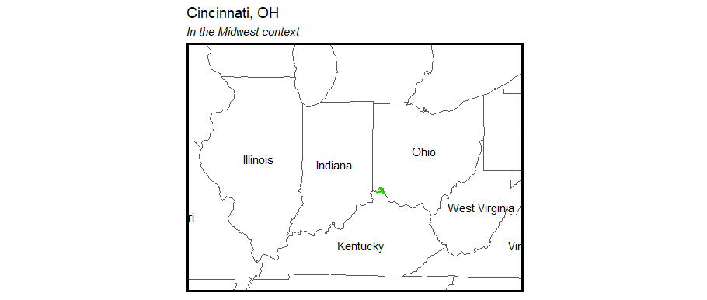
Opioid Overdoses in Cincinnati, Ohio
Claire Allen-Platt and Nicolas Corona

Slide 2
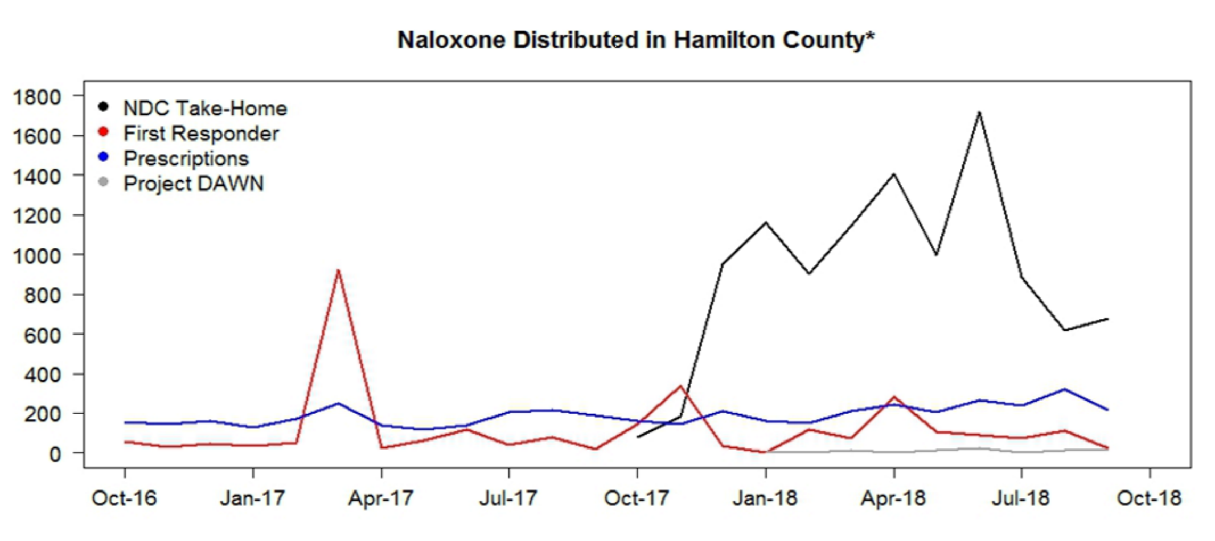
The Problem: fatal heroin overdoses in Ohio
Business as usual
Narcan (naloxone): intranasal or intramuscular treatment for opioid overdose
Cincinnati EMS regularly deploys personnel and resources to high-risk areas
Local nonprofits
distribute Narcan
and host Narcan
training sessions
Notes:
Problem:
Public health: 529 fatal opioid overdoses in 2017, driven by fentanyl
EMS resources: 3065 heroin-related responses in 2017
Mayor, regarding 2016: “first responders have gone to about 1,600 overdose runs this year so far, yielding a $1.6 million cost so far for EMS services.” Naloxone breaking the bank.
Business as usual

Slide 3
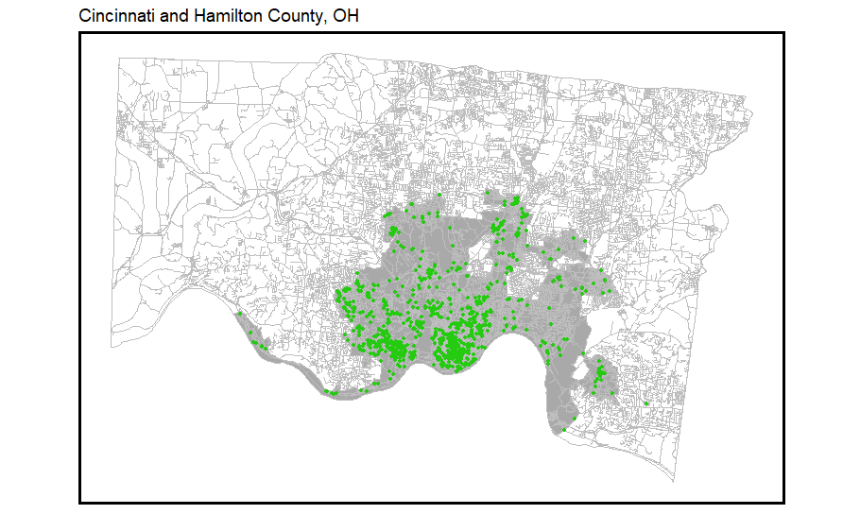
Problem
Midwest
In 2017, Ohio had the second highest opioid overdose rate in the US¹
Southwestern Ohio reported the highest overdose death rate²
The city of Cincinnati experienced a 50% rise in opioid overdoses since 2015³, with heroin overdoses declared an “epidemic”⁴
The county began distributing take-home kits of the overdose reversal drug Naloxone in 2017
Hamilton County, OH
Cincinnati
Locations of heroin overdose events
¹National Institute on Drug Abuse, 2019; ²Ohio Dept. of Health, 2017; ³Li et al., 2019; ⁴CincyInsights, 2019

Slide 4
Our Proposed Data-driven Approach
Build a statistical model to predict the latent risk of heroin overdoses
Identify areas in Cincinnati that are high-risk for overdoses
Overdose deaths are hyper-local
Overdose patterns vary over time seasonally
Use the results to identify areas in which to focus the Narcan Distribution Collaborative’s take-home kit distribution and training programs
Notes:
Problem:
Public health: 529 fatal opioid overdoses in 2017, driven by fentanyl
EMS resources: 3065 heroin-related responses in 2017
Mayor, regarding 2016: “first responders have gone to about 1,600 overdose runs this year so far, yielding a $1.6 million cost so far for EMS services.” Naloxone breaking the bank.
Business as usual

Slide 5
Data
Outcome of interest: EMS calls either caused explicitly in response to heroin overdoses or that led to the administration of Narcan
Cincinnati Open Data
Crime reports: drug-related crime
311 calls
Code violations
Abandoned homes, etc.
Police calls
Zoning / park boundaries
Census / ACS Data
Racial proportions
Gender distribution (MALE)
Age groups – by gender, too
Poverty / bachelor’s / unemployment

Slide 6
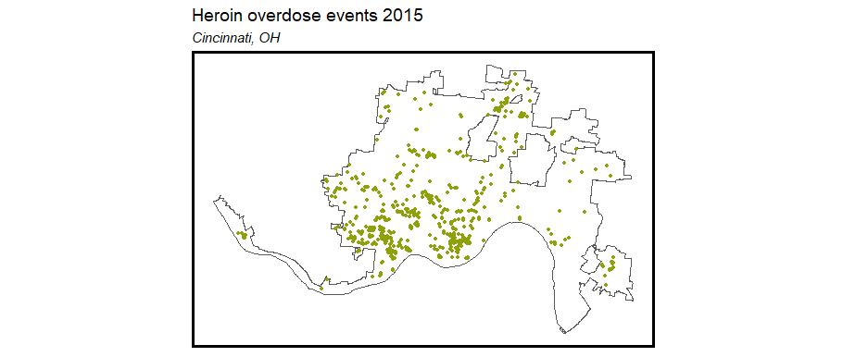
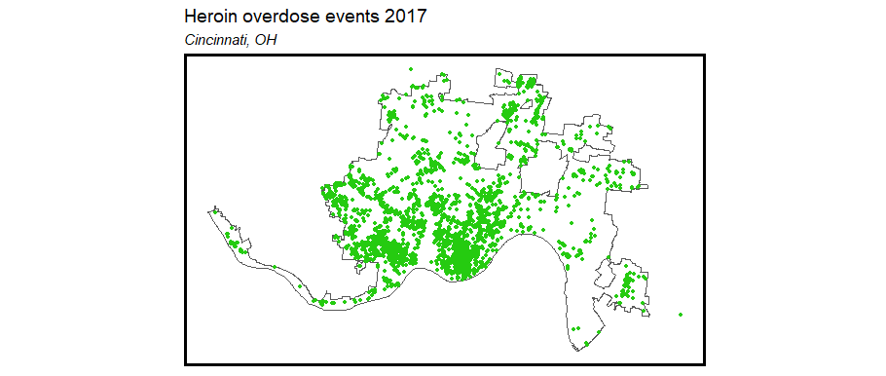
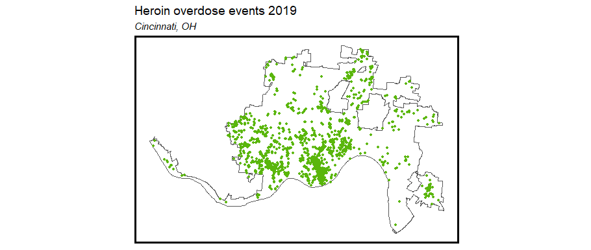
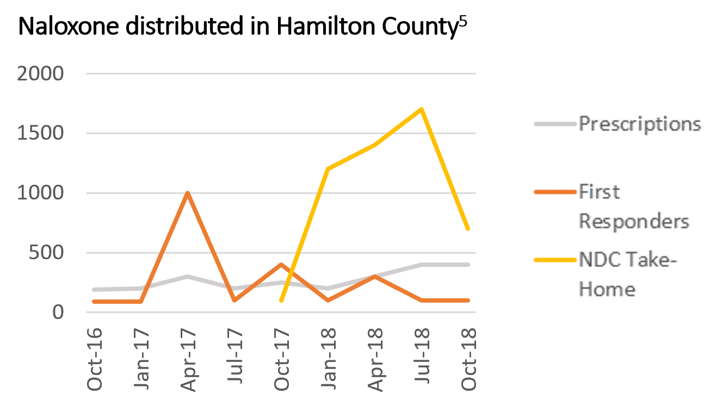
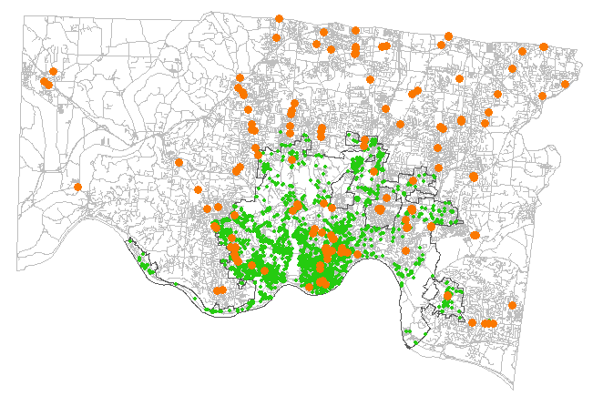
Exploratory Analysis
Heroin overdose events in Cincinnati spiked in 2016-2017 and have begun to decline
2015
2017
2019
Supply versus demand: heroin overdoses
vs. Naloxone distribution sites
Heroin overdose
Naloxone distribution site
⁵Ingram, 2018

Slide 7
Exploratory analysis (spatial process)

Slide 8
Data
Poisson regression
Temporal and spatial components
Train on 2015 – 2018 data (through the parabola trend shape), test on 2019 data
Time-invariant covariates
Census tract data (ACS 2015)
Total population
Male population
Racial/ethnic makeup
Median household income
Poverty rate
Unemployment
Zoning (manufacturing, commercial, residential)
Number of fast food restaurants
Time-varying covariates
Distance from event to pharmacies, hospitals, EMT stations
Distance from event to Naloxone distribution
Crime
Weather/season and day of week

Slide 9
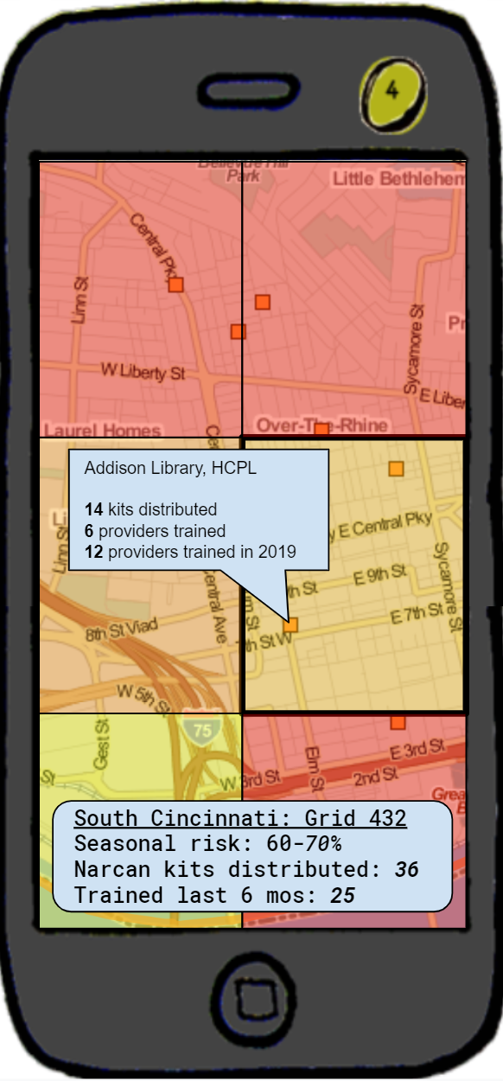
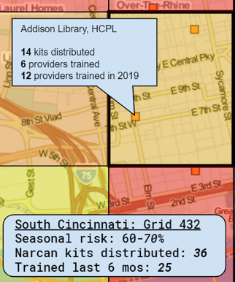
Narcan Distributor
Overlays color-coded risk data on navigable map
Displays risk assessment and distribution and training data by grid cell
Identifies prior distribution and training sites
Notes:
App called “Narcan Distributor” or “Narcan Mapper”
Functionalities
- Identify at-risk locations and map allocation of home-kits to the public near those locations.
- Identify areas without recent training - app recommends you set up shop for retraining.
- App recommends areas where NDC should set up stands for narcan distribution and training.
- App recommends buildings or locations where people should have narcan and narcan training in hotspot areas (parks, fast food restaurants, etc).
- App maps change in demand over time seasonally and recommends shifting focuses over time.

Slide 10
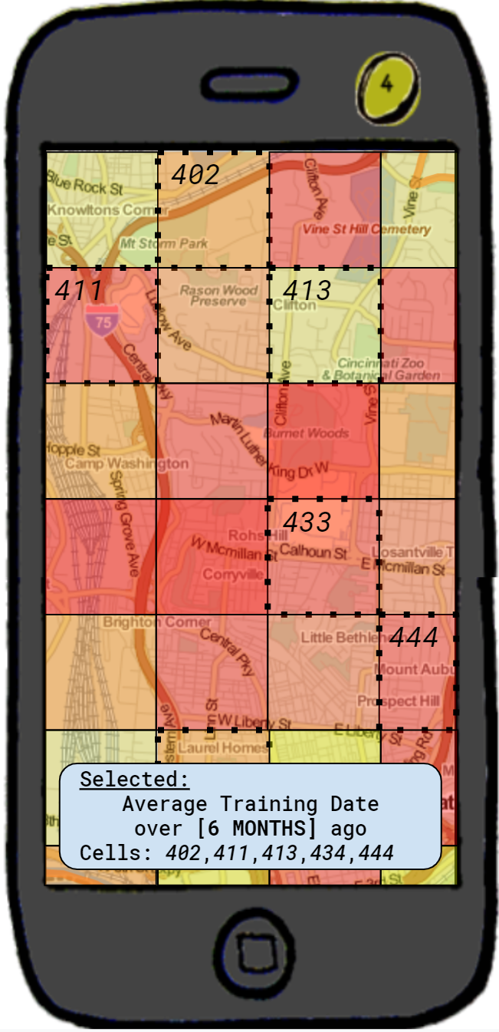
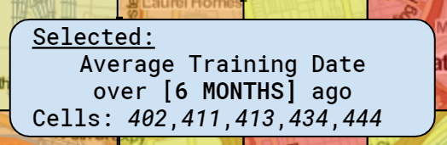
Narcan Distributor
Identifies locations with a mismatch between risk and kit distribution or training
Identifies areas without recent refresher training
Maps change in risk over time and shifts its recommendations accordingly
Recommends locations (parks, fast-food restaurants, libraries) for direct outreach

Slide 11
