Slide 1
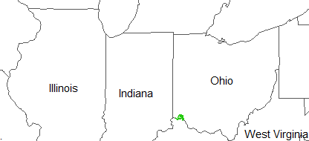
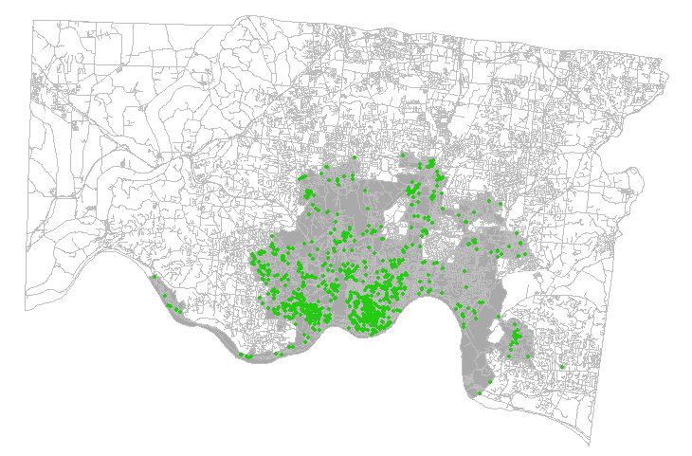
Problem
Midwest
In 2017, Ohio had the second highest opioid overdose rate in the US¹
Southwestern Ohio reported the highest overdose death rate²
The city of Cincinnati experienced a 50% rise in opioid overdoses since 2015³, with heroin overdoses declared an “epidemic”⁴
The county began distributing take-home kits of the overdose reversal drug Naloxone in 2017
Hamilton County, OH
Cincinnati
Locations of heroin overdose events
¹National Institute on Drug Abuse, 2019; ²Ohio Dept. of Health, 2017; ³Li et al., 2019; ⁴CincyInsights, 2019

Slide 2
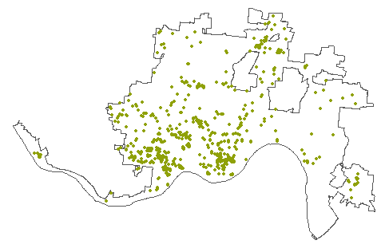
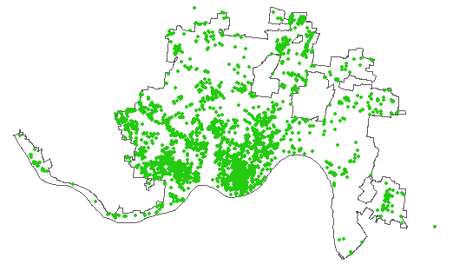
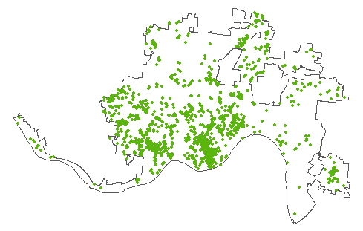
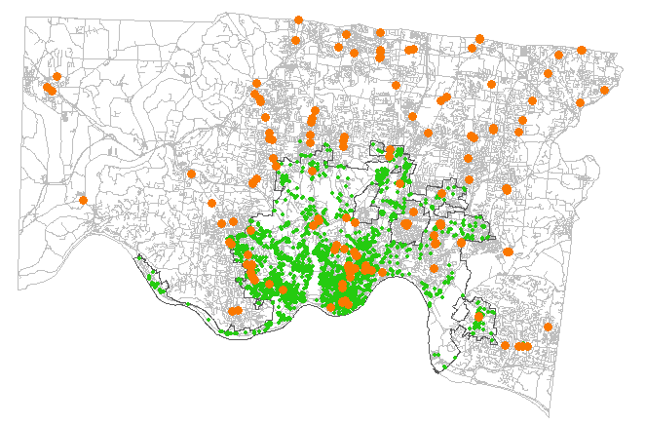
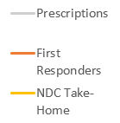
Exploratory analysis
Heroin overdose events in Cincinnati spiked in 2016-2017 and have begun to decline
2015
2017
2019
Supply versus demand: heroin overdoses
vs. Naloxone distribution sites
Naloxone distributed in Hamilton County⁵
Heroin overdose
Naloxone distribution site
⁵Ingram, 2018
Notes:
“While people who bought crack or meth would buy their crack or meth, then drive home and do it, here, because … the physical opiate withdrawal … is so powerful … often we find the person overdosing near the location where they bought the drug.”⁶
Hamilton Co. Heroin Coalition Task Force

Slide 3
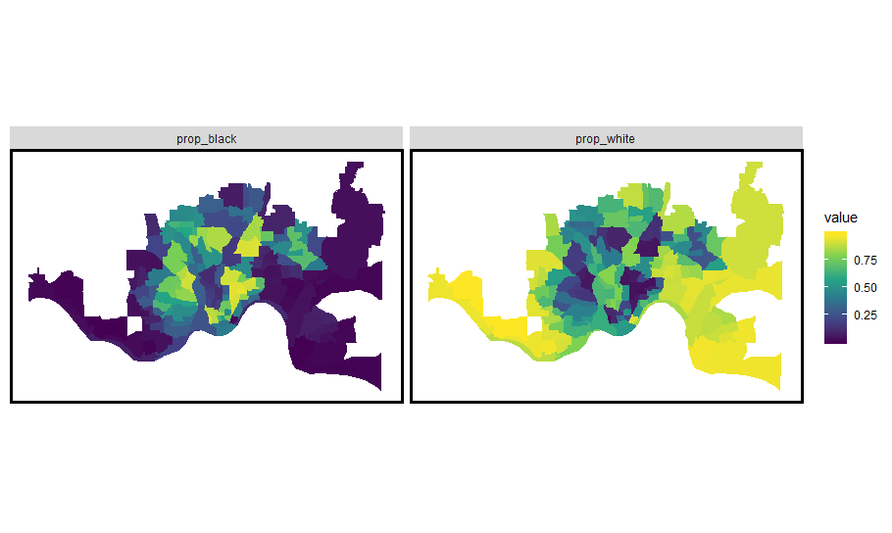
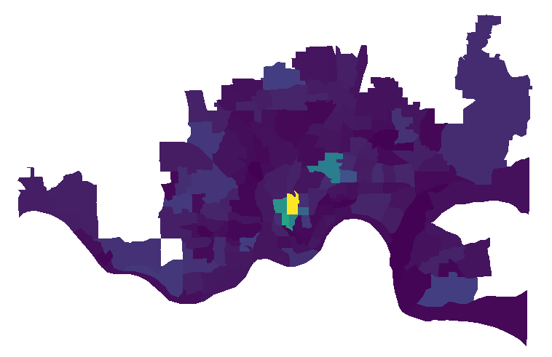
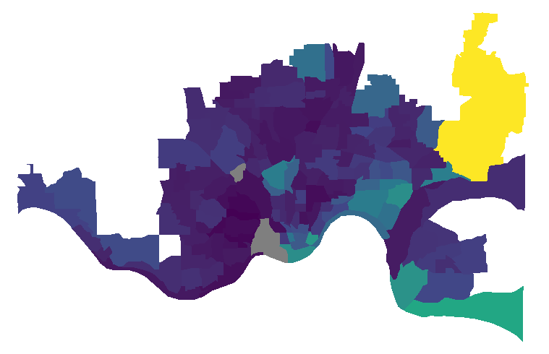
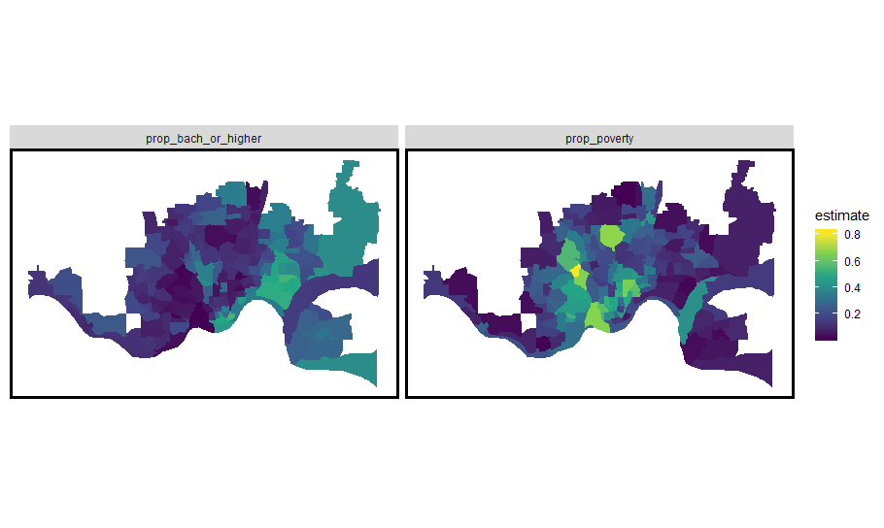
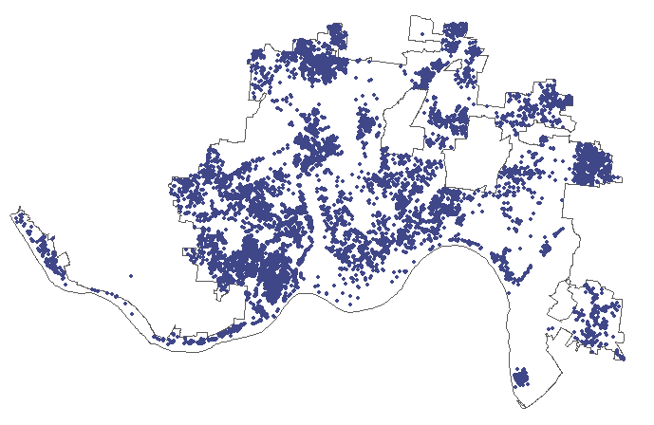
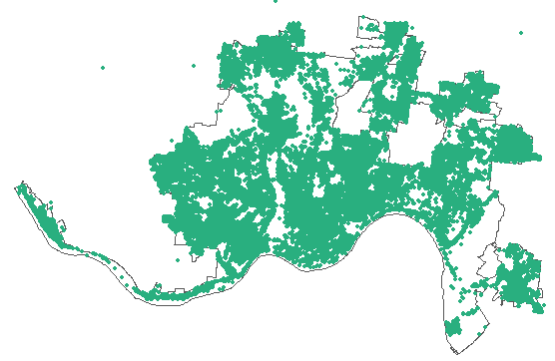
Exploratory analysis
Proportion Black
Proportion White
Men aged 18-24
Median home value
Proportion in poverty
Proportion with college degree
Abandoned vehicles
Trash complaints

Slide 4
Model features
Poisson regression
Temporal and spatial components
Train on 2015 – 2018 data (through the parabola trend shape), test on 2019 data
Time-invariant covariates
Census tract data (ACS 2015)
Total population
Male population
Racial/ethnic makeup
Median household income
Poverty rate
Unemployment
Zoning (manufacturing, commercial, residential)
Number of fast food restaurants
Time-varying covariates
Distance from event to pharmacies, hospitals, EMT stations
Distance from event to Naloxone distribution
Crime
Weather/season and day of week

Slide 5
References
Bates, S., Leonenko, V., Rineer, J., & Bobashev, G. (2018). Using synthetic populations to understand geospatial patterns in opioid related overdose and predicted opioid misuse. Computational and Mathematical Organization Theory, 25, pp. 25-36.
CincyInsights. (2019). Heroin overdose responses [webpage]. City of Cincinnati. Accessed from https://insights.cincinnati-oh.gov/stories/s/Heroin-Overdose-Responses/dm3s-ep3u/
Ingram, T. (2018). Narcan distribution collective. Hamilton County Department of Public Health. https://www.naccho.org/uploads/downloadable-resources/49-51-Hamilton-County-Narcan-Distribution-Collaborative.pdf
Li, Z.R., Xie, E., Crawford, F.W., Warren, J.L., McConnell, K., Copple, J.T., Johnson, T., & Gonsalves, G.S. (2019). Suspected heroin-related overdoses incidents in Cincinnati, Ohio: A spatiotemporal analysis. PLOS Medicine, 16(11), pp. 1-15.
National Institute on Drug Abuse. (2019). Opioid summaries by state. Accessed from https://www.drugabuse.gov/drugs-abuse/opioids/opioid-summaries-by-state
Ohio Department of Health. (2017). Ohio drug overdose data: general findings. Accessed from https://odh.ohio.gov/wps/wcm/connect/gov/5deb684e-4667-4836-862b-cb5eb59acbd3/2017_OhioDrugOverdoseReport.pdf

