Slide 1
HPC Advanced topics

Slide 2
Your PATH and Virtual Environments

Slide 3
Recap on the PATH
$PATH:
A unix environmental variable that tells the OS where to look for accessible programs
Priority is leftmost -> rightmost. (ie. two programs with the same name in the path, “program” in the “A” folder will always be used over the “program” in “B”).
You can add to the PATH manually, but changes are lost when you logout.
A
B

Slide 4
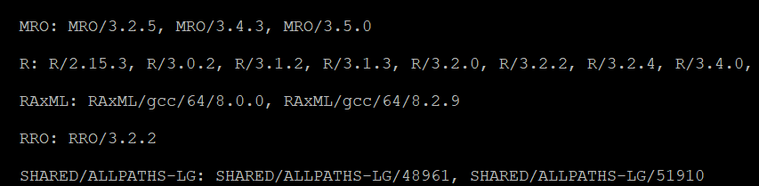
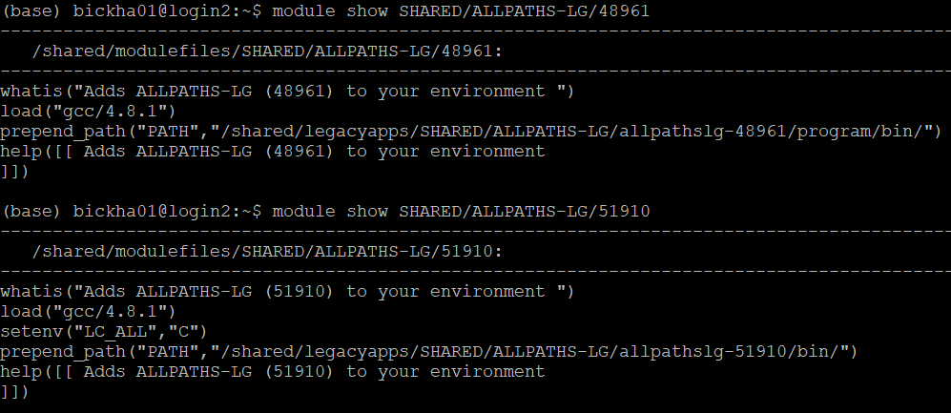
Program or requirement collisions
Program dependencies can be complicated.
Anunna module system helps manage this by adding to PATH
Top: $ module spider
Bottom: $ module show
Different versions of the same program have different requirements

Slide 5
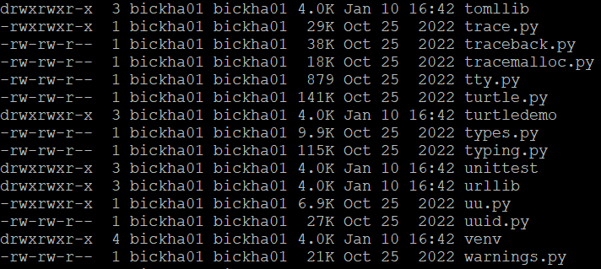
The Python problem: package updates
Python package files cannot have version ids in their names.
It is impossible to know which version you are loading.
Loading a newer version may ‘break’ your other packages that depend on a specific version of that package!

Slide 6
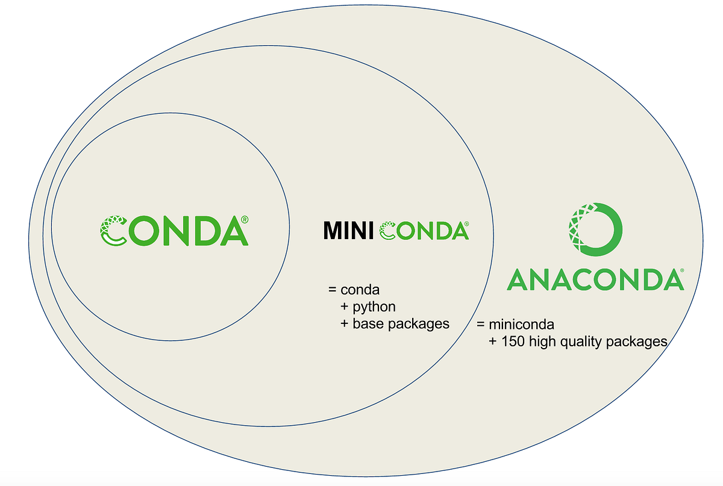
A solution in Conda environments
Conda is a large package repository that has portable versions of many major programs and packages.
MiniConda is a software tool that searches Conda and can download and install packages/software in “virtual environments”
AnaConda is a step above MiniConda by providing top Python packages/IDEs in a single distribution

Slide 7
What is a “virtual environment?”
A virtual environment is a controlled and reversible modification of your $PATH to allow you to run specific programs or packages.
You access and modify your virtual environments with “miniconda” (the $ conda command), and can deactivate them at any time.

Slide 8
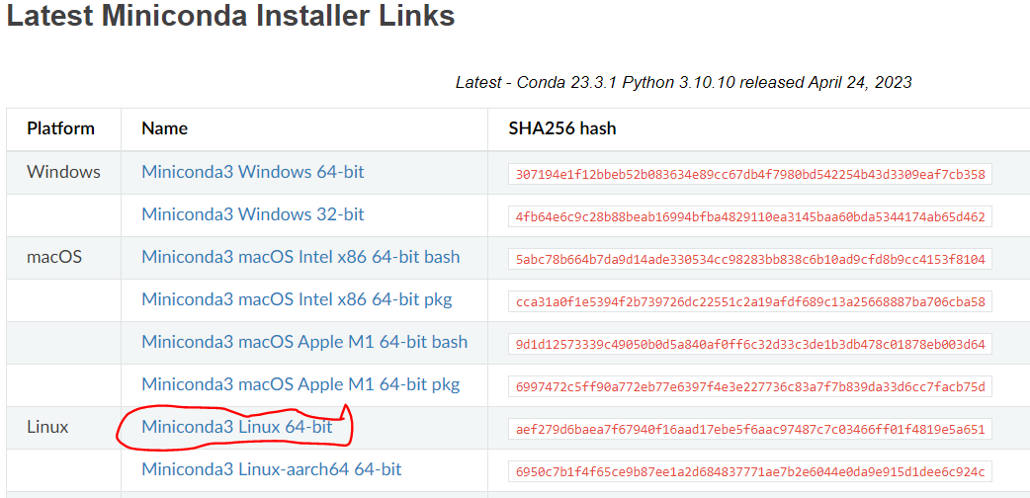
Installing MiniConda on Anunna
https://docs.conda.io/en/latest/miniconda.html
Right (or command) click the link. “Copy link address”

Slide 9
Installing MiniConda on Anunna (cont)
Use “wget” to download on Anunna
Run the installation script
Answer the prompts.

Slide 10

Using Miniconda
Help menu
Create an environment
Activate an environment
Within an environment:
Install packages
Update packages
Exit an environment

Slide 11
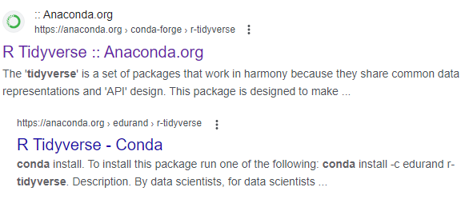
Exercise: creating a virtual environment for R’s tidyverse
The “tidyverse” is a collection of R packages designed to make data management easier.
Let’s see if this package exists in Conda! First, google: “Conda Tidyverse”
Click here!

Slide 12
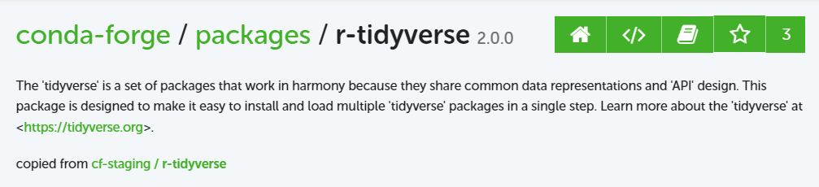
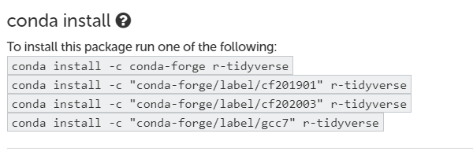
Finding information on the web about Conda
Package name and version:
Hint on how to install:

Slide 13


Lesson 1: Creating the environment
Start an interactive session to begin the installation:
Let’s create an environment with the python “Pandas” package to run our test script:

Slide 14
Lesson1 (continued): Running the command
Now that you’ve created and activated the environment, let’s run some test data through it!
What do you see?

Slide 15
Deactivation
Now that you are finished, you should deactivate the environment. Here is how to do it:
Why do this?
You can only run one environment at a time
You may want to load a module (to avoid conflicts in perquisites)
Now, try to rerun the previous example code:

Slide 16
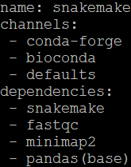
Lesson2: create a virtual environment from a template
We are now going to create an environment that may be useful later! We have a “recipe” file in “YAML” format that will help us define the environment. Move to the lesson 2 folder and take a look at that file:
ENV name
Conda channels
Programs to install

Slide 17
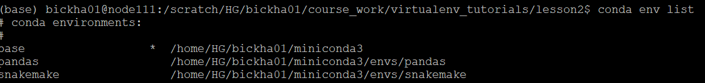
Lesson2: creating the environment (continued)
In order to create the environment from the recipe, you type the following:
Now let’s see where all of those environments are located using the following command:
Take the time to explore the snakemake repository now

Slide 18
Lesson2: sharing your environment
You just created a new environment from a template, but apart from writing the template yourself, can you share it with others? Yes!
Type the following:
The environment must be in your “conda env list” to be exported
The output file specified in (-f) “snakemake2.yml” can now be shared with others.
Do you notice anything different in the snakemake2.yml file?

Slide 19
Take-home points
Virtual environments are a great way to “install” programs and their requirements for later use.
Many packages are available for Conda on the web, and you can find easy-to-install repositories for use in your virtual environments
You must activate and deactivate virtual environments to properly manage your programs and commands.

Slide 20
Developing workflows with Snakemake

Slide 21
What is Snakemake?
Snakemake is a backwards-looking workflow language implemented in Python
It ships by default within most current Python distributions (you install Python, you get Snakemake for free!).

Slide 22
Why use Snakemake?
Strengths
Rapid development time
Reproducibility
Built-in management and dependencies (file deletion, checkpoints)
Cluster job submission
Conda integration
Python and R integration
Weaknesses
Requires file names to identify process completion
Poor or underdeveloped debugging tools
Strict naming and coding conventions
Cryptic error messaging

Slide 23
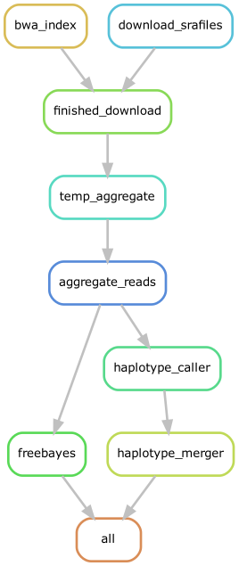
Example Snakemake workflow graph
Execution
This workflow is designed to download free sequence data and to call SNP variants
Each node is a “rule” that is run on each sample
Nodes are executed if “needed” based on requirements, starting from the “end” of the workflow
Interpretation

Slide 24
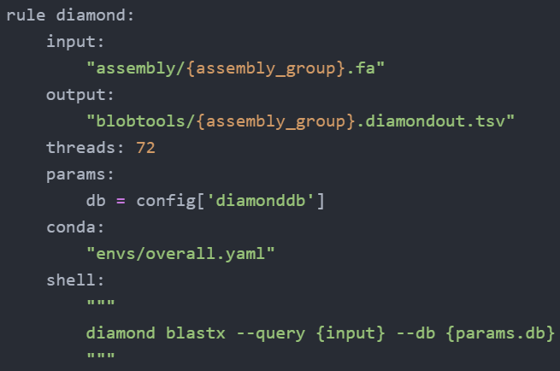
Snakemake rule syntax
Tabs required!
Rule: (required)
Input (optional)
output (optional)
Resources (optional)
Params, threads
Conda (optional)
Operation (required)
shell (unix), run (python), script (python or R)

Slide 25
Running Snakemake
In the same folder, you just have to type snakemake and the number of jobs (-j)
Example: $ snakemake –j 1
There are more parameters that can customize your job, but this is the easiest way to start the workflow
Dependencies:
To run snakemake in this fashion, you must be in the same directory as the snakefile
Also, the snakefile must be named, Snakefile, or SnakeFile or snakefile

Slide 26
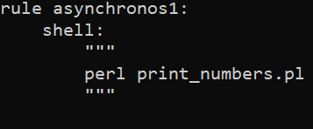
Lesson1: A simple Snakemake rule
“cd” into the “Lesson1” folder and view the file, “SnakeFile”
You should see two rules, but we will only run one here
Note the syntax of the top rule: You only need the “shell” command here
Run the following command →
Snakemake will execute the first rule by default

Slide 27
Lesson 1 part two: running multiple rules
But there are two rules in our snakefile! How do we run both at the same time?
The snakemake executable allows you to specify rules at the end! The syntax is like this: $ snakemake –j 2 <rule1> …
So how can you run both rules simultaneously?

Slide 28
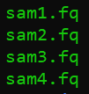
Snakemake files – recognition and patterns
Snakemake identifies tasks and input files through file naming patterns
Example: {sample}.fq -> {sample} = [sam1, sam2, ..]
If you organize and name your files consistently, you can automate the data input and output process!

Slide 29
Lesson 2: Tracking input and output
Please move into the “lesson2” folder, where you should find four similarly named fastq files.
Let’s write a rule that tracks their input and generates specific output for each. We will be using the fastqc program, which takes as input one fastq file and generates a “{sample}_fastqc.html” output file, in return.

Slide 30
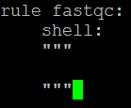

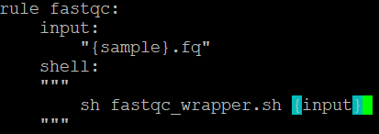
Lesson2: writing input and output tracking
Create the Snakefile and let’s start with the obvious mandatory sections of the rule:
BUT! We want to process all files, so let’s include the following input statement:
Snakemake will now be smart enough to identify the files from the pattern matching
Now we pass each input from the rule to the script like so:

Slide 31

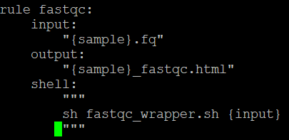
Lesson2: finishing up
We now have enough data for Snakemake to run! But, we also want snakemake to recognize if there is a mistake.
We can do this by adding an output statement to ask Snakemake to track the output, like so:
The whole rule should look like this:
Try running it!

Slide 32

Error! (this was expected!)
Snakemake did not like that, huh? As it turns out, we need one last command to have Snakemake track everything. First, define all samples at the top of the file:
Next, we will create an “all” rule that requests all files:
This tells snakemake that we expect four files as output, and it will work backwards to make sure that all four are accounted for.

Slide 33
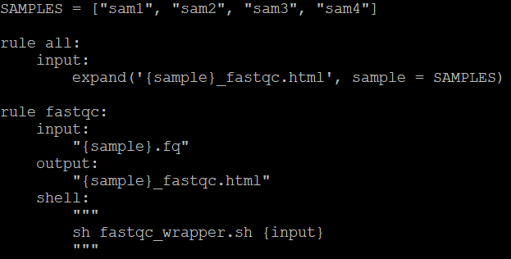
The whole file, a simple snakemake rule with tracking
Here is what the whole file should look like:
It seems like allot of text just to automate this process, but here is what you are getting by doing it this way:
Automatic file recognition and tracking
Automated logs when the task is finished
Automated queues for new tasks

