Slide 1
HPC Workshop introduction

Slide 2
Agenda
Introduction: WUR IT and HG Participants
HPC basics checkpoint – any questions on the use of SLURM?
HPC advanced usage questions – Have any difficulties or issues with the cluster? Any tips or tricks?
Workshop topic: Virtual environments
Workshop topic: Snakemake tutorial

Slide 3
HPC basics
Anunna cluster description/basics
Who has not used SLURM before?

Slide 4
HPC advanced topics
Examples of tough jobs that might need to be debugged?
Anyone currently using job arrays?
Examples of “dependency chaining?”

Slide 5
HPC Advanced topics

Slide 6
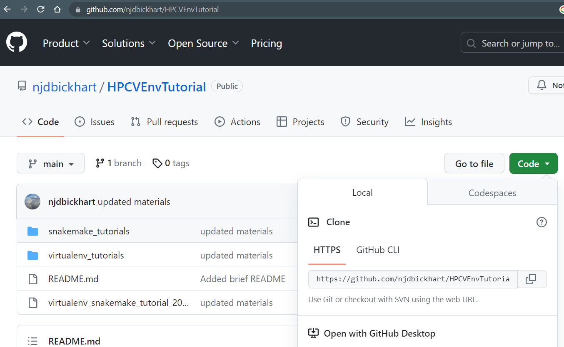
Copy the repository for slides and materials
Github.com/njdbickhart/HPCVEnvTutorial
Git clone https://github.com/njdbickhart/HPCVEnvTutorial.git

Slide 7
Your PATH and Virtual Environments

Slide 8
Recap on the PATH
$PATH:
A unix environmental variable that tells the OS where to look for accessible programs
Priority is leftmost -> rightmost. (ie. two programs with the same name in the path, “program” in the “A” folder will always be used over the “program” in “B”).
You can add to the PATH manually, but changes are lost when you logout.
A
B

Slide 9
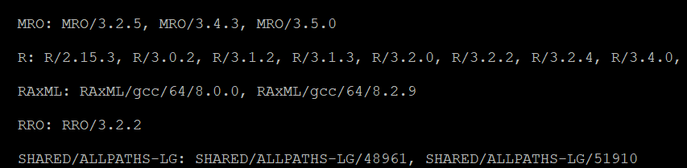
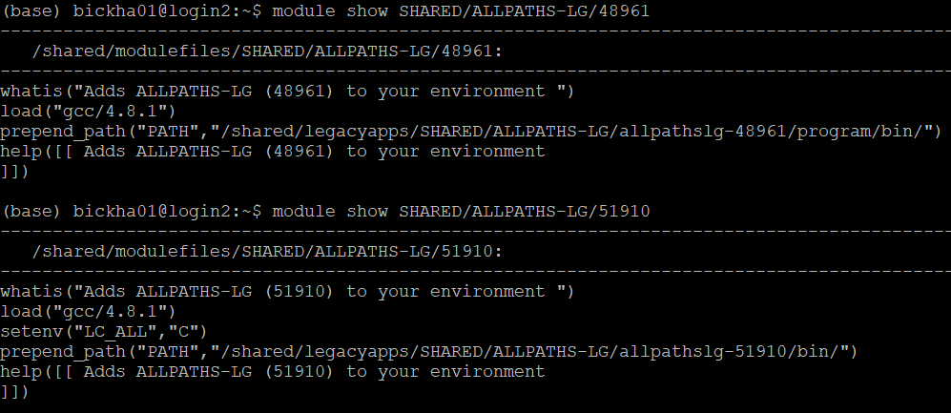
Program or requirement collisions
Program dependencies can be complicated.
Anunna module system helps manage this by adding to PATH
Top: $ module spider
Bottom: $ module show
Different versions of the same program have different requirements

Slide 10
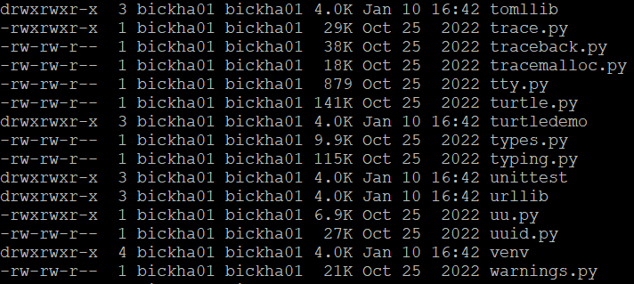
The Python problem: package updates
Python package files cannot have version ids in their names.
It is impossible to know which version you are loading.
Loading a newer version may ‘break’ your other packages that depend on a specific version of that package!

Slide 11
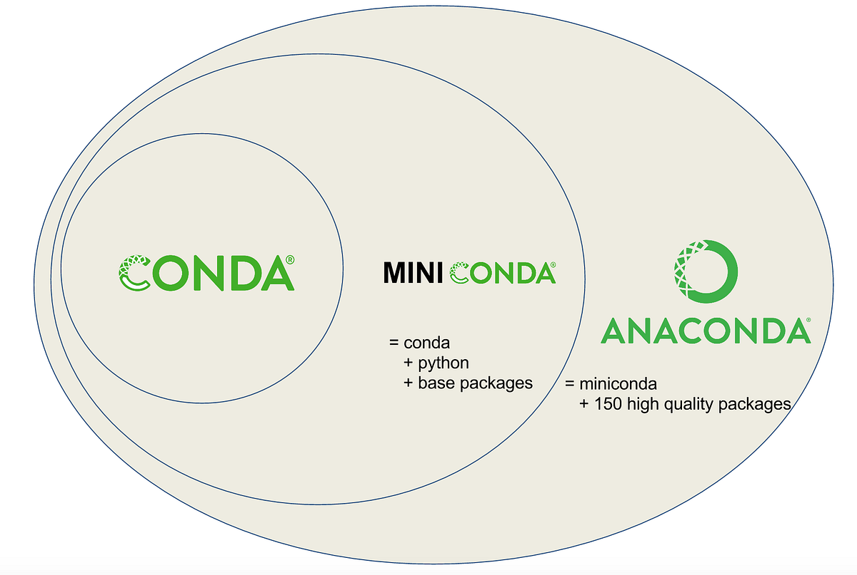
A solution in Conda environments
Conda is a large package repository that has portable versions of many major programs and packages.
MiniConda is a software tool that searches Conda and can download and install packages/software in “virtual environments”
AnaConda is a step above MiniConda by providing top Python packages/IDEs in a single distribution

Slide 12
What is a “virtual environment?”
A virtual environment is a controlled and reversible modification of your $PATH to allow you to run specific programs or packages.
You access and modify your virtual environments with “miniconda” (the $ conda command), and can deactivate them at any time.

Slide 13
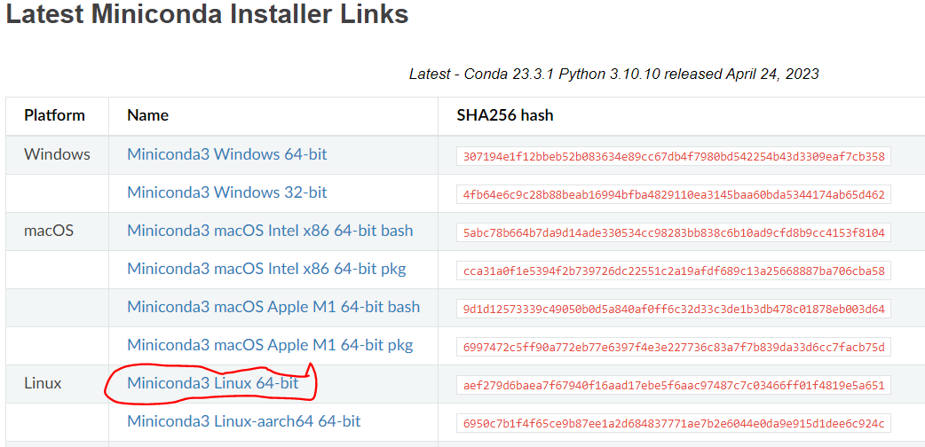
Installing MiniConda on Anunna
https://docs.conda.io/en/latest/miniconda.html
Right (or command) click the link. “Copy link address”

Slide 14
Installing MiniConda on Anunna (cont)
Use “wget” to download on Anunna
Run the installation script
Answer the prompts.

Slide 15

Using Miniconda
Help menu
Create an environment
Activate an environment
Within an environment:
Install packages
Update packages
Exit an environment

Slide 16
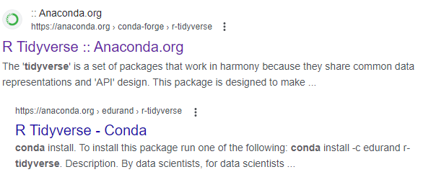
Exercise: creating a virtual environment for R’s tidyverse
The “tidyverse” is a collection of R packages designed to make data management easier.
Let’s see if this package exists in Conda! First, google: “Conda Tidyverse”
Click here!

Slide 17
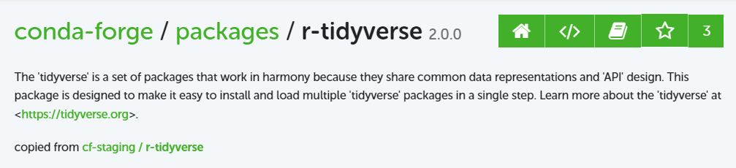
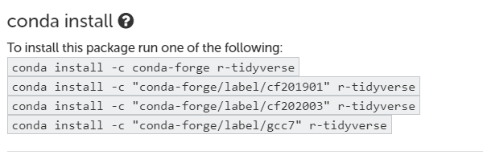
Finding information on the web about Conda
Package name and version:
Hint on how to install:

Slide 18


Lesson 1: Creating the environment
Start an interactive session to begin the installation:
Let’s create an environment with the python “Pandas” package to run our test script:

Slide 19
Lesson1 (continued): Running the command
Now that you’ve created and activated the environment, let’s run some test data through it!
What do you see?

Slide 20
Deactivation
Now that you are finished, you should deactivate the environment. Here is how to do it:
Why do this?
You can only run one environment at a time
You may want to load a module (to avoid conflicts in perquisites)
Now, try to rerun the previous example code:

Slide 21
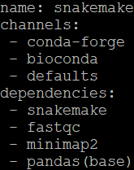
Lesson2: create a virtual environment from a template
We are now going to create an environment that may be useful later! We have a “recipe” file in “YAML” format that will help us define the environment. Move to the lesson 2 folder and take a look at that file:
ENV name
Conda channels
Programs to install

Slide 22
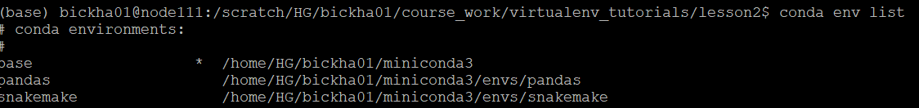
Lesson2: creating the environment (continued)
In order to create the environment from the recipe, you type the following:
Now let’s see where all of those environments are located using the following command:
Take the time to explore the snakemake repository now

Slide 23
Lesson2: sharing your environment
You just created a new environment from a template, but apart from writing the template yourself, can you share it with others? Yes!
Type the following:
The environment must be in your “conda env list” to be exported
The output file specified in (-f) “snakemake2.yml” can now be shared with others.
Do you notice anything different in the snakemake2.yml file?

Slide 24
Take-home points
Virtual environments are a great way to “install” programs and their requirements for later use.
Many packages are available for Conda on the web, and you can find easy-to-install repositories for use in your virtual environments
You must activate and deactivate virtual environments to properly manage your programs and commands.

Slide 25
Developing workflows with Snakemake

Slide 26

What is Snakemake?
Snakemake is a backwards-looking workflow language implemented in Python
It ships by default within most current Python distributions (you install Python, you get Snakemake for free!).

Slide 27
Why use Snakemake?
Strengths
Rapid development time
Reproducibility
Built-in management and dependencies (file deletion, checkpoints)
Cluster job submission
Conda integration
Python and R integration
Weaknesses
Requires file names to identify process completion
Poor or underdeveloped debugging tools
Strict naming and coding conventions
Cryptic error messaging

Slide 28
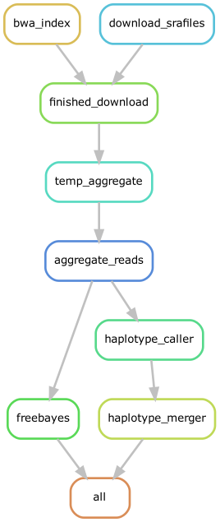
Example Snakemake workflow graph
Execution
This workflow is designed to download free sequence data and to call SNP variants
Each node is a “rule” that is run on each sample
Nodes are executed if “needed” based on requirements, starting from the “end” of the workflow
Interpretation

Slide 29
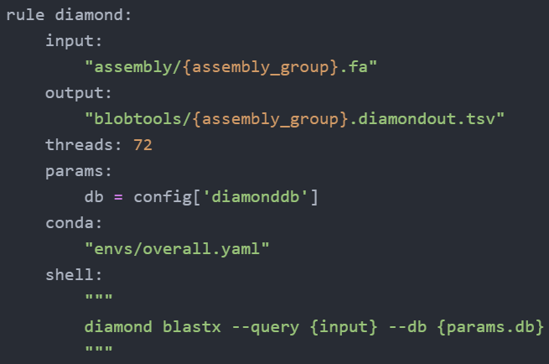
Snakemake rule syntax
Tabs required!
Rule: (required)
Input (optional)
output (optional)
Resources (optional)
Params, threads
Conda (optional)
Operation (required)
shell (unix), run (python), script (python or R)

Slide 30
Running Snakemake
In the same folder, you just have to type snakemake and the number of jobs (-j)
Example: $ snakemake –j 1
There are more parameters that can customize your job, but this is the easiest way to start the workflow
Dependencies:
To run snakemake in this fashion, you must be in the same directory as the snakefile
Also, the snakefile must be named, Snakefile, or SnakeFile or snakefile

Slide 31
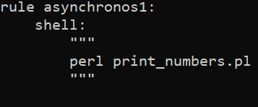
Lesson1: A simple Snakemake rule
“cd” into the “Lesson1” folder and view the file, “SnakeFile”
You should see two rules, but we will only run one here
Note the syntax of the top rule: You only need the “shell” command here
Run the following command →
Snakemake will execute the first rule by default

Slide 32
Lesson 1 part two: running multiple rules
But there are two rules in our snakefile! How do we run both at the same time?
The snakemake executable allows you to specify rules at the end! The syntax is like this: $ snakemake –j 2 <rule1> …
So how can you run both rules simultaneously?

Slide 33
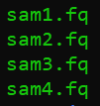
Snakemake files – recognition and patterns
Snakemake identifies tasks and input files through file naming patterns
Example: {sample}.fq -> {sample} = [sam1, sam2, ..]
If you organize and name your files consistently, you can automate the data input and output process!

Slide 34
Lesson 2: Tracking input and output
Please move into the “lesson2” folder, where you should find four similarly named fastq files.
Let’s write a rule that tracks their input and generates specific output for each. We will be using the fastqc program, which takes as input one fastq file and generates a “{sample}_fastqc.html” output file, in return.

Slide 35
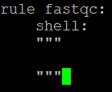

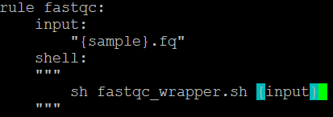
Lesson2: writing input and output tracking
Create the Snakefile and let’s start with the obvious mandatory sections of the rule:
BUT! We want to process all files, so let’s include the following input statement:
Snakemake will now be smart enough to identify the files from the pattern matching
Now we pass each input from the rule to the script like so:

Slide 36

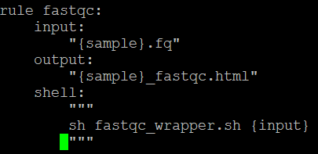
Lesson2: finishing up
We now have enough data for Snakemake to run! But, we also want snakemake to recognize if there is a mistake.
We can do this by adding an output statement to ask Snakemake to track the output, like so:
The whole rule should look like this:
Try running it!

Slide 37

Error! (this was expected!)
Snakemake did not like that, huh? As it turns out, we need one last command to have Snakemake track everything. First, define all samples at the top of the file:
Next, we will create an “all” rule that requests all files:
This tells snakemake that we expect four files as output, and it will work backwards to make sure that all four are accounted for.

Slide 38
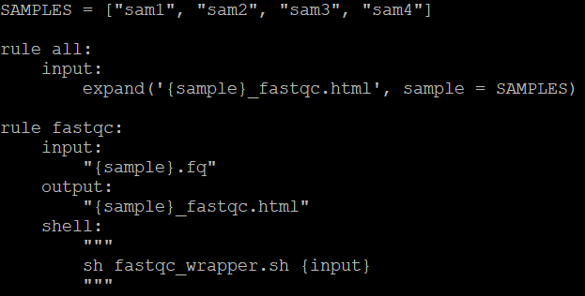
The whole file, a simple snakemake rule with tracking
Here is what the whole file should look like:
It seems like allot of text just to automate this process, but here is what you are getting by doing it this way:
Automatic file recognition and tracking
Automated logs when the task is finished
Automated queues for new tasks

Slide 39
Lesson 3: chaining rules
The real power of snakemake is in automating unconnected rules
The snakemake rule development process is quite easy and allows for iterative development (write a rule, run it, then write the next rule)
Once you are finished, the pipeline can be used for other tasks!

Slide 40
Lesson 3: Building on your previous example
We are going to automate a typical sequence data alignment workflow. To keep things easy, I have created scripts to run the main tasks for you
Order of operations:
1. Generate QC assessment of sequence data (fastq files)
2. Align sequence files (fastq) to the reference genome (fasta) to create a BAM file
3. Consolidate all BAM files together
4. Generate statistics on that BAM file

Slide 41
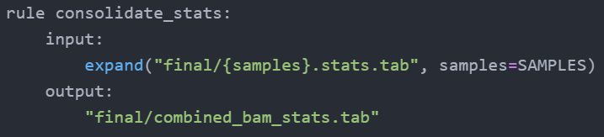
Lesson 3: Topic consolidation
Based on that workflow, you can already see that we need to eventually “merge” (or consolidate) files towards the end of the workflow
If we know the file prefix names, or the number of files we need, we can use the “expand” keyword to gather all files as our input like so:

Slide 42
Lesson 3: Topic consolidation (cont)
Note that the expand statement is in the “input” section, and a single file is in the “output” section. Here is the following rule for Snakemake to consolidate (or expand) your files/processes:
Input: single file
Input: expand()
Output: expand()
Output: single file

Slide 43
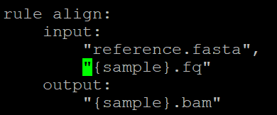
Lesson 3: Let’s write the rules
OK, we have enough information to start customizing our rules! Let’s start writing code! First, copy over your snakefile from Lesson2 so that we can start with a foundation.
Let’s write a rule to align the sequence files ({sample}.fq) to the reference genome fasta file (reference.fasta):
We already have a complication!
How do we distinguish between two different input files?

Slide 44
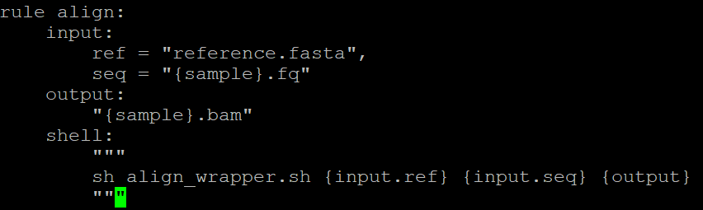
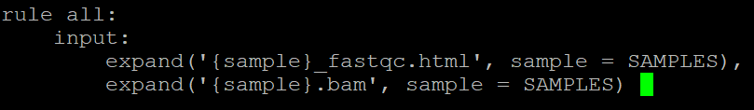

Lesson 3: rules continued
We can provide “nicknames” to the input files to help snakemake distinguish them, and it is then easy to reference them in the “shell” command:
Now modify the “all” rule:
Let’s run the file!

Slide 45
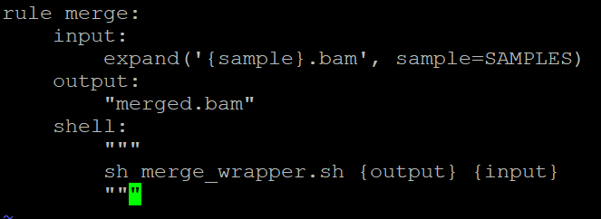
Lesson 3: adding a consolidation rule
OK, you have all of the bam files, but you want to merge them all into one single one! We need to add another rule:
Snakemake automatically “prints” all of the input bam files with spaces in the {input} tag for you.

Slide 46
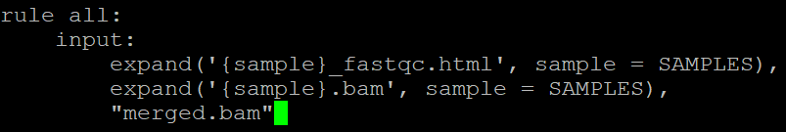
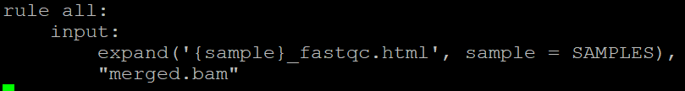
How should we modify our “all” statement?
Like this?
Or like this?
Try running the command – does it redo all of the steps?

Slide 47
Lesson 3: bringing it all together
There is one last rule that we need to write: the stats rule using the “stats_wrapper.sh” script!
Try writing a rule for this script and running your workflow.

Slide 48
Lesson 3: cluster job submission
That’s not all! Snakemake also allows you to submit jobs to the cluster!
We can assign a generic cluster statement to each Snakemake rule so that the jobs are submitted to slurm automatically:
This means that snakemake can help you parallelize jobs on the cluster as well.

Slide 49
More learning
Snakemake tutorial: https://snakemake.readthedocs.io/en/stable/tutorial/tutorial.html
Some example snakemake workflows: https://github.com/njdbickhart/python_toolchain/tree/master/snakeMake

