Slide 1
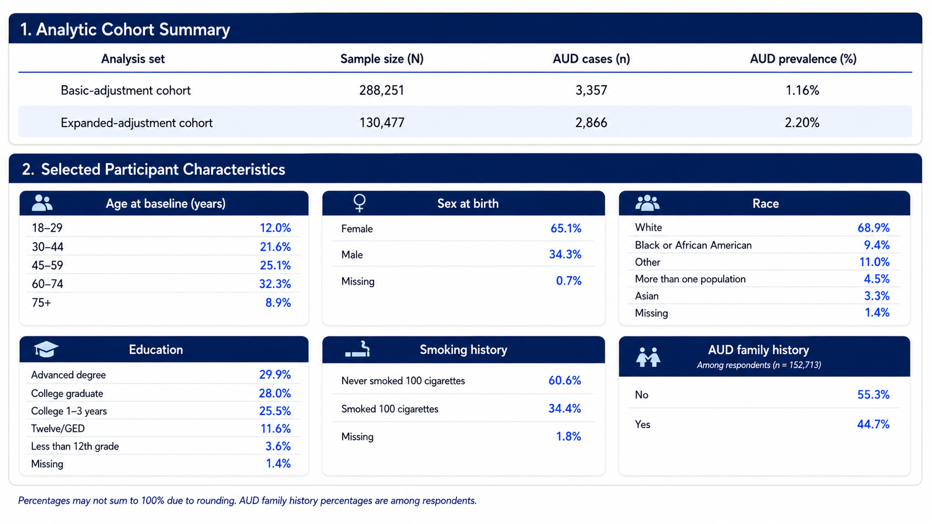
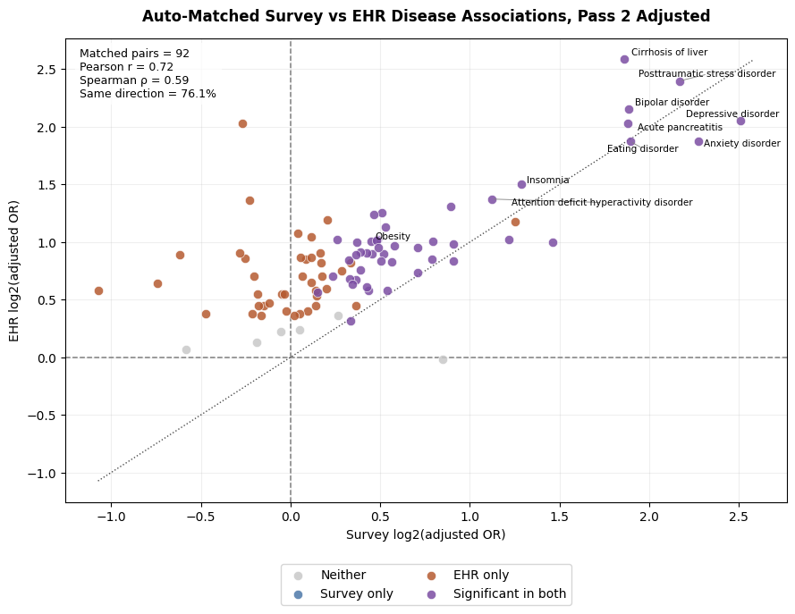
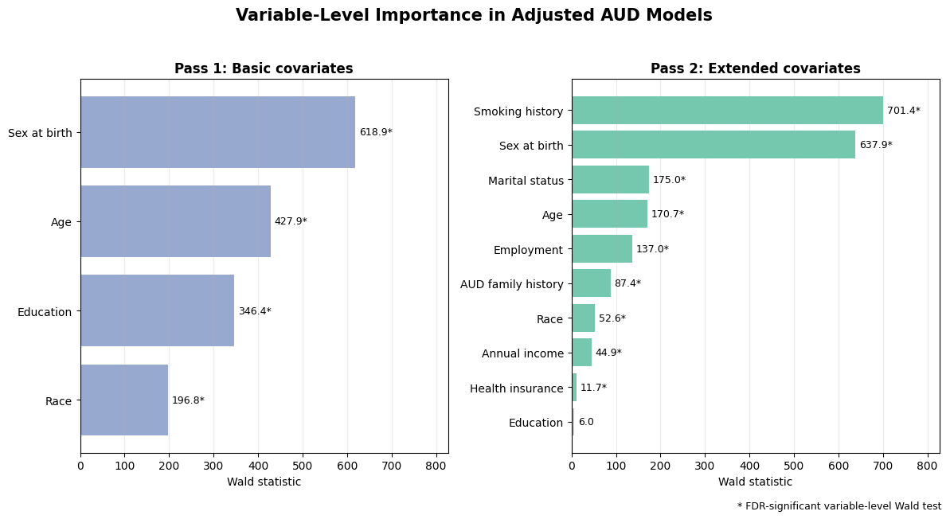
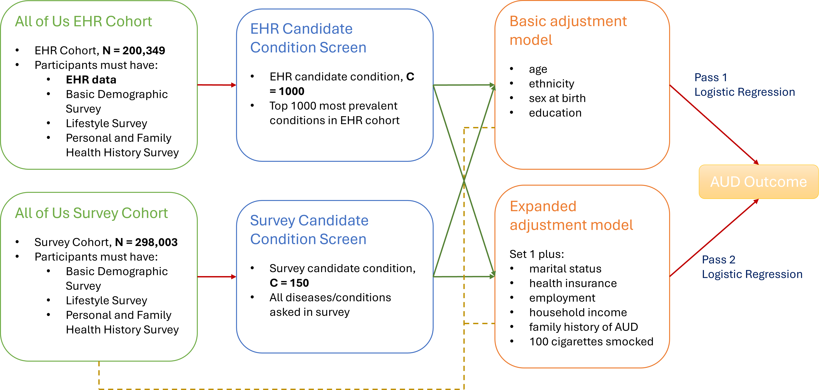
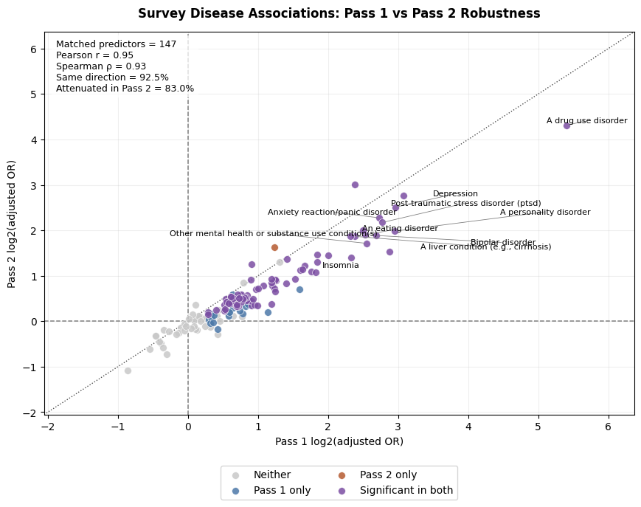
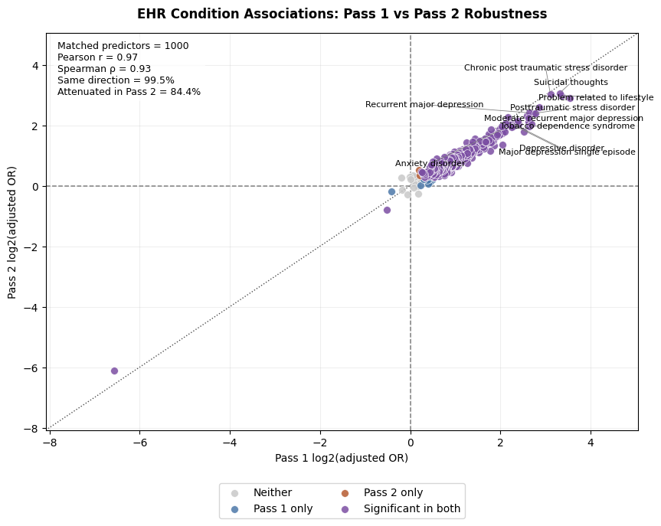
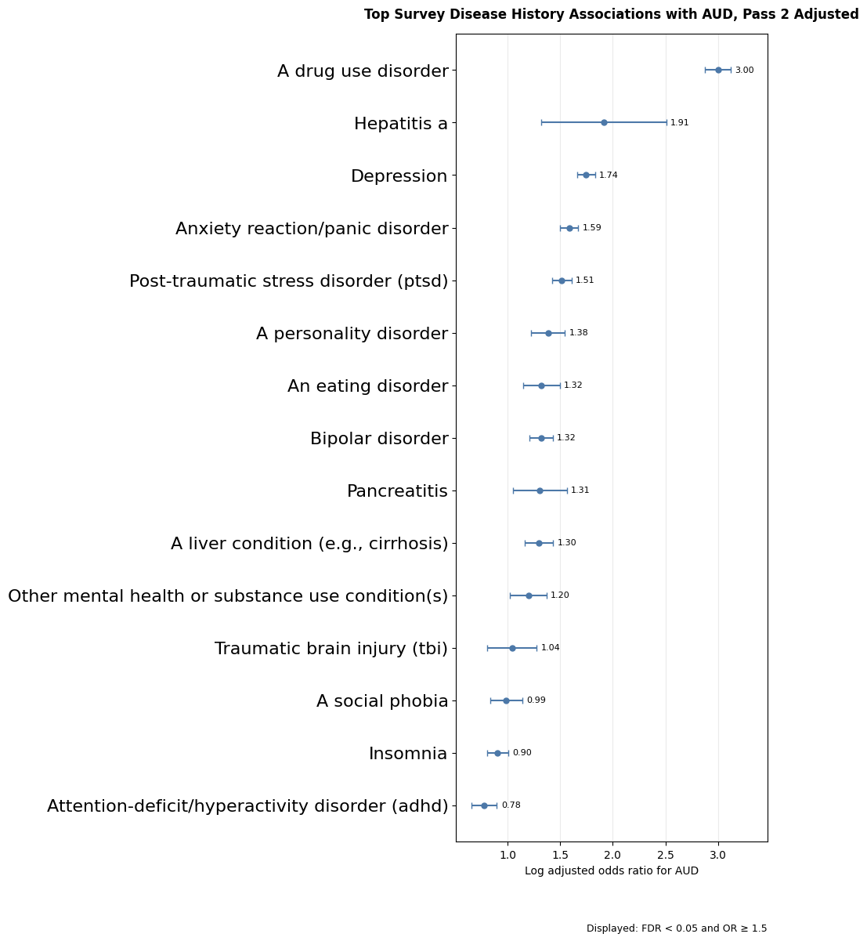
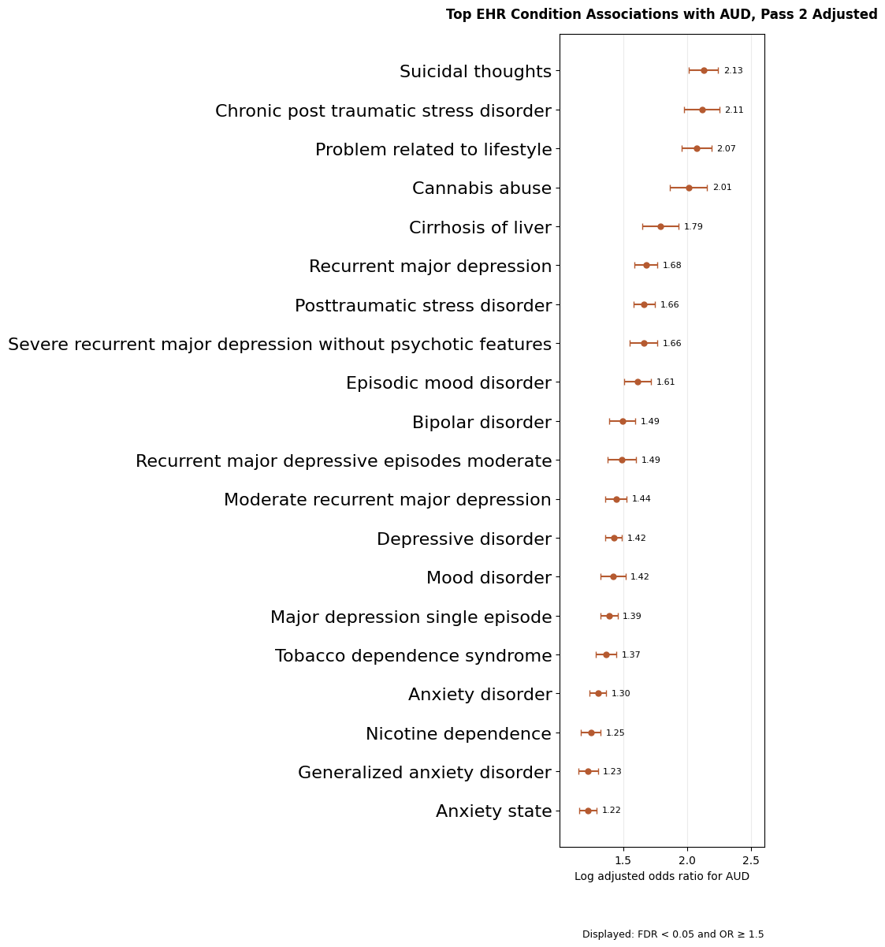




Clinical and Behavioral Factors Associated with Alcohol Use Disorder in the All of Us Research Program
Jiarun Liu, Stanislav Listopad, Qian Peng | UCSD, Scripps Research | RSA 2026 | Poster # S12
Keywords: AUD risk and comorbidity, All Of Us, Electronic Health Record (EHR)
1. Introduction, Workflow & Study Design
2. Cohort & Covariate Groups
3. Main Results & Takeaway (Cont’d)
Study question
Cohort Statistics
Survey–EHR Comparison: Convergent AUD Signals
Which clinical conditions are associated with AUD after adjusting for demographic, behavioral, socioeconomic, and family-history factors?
Introduction
Alcohol use disorder (AUD) is clinically complex and may be associated with mental health, substance use, liver disease, family history, socioeconomic background, and other life-context factors.
The All of Us Research Program links participant survey responses with electronic health record (EHR) data, enabling large-scale analysis of AUD-associated clinical patterns.
Survey data provide participant-reported disease history and background covariates, while EHR data provide clinically documented diagnoses.
This study used both survey-derived and EHR-derived AUD definitions to identify clinical conditions associated with AUD after covariate adjustment.
The main goal was to compare whether similar AUD-associated clinical themes appear across survey and EHR data.
Survey-based analysis
EHR-based analysis
Covariate Importance and Adjustment
Workflow
Basic–Expanded Adjustment Model comparison
3. Main Results & Takeaway
Method
Expanded-Adjustment Condition Associations with AUD
Data source: All of Us Research Program survey and electronic health record (EHR) data
AUD outcome definitions:
Survey AUD: defined from the Personal and Family Health History survey
EHR AUD: defined from clinical diagnosis records
Candidate condition screens:
Survey screen: ~150 survey-reported diseases/conditions
EHR screen: top 1,000 most prevalent non-AUD EHR conditions
Modeling approach:
Used logistic regression to estimate each condition’s association with binary AUD status
Reported adjusted odds ratios and confidence intervals
Covariate adjustment:
Basic model: age, race/ethnicity, sex at birth, education
Expanded model: marital status, health insurance, employment, household income, smoking history, and AUD family history
Education was removed from the final expanded model after losing independent significance under richer adjustment
Survey–EHR comparison:
Matched condition names across survey and EHR sources using text similarity
Compared adjusted odds ratios to identify convergent AUD-associated clinical signals
Conclusion
AUD-associated conditions clustered around three major clinical domains: substance use, mental health, and liver/pancreatic disease.
Similar clinical themes appeared in both survey-reported and EHR-derived analyses, supporting a consistent AUD-related comorbidity pattern across data sources.
Survey and EHR data were not interchangeable: survey data captured participant-reported disease history, while EHR data reflected clinically documented diagnoses.
Expanded covariate adjustment helped account for demographic, behavioral, socioeconomic, and family-history factors, making the observed associations more conservative and interpretable.
Acknowledgements
We gratefully acknowledge All of Us participants for their contributions, without whom this research would not have been possible. We also thank the National Institutes of Health’s All of Us Research Program for making available the participant data examined in this study.
Funded by grants from National Institute on Alcoholism and Alcohol Abuse (NIAAA) T32 AA007456, and National Institute of Drug Abuse (NIDA) grants DP1 DA054373.
Notes:
Method， cohort build
Title to 80
Abstract to bullet point
Text size to 28
Check figure size

