Slide 1
Investing In Netflix
Netflix Stock Prices compared to Dow Jones Industrial Average -
Development and Trend in 2017

Slide 2
Prepared and compiled by: Manfred Deller for: Capstone Data Visualization Project
Financial Data by Yahoo Finance
Period of Analysis: 2017
Uncderlying Data Were Visualized Using Python Matplotlib

Slide 3
List of Figures:
Fig. 1: How Did Netflix Stock Price Perform in 2017?
Fig. 2: Earnings per Netflix Share in Cent in 2017
Fig. 3: Netflix Revenue and Earnings by Quarter in 2017
Fig. 4: Netflix Stock Better Than Dow Jones Industrial in 2017?

Slide 4
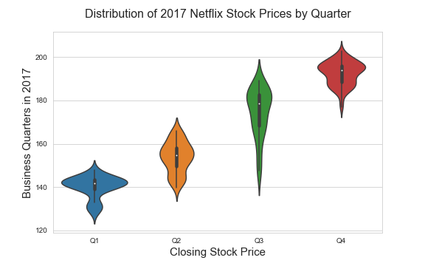
How Did Netflix Stock Price Perform in 2017?
Steady increase in stock price.
Notable fluctuation in Q3 probably due to end of cooperation with Disneys.
Main ranges of most of the prices throughout the year: $140 - $150 and $180 - $190.
Highest price ~$205 whilst lowest was ~$122.

Slide 5
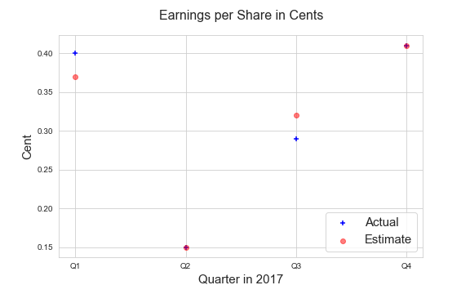
Earnings per Netflix Share in Cent in 2017
Estimated Earnings per Share in Second and Fourth Quarter Match Actual Values.
Actual Earnings in First Quarter Outmatched Estimated Values.
Actual Earnings in Third Quarter were Overrated.

Slide 6
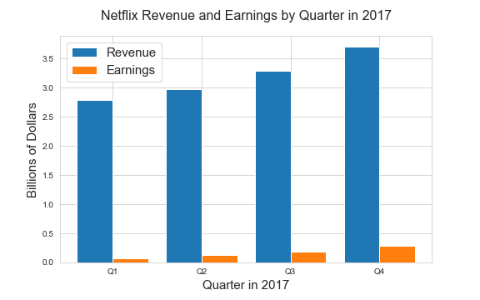
Netflix Revenue and Earnings by Quarter in 2017
Both Revenue and Earnings Show an Increasing Trend Throughout the Year.
Increase in Earnings is Higher Than Increase in Revenue in All Four Quarters.
Earnings Percentage of Total Revenue Increases from ~ 2% in First Quarter to Around 8% in Fourth Quarter.

Slide 7
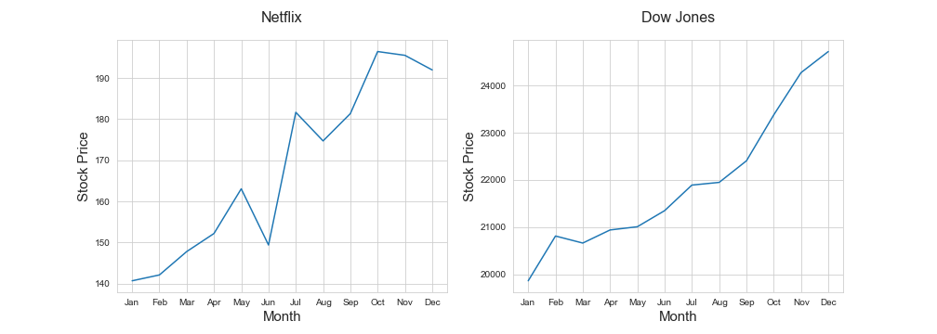
Netflix Stock Better Than Dow Jones Industrial in 2017?
Both Netflix and Dow Jones Industrial Showed a More or Less Steady Increase Throughout the Year 2017.
Netflix Overperforming Dow Jones Industrial. Increase by ~40%, Dow Jones by ~25%.
Volatility of Netflix Stocks was Higher as Compared to Dow Jones.

