Slide 1
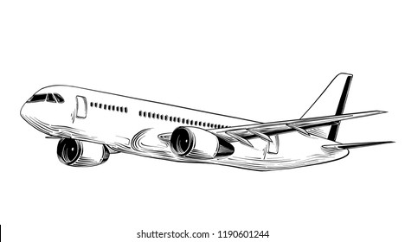
Title
ANALYSIS OF THE AIRCRAFT WITH THE LOWEST RISK

Slide 2
Overview
This project explores aircraft data in order to offer suggestions for a company looking to learn more about aviation safety.
Based on descriptive data, we have identified key findings regarding the safety of various aircraft.
These insights can assist the business in establishing guidelines for their upcoming venture in the aviation sector.

Slide 3
Business Problem
The company wants to buy and fly aircraft
The is unaware of the risks involved:
Aircraft damage and loss
Number of accidents and incidents
3 Assist in selecting which aircraft is best to buy

Slide 4
Business understanding
This business is diversifying its holdings by venturing into new markets.
In particular, they are eager to buy and run aircraft for both individual and commercial use, yet they have no knowledge of the possible hazards associated with aviation.
It requires assistance in identifying which aircrafts have the least amount of danger when launching a new company aircraft.

Slide 5
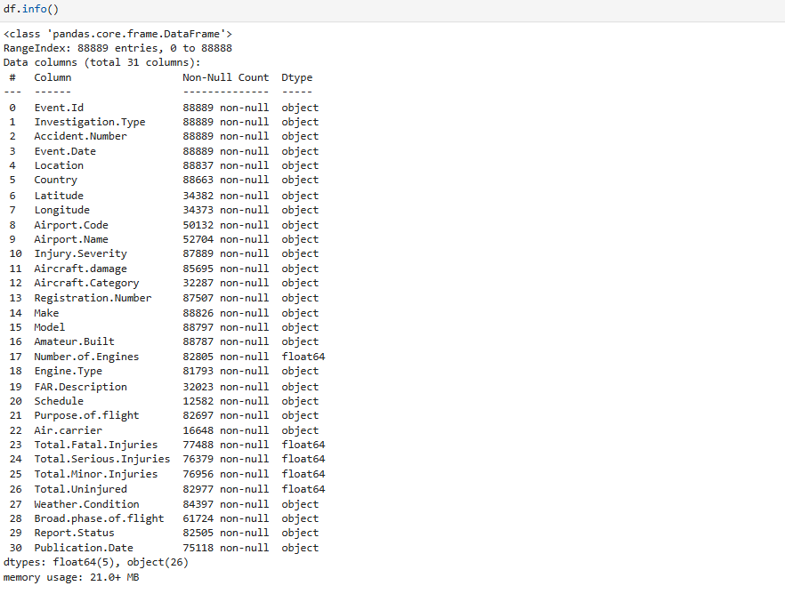
Data Analysis
.

Slide 6
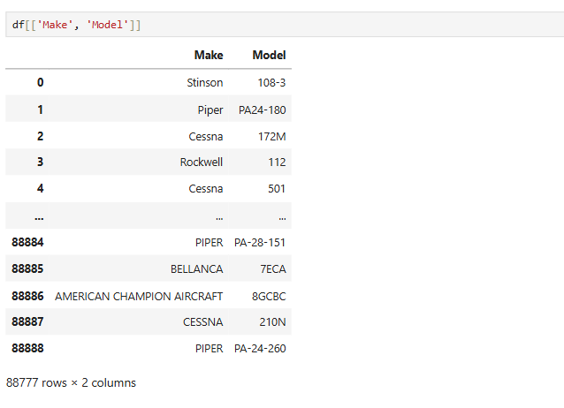
Data Understanding

Slide 7
Recommendations
I recommend Boeing-b737-2h4 and Rockwell-na-265-80 because they are associated with the least risks of accidents, incidents, injuries and damages
.Also they are professional well built.
The engine type built on this aircraft have the least number of incidents associated with them.

Slide 8
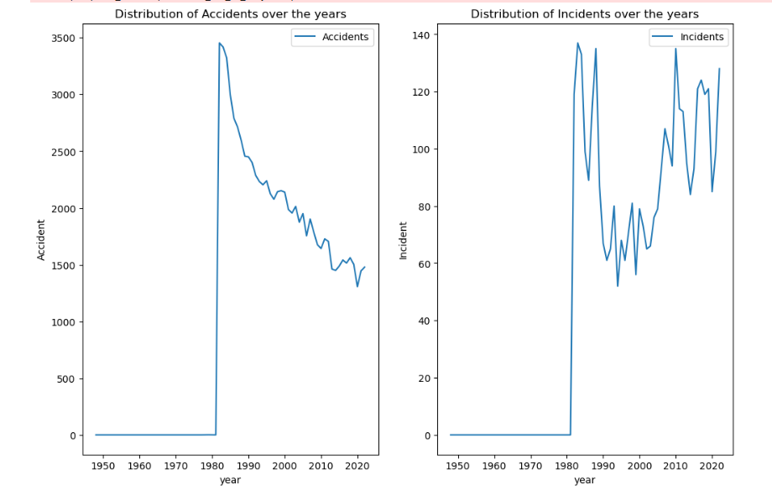
RESULTS Checking on how accidents and incidents were distributed over the years

Slide 9
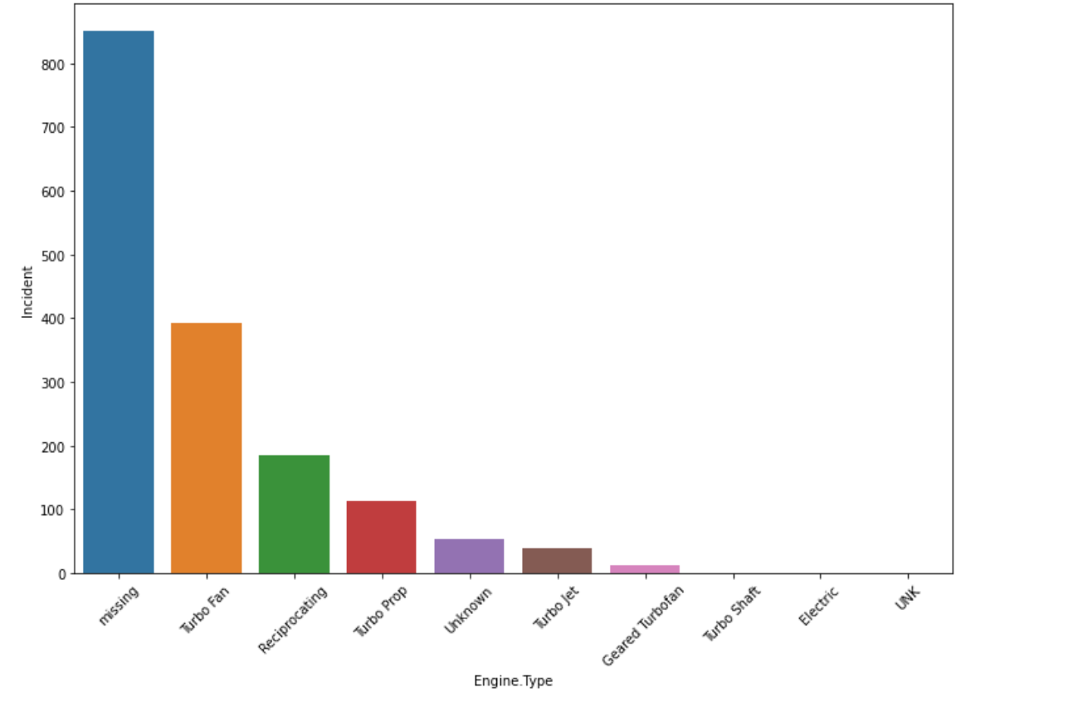
RESULTS Plotting the distribution of incidents by Engine Type

Slide 10
Conclusions
I recommend Boeing-b737-2h4 and Rockwell-na-265-80 because they are associated with the least risks of accidents ,incidents,injuries and damages.
Also they are proffessional well built.The engine type built on this aircraft have the least number of incidents associated with them.

Slide 11
Thank YOU!!
NAME: NJERI MBURU
LINKEDLIN: @NJERI MBURU

