Slide 1
Water Bottle Resonator
Nicholas Richardson
SYDE 750: Physical and physiological acoustics​
Course Instructor: Dr. Nima Maftoon

Slide 2
Overview
Goals for creating this project
Learning objectives
Description
Equipment
Sample experiment
Calculations and code
Discussion

Slide 3
Goals for the project
Incorporate many acoustics topics
Vibration, Oscillation, Decibel Scale, Radiation, Mics, Speakers, Pipes, and Resonance
Senior undergrad level
Content is self contained (extensive research or literature review not required)
Should be able to derive expressions independently
Assume basic coding skills
“At-home” friendly
Only use materials found around the house
Not require specialize room or measuring devices

Slide 4
Learning Objectives
“In this project, you will apply your knowledge of acoustic phenomenon to a water bottle Helmholtz resonator. The main topics that will be applied are 1D vibration & oscillation, radiation, cavities & pipes, microphones, and Helmholtz resonators. The main tasks will be to use a water bottle to 1) find the speed of sound in air, 2) test the end correction for an unflanged pipe, and 3) find the Q value for an unflanged pipe.
Clearly state main topics and tasks
Tasks are
Find speed of sound in air
Find and measure end correction of a pipe
Find and measure Q for a pipe

Slide 5


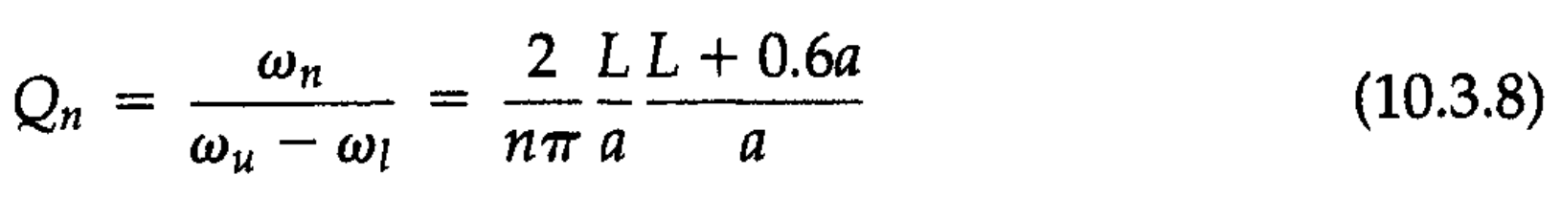
Project Description
Explain how we can perform these tasks
But don’t feed them all the formulas
What are the formulas?

Slide 6





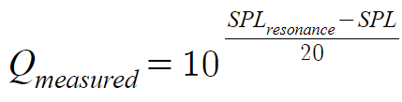
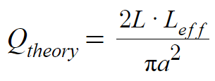
Our exact relationships

Slide 7
Equipment and Software
Water bottle with removable lid
Tap water to fill bottle
Ruler
Frequency/Decibel measuring device (ex. dB Meter app for iPhone/Android)
Small external speaker (ex. Bluetooth speaker)
Tone generator website (ex. https://www.szynalski.com/tone-generator/)
Coding program (ex. Python)
Notes:
Assume cylindrical so we can closely approx. 1D tube
Flat sides and unflanged

Slide 8
Part A
Finding speed of sound and end correction
Notes:
- Helpful constants to describe our acoustic system
How much power a speaker provides
How wide or narrow is the sound radiating from a speaker
Get into the heavier math first and then more demos in the second half

Slide 9
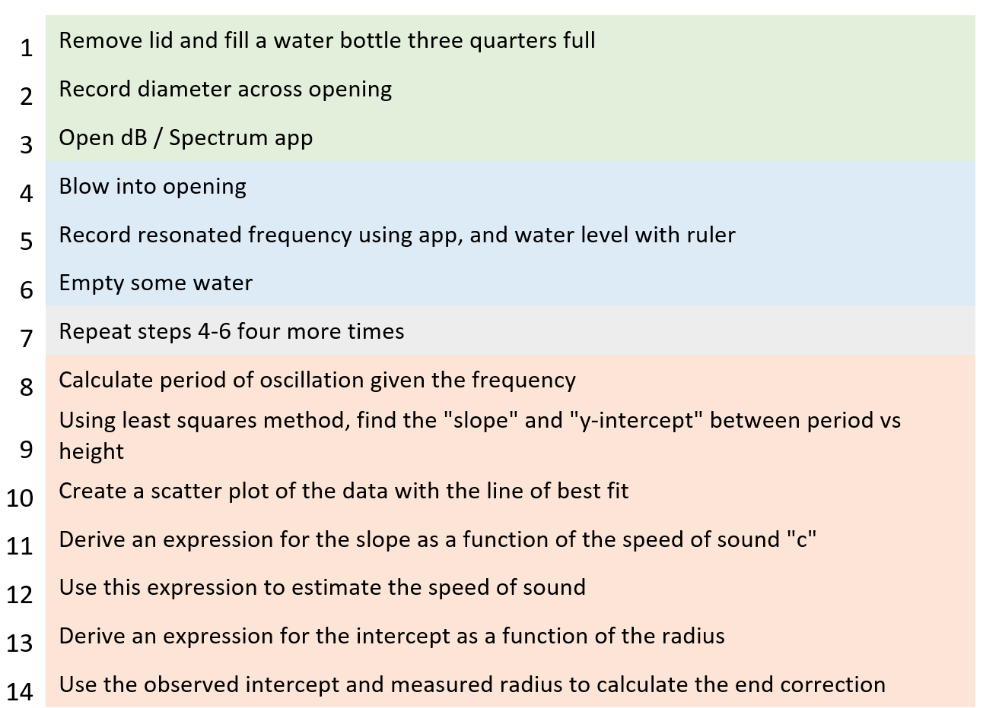
Task Breakdown
Let’s test this out!

Slide 10
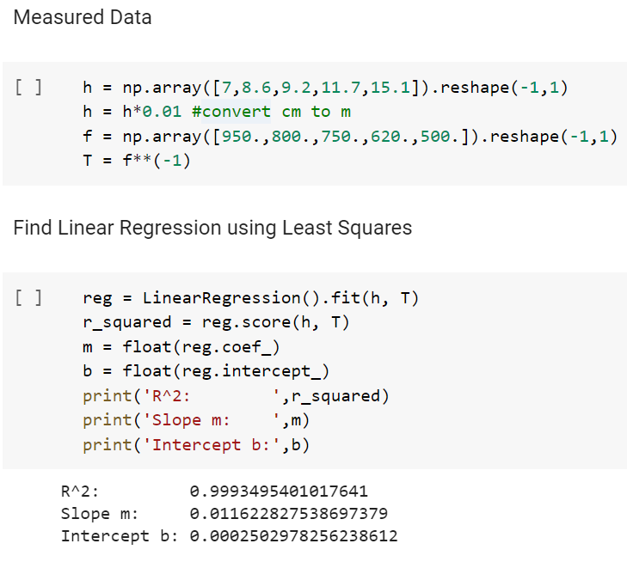

Slide 11
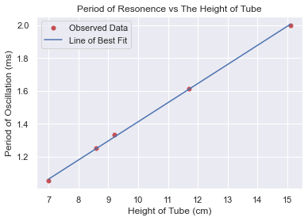

Slide 12
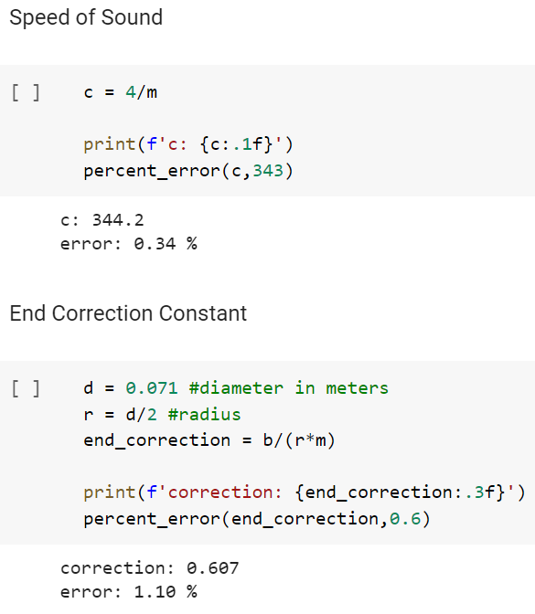

Slide 13
Part B
Testing pressure amplitude gain Q
Notes:
- Helpful constants to describe our acoustic system
How much power a speaker provides
How wide or narrow is the sound radiating from a speaker
Get into the heavier math first and then more demos in the second half

Slide 14
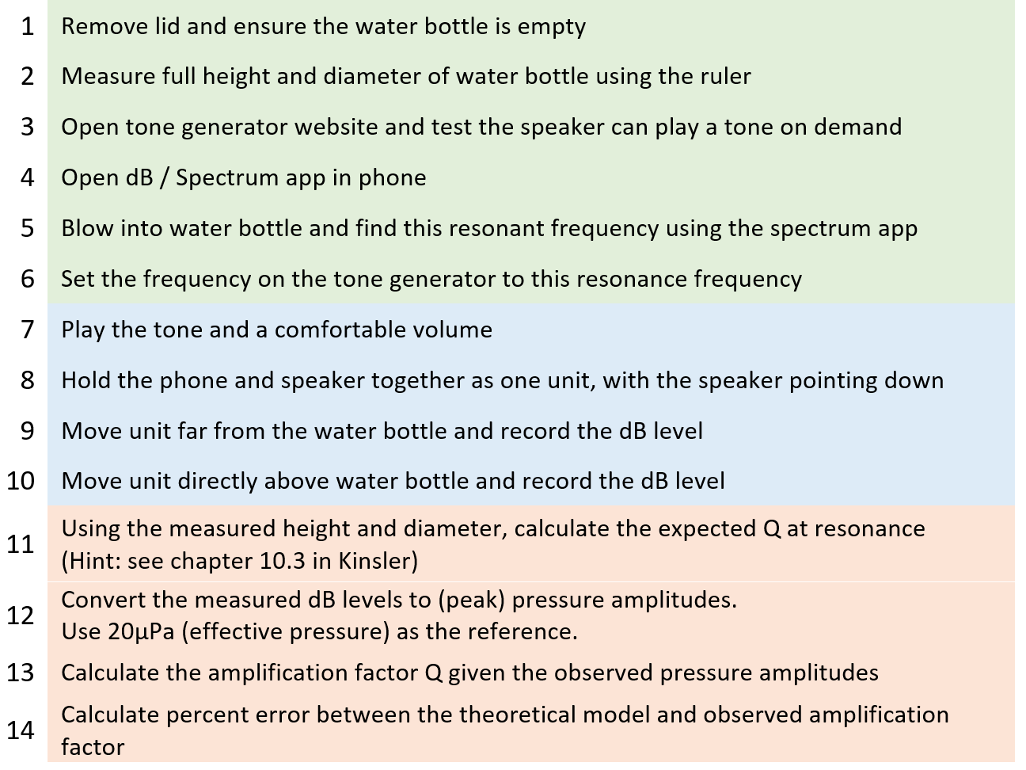
Task Breakdown
Let’s test this out!
Notes:
Why make the water bottle empty?
- Q increases with an increase of L, so we should observe the biggest gain

Slide 15
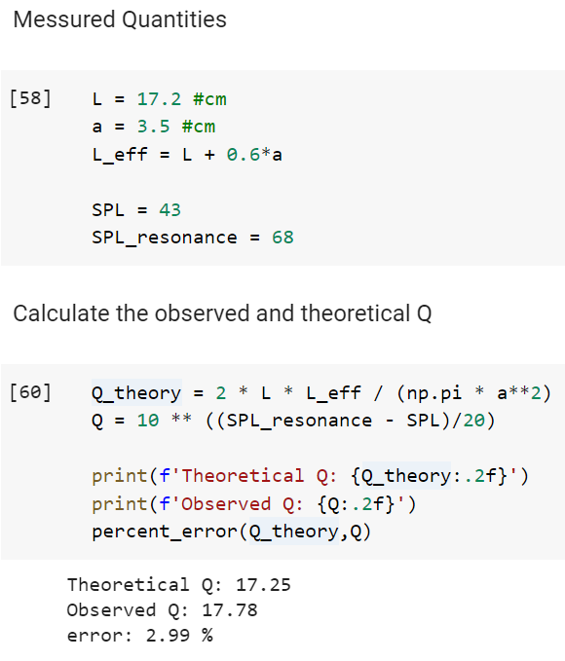

Slide 16
Discussion

Slide 17
Reasons for Error?
Water bottle isn’t a perfect tube
I excite by blowing rather than a perfect sinusoidal piston (in part A)
Used the speed of sound at room temperature
Did not measure the pressure IN the bottle, just outside
Ambient sounds (fan, AC, computer) in the room
Notes:
I want to ask YOU first

Slide 18
Modifications
Could use the temperature to find a more accurate “ground truth” for speed of sound
Could perform repeated measurements of SPL difference
Obtain Q using the average difference
Less prone to error
Any others?
Notes:
To address two of these
What other modifications/additions would you make?

Slide 19
Possible additions pt. 1
Test transmission and reflection
Cut holes into cheep water bottle and compare intensity levels at different openings to find transmission and reflection coefficients
Find impedance
Using a Helmholtz style water bottle (one with a neck), take physical measurements to find impedance
Find absorption of medium
Set up a tube with a speaker at one end, and medium of interest at other. Compare intensity before and after medium

Slide 20
Possible additions pt. 2
Compare flanged vs. unflanged
Cut a hole for water bottle in a large piece of cardboard. Redo Part A with the flanged water bottle and see how the end correction coefficient changes
Could also make different sized flanges and see how big the flange needs to be to have a large effect on resonance frequency
Create a Helmholtz resonator
Using cardboard, cover the water bottle opening, and cut small hole in top. Compare the resonance frequency with the open bottle
Can also perform impedance and other calculations on this new resonator

Slide 21
References
​Kinsler, L. E. (2000). Fundamentals of acoustics (4th ed.). Wiley.
Müller, G., & Möser, M. (Eds.). (2013). Handbook of Engineering Acoustics. Springer-Verlag.
“Physics Tutorial: The Speed of Sound.” The Physics Classroom, www.physicsclassroom.com/class/sound/Lesson-2/The-Speed-of-Sound.
Code can be found on Collabs here:
https://colab.research.google.com/drive/1xGMEdj-Ml6gLR5_ZM8ijrZvaA71Y6uIJ?usp=sharing

