Slide 1

Navigating the Publishing Process: Scholarly Books and Open Research in STEM
Mr Gauravjeet Singh Reen
Senior Editor: Electrical and Computer Engineering

Slide 2
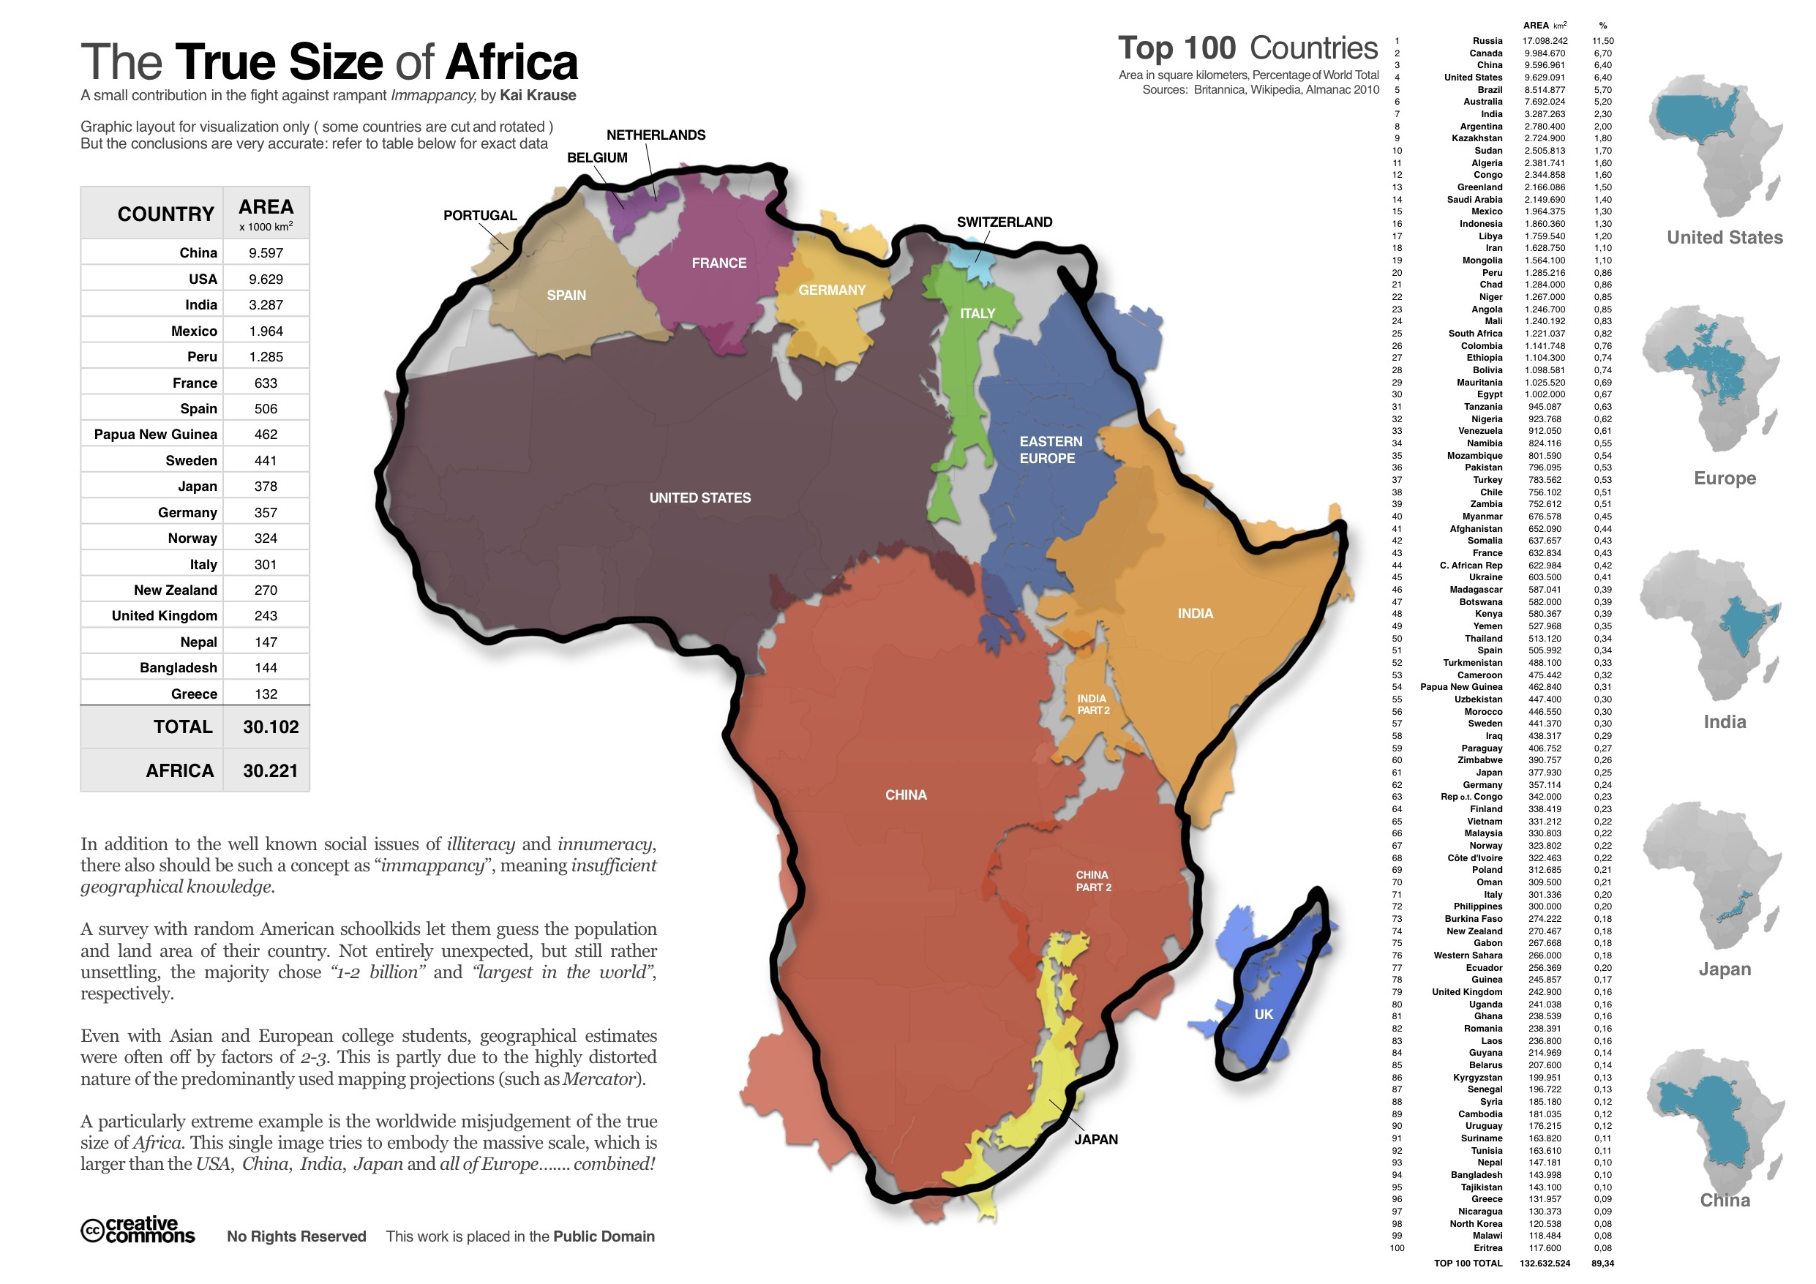

Slide 3
African Union Agenda 2063:
Science, Technology and Innovation (STI) as multi-functional tools and an enablers for achieving continental development goals
AU Science, Technology and Innovation Strategy for Africa 2034 (STISA-2034)
Vision
“An integrated, prosperous, and peaceful Africa where science, technology, and innovation drive sustainable
socio-economic development.”
Mission
“To harness the transformative power of science, technology, and innovation in accelerating Africa’s transition into a knowledge-based and innovation-driven continent”.

Slide 4







Fostering Human Progress through Knowledge
Advancing research and enriching lives since the 18th century
Our family of imprints includes Taylor & Francis, Routledge, CRC Press, F1000 Research, and Dovepress
Serving knowledge makers worldwide with over 180,000 book titles and 2,700+ journals
More than 100,000 eBooks available through their digital platforms
Global pioneers of Open Access Publishing, with 330+ open journals, 4,000+ OA books, diverse publishing pathways, and rigorous quality standards
Copyrights @RadhikaSharma

Slide 5
Books

Slide 6
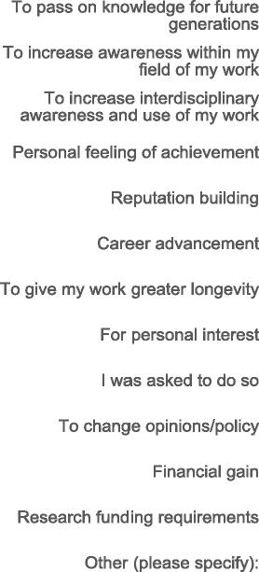

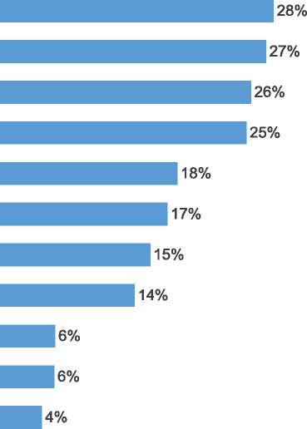
Need for Publishing a Book

Slide 7
Benefits of Publishing Book
Academic Recognition
Knowledge Dissemination
Impact on Policy and Practice
Longevity
Networking
Credibility
Notes:
Publishing a book carries a multitude of advantages. First and foremost, it serves as a powerful tool for knowledge dissemination, allowing authors to share their expertise, insights, and research with a wider audience. A published book is often considered a significant achievement in academia, leading to increased visibility and credibility within the scholarly community. The books have the potential to shape policy and practice.They offer increased longevity-They can continue to inform and inspire readers for generations, leaving a lasting impact on the intellectual landscape. Authors are perceived as experts in their respective fields, Authors can connect with fellow authors, experts, and professionals in their field, facilitating valuable collaborations and knowledge exchange.

Slide 8
Developing your idea
What is your book about?
Who is your book for?
Why does the audience need it or want it?
What type of book? (Reference, Textbook, Authored, Edited, Professional, Monograph, Handbook)
What will it do better than the competition?
Discuss your book idea with:
Colleagues
Authors published in the field and series editors
A commissioning editor
Notes:
What – can’t be all your research – maybe a project, or your thesis,
Start shaping the story you want to tell
It needs to be original – not been researched before or not been researched in that way (different methods and methodology, different context) or develops previous work.
What are your ideas? How are they original?
Then think about who you are writing for
- why they want it! What will make them buy, read and cite your book. Think about why your book is better than the competition.
So discuss your idea with…
Needs to be something you’re interested in (remember you could be working on this a long time) and is interesting to others.

Slide 9
How to start
Why have you decided to write a book? What type of book you wish to write? Reference, Textbook, Authored, Edited, Professional, Monograph, Handbook
Consider the TABLE of CONTENTS/KEYWORD technique
Choose a TITLE
Consider your market: Competition
Set a DEADLINE
Number of PAGES : Less is More!
Essentially, This is your book proposal…

Slide 10
Tips for writing a strong book proposal
Title - Use a clear title
Market Need – Justify the need of the book
Audience – Include a brief description of your target readership
Table of Contents & Key Features - Include a detailed table of contents with chapter descriptions or abstracts to show how you will set out the content
Competition - Give a brief analysis of some of the most closely related books to your proposed book. How will your book add to existing literature?

Slide 11
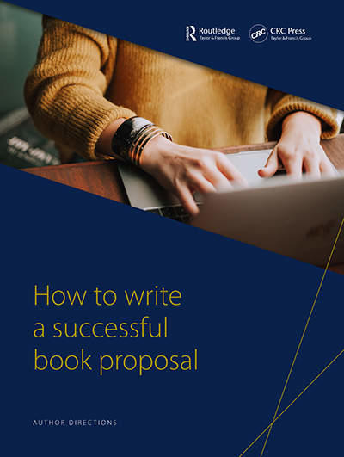
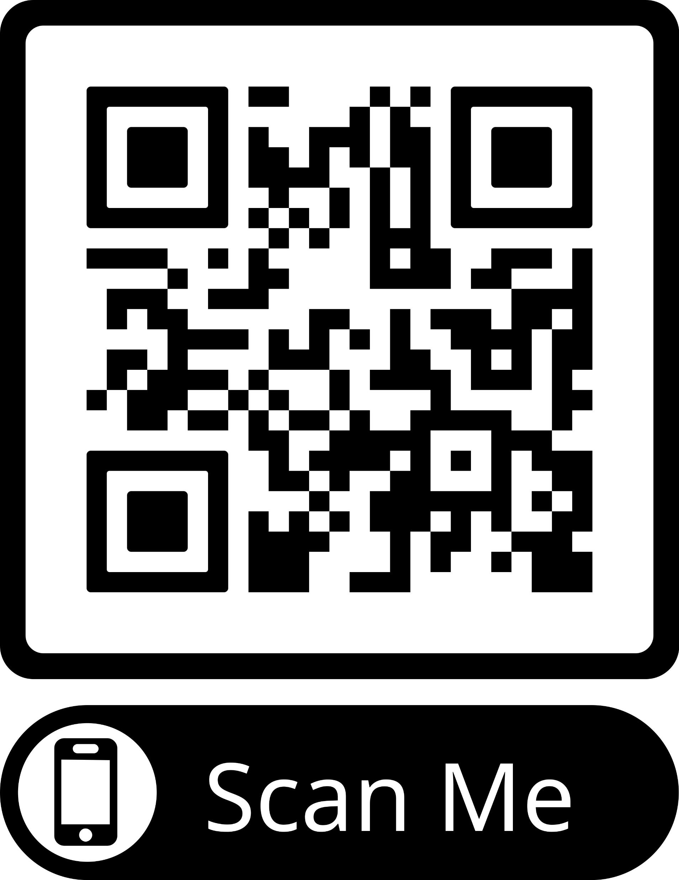

Slide 12
The Review Process
Single-blind review: where the reviewer's name is hidden from the author.
How many reviews are necessary?
What is the timeline for the reviews?
Must I incorporate reviewers’ suggestions I don’t agree with?
Why do proposals get rejected? Can a bad review hurt my chances of getting this book published?
What are you expected to do when you get reviews?

Slide 13
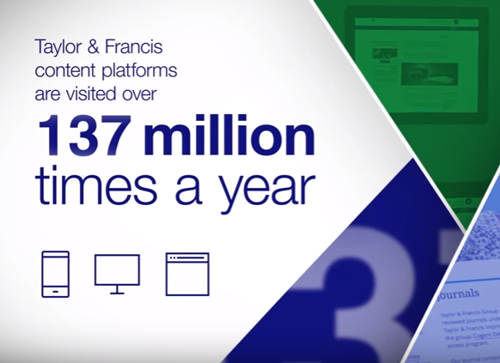
The Writing Phase…..
How much time a publisher allows author to write a book?
Sample Chapters
Understanding the author guidelines
Asking Questions/Be in touch with publisher
Manuscript Submission

Slide 14

After you submit the manuscript…..
Pre-Production Review
Handover to Production/Project Editor
Typesetting/Copyediting
Proofs
Cover Designing
Off to Printer
Book Releases Worldwide

Slide 15
What do prospective authors need to know?
Compliance with DHET Requirements/MS Review/Timelines
Royalties
Copyright Permissions
Complimentary copies
TIMELINES/DEADLINES
Chapter Abstracts
Indexing (SCOPUS/WoS/Google)
Flexibility
Role of EDITOR in a Contributed Book

Slide 16
Why do proposals get rejected?
Absence of unique value proposition
Sloppily filled proposal form
Proposals having a very narrow market / written for a very small audience?
Author’s not revising the proposal based on the Editor’s / reviewers’ suggestions
Copyright Infringement
Outside of the scope of the publishing list

Slide 17
Publishing Process
Submit Proposal
Internal Editorial Assessment
Peer Review
Discuss review
Editorial Board Meeting
Sign Contract
Writing Phase
Manuscript Delivery
Production
Marketing
Sales
Notes:
Comprehensively fill our standard proposal form and submit it to the most appropriate acquiring editor of your subject area with supporting material such as Table of Content , any Sample Chapter.
Once you submit your book proposal, it is reviewed by the acquiring editor and if your book proposal meets our criteria for quality, relevance, and marketability, the acquiring editor submits the proposal for peer review by experts in the field who will offer their opinions on the potential strengths and weaknesses of your proposal, including its importance to the field. If it is determined that your book has the potential to be mutually profitable and is seen as advancing your field or promoting education within its field, approval is granted and a contract is offered. Read over the contract carefully. Your CRC Press acquiring editor will discuss the terms with you and is able to answer any questions you might have. The goal is to prepare a book manuscript that is clear, to the point, and allows for an easy transition to production.
Once you submit us the manuscript to production it would go through Copyediting, Proofreading, indexing, Typesetting of the manuscript takes place.

Slide 18
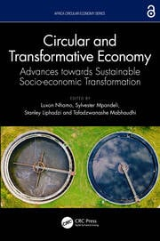
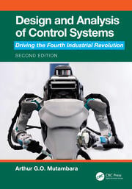
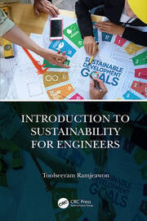

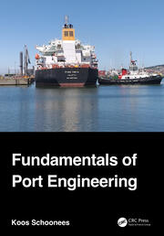



African Authors

Slide 19
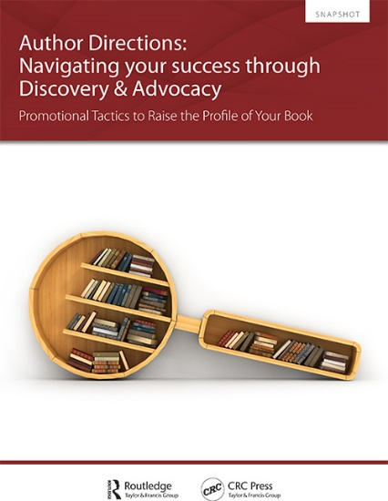
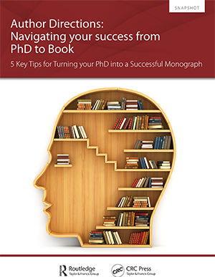
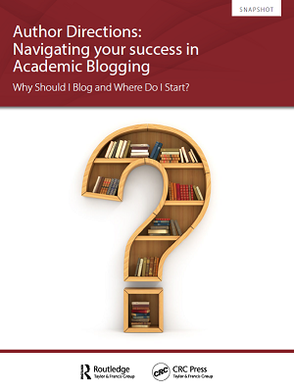
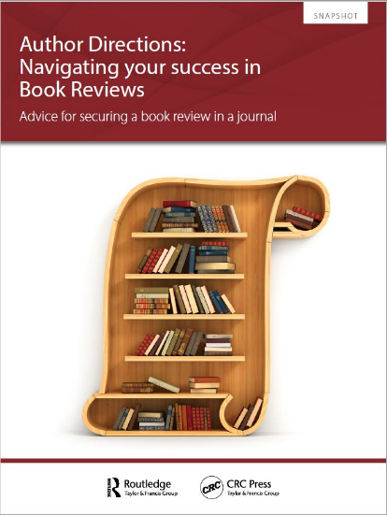
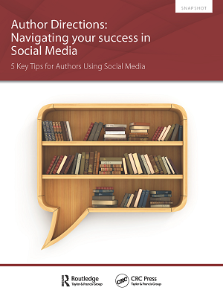
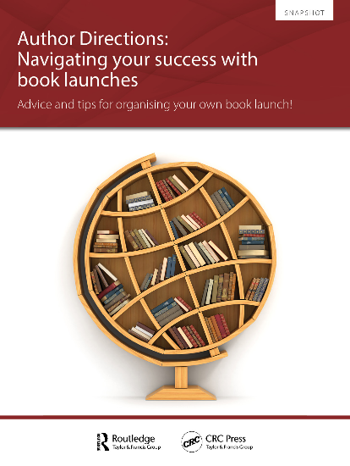
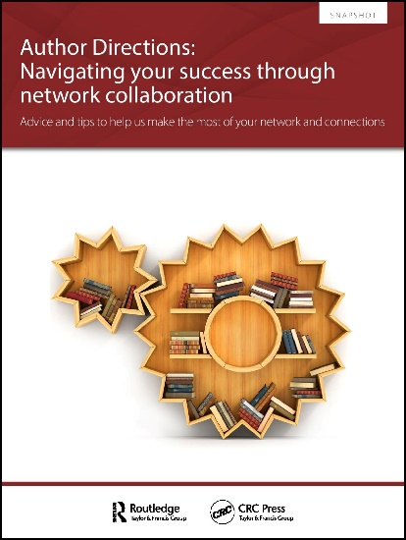
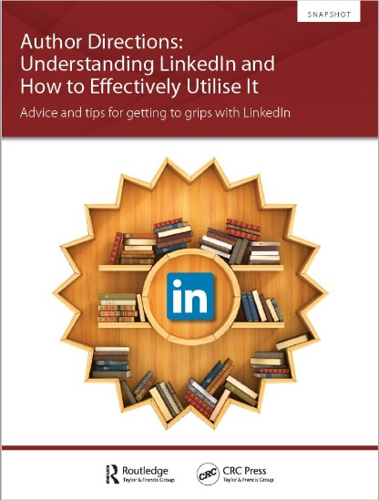

Slide 20

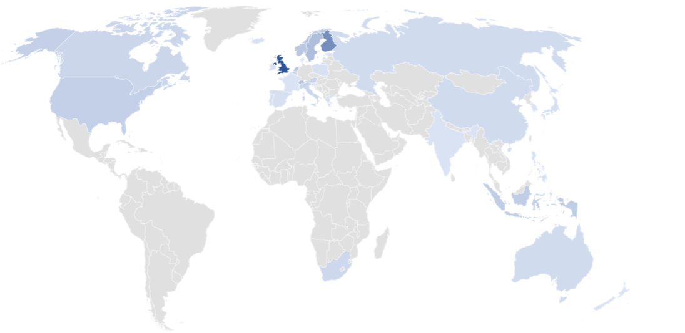
T&F is one of the world’s largest publishers of open-access research.
T&F OA books since 2013
Notes:
Taylor & Francis is one of the world’s largest publishers of open-access research.
Your book or chapter can be read by anyone, anywhere.
If you choose to publish with us, a wide range of open-access options are available to you. This means you can comply with any funder requirements and ensure your research makes a difference.
One thing that is also important is Open Access. This is another way that you can maximize your research impact.

Slide 21

What is Open Access?
Content that is freely and permanently available online
Anyone, anywhere in the world can read and build upon this research
i.e., no financial, legal or technical barriers
Aims of Open Access
UNESCO – reduce the gap between industrialised countries and those in the emerging economy
Berlin Declaration on Open Access to Knowledge in the Sciences and Humanities (2003) – “to realize the vision of a global and accessible representation of knowledge, the future Web has to be sustainable, interactive, and transparent. Content and software tools must be openly accessible and compatible.”
Image source: https://upload.wikimedia.org/wikipedia/commons/7/77/Open_Access_logo_PLoS_transparent.svg
Notes:
Note: we still sell the physical copy!

Slide 22
Open Access – Increased impact
Downloads
Citations
Readership
International collaboration
Interdisciplinary engagement
Chapters in OA books are 7 times more downloaded than non-OA books
OA books are cited 1.5 times more than non-OA books
OA books have approximately twice as many nationally diverse readerships as non-OA books
You may connect with researchers in unexpected countries and start joint research
Researchers who might not otherwise pay for access can read your work and open new routes of collaboration
Notes:
The main benefit of OA – increased impact

Slide 23
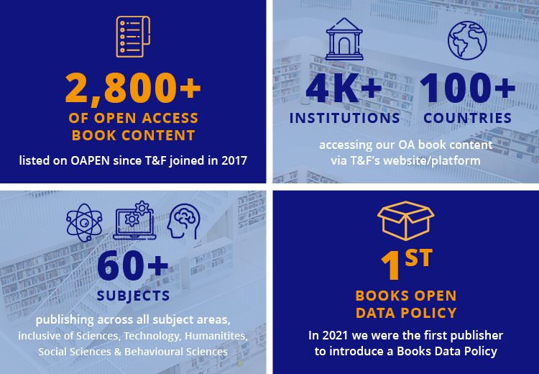
Open Access at T&F
Creative Commons licensing (usually CC BY NC ND)
Downloadable from Taylor & Francis or distributors such as Amazon
Print version also available for purchase (with royalties!)
Deposit copies are placed in the OAPEN repository and others
Notes:
Our OA book content has been accessed over 2 million times

Slide 24
Are our OA books different to non-OA books?
Range of Flexible OA book and chapter publishing options
Same recognised academic and publishing standards
Hosted and easily accessed via our ebook platform and OA specific channels such as OAPEN
Twice the geographical reach in the first 6 months
16 times more readers
Notes:
Open Access content is far more likely to be downloaded and cited.
We are also into publishing Open Access books and journals. Whether you go ahead with open access books or journal it is a paid
So please free to connect with us in case there are any funded project where there is scope of OA publishing whether in book or journals as this can be much more impactful in research community

Slide 25

How do we publish OA?
We have 3 main types of OA book publishing:
1. Born OA
2. Retrospective OA
3. Chapter OA
Notes:
How do we publish OA?
Our OA publishing options have grown up in response to the needs of our authors and now include 3 main strands:
Born OA – this means the book has been published Open Access immediately. The eBook is free to access from our own platform and other channels, the print book is still sold.
Retrospective OA – This is where someone funds making the book open access at some point post publication, this could be 12 months, or it could be 3 or 5 years down the line.
Chapter OA – where funding is limited or ringfenced, or where we have contributors to a book who are particularly keen to make their own chapter Open access within a book that is otherwise behind a traditional paywall.

Slide 26
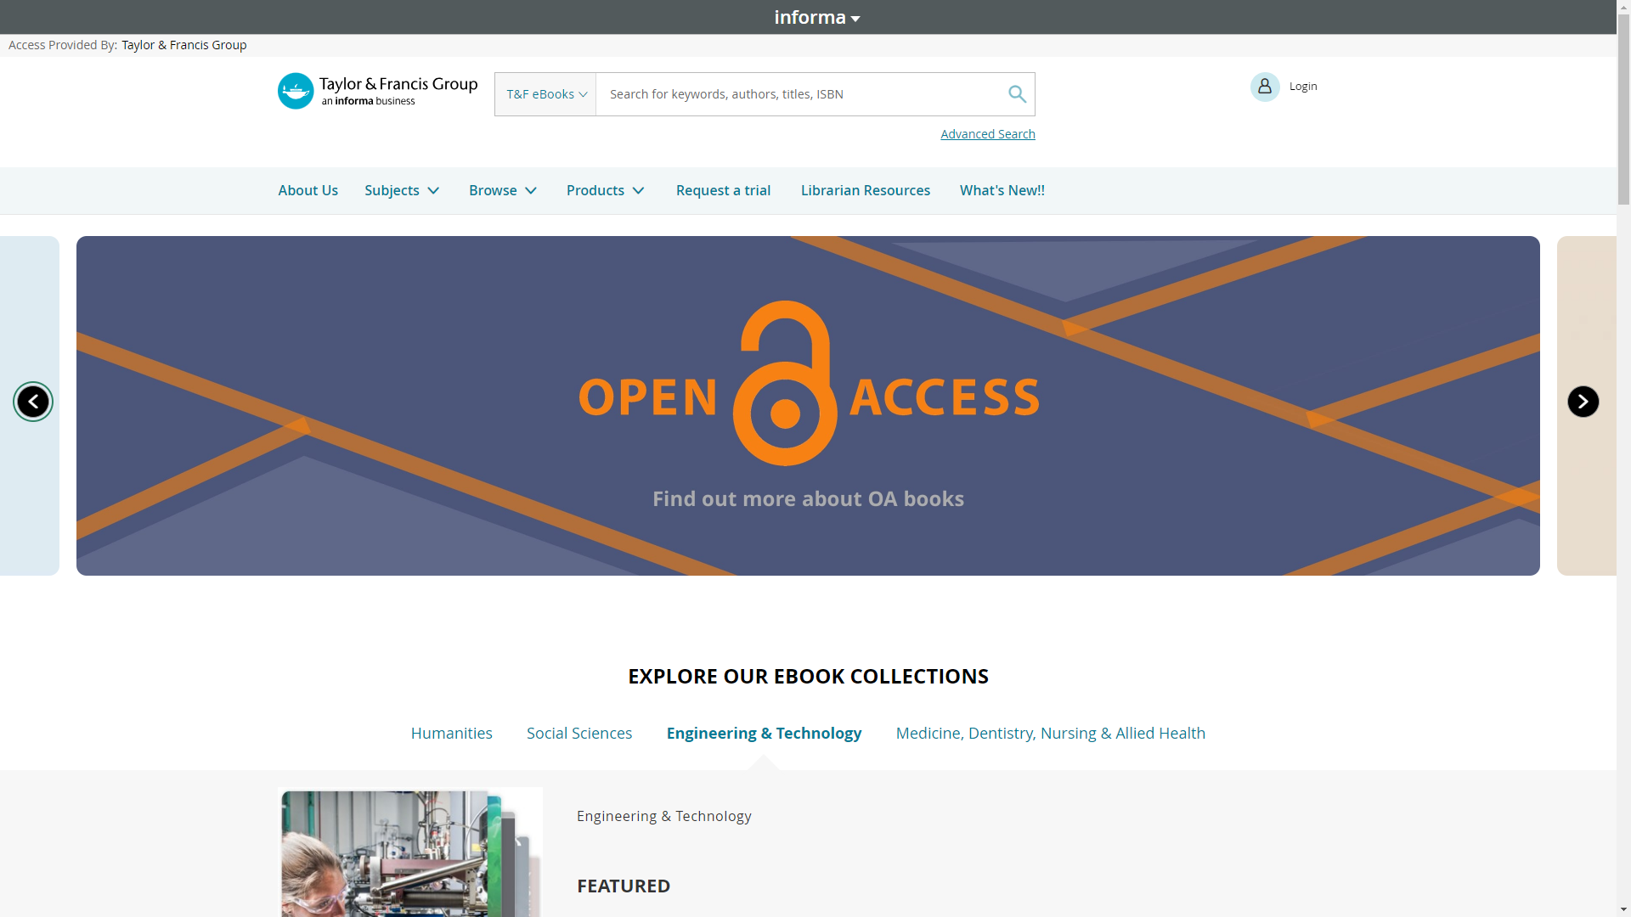
Dedicated TaylorFrancis.com eBooks platform
Notes:
Search by subject, browse collections, eBook series, OA content
View content freely available to you (OA and institutional access)
Read online or download

Slide 27
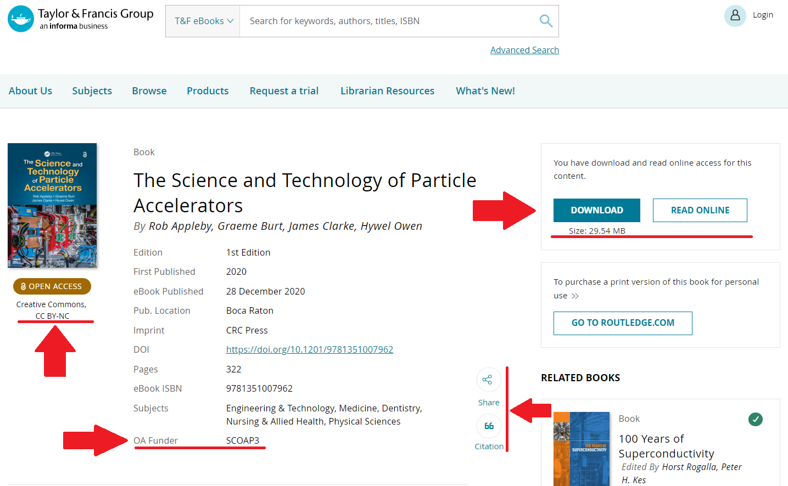
Notes:
This slide shows what an OA book looks like on our own T&F eBooks platform, with options to read online and to download, and clearly stating the license and funder information.

Slide 28

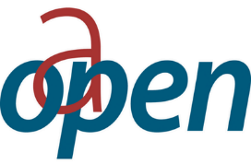




T&F and the Open Access community
Open Access Scholarly Publishers Association
Member
Open Access Publishing in European Networks
Gold Sponsor
All our content is deposited in OAPEN library
Directory of Open Access Books
Publisher Member
All our OA books are indexed here
Notes:
We are a member of the Open Access Scholarly Publishers Association (OASPA) and a publisher member of the Directory of Open Access Books ( DOAB ).
All our OA content is also deposited in the Open Access Publishing in European Networks ( OAPEN ) online library. We are now the largest OA Book publisher by volume on the OAPEN platform.
And as mentioned before, uploaded to the Open Research Library, as well as archives like Portico to ensure long-term preservation
All organizations uphold the highest standards of OA publishing

Slide 29
Open Access and academic quality
Our Open Access books undergo the same peer review process and are subject to the same high production standards as our non–Open Access books
Regardless of which publisher you choose, ensure that it conducts a full and proper peer review process
If it does not, it is likely a predatory publisher that exploits the Open Access model and deceives authors
Notes:
Researchers get a lot of emails
(e.g. someone I spoke to receives at least four a week)
Difficult to know which are legitimate publishers and which are not

Slide 30

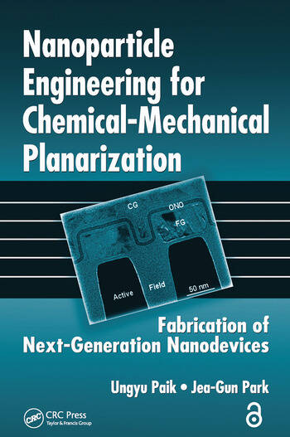
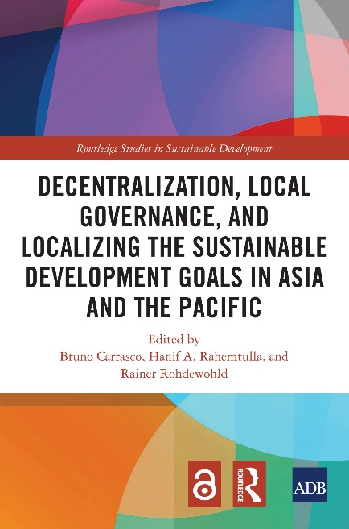
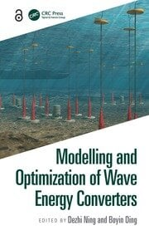
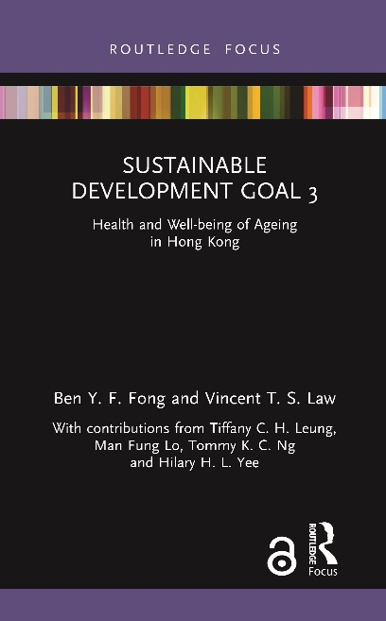
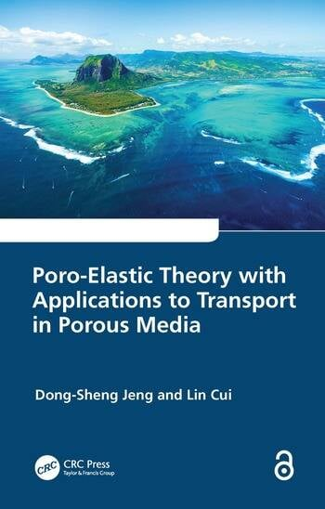
What kinds of OA books do we publish?
Notes:
The History of Japanese Economic Development – OA Textbook
Sustainable Development Goal 3 – Shortform book!
Decentralization, Local Governance, and Localizing the Sustainable Development Goals in Asia and the Pacific – business monograph
Poro-Elastic Theory with Applications to Transport in Porous Media – Civil Eng reference
Modelling and Optimization of Wave Energy Converters – Civil Eng reference
Nanoparticle Engineering for Chemical-Mechanical PlanarizationFabrication of Next-Generation Nanodevices – Materials and Chemical Eng – Professional
A lot of business research is geared towards policy responses to the crises, how the economy can return to growth, the impact on global value chains, questions around globalisation and the impact on developing economies.
At the same time, advances in new technology and AI are leading to significant research around the economics of business and innovation, the future of work and sustainable infrastructure.
And the climate crisis is leading to significant work on sustainable finance and accounting particularly around the SDGs, ESG investment and ‘green’ finance. Communicating with stakeholders is also important.
This list is non-exhaustive and we are often surprised and intrigued by the proposals we receive.

Slide 31
If you have any ideas for a book, please reach out to Mr Gauravjeet Singh Reen to discuss further: gauravjeetsingh.reen@taylorandfrancis.com
THANKS

