Slide 1
From Results to Discussion and back to Objectives
Francis Oloo (Dr. rer. Nat)

Slide 2
Outline
Understand the function of Discussion relative to Results
Structuring the discussion section
Link the discussion back to the study's objectives

Slide 3
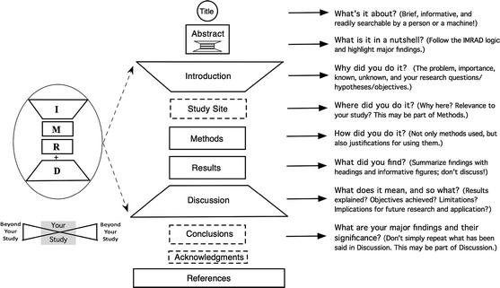
Recap on IMRAD method

Slide 4
Discussion
The introduction narrows down to a gap/objective while Discussion widens back out to the field

Slide 5
Research Workflow
Design
Problem
Objectives
Data collection
Results
Discussion
Conclusion
Data analysis
A Discussion that cannot be traced back, point by point, to the study's stated objectives has broken the "golden thread" — even if every sentence in it is well written.

Slide 6
Results→ Discussion (what changes?)
Results | Discussion
Reports what was found | Interprets what the finding means
Descriptive, neutral tone | Evaluative, argumentative tone
No reference to prior literature | Compares findings to prior literature
No claims beyond the data | Draws implications, with caveats
Organised by variable/theme/hypothesis | Organised by argument, revisiting objectives

Slide 7
Argument
Arguments are claims backed by reasons that are supported by evidence

Slide 8
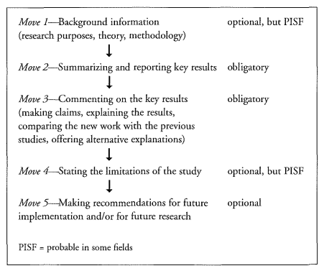
Writing the discussion
One typical model is 5-step Move model from Swales & Feak's (2012) → Get a copy here, page 368

Slide 9
Sample 5-Step Move Model
Move 1 – Background: This study set out to quantify how a new drought-tolerant maize variety performs relative to the local check variety under farmer-managed conditions, given limited independent field-scale evidence.
Move 2 – Summarizing key results: Across all three trial sites, the drought-tolerant variety showed significantly lower yield loss under moderate-to-severe drought stress than the local check.
Move 3 – Commenting on key results: This effect size is practically meaningful for smallholder food security and is consistent with variety trials reported elsewhere in the region; the smaller effect observed at one site is likely explained by its shallower soil depth, which limited moisture retention for both varieties.
Move 4 – Summarizing the study / limitations: These findings are based on a single growing season across three sites, which limits how confidently the results can be generalized across seasons or agro-ecological zones.
Move 5 – Recommendations: Multi-season replication is recommended before any variety-replacement programme is scaled to farmers more broadly.

Slide 10
Discuss more examples from participants

Slide 11
Reporting, Summarizing, Commenting
Reporting
"Yield loss under drought stress was 18% lower for the new variety (95% CI: 12–24%)."
Summarizing
"Across all three sites, the new variety consistently outperformed the local check under drought stress."
Commenting
Interpreting, comparing to literature, accounting for anomalies, evaluating strength/importance

Slide 12
Commenting on Results
Interpreting
Comparing
Explaining what a result means in plain terms
Situating the finding against prior studies
"This suggests that..."
"This finding is consistent with..."
Accounting For
Evaluating
A plausible explanation for an unexpected result
Judging the strength or importance of a finding
"One possible explanation is..."
"This effect, while significant, was modest..."

Slide 13
Linking Discussion to Objectives
Build one row per objective/question/hypothesis, trace the result and the discussion point
Anything in the Discussion that can't be traced to a row is either scope creep or unlabeled exploratory material
Objective / Question / Hypothesis | What Results Showed | Discussion Point to Make
(as stated in Introduction) | (the specific finding) | (interpretation, comparison, implication)

Slide 14
Example from quantitative data
Discussion Element | Content
Background | Restate the objective: quantifying yield difference under drought stress
Reporting/ Summarizing | New variety showed significantly lower yield loss across all three sites
Commenting | Interpret effect as practically meaningful; compares with prior trials; accounts for the weaker site due to shallower soil
Evaluating the study | One growing season in three sites — limits generalisability
Deductions | Recommends multi-season replication before scaling — answers the objective

Slide 15
Handling unexpected results
State the unexpected result plainly before attempting to explain it
Offer a plausible account
Distinguish a null result (no detectable effect) from a disproved hypothesis
Do not reinterpreting the objective so that null result looks plausible

Slide 16
Implications/Recommendations
Common errors
Re-presenting full results tables instead of interpreting them
Introducing new data or citations without framing them as new context
Discussing findings out of order from how objectives were introduced
Claiming an objective was met when results only partially support it
Generic limitations ("more research is needed") that specify nothing
Never explicitly stating whether each objective was answered
Practical implications — what practitioners/policymakers might do differently
Research implications — what the field should study next
Recommendations should be proportionate to the evidence (replicate ≠ scale nationally)

Slide 17
Assignment
Using your own study or a sample published work, trace the results and discussion points from the objectives. Write a paragraph of one discussion point using the 5-Step Move model
Objective / Question / Hypothesis | What Results Showed | Discussion Point to Make
(as stated in Introduction) | (the specific finding) | (interpretation, comparison, implication)

Slide 18
Questions and discussions

