Slide 1

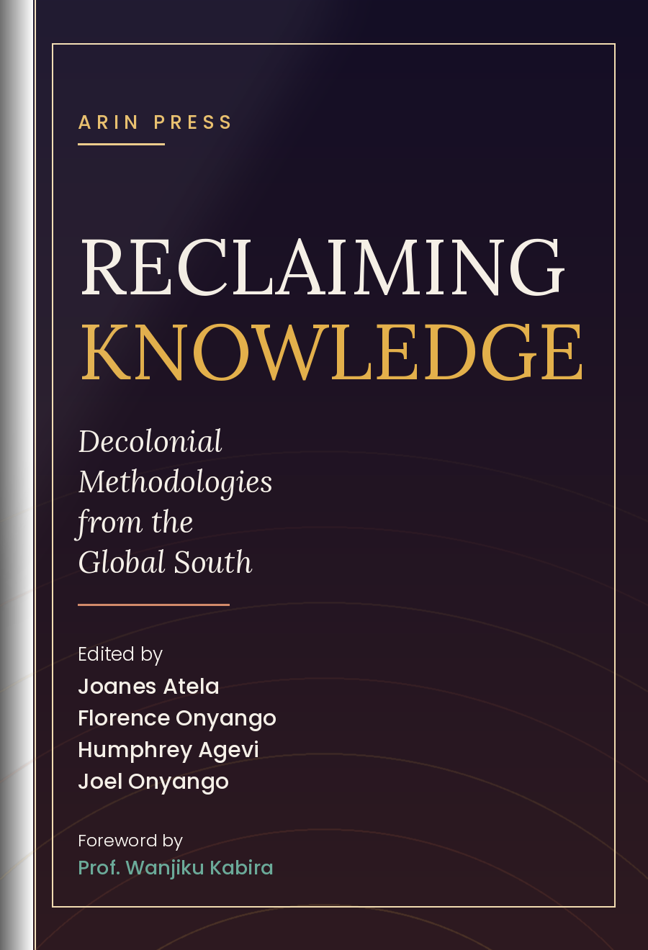
The Voices
EIGHT AUTHORS AND EDITORS · ONE ARGUMENT FOR RESEARCH ON OUR OWN TERMS
RECLAIMING
— Centring African and Global South perspectives in how research is designed, conducted and owned.
RECLAIMING KNOWLEDGE
Dr. Ali Adan Ali
CONTRIBUTING AUTHOR · CHAPTER 1
Ubuntu as an African philosophical framework — and what centring Ubuntu and other African knowledge systems could mean for Africa's development journey.
Adriana Moreno-Cely
CONTRIBUTING AUTHOR · CHAPTER 2
Vivencias as a method for valuing lived experience, memory and collective action as knowledge in their own right — drawing on work with Indigenous and local communities in Abya-Yala.
Luana Xavier Pinto Coelho
CONTRIBUTING AUTHOR · CHAPTER 5
How urban planning research can be reframed around who conducts it, how, what and when — and what changes when researchers examine their own positionality and power.
Ata Senior Yeboah
CONTRIBUTING AUTHOR · CHAPTER 6
What it takes to genuinely embed Indigenous African knowledge systems in the design, conduct and use of research — well beyond simply acknowledging them.
Dr. Joanes Atela
LEAD EDITOR · EXECUTIVE DIRECTOR, ARIN
The vision behind Reclaiming Knowledge, and its implications for ARIN's broader commitment to African-led research and knowledge production.
Florence Onyango
EDITOR
The editorial journey of the book — from writing the preface through to full manuscript editing — and what it took to bring these diverse voices together.
Dr. Humphrey Agevi
EDITOR
Why Africa and the Global South need stronger platforms to produce and publish their own knowledge — drawing on his role in bringing the book to ARIN Press, and his work at the intersection of climate change, health and community resilience.
Joel Onyango
EDITOR
What must change in how research is produced and translated into policy so that African and Global South knowledge can carry greater influence and impact — drawing on his work at the African Centre for Technology Studies.
FOREWORD BY
Prof. Wanjiku Kabira
University of Nairobi, Kenya
KNOWLEDGE
Whose knowledge counts?
And who decides?
— Treating Indigenous knowledge systems and lived experience as legitimate knowledge in their own right.
Decolonial Methodologies from the Global South
Decolonial Methodologies from the Global South
— Building research, publishing and policy that answer to the communities they claim to serve.
EDITED BY JOANES ATELA · FLORENCE ONYANGO · HUMPHREY AGEVI · JOEL ONYANGO
OUT NOW FROM ARIN PRESS
Join us at the launch webinar
ARIN PRESS · BOOK LAUNCH WEBINAR
Notes:
ANIMATED BOOK TRAILER — one slide, ~74 seconds. The whole sequence plays automatically when the slide opens in Slide Show mode (press F5 / Slide Show > From Current Slide). If it waits, press the space bar once to start it. TO ADD YOUR BACKGROUND MUSIC: 1. Insert > Audio > Audio on My PC, and pick your track. 2. Select the speaker icon, then Playback tab > Start: Automatically, tick 'Play Across Slides', 'Loop until Stopped' and 'Hide During Show'. 3. Playback tab > Fade In 1s, Fade Out 3s for a clean finish. Trim the track to about 74 seconds so it lands with the closing frame. Timings live in Animations > Animation Pane if you want to speed up or slow down any beat.

