Slide 1
Operating System
Multiple Access Chatting Program using Multithread
Han Jun Bae
Korea University
Notes:
http://forbes.tistory.com/64

Slide 2
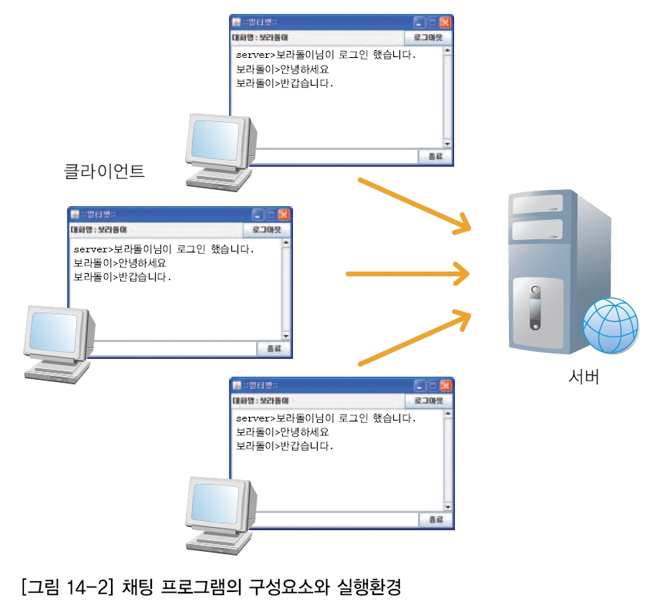


Project purpose
Main purpose of this Project
  Understand Thread
  Develop to linux through C programming
  Enable to test on one computer
  (IP – 127.0.0.1)
client1
server
client2
client3

Slide 3
Function of socket program
Function of program
  Server program
    Relay to chatting message between client and client.
    Enable to network connect many clients at the same time using multithread.
    Every message should be delivered to every connected client.
  Cilent program
    Should be able to connect to the server when you input the server IP and PORT.
    This program is able to input the message and output the message received from server.
  You can programming it if you know how to use the network related socket function even if you don’t have the enough knowledge about network.

Slide 4
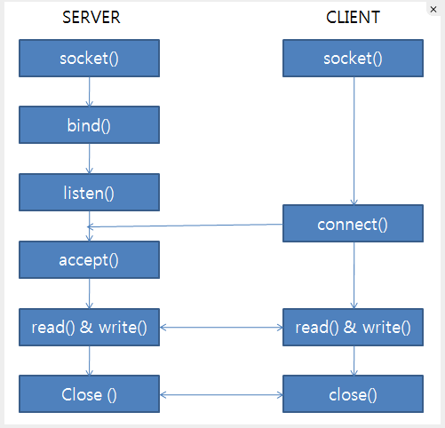
Configuration of server and client
Purchase phone
Assigned phone number
Listening
Pick up the phone
Conversation
End of conversation
Purchase phone
Make a call
Conversation
End of conversation
Connection
request
Transmitting and receiving data
Connection
determination

Slide 5
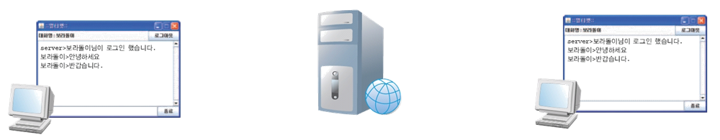
Multithread through chatting program
Client1
Server
Client2
Read
Read
Read
Write
Write
Write
Received messages from the client is sent to all clients.
Send message.

Slide 6
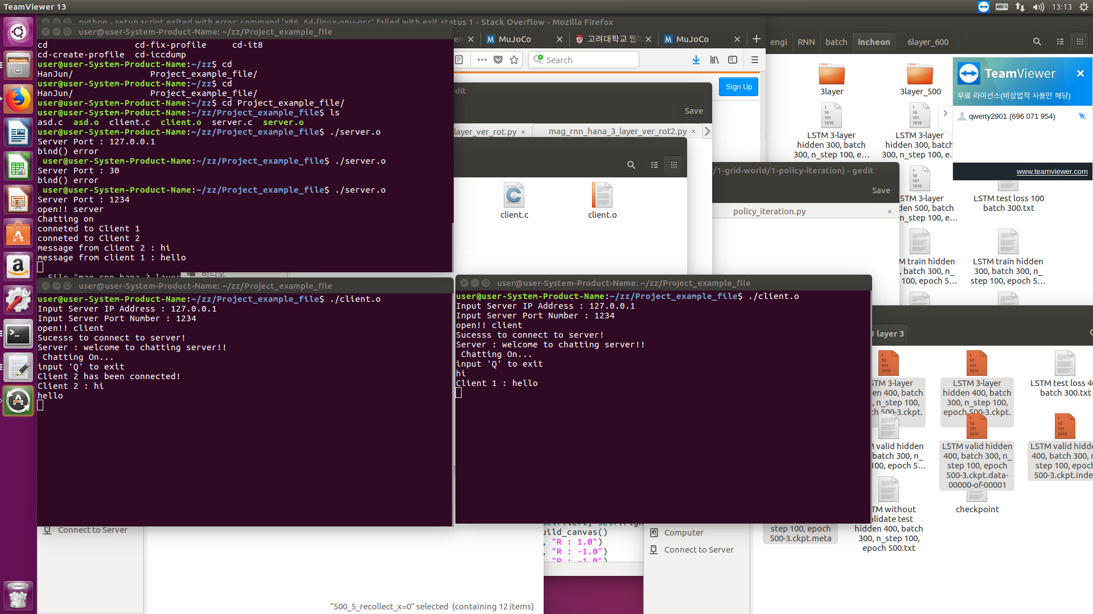
Chatting program example
Server
Client 1
Client 2

Slide 7
pthread
#include <pthread.h>
  To use the pthread function, you should be declare the header file.
  http://pubs.opengroup.org/onlinepubs/7908799/xsh/pthread.h.html
Compile in Linux
  gcc –c [compile target].c
  gcc –pthread –o [output file name] [compile target].c
  -pthread command connects library to use thread.
  ./server.o
  ./client.o

Slide 8

pthread
int pthread_create( pthread_t *th_id, const pthread_attr_t *attr, void* function_name, void *arg );
  Create pthread
  First argument: If the thread is created successfully with the pthread identifier, a thread identification value is given.
  Second argument: pthread attribute (optional), or NULL if using the default thread attribute
  Third argument: The function to branch to pthread. Only functions whose return value is of type void * and whose parameters are declared void * are also possible.
    ex) void * handler (void * arg) {...}
  Fourth argument: The argument value to be passed to the branch function. Since you do not know which datatype to pass, you can pass it as void and cast it to the original datatype in a function that branches to your situation.
  Return value: Return 0 if pthread is successfully created

Slide 9
pthread
int pthread_join( pthread_t th_id, void** thread_return );
  Wait until the specific pthread is terminated, and release the resource when the specific pthread exits.
  First argument: an identifier that determines which pthread to wait for
  Second argument : the return value of pthread, which receives the value as a pointer.
int pthread_detach( pthread_t th_id );
  The pthread with the th_id identifier is independent from the parent pthread.
  That is, independent pthreads are automatically released at the end without pthread_join ().

Slide 10
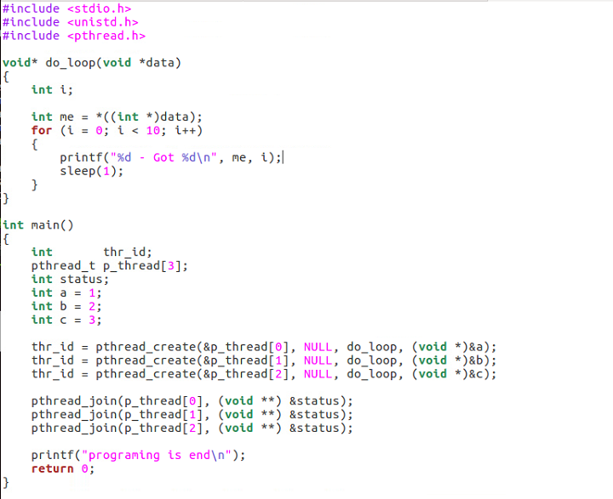
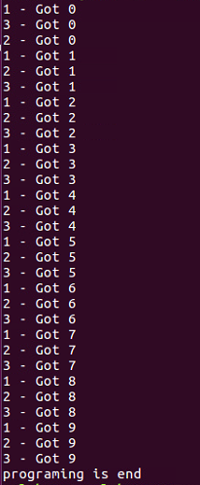

pthread example

Slide 11

Project
Due date : December 7 (Friday)
Multiple access chatting program using multithread
  Both client and server should be able to send and receive messages to each other.
  Program should be contain concept of multithread.
A code file [filename.c] : 40%
  ex) server.c, client.c
  Include detailed comments inside your code

Slide 12
Project
A word / hwp document that describes your program : 60%
  File name is your student number. ex) 2015000001.doc
  You can use any word program.
  You should be explain your program in detail.
All the files are compressed into one file (ex: 2015000001.zip)
Submit your zip file to qwerty2901@korea.ac.kr
If you have any question, please mail me or use bulletin board in laboratory homepage(http://it.korea.ac.kr) or visit to laboratory(engineering bldg #236)

