Slide 1

Project Purpose Summary
To create a complete or partial software application utilizing concepts related to my education, work history, and interests:
DW Concepts (
DB and Table structuring,
Data Formatting,
Data Normalizing/Denormalizing,
SQL Tuning,
Data Integration,
Data Movement,
ER Diagramming,
Reporting
)
Operations and Logistics (
Inbound/Outbound Shipping,
Order Fulfillment,
Inventory Management,
Resource Allocation,
Process Improvement,
Proactivity
)
Programming (
Python,
Networking,
Web Services,
Algorithms,
GUI's,
OOP
)
Mobile Devices (
Smart Phones,
Pagers and PDA's (ya right :>),
Tablets and Laptops,
Drones
)

Slide 2
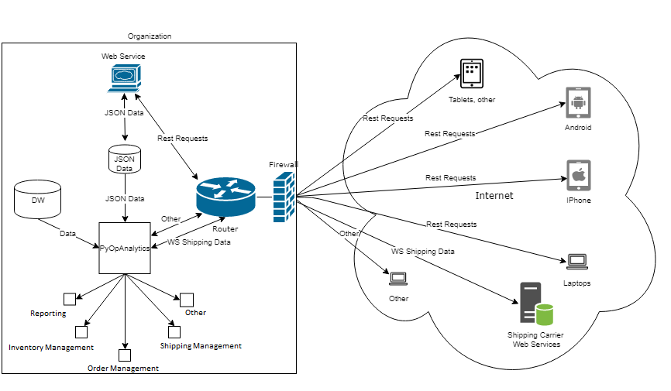
pyOpAnalytics 0.9
  What is pyOpAnalytics 0.9?
  A python based business operations management and analytical application.

Slide 3
pyOpAnalytics 0.9
Completed Reporting Features:
    Generate report work items (orders, open orders, shipments, customers, products...etc).
    View report work item properties and data sets.
    View and configure report work item queries and join conditions.
    Generate reports, ERD's, and excel workbooks using report work items.
  Completed Operations Features:
    Open Orders Work Item:
Auto generate the open orders work item from data received by a restful web service obtained from devices via rest query parameters and/or from web forms.
Completed Miscellaneous Features:
    Misc. Work Items:
    Auto generate work items based off data obtained from public web services (omdb, geolocations,...etc.) and populate the work item with the obtained data.

Slide 4
pyOpAnalytics 0.9
Partially Implemented Reporting Features:
Auto data denormilization and normalization:
Denormalize (flatten) data obtained from a restful web service. Specify a normalization depth level and perform a normalization operation. In general, this feature should improve the report generation abilities of the application.
Partially Implemented Operations Features:
Open Orders Work Item
Generate shipments by dragging an open order work item to the outgoing shipments work item.

Slide 5
pyOpAnalytics 0.9
Python Libraries Utilized:
Tkinter Library:
Tkinter was chosen to generate the gui after reviewing the pros and cons of various
gui libraries for python.
More information about this library can be found here: https://wiki.python.org/moin/TkInter
Flask Library:
Flask was chosen to implement a restful web service to send/receive data from devices.
More information about this library can be found here:
http://flask.pocoo.org/
SQLite Library:
sqlite handles the applications data storage and data operations, but using SQLSERVER or Oracle will work as well.
More information about the sqlite library can be found here:
https://www.sqlite.org/index.html

Slide 6
pyOpAnalytics 0.9
Python Libraries Utilized...continued
Report Lab Library:
Report Lab was chosen to implement logic to generate reports in .pdf format.
More information about this library can be found here:
https://www.reportlab.com/
Openpyxl Library:
Openpyxl was chosen to implement logic to generate excel documents from exported data.
More information about this library can be found here:
https://openpyxl.readthedocs.io/en/stable/
Request and JSON Libraries:
Python's Request library is used by the flask web service for generating get and put
request responses.
More information about this library can be found here:
http://docs.python-requests.org/en/v0.10.6/api/
Python's JSON library is used by the flask web service for formatting data received
or sent from restful endpoints, and pyopAnalytics uses the JSON library to work with the received data.
More information about this library can be found here:
https://docs.python.org/3/library/json.html

Slide 7
pyOpAnalytics 0.9
Next Steps:
A demo of the application will be available on my website shortly.
My main concern at the moment is unit testing and code refactoring for all implemented features. When I'm satisfied with the testing results and code refactoring I'll make a determination to move forward with the project or start something new.
Thank you draw.io your web diagramming software is great.
https://www.draw.io/

Slide 8
pyOpAnalytics v1.0 – Completed Improvements
✅ Code Quality & Structure
• Refactored core classes for clarity and maintainability
• Aligned codebase with PEP 8 standards
• Removed legacy JSON normalization/denormalization logic
✅ Security Enhancements
• Implemented input handling to mitigate SQL injection vulnerabilities
✅ Feature Enhancements
• Integrated pandas to handle arbitrary JSON structures
• Enabled seamless ingestion of any REST API response into structured SQLite tables
• Added ability to export table data to S3, using table_name_YYYYMMDD as bucket or object key format
🔑 Key Feature
• Load any JSON dataset from any REST API endpoint and store it automatically in a normalized, queryable format using pandas.json_normalize()

