Slide 1
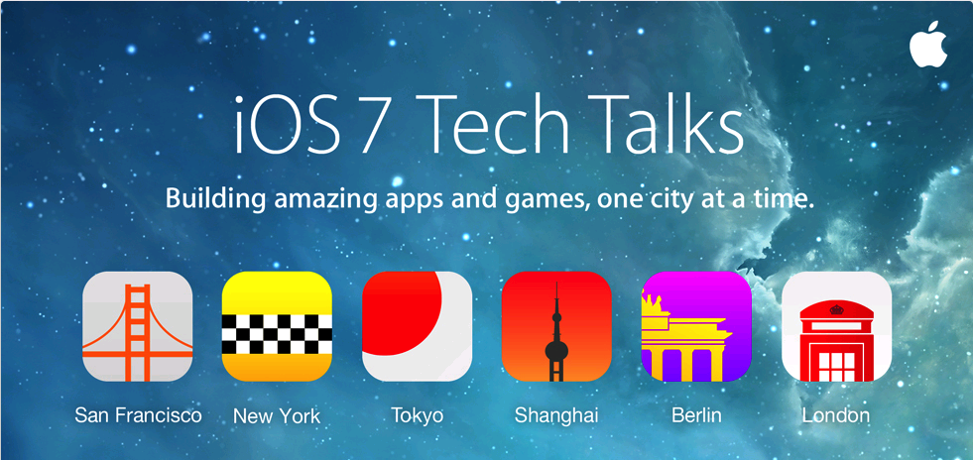
Nan, Dongxin, Rongfang, Wenyin
11/25/2013

Slide 2
iOS 7 Tech Talks Contents
User Interface Design for iOS 7 Apps
Architecting Modern Apps
App Store Distribution and Marketing
Integrating iOS 7 Technologies
Security and Privacy in iOS 7
Hidden iOS 7 Development Gems

Slide 3
Architecting Modern Apps
Motions
Dynamics
Custom Transition
Interactive Transition
Layout
Text Kit

Slide 4
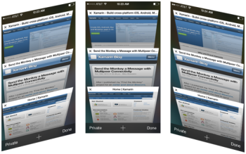

Motions
Core Motion framework
UIMotionEffect
  keyPathsAndRelativeValuesForViewerOffset:
Subclass - NSCopying and NSCoding protocol
  UIInterpolatingMotionEffect
UIMotionEffectGroup

Slide 5
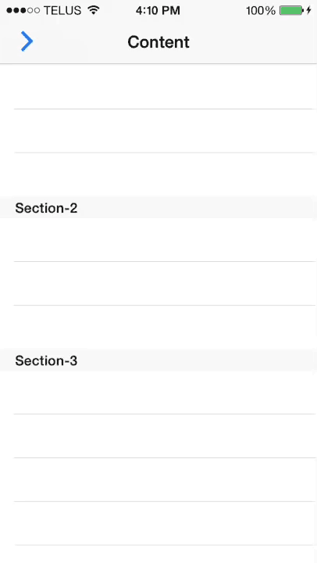

Dynamics

Slide 6
UI Dynamics
Component:
  UIDynamicAnimator
  UIDynamicBehavior
  UIDynamicItem
Steps:
  1. Create a UIDynamicAnimator
  2. Create one or more UIDynamicBehavior
  3. Make sure UIDynamicBehaviors is a valid state within the UIDynamicAnimator simulation

Slide 7
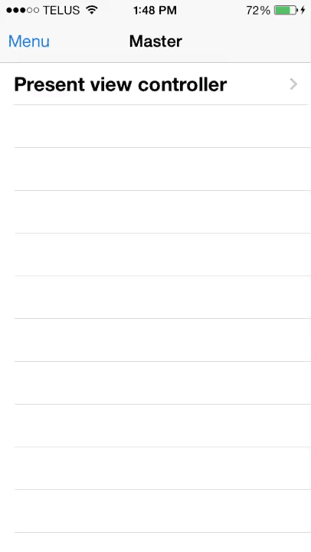
Custom Transition

Slide 8
Custom Transition
Animation are vended by delegates
  <UIViewControllerTransitioningDelegate>
  <UINavigationControllerDelegate>
  <UITabBarControllerDelegate>
Transition confirm to Protocol
  <UIViewControllerAnimatedTransitioning>
  Funtions:
    - (void)animateTransition:(id<UIViewControllerContextTransitioning>)
    - (NSTimeInterval)transitionDuration:(id<UIViewControllerContextTransitioning>)
Context confirm protocol
  <UIViewControllerContextTransitioning>
  Must call completeTransition: when animation finished

Slide 9

Custom Transition
UIView
Controller
Custom Transition ?
UIKit Framework
Transitioning
Delegate
Finish
Animation
Yes
Context
Animation Transition
Start

Slide 10

Interactive Transition
Notes:
UIKit provides a concrete interaction controller class

Slide 11
Interactive Transition
Protocol
  <UIViewControllerInteractiveTransitioning>
Could run forward or backward
UIPercentDrivenInteractiveTransition
WWDC 2013
  Framework - Section 218
Notes:
UIKit provides a concrete interaction controller class

Slide 12
Interactive Transition
UIView
Controller
UIKit Framework
Transitioning delegate
Finish
Transitioning
Delegate
Interactive animation
Yes
Complete
Animation Transition
Context
Yes
Start Animation
Interactive Transition
Update percent (%)
Complete/Cancel animation

Slide 13
Layout
Extended Layout
  UIViewController.edgesForExtendedLayout = UIRectEdgeAll / UIRectEdgeNone;
Status Bar
  Style: Default and light
    [UIViewController - (UIStatusBarStyle)preferredStatusBarStyle]
  Hidden
    [UIViewController - (BOOL)prefersStatusBarHidden]
  Need Call if property changes (could animated)
    [UIVIewController - (void)setNeedsStatusBarAppearanceUpdate]
Notes:
Call this method if the view controller's status bar attributes, such as hidden/unhidden status or style, change. If you call this method within an animation block, the changes are animated along with the rest of the animation block.

Slide 14
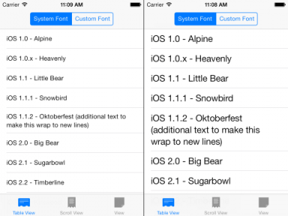
Text Kit
Notes:
Text Kit brings many powerfull features of core text

Slide 15
Text Kit
UIFontDescriptor
  Describe font with dictionary
  Partially describe a font
Text Style
  UIFontTextStyleHeadline
  UIFontTextStyleSubheadline
  UIFontTextStyleBody
  UIFontTextStyleFootnote
  UIFontTextStyleCaption1
  UIFontTextStyleCaption2
Responding to Content Size Changed
  UIContentSizeCategoryDidChangeNotification
Notes:
Call this method if the view controller's status bar attributes, such as hidden/unhidden status or style, change. If you call this method within an animation block, the changes are animated along with the rest of the animation block.

