Slide 1
Unveiling Customer Behavior for Strategic Business Growth
Data-Driven Insights for Smarter Decisions
By Aisha - 2025

Slide 2
Introduction & Objective
Dataset covers customer transactions, demographics, and purchase patterns.
Objective: Understand customer behavior to optimize sales and marketing.
Identify high-value customers, popular products, and key trends.

Slide 3
Data Overview
Total Records: Over 23,000 records.
Key Fields: customer_id, customer_name, product_category, purchase_amount, country, customer_age, customer_gender.
Data Cleaning: Removed duplicates, handled null values, standardized product categories.

Slide 4
Tools & Skills Used
SQL: Advanced joins, subqueries, CTEs for insight extraction.
Python (Pandas): Data cleaning and preprocessing.
Tableau: Data visualization and interactive dashboard creation.

Slide 5
Business Questions Answered
1. Top customers & their favorite products.
2. Loyalty program effectiveness.
3. Regional sales performance.
4. Delivery & payment performance.
5. Demographic impact on spending.
6. Countries with most sales & products.

Slide 6
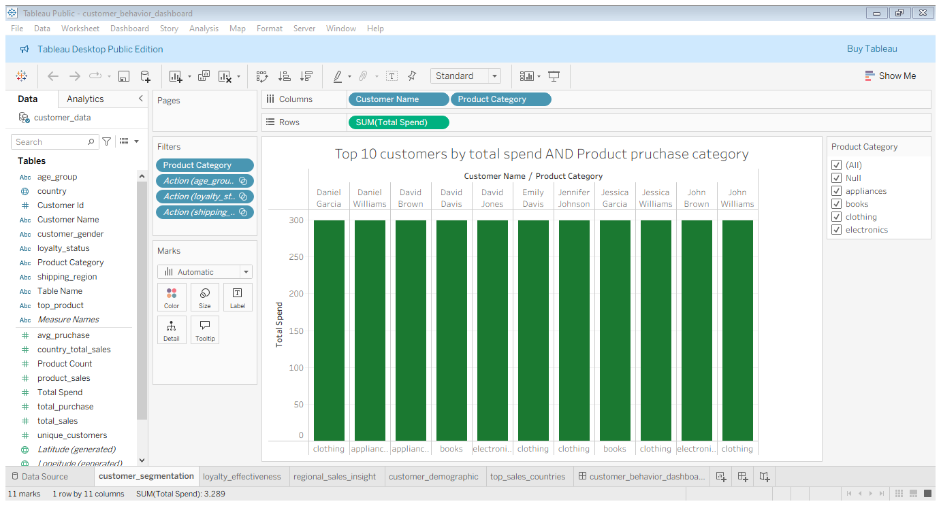
Top Customers & Favorite Products
Key Insight: All our top 10 customers have equal amount of spending and equal number of products

Slide 7
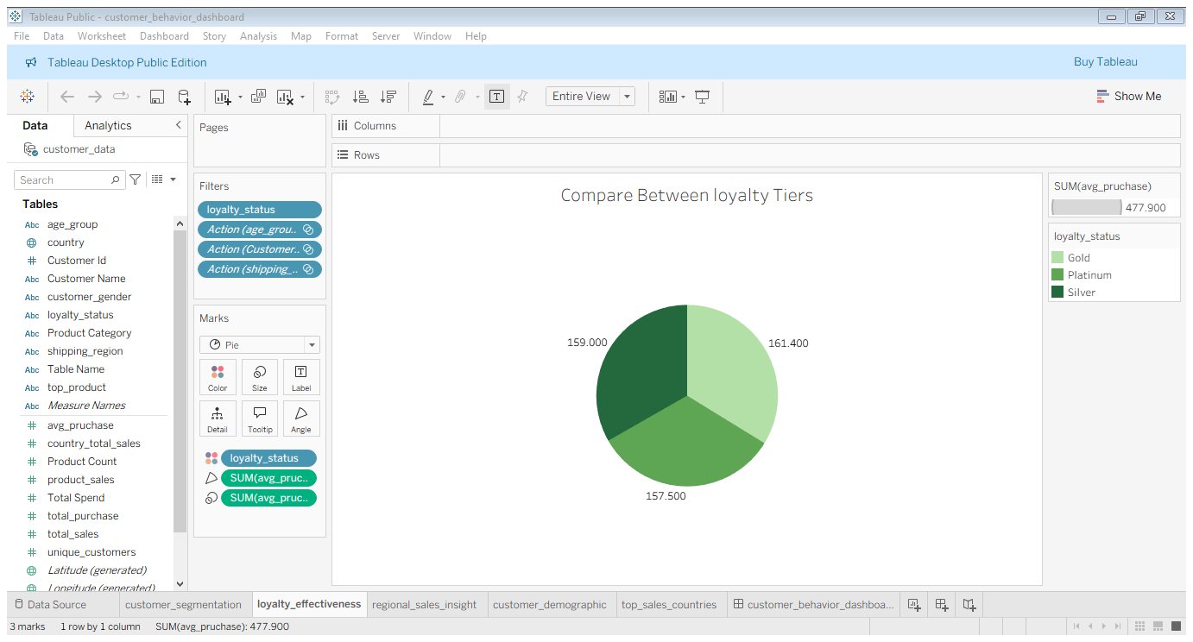
Loyalty Program Effectiveness
Key Insight: customers with gold program have highest average pay then that of silver and platinum

Slide 8
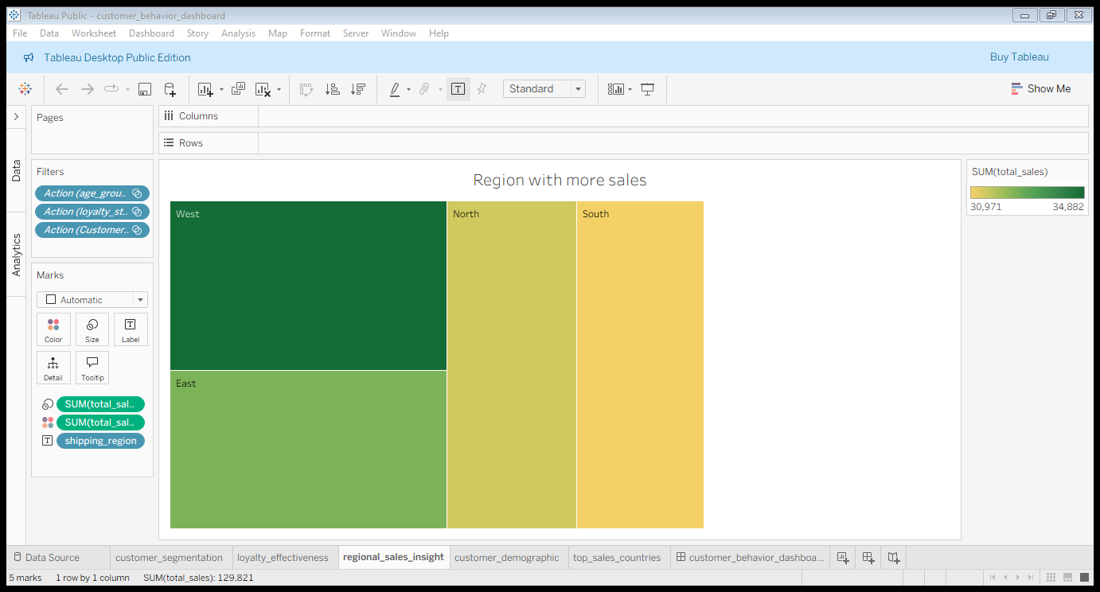
Regional Sales Performance
Key Insight: The western region has highest sales performance

Slide 9
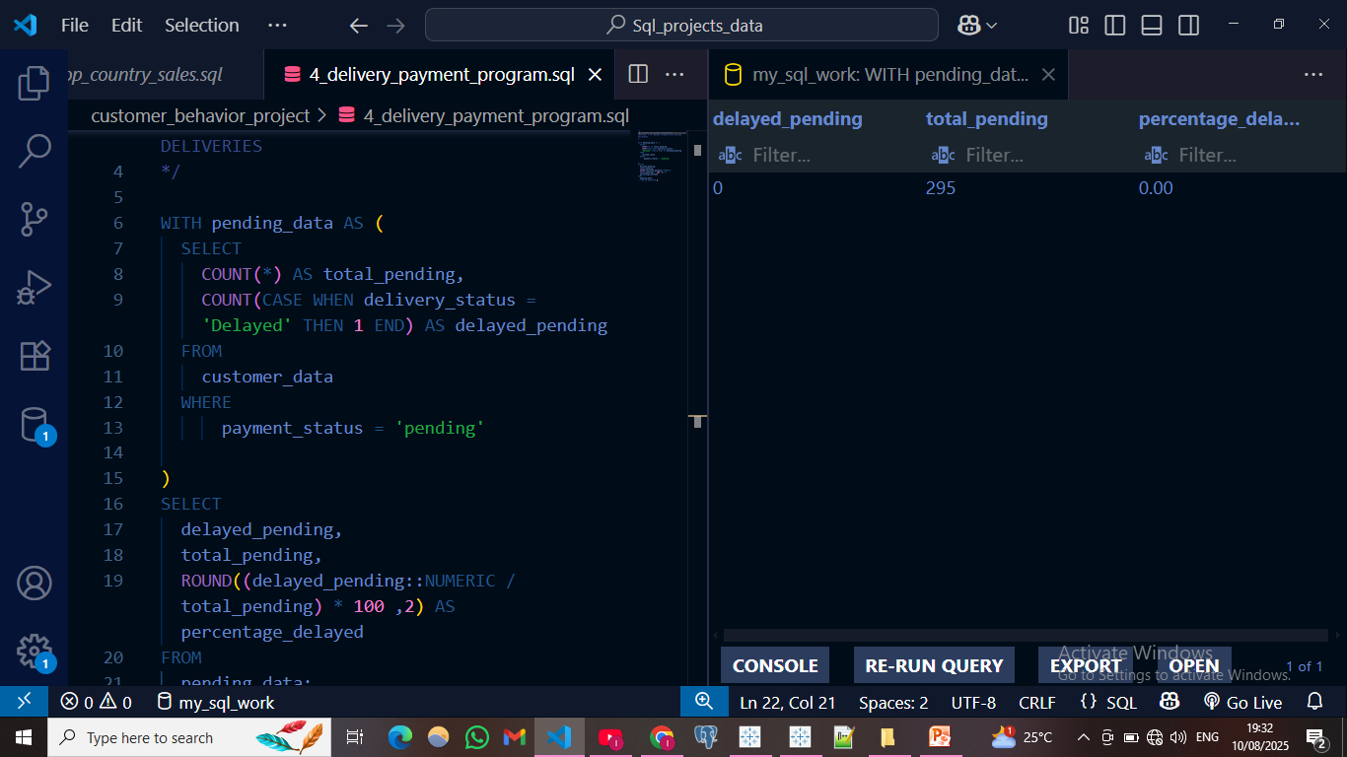
Delivery & Payment Performance
Key Insight: the insights shows that there is no delayed pending, which results to 0% of percentage delayed

Slide 10
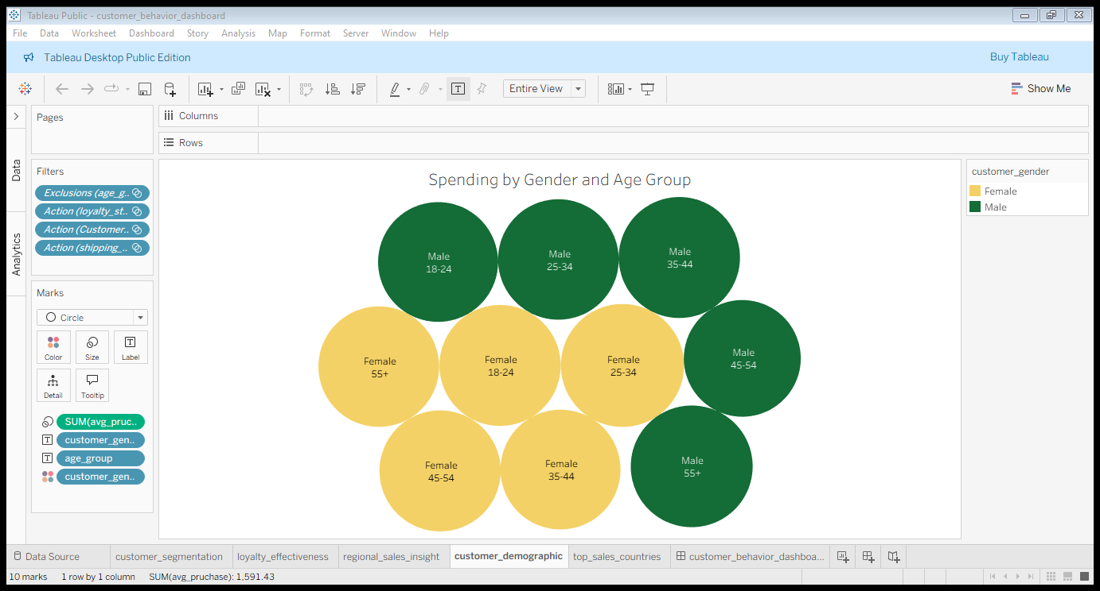
Demographic Impact on Spending
Key Insight: Equal number of male and female spending from all age groups.

Slide 11
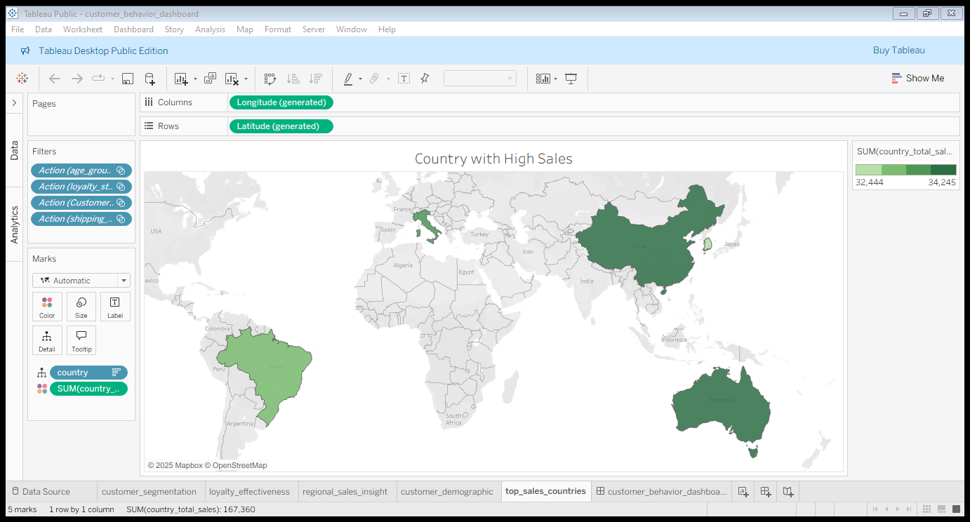
Top Countries & Products Sold
. Key insight: China is the top sales country followed by the Australia, Italy and then Brazil

Slide 12
Key Findings
High-value customers tend to favor specific product categories.
Certain regions outperform others significantly in sales.
Delayed deliveries often correlate with pending payments.
Demographics (age & gender) strongly influence purchasing patterns.
Top countries account for a majority of total sales.

Slide 13
Business Recommendations
Develop targeted marketing campaigns for top customer segments.
Prioritize inventory in high-performing regions.
Improve delivery systems to reduce payment delays.
Personalize offers based on age and gender demographics.
Strengthen market presence in top-performing countries.

Slide 14
Closing & Next Steps
Continue monitoring customer behavior trends regularly.
Incorporate real-time analytics for faster decision-making.
Expand analysis to include product profitability metrics.
Potential next project: Financial Inclusion in Africa analysis.

