Slide 1


Optimal control of the impacts of COVID-19 via non-pharmaceutical interventions
Nicholas Irons
In collaboration with Zaid Harchaoui and Adrian Raftery
CSDE Lightning Talks, Winter 2022

Slide 2
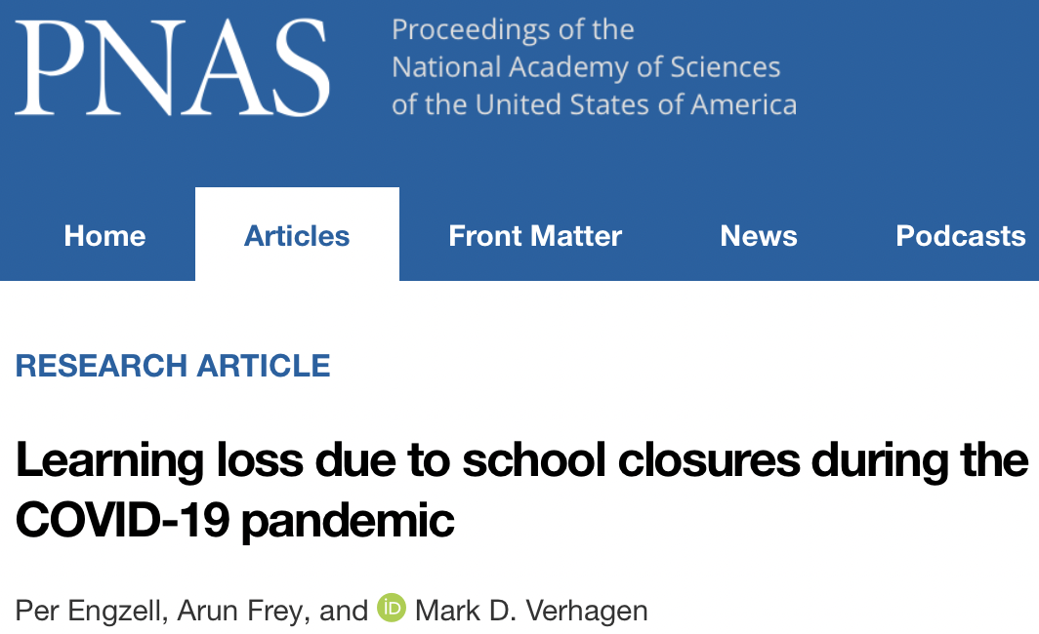
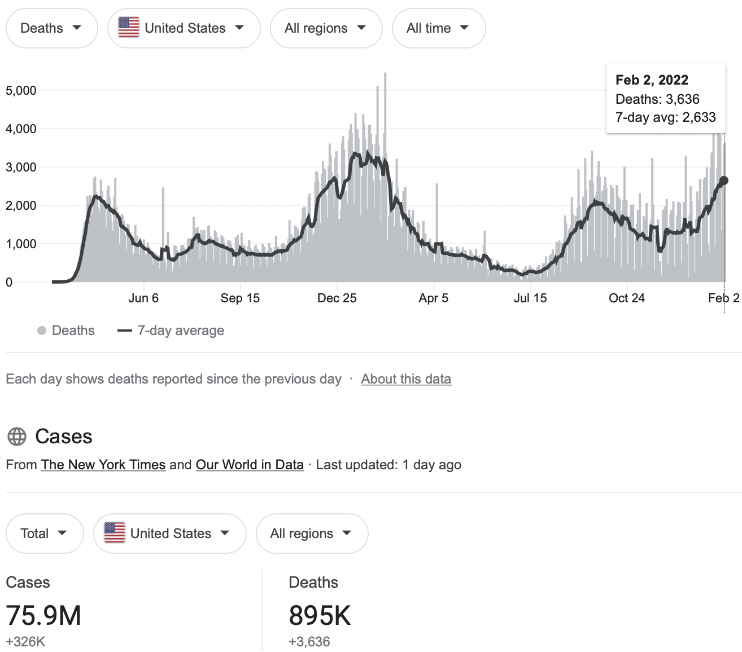
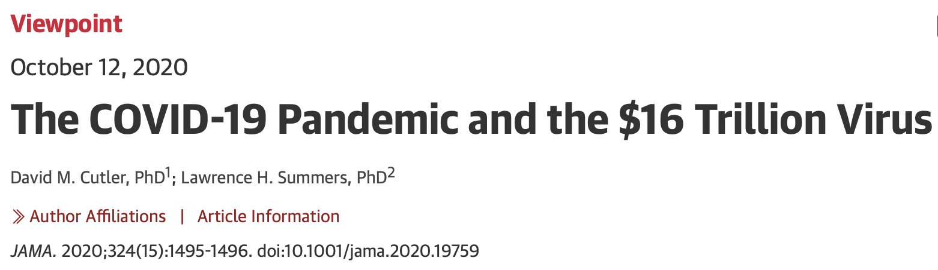
Impacts of COVID-19
Notes:
~75,000,000 reported cases, ~900,000 confirmed deaths
Millions of jobs lost; Contraction of the global economy by 3.3% in real GDP in 2020 (IMF estimate)

Slide 3
Decision-making under uncertainty
Goals and contributions
The pandemic has posed significant challenges to decision-makers at every level of government
Difficult real-time decisions with limited data
Contentious debate about non-pharmaceutical intervention (NPI) policies that reduce viral transmission but present severe economic and social consequences:
Non-essential business closures
School closures
Stay-at-home orders
Social distancing measures
We develop a statistical decision framework based in optimal control theory to address the economic and public health trade-offs of NPIs.
Derive optimal NPI policies
Quantitatively assess the efficacy of policies that have been implemented during the pandemic
A number of gaps in the optimal control literature modeling NPI mitigation of COVID-19 severely limit its value in informing and evaluating policies
We model multiple specific NPIs calibrated to US state-level COVID data.
Prior work models a catch-all “lockdown” NPI
We account for uncertainty in the relevant model parameters to derive robust policies
Prior work ignores parameter uncertainty, which is problematic.

Slide 4
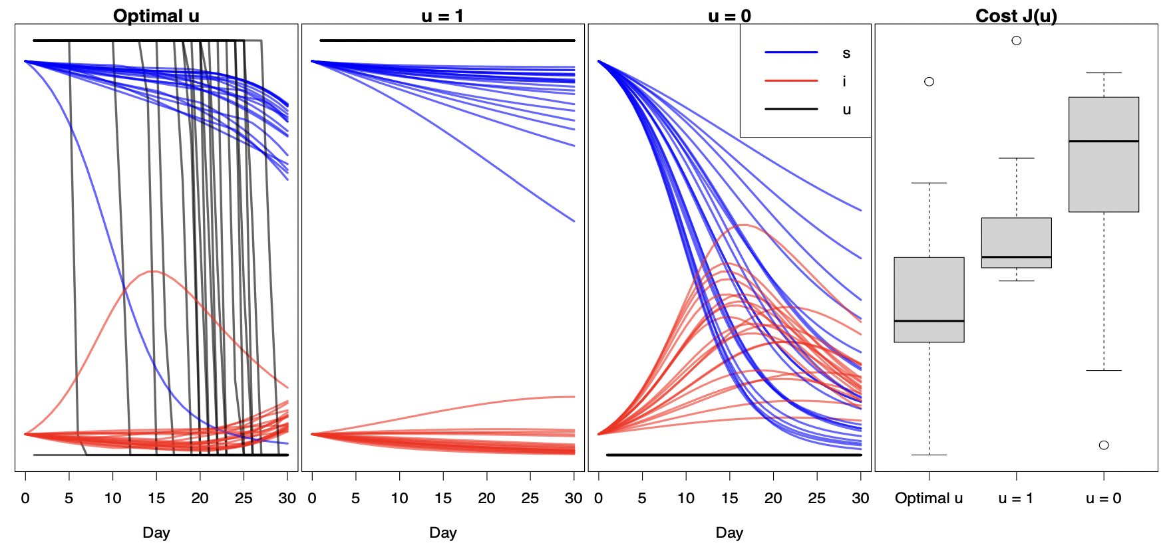

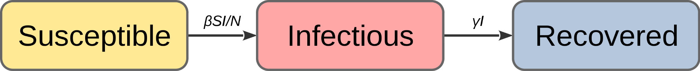
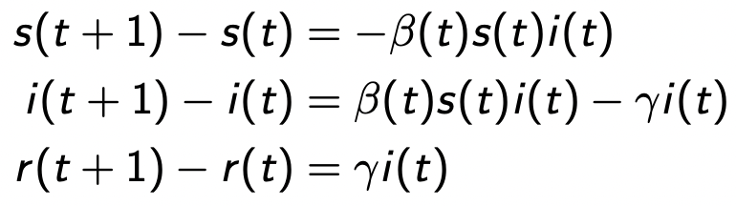

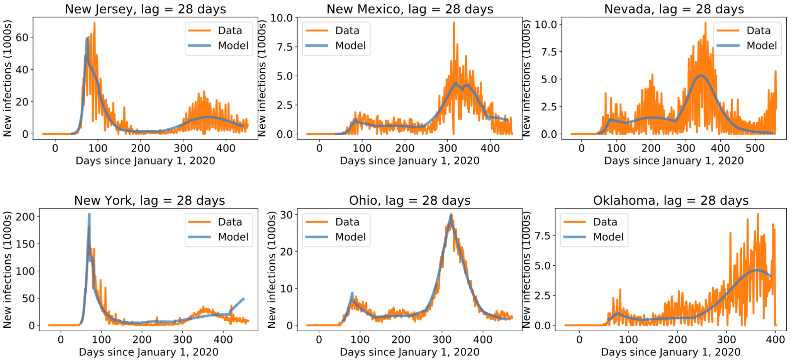
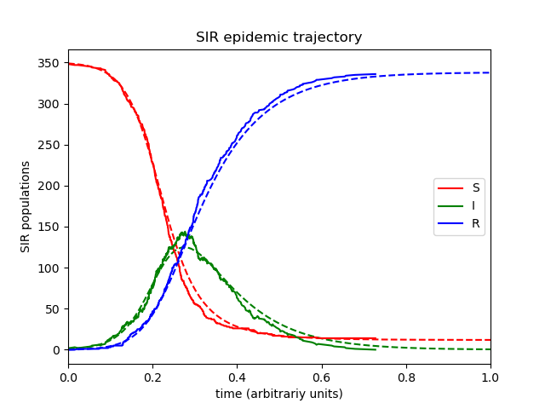
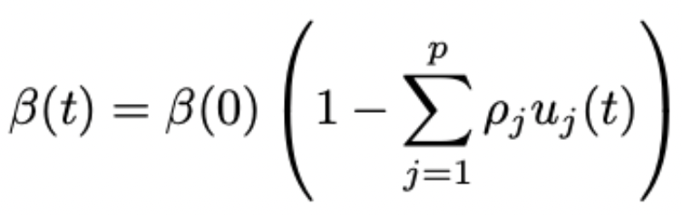
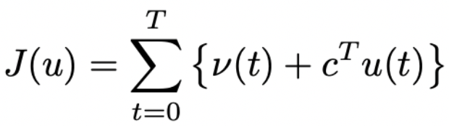
Optimal control of the impacts of COVID-19 via non-pharmaceutical intervention
Nicholas Irons, UW Statistics
Goals and Contributions Develop a statistical decision framework based in optimal control theory to address the economic and public health trade-offs of NPIs.
Parameter Uncertainty
Data State-level NPI policies: Oxford COVID-19 Government Response Tracker
State-level COVID transmission data: JHU Center for Systems Science and Engineering
Model multiple specific NPIs
Account for and quantify parameter uncertainty
Epidemiological SIR Model
Results Fitting the control model to state-level COVID data
Controlling transmission with NPIs
Optimal control Solve for policies minimizing cost function

