Slide 1
Interactive Large-Scale Data and Graph Analytics
Conclusion
Oliver Alvarado Rodriguez, Naren Khatwani, Zhihui Du, David Bader

Slide 2
Arkouda Performance Results

Slide 3
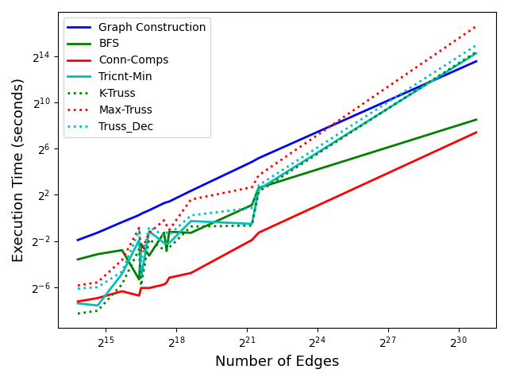
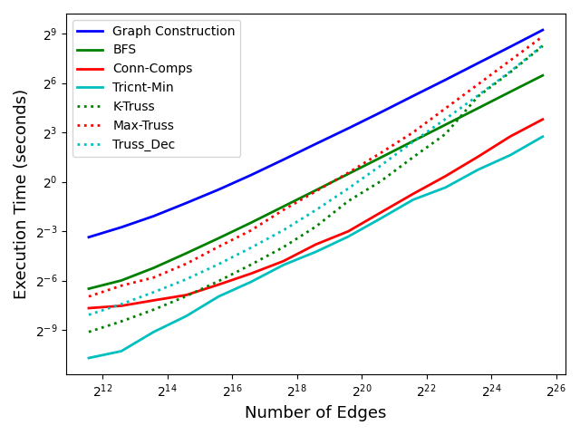
Arachne Performance Results – Real-World and Synthetic Graphs
Key Points:
Graph construction is time consuming but once the graph is built into memory all the algorithms can use it in a highly efficient way.
The structural properties of graphs can significantly affect execution times even for the same algorithm.
Key Points:
Synthetic graphs demonstrate the scalability of our algorithms as the number of edges in a graph increase.

Slide 4
Towards Arachne 1.5 and Beyond
We show functionality for novel algorithms that perform well in shared-memory parallelism… how about distributed-memory?
Arachne needs to show proof of scalability on distributed systems.
This will provide a rounded software for all data scientists to run on personal devices through supercomputers.
Our current graph analysis package must be extended further with other very important graph analytical kernels such as community detection.

Slide 5
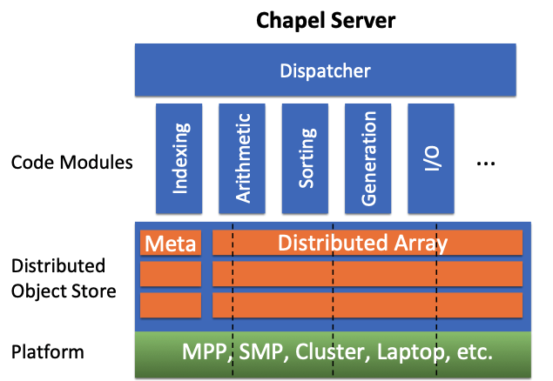
Hybrid Arachne
Chapel Server
Arachne 1.5
Overarching Dispatcher
BFS-shared
BFS-dist
BFS
CC
K-Truss
…
CC-shared
CC-dist
…
Meta
Distributed Array
We want a proper hybrid system for any architecture it runs on.
MPP, SMP, Cluster, Laptop, etc.
MPPs (massively parallel processors) and Clusters → communication is a huge bottleneck
SMPs (symmetric multiprocessing)→ cannot achieve the scalability we want

Slide 6
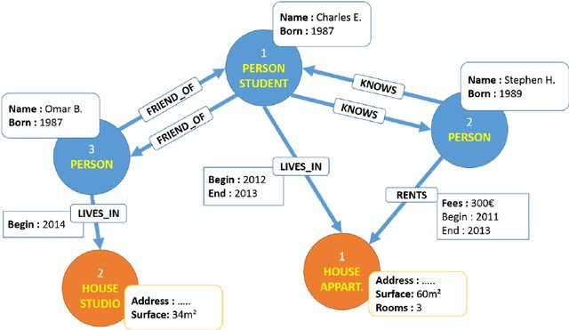
Enhancing Arachne for Property Graphs
1
2
3
simple graphs
property graphs [Bouhali, Laurent, 2015]

Slide 7
Conclusion
We have shown proof of concept of Arachne through breadth-first search, truss analytics, connected components, etc.
We have outlined our goals of fleshing out Arachne to be memory-hybrid solution for all graph analysis.
We propose the addition of a community detection suite that will take into consideration everything we learn from creating a hybrid graph analytical suite.
We have outlined future optional problems that may arise.

Slide 8
Thank You ☺ Questions?

