Slide 1
Interactive Large-Scale Data and Graph Analytics
Conclusion
Oliver Alvarado Rodriguez, Naren Khatwani, Zhihui Du, David Bader

Slide 2
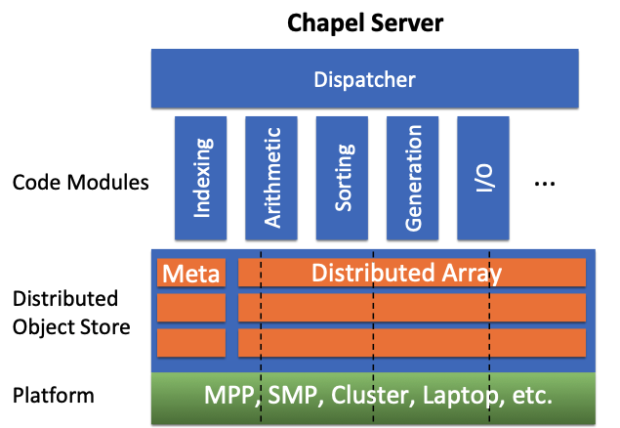
Scaling Arachne from SMPs to MPPs & Clusters
Chapel Server
Arachne 1.5
Overarching Dispatcher
BFS-shared
BFS-dist
BFS
CC
K-Truss
…
CC-shared
CC-dist
…
Meta
Distributed Array
We want a proper hybrid system for any architecture it runs on.
MPP, SMP, Cluster, Laptop, etc.
MPPs (massively parallel processors) and Clusters → communication is a huge bottleneck
SMPs (symmetric multiprocessing)→ cannot achieve the scalability we want

Slide 3
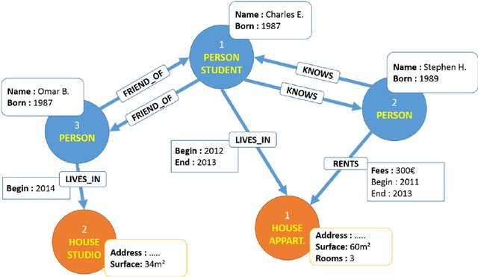
Enhancing Arachne (2.0) for Property Graphs
1
2
3
simple graphs
property graphs [Bouhali, Laurent, 2015]

Slide 4
Conclusion
We have shown the usability of Arkouda for large-scale data analysis.
We have shown proof of concept of Arachne through breadth-first search, truss analytics, connected components, etc.
We have outlined our goals of fleshing out Arachne to be a hybrid solution for (property) graph analysis scaling from SMPs to MPPs and clusters
We have outlined the blueprint for the future of Arachne.

Slide 5
Thank You ☺ Questions?

