Slide 1

A Multiplexed Microfluidic Point-of-care technology for early detection of Liver Biomarkers
Under the Supervision of
Prof. Dipankar Bandyopadhyay
Presented by
Neeraj Jaswal
(MTech. Biomedical Engineering)

Slide 2
Biomarkers of interest
AST (Aspartate transaminase)
Found in cytosol & mitochondria of liver, heart, kidney cells
Function- catalyze transamination reaction in amino acid metabolism & energy production
ALT (Alanine transaminase)
Most abundant in hepatic cells
Normal range in blood: 0-45 IU/L
ALP (Alkaline Phosphatase)
Ectoenzyme, present on cell surface in 6 iso-enzymatic forms
Elevated levels in blood indicates liver damage, hepatitis, cirrhosis & DILD
Normal range in blood: 0-35 IU/L
Function- catalyze transamination reaction in amino acid metabolism & energy production
specific marker for liver health
Elevated levels in blood indicate liver diseases like hepatitis, fatty liver disease, cirrhosis &DILD
In jaundice - >1000 IU/L
In alcoholic liver – AST > ALT
Elevated levels indicate the bile ducts disorders like cholestasis, gallstones or tumors
In obstructive cases – 10-12 times elevation in blood
Normal range in blood: 30-120 IU/L
Function- removes phosphate groups from the various biomolecules under alkaline conditions

Slide 3

How to detect biomarkers – Colorimetric Assay
Via Multiplexed Microfluidic device
Substrate Inlets
Sample Inlet
Outlet chamber
Three distinct Hybrid chambers
1. Agarose-hydrogel
2. Artificially synthesized Nano-enzymes (Au/LDO)
3. Peroxidase enzymes like GLOD & PYOD
4. TMB reagent
5. HAc-NaAc buffer
5 Inlet channels –
4 for substrates &
1 for sample input

Slide 4
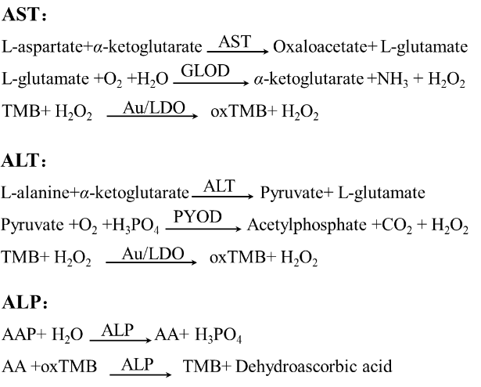
Assay principles for AST, ALT & ALP

Slide 5
Colorimetric assay kits available for ALT :-
Currently targeting ALT-
Cayman chemical’s ALT Colorimetric
Activity Assay Kit
Abcam’s
ALT Activity Assay Kit
Sigma-Aldrich’s
ALT Activity Assay Kit
Elabscience’s
ALT Activity Assay Kit

Slide 6
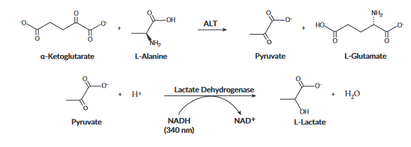
ALT Colorimetric Activity Assay Kit
detecting ALT activity in serum, plasma, tissue samples and cell lysates
Principle behind this assay:-
monitoring the rate of NADH oxidation in a coupled reaction system employing
lactate dehydrogenase (LDH).
The oxidation of NADH to NAD+ is accompanied by a decrease in absorbance at 340 nm.
When ALT activity is rate limiting, the rate decrease is directly proportional to the ALT activity in the sample.

Slide 7
Thank you…!

