Slide 1

Different colorimetric assay kits for detection of Liver Biomarker - ALT
Under the Supervision of
Prof. Dipankar Bandyopadhyay sir
Presented to
Aayushi Mam & Sahil Sir
Presented by
Neeraj Jaswal
(MTech. Biomedical Engineering)

Slide 2
Significance of Alanine transaminase (ALT):
homo-dimeric cytoplasmic pyridoxal phosphate-dependent enzyme
Most abundant in hepatic cells
Normal range in blood: 0-45 IU/L
Functions :- catalyzes transamination reaction in amino acid metabolism & energy production(liver gluconeogenesis)
Specific marker for liver health
Elevated levels in blood indicate liver diseases like hepatitis, fatty liver disease, cirrhosis &DILD
In jaundice - >1000 IU/L

Slide 3
Colorimetric assay kits available for ALT :-
Cayman chemical’s ALT Colorimetric
Activity Assay Kit
Abcam’s
ALT Activity Assay Kit
Sigma-Aldrich’s
ALT Activity Assay Kit
Elabscience’s
ALT Activity Assay Kit

Slide 4
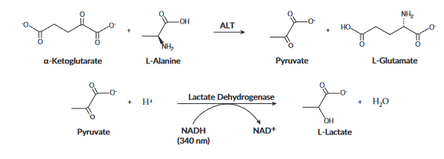
Cayman chemical’s ALT Colorimetric Activity Assay Kit
detecting ALT activity in serum, plasma, tissue samples and cell lysates
Principle behind this assay:-
monitoring the rate of NADH oxidation in a coupled reaction system employing
lactate dehydrogenase (LDH).
The oxidation of NADH to NAD+ is accompanied by a decrease in absorbance at 340 nm.
When ALT activity is rate limiting, the rate decrease is directly proportional to the ALT activity in the sample.

Slide 5
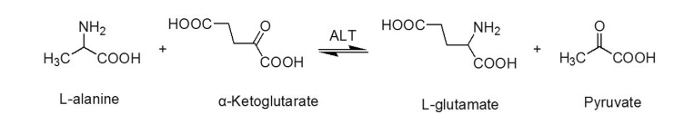
Abcam’s ALT Activity Assay Kit
Detecting ALT in cell culture supernatant, Urine, Serum, Plasma & tissue extracts
Principle behind this assay:-
The pyruvate developed via transamination reaction, is detected in a reaction that converts a nearly colorless probe to a form that is colored (ODmax = 570 nm) and fluorescent (Ex/Em = 535/587 nm).
The kit has a detection limit of 10 mIU per well.

Slide 6

Sigma-Aldrich’s ALT Activity Assay Kit
detecting ALT activity in serum, plasma, tissue sample
Principle behind this assay:-
ALT activity is determined by a coupled enzyme assay which results in a colorimetric (570 nm)/fluorometric(λ ex= 535nm/λem = 587 nm) product, proportional to the pyruvate generated.
1IU ALT is the amount of enzyme that generates 1.0 mM of pyruvate per minute at 37C.
The kit is sufficient for 100 assays in 96 well plates.

Slide 7
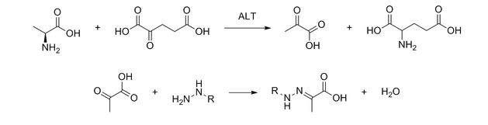
Elabscience’s ALT Activity Assay Kit
detection of ALT in Serum, plasma cells, animal tissue
Principle behind this assay:-
ALT catalyzes the amino conversion reaction between alanine and α-ketoglutaric acid to produce pyruvic acid and glutamic acid at pH 7.4 and 37℃.
Then phenylhydrazine was added to form phenylhydrazone with pyruvic acid.
Phenylhydrazone is reddish brown under alkaline conditions.
ALT activity can be calculated by measuring the OD values at 510 nm.

Slide 8
Links for the Manuals:-
Cayman chemical’s ALT Colorimetric Activity Assay Kit
https://www.caymanchem.com/product/700260/alanine-transaminase-colorimetric-activity-assay-kit
Abcam’s ALT Activity Assay Kit
https://www.abcam.cn/products/assay-kits/alanine-transaminase-activity-assay-kit-
colorimetricfluorometric-ab105134.html
Sigma-Aldrich’s ALT Activity Assay Kit
https://www.sigmaaldrich.com/IN/en/product/sigma/mak052?gclid=CjwKCAjwivemBhBhEiwAJxNWN-me3Y5fnxMxIOxTihwJVmEUfwWLWidlz9WwICHTuz4dRf_QC-TPcBoCWaEQAvD_BwE&gclsrc=aw.ds
Elabscience’s ALT Activity Assay Kit
https://www.elabscience.com/search-category=metabolism%20assays&keywords=alt.html

Slide 9


