Slide 1
AIMS Paper Figures

Slide 2
Study 1 move to conceptual organization

Slide 3
Results Outline
More ELA → lower resilience + higher trait anxiety
Correlation matrix (eBMRQ + ELA) [study 1]: four block figure (AIMS + threat for both)
Correlation (?) replication (conceptual replication w/ AIMS → threat + chaos) [study 2]
HUMS ~ absorption [try study 2]
Escapsim ~ BMRQ + AIMS subscales (only sig. ‘Predictor’ is AIMS; use full score. Secondary analyses of using subscales of escapism [pos & neg]; interaction with pos+neg but with just AIMS)
Absorption → resilience
Mediation model (CHAOS - AIMS - resilience) / (check STAI)
N.s. for just childhood
Significant for adolescence
CHAOS mediation remained sig w/ age as a covariate (cite music reward decreasing of age/retrospective reporting could be confound)

Slide 4
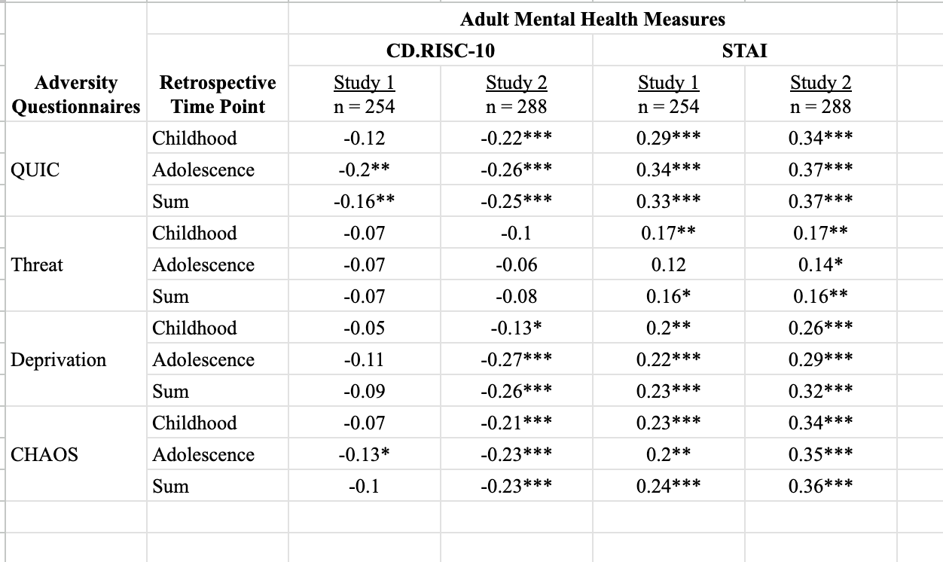
ELA & Mental Health Outcomes Table

Slide 5
All dimensions of ELA are positively associated with reports of absorption into music

Slide 6
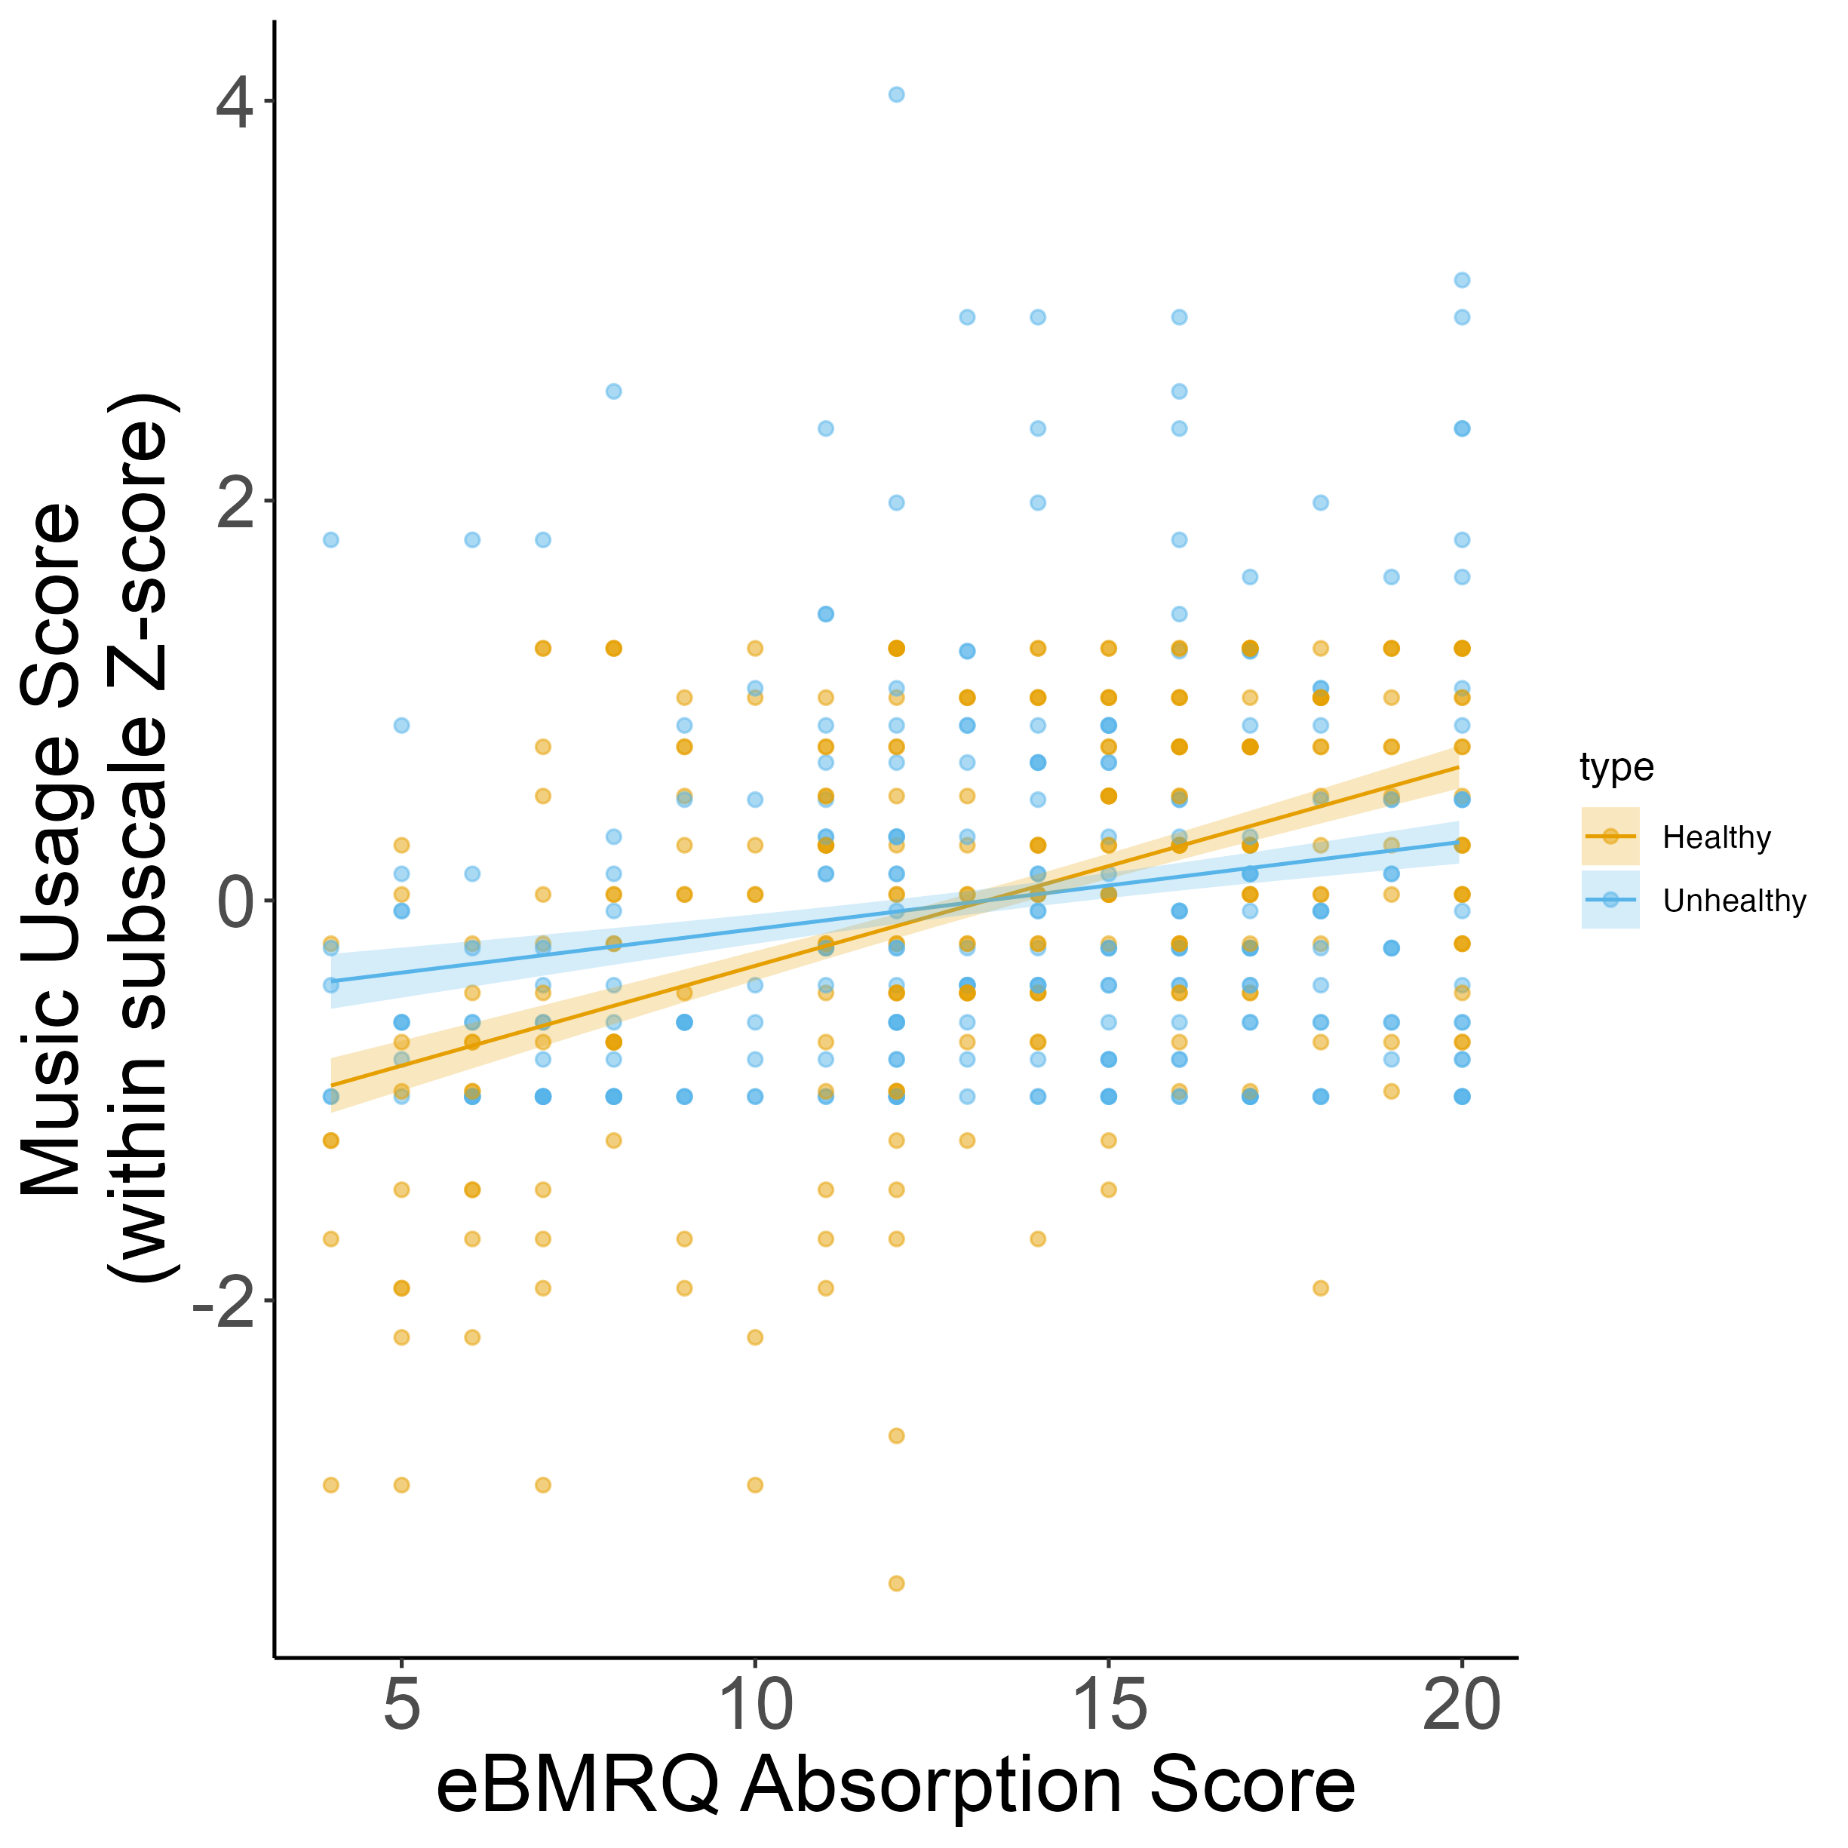
Study 1: Absorption related to both healthy + unhealthy music usage, but more strongly associated with healthy music usage
Notes:
How do we account for the fact that there are more questions on Unhealthy compared to Healthy?

Slide 7
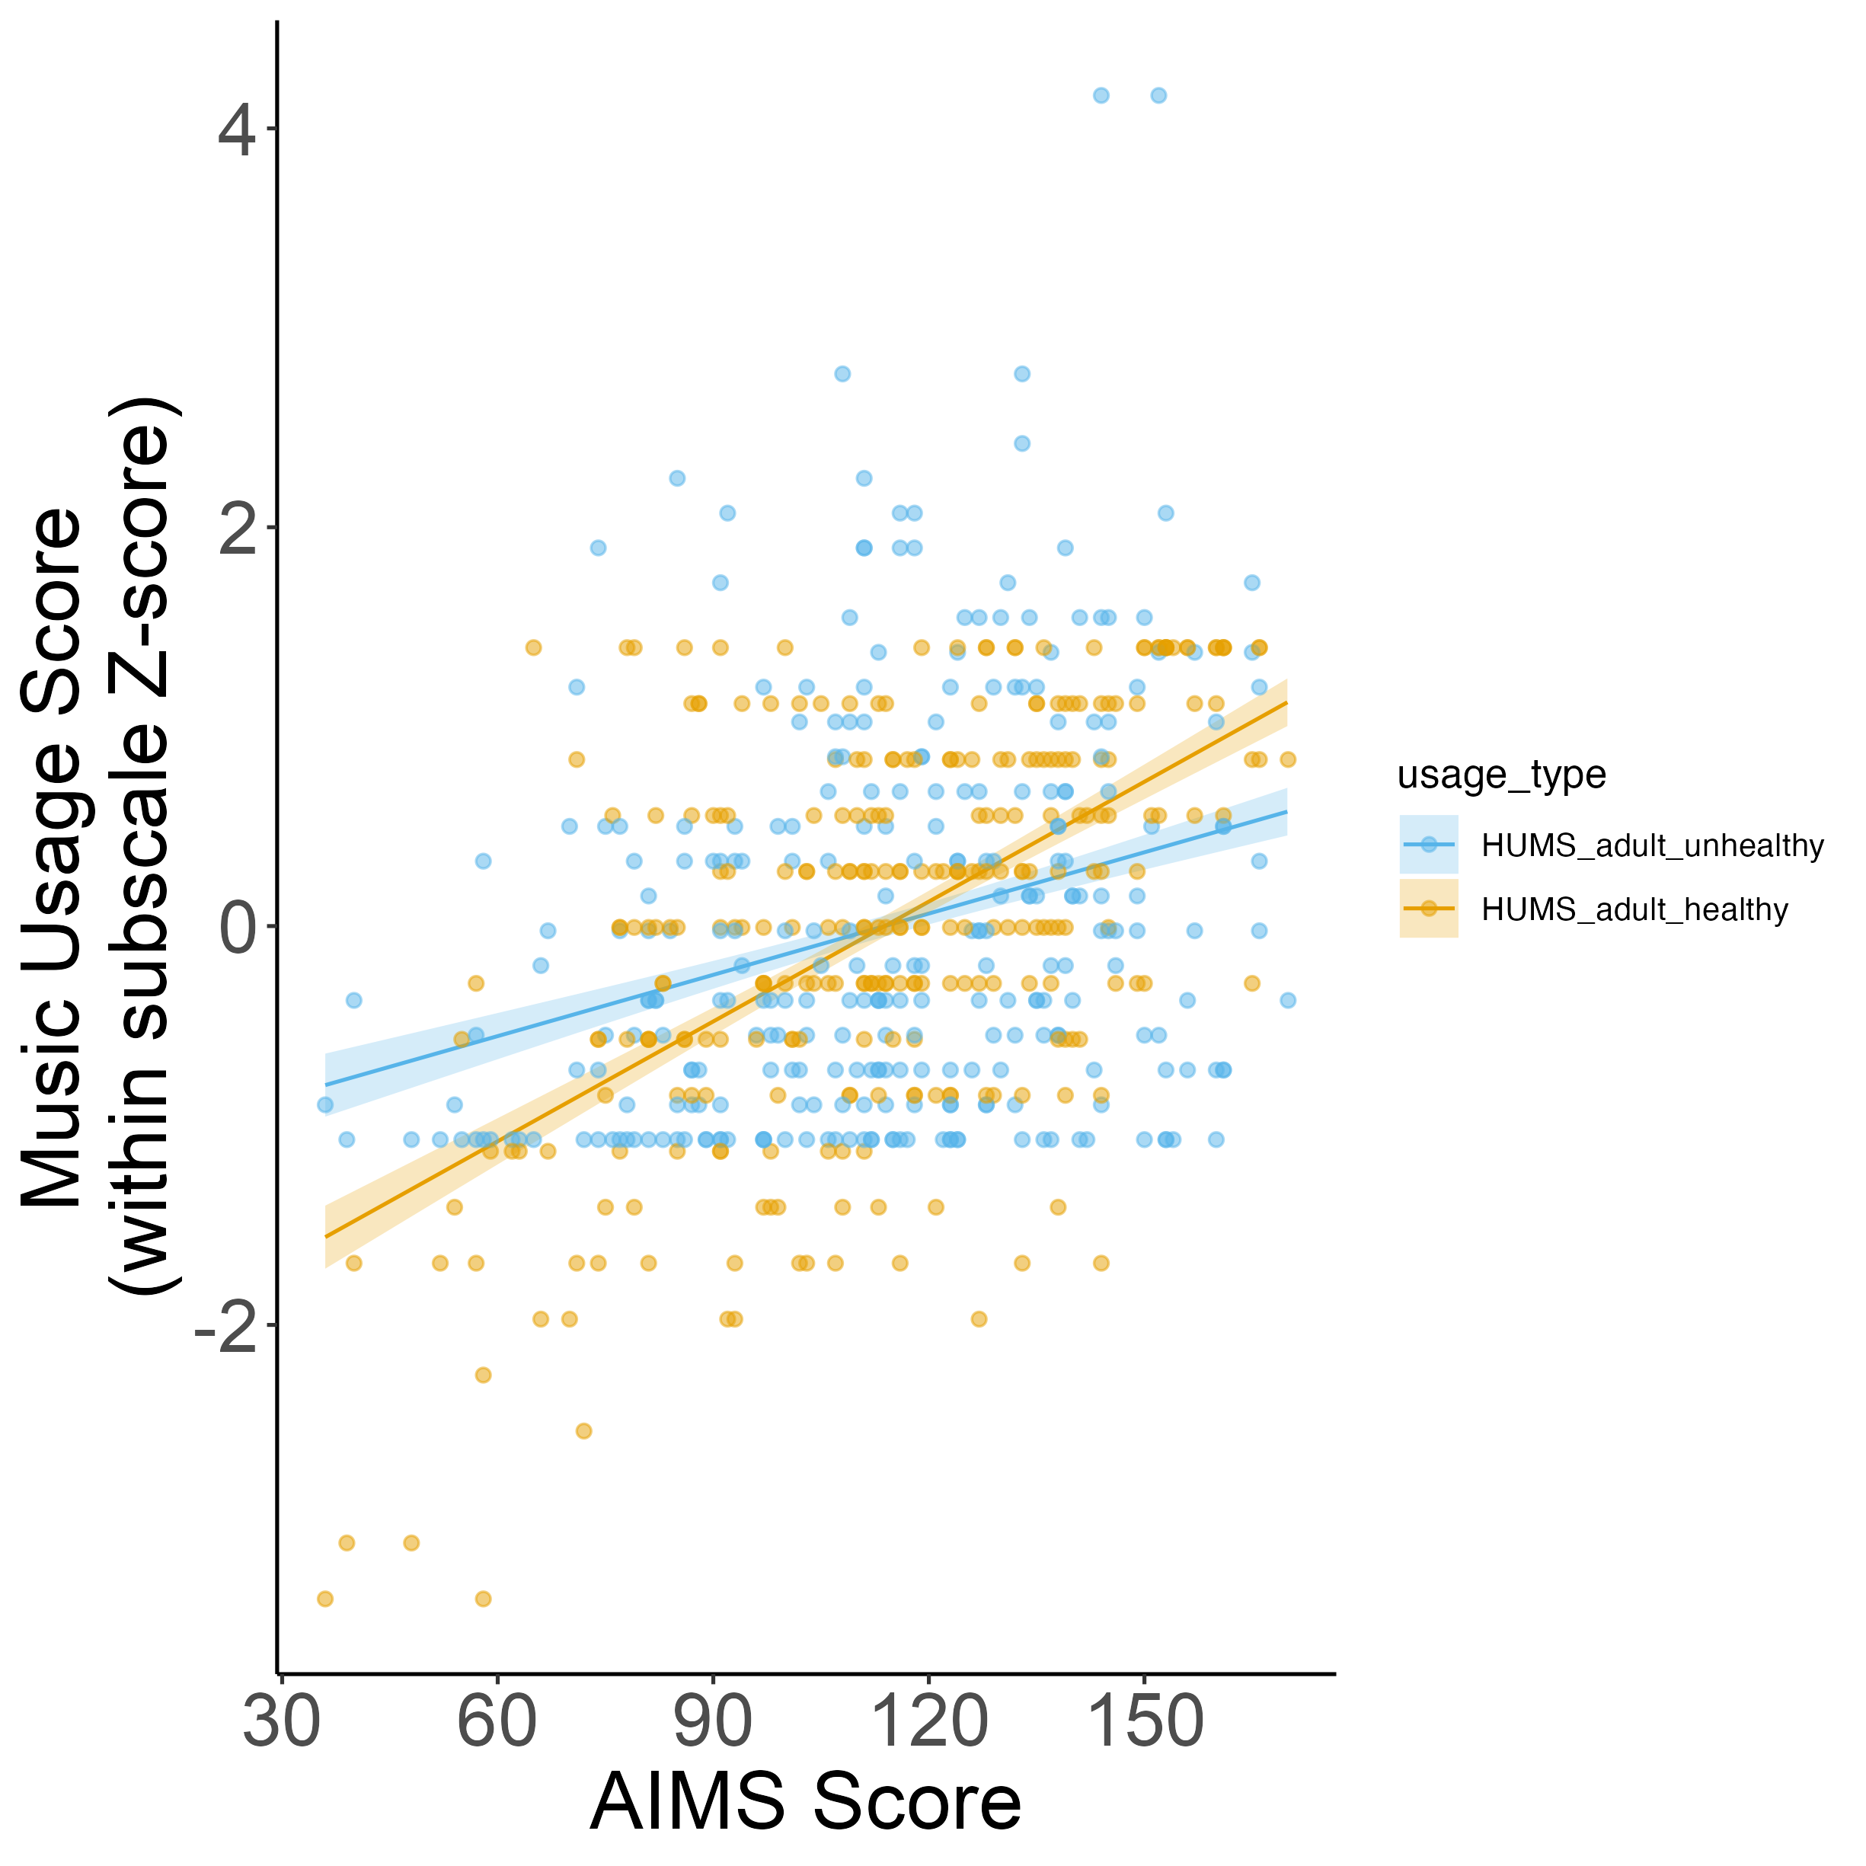
Study 2 Conceptual Replication

Slide 8
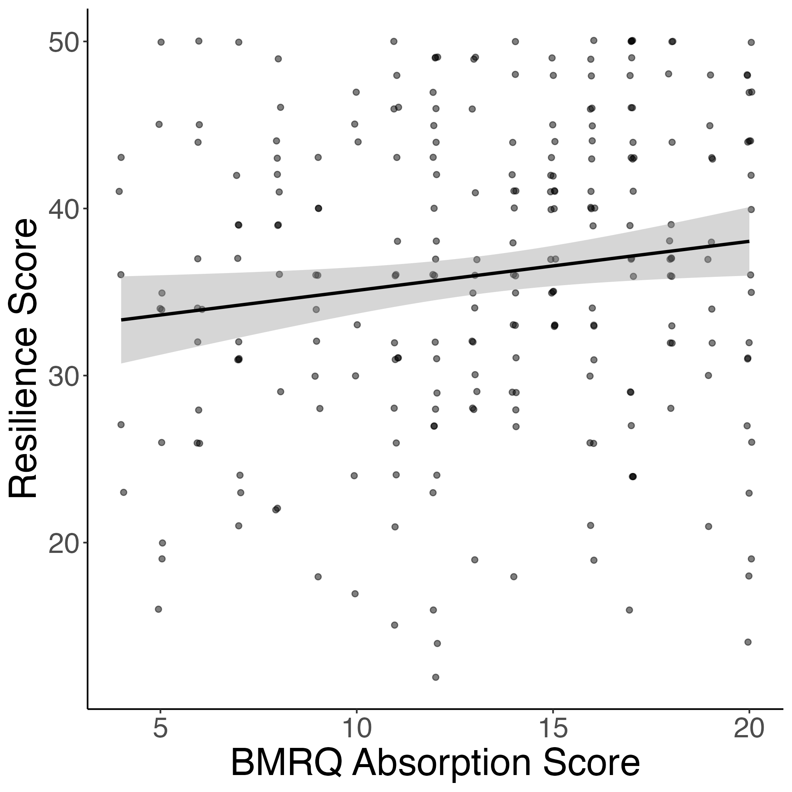
Absorption also positively related to resilience

Slide 9
Study 2

Slide 10
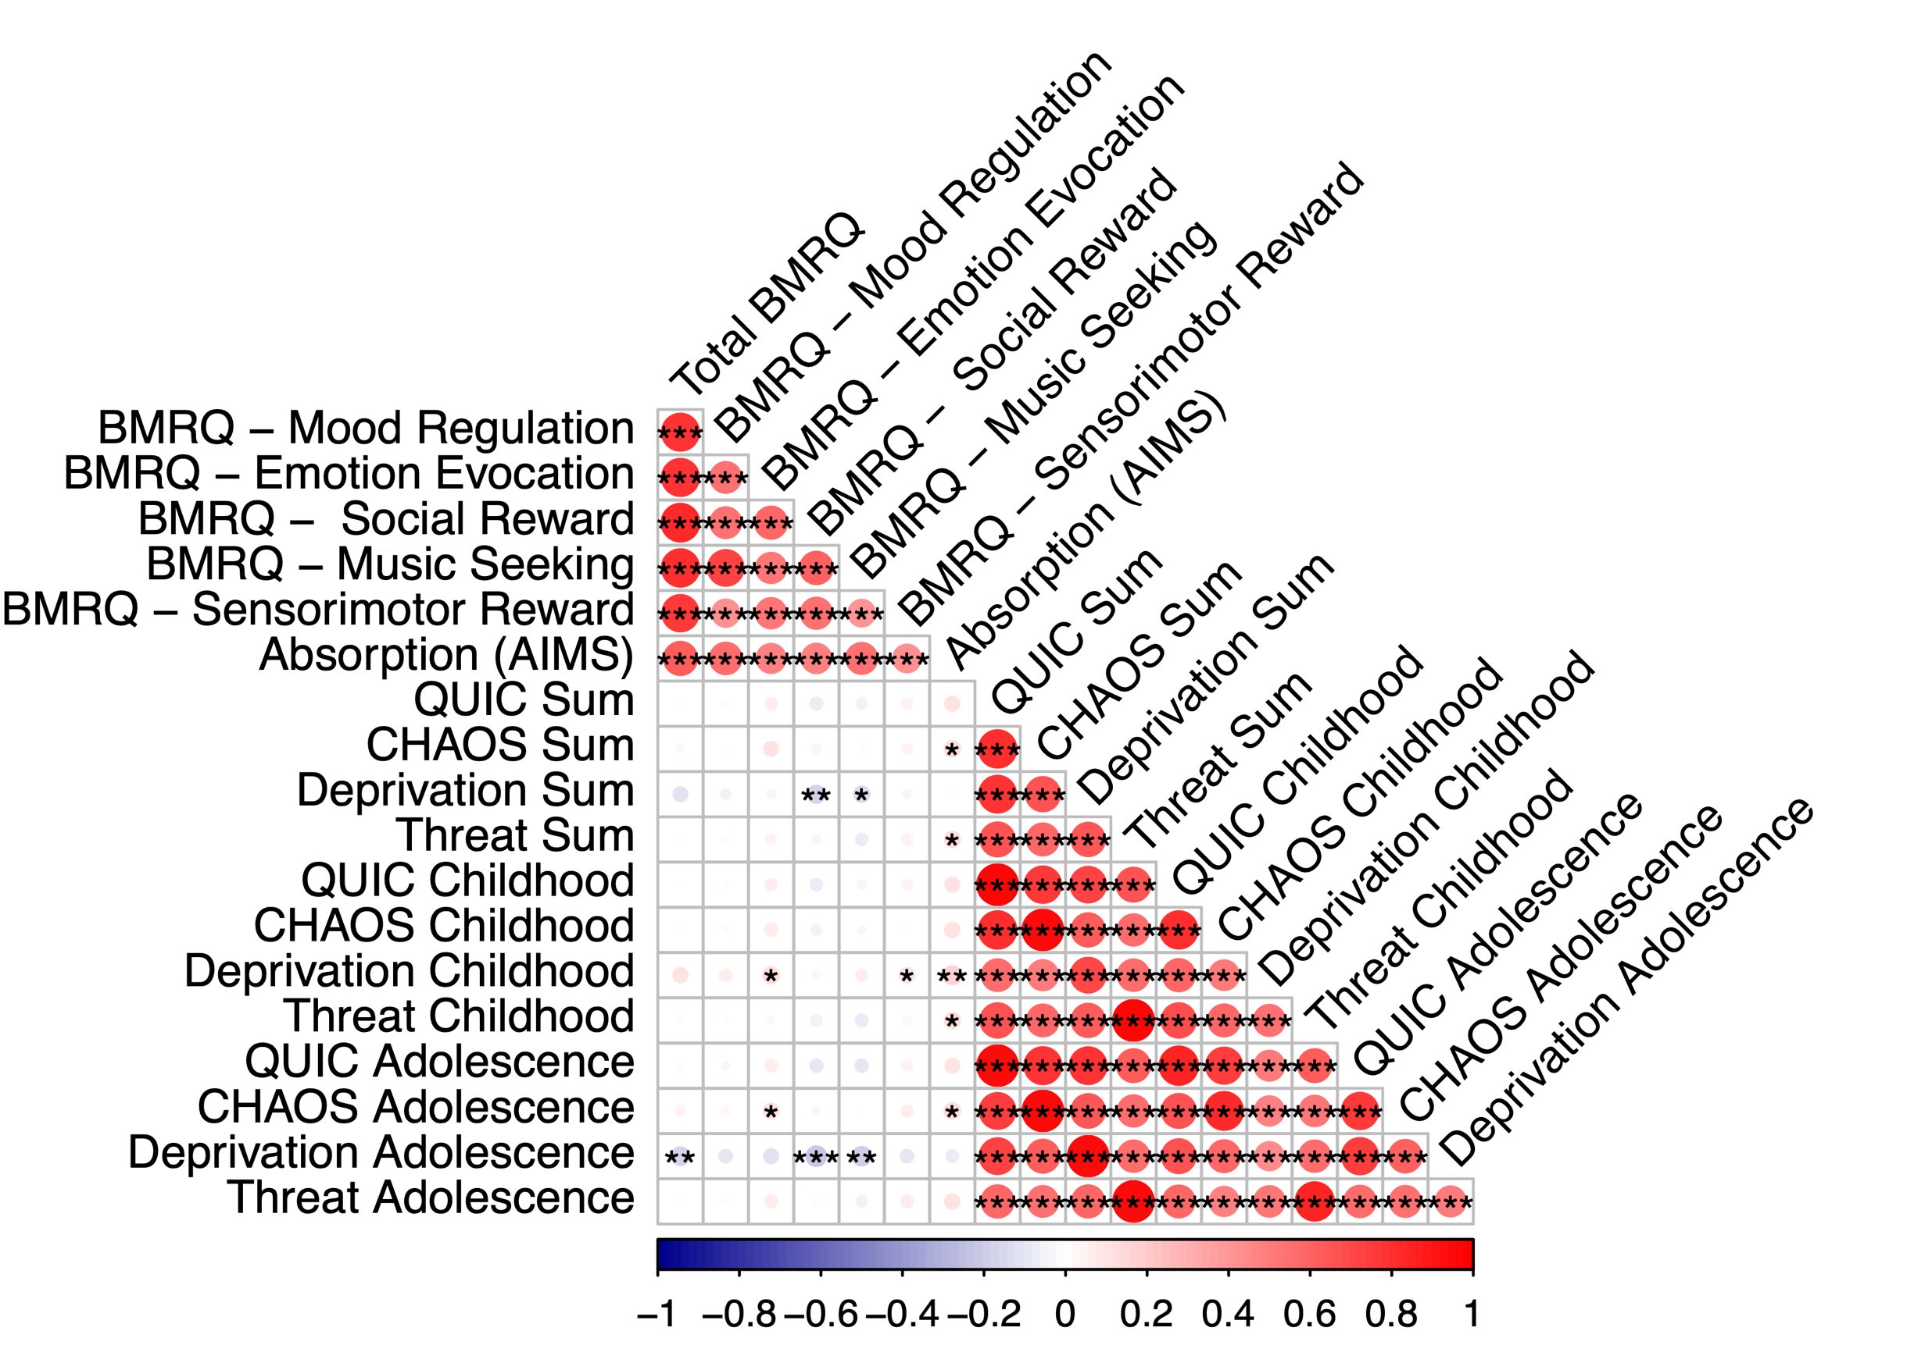
Conceptual replication of CHAOS & threat associations with absorption (via AIMS)

Slide 11
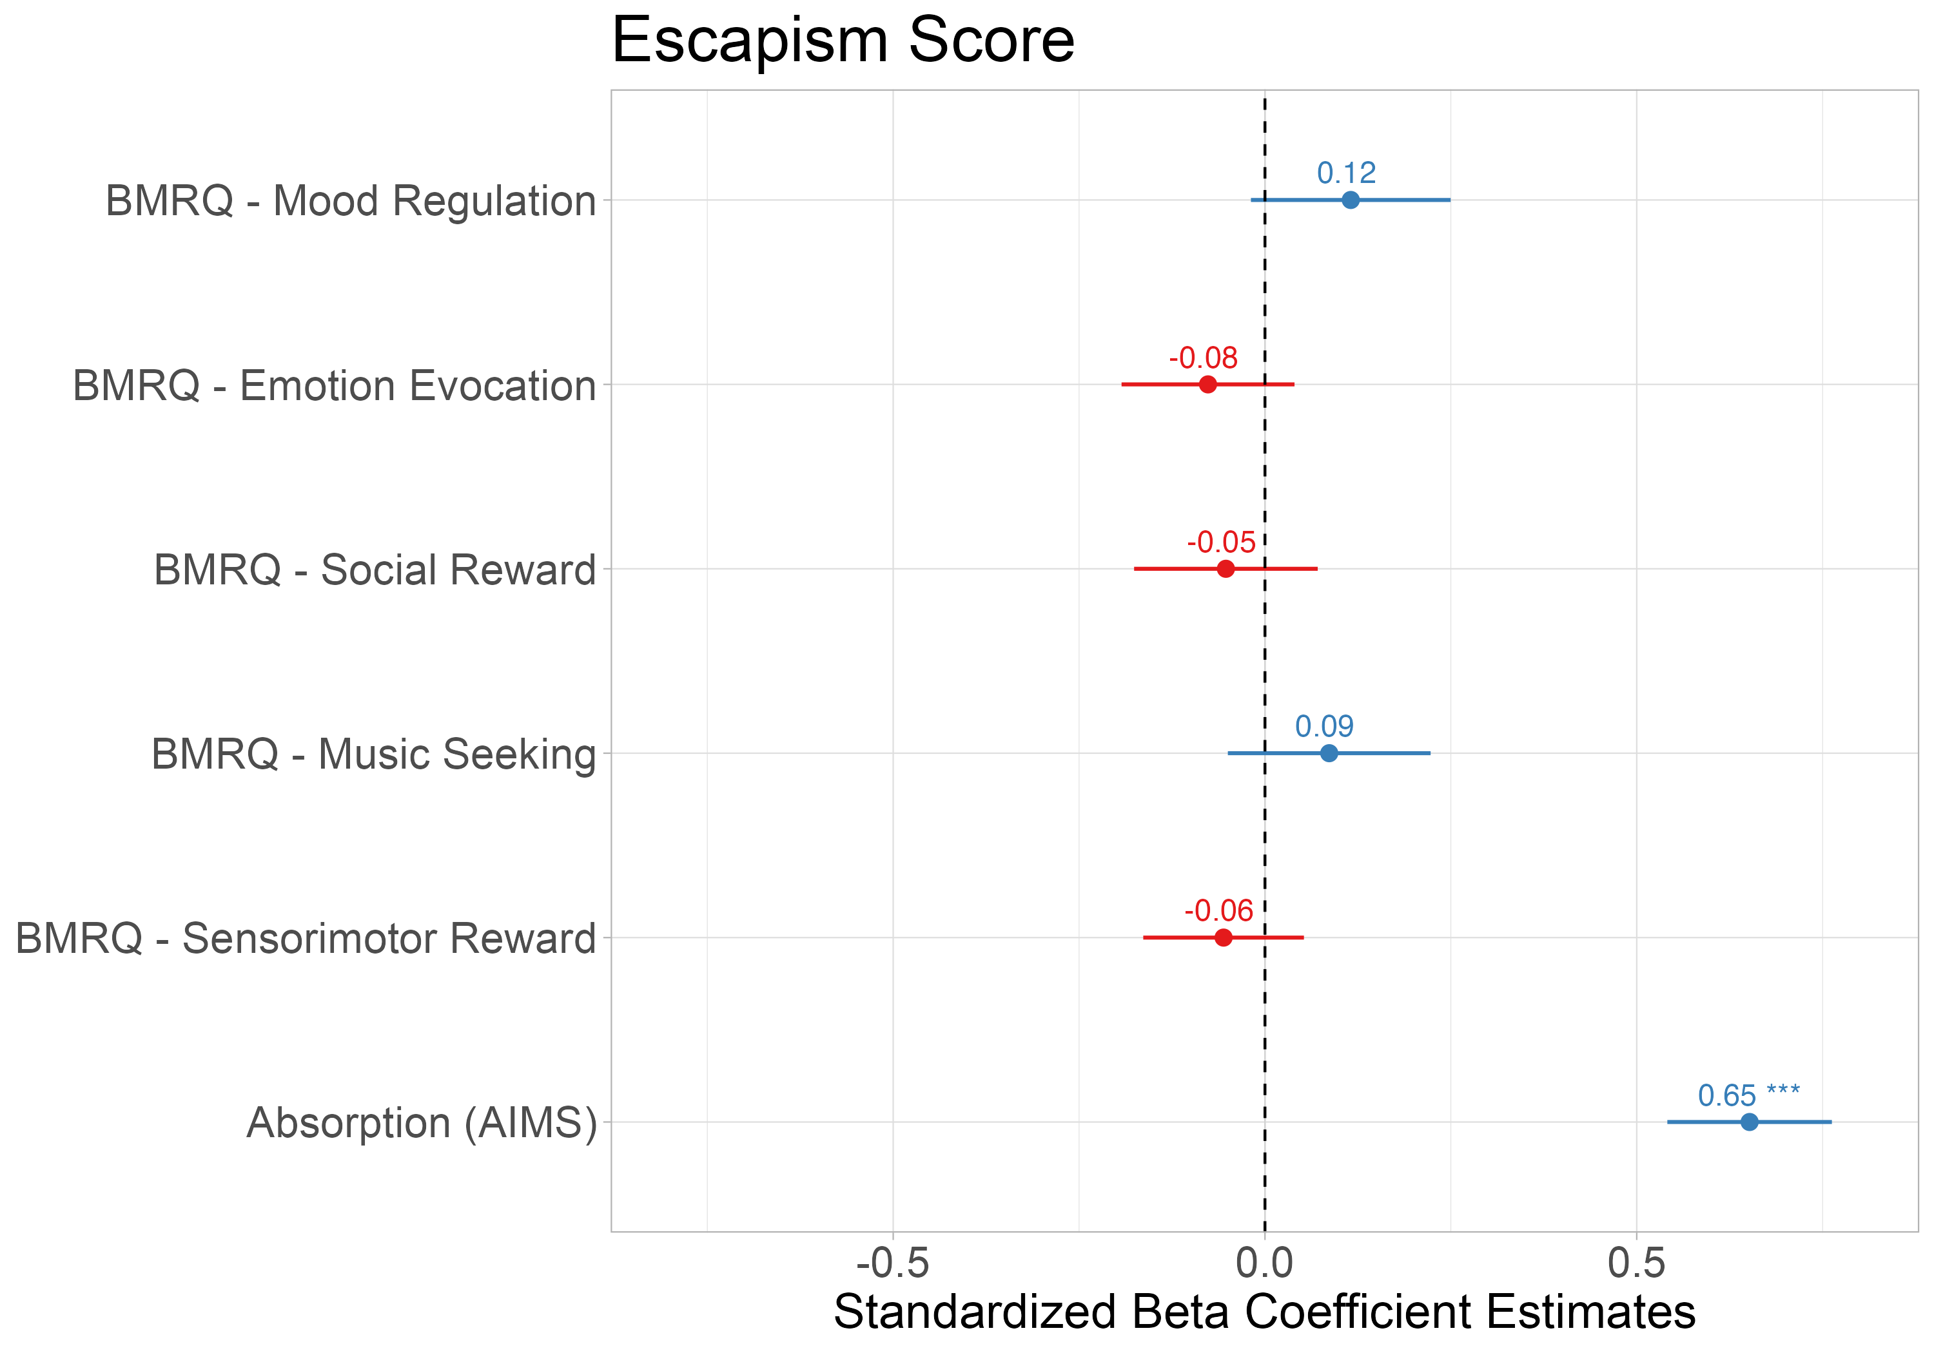
Absorption into music associated with using music for escapism
Notes:
Secondary analyses of using subscales of escapism [pos & neg]; interaction with pos+neg but with just AIMS

Slide 12
Absorption mediates the relationship between CHAOS and resilience

