Slide 1


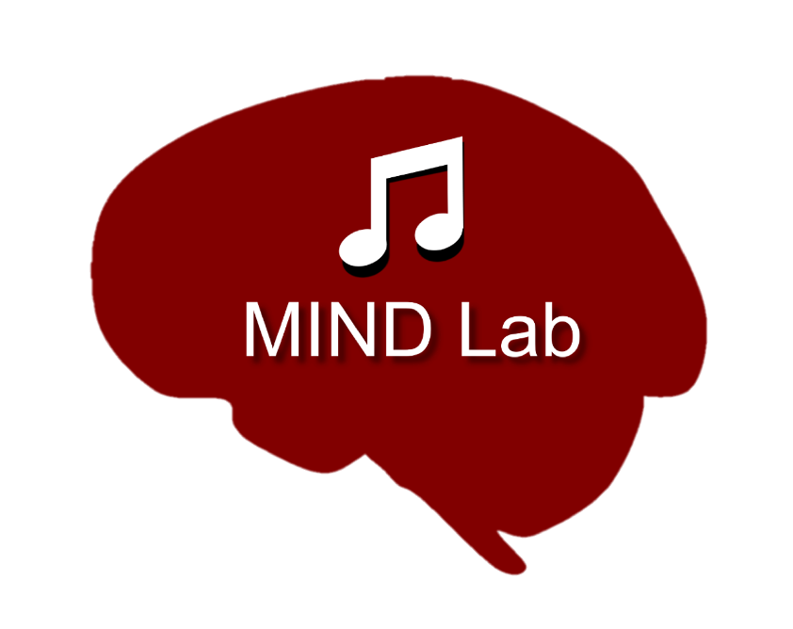
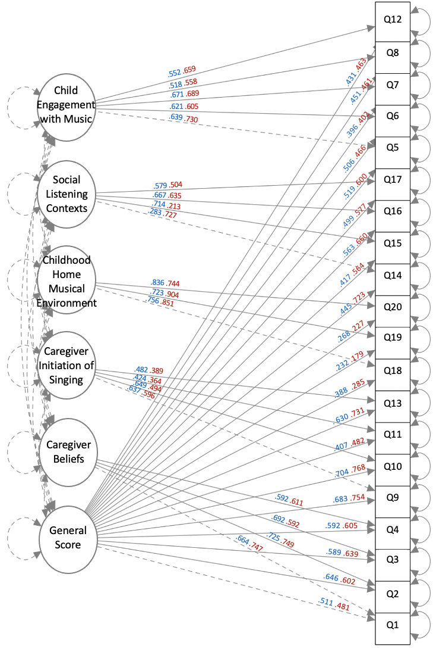



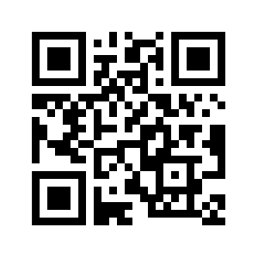
Music@Home Retrospective:
A New Measure to Retrospectively Assess Early Home Music Environments
Kelsie Lopez, Nicholas Kathios, Laurel Gabard-Durnam, Psyche Loui
Northeastern University, Boston, MA
Background
Factor Analyses
Relevance to Adult Behavior
Heightened brain plasticity during early childhood facilitates experiences impart lasting effects on individuals¹
Survey, interview, and in-home recording studies have shown that many children engage in informal musical activities (such as spontaneous singing, being sung to, and playing with musical toys) starting in infancy and extending throughout childhood²
Both early passive music exposure & formal musical training have lasting effects on music perception, cognition, and brain structure³
The only existing measure of the home musical environment, the Music@Home scale⁴ is a caregiver report intended for infants and preschoolers, limiting its applicability in understanding downstream effects of such music exposure
Here, we present the Music@Home-Retrospective scale, a measure aimed at capturing adult self-reports of their informal musical engagement at home during development, as a tool to probe the long-term effects of early music engagement on brain and cognitive health and socioemotional well-being.
*
*
Methods
*
STUDY 1:
• 299 participants (167F; mean age = 36) recruited from a previous experiment
• Participants completed the 34-item Music@Home – Retrospective, the Questionnaire of Unpredictability in Childhood³ (QUIC), the short-form Confusion, Hubbub, and Order Scale⁴ (CHAOS), McLaughlin Deprivation & Threat Scales⁵
• All retrospective adversity measures were reported for both childhood (6-12 years) and adolescence (13-18 years)
• Participants also completed the Extended Barcelona Music Reward Questionnaire (eBMRQ) and the Goldsmith Musical Sophistication Index (GoldMSI) in the previous study
STUDY 2:
• 288 participants (141F) recruited from another previous experiment
• Participants completed the 20-item Music@Home – Retrospective, the QUIC, the full CHAOS, McLaughlin Deprivation & Threat Scales, Social Reward Questionnaire (SRQ), the Musical Ear Test (MET), the Connor-Davidson Resilience Scale (CD-RISC-10), the State-Trait Anxiety Inventory (STAI), and Healthy-Unhealthy Music Usage Scale (HUMS)
• Participants also completed the Barcelona Music Reward Questionnaire (BMRQ) and the Goldsmith Musical Sophistication Index (GoldMSI) in the previous study
Blue loadings correspond to Study 1 (EFA) whereas Red loadings correspond to Study 2 (CFA).
Music@Home – Retrospective Scale Examples
Discussion
Caregiver Beliefs:
My caregivers believed that I should learn to play an instrument.
Caregiver Initiation of Singing:
My caregivers sang to/with me in many different situations (e.g. during playtime, with friends and family, in the car).
Childhood Home Musical Environment:
I have negative memories of the music I heard in the home as a child. (R)
Social Listening Contexts:
I associate music I heard as a child with social contexts (listening with caregivers, siblings, friends).
Child Engagement with Music:
I enjoyed making sounds/interacting with musical instruments (including toy ones).
Exploratory and confirmatory analyses revealed a five-factor solution to the Music@Home – Retrospective, with three factors maintained from the original Music@Home scale (Caregiver Beliefs, Caregiver Initiation of Singing, and Child Engagement with Music) and two novel factors (Attitude towards Childhood Home Musical Environment and Social Listening Contexts)
Caregiver Beliefs and Child Engagement with Music scores were significantly positively correlated with MET – Melodic scores, suggesting that early musical engagement imparts lasting improvements in auditory perception
Caregiver Initiation of Singing scores were significantly negatively correlated with levels of adult anxiety, suggesting caregiver singing during this time might result in lower baseline levels of anxiety or improved emotion regulation abilities in adulthood
Developing Music@Home – Retrospective Items
Music@Home - Retrospective Validity
References
31 Items:
17 from M@H Preschool + 14 new items
1.
The childhood home musical environment
2.
Adolescent attitudes toward childhood home musical environment
3.
Current attitudes toward childhood home musical environment
lopez.ke@northeastern.edu
@KelsieLLopez
kathios.n@northeastern.edu
@nickkathios

