Slide 1



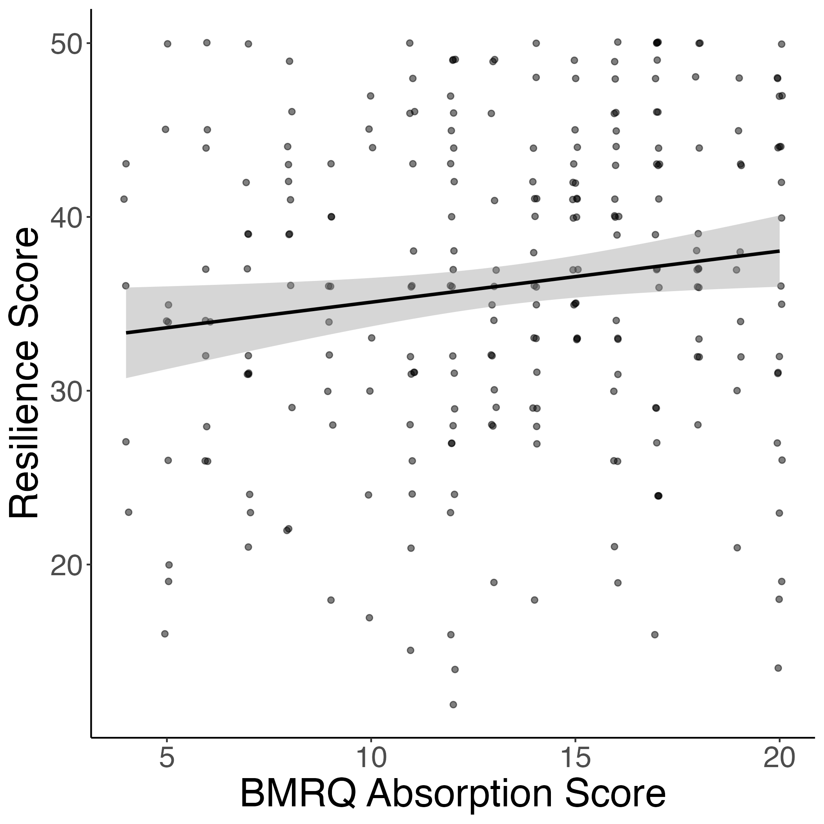
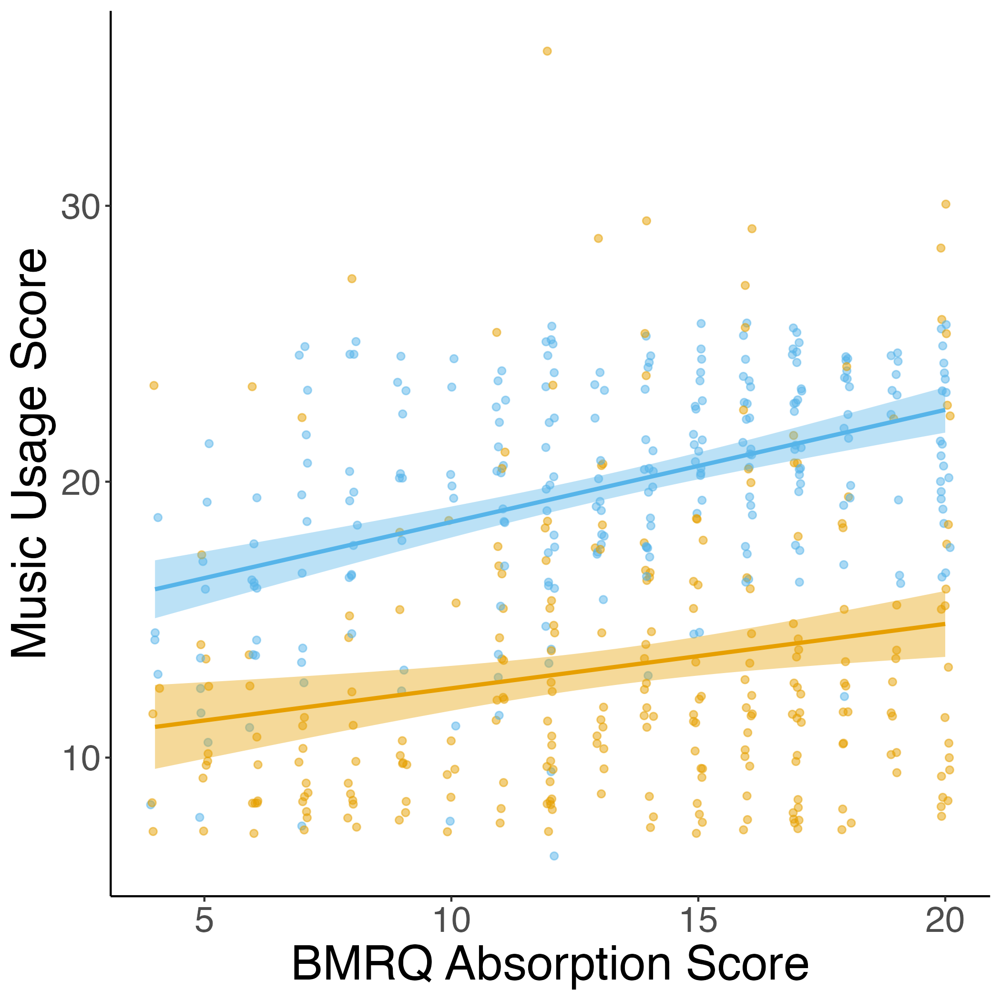






Early Life Adversity Reveals Adaptive Use of Absorption in Music
Nicholas Kathios, Kelsie L. Lopez, Psyche Loui, Laurel Gabard-Durnam
Northeastern University, Boston, MA
Introduction
Absorption is also positively related to resilience & both healthy and unhealthy music usage
AIMS mediates the relationship between ELA and resilience
Music accrues implicit reward value by exploiting reward-prediction mechanisms: listeners tend to prefer music with predictable acoustic and structural features
Pleasurable music listening experiences involve interactions between the auditory and reward systems
ELA depression/structural brain changes
connection
Interim Conclusion
Hypothesis: Individuals who have experienced higher levels of early life adversity (across all dimensions) will demonstrate lower music-reward sensitivity. This relationship will be mediated by levels of general anhedonia.
Study 1 Methods
Discussion
Follow-up Hypothesis: The degree to which individuals report absorption into music will be related to how much they report using music as a form of escapism
Study 2 Methods
All dimensions of ELA are positively associated with reports of absorption into music
Absorption in music significantly related to positive and negative escapism (and ELA)
References
kathios.n@northeastern.edu
@nickkathios

