Slide 1



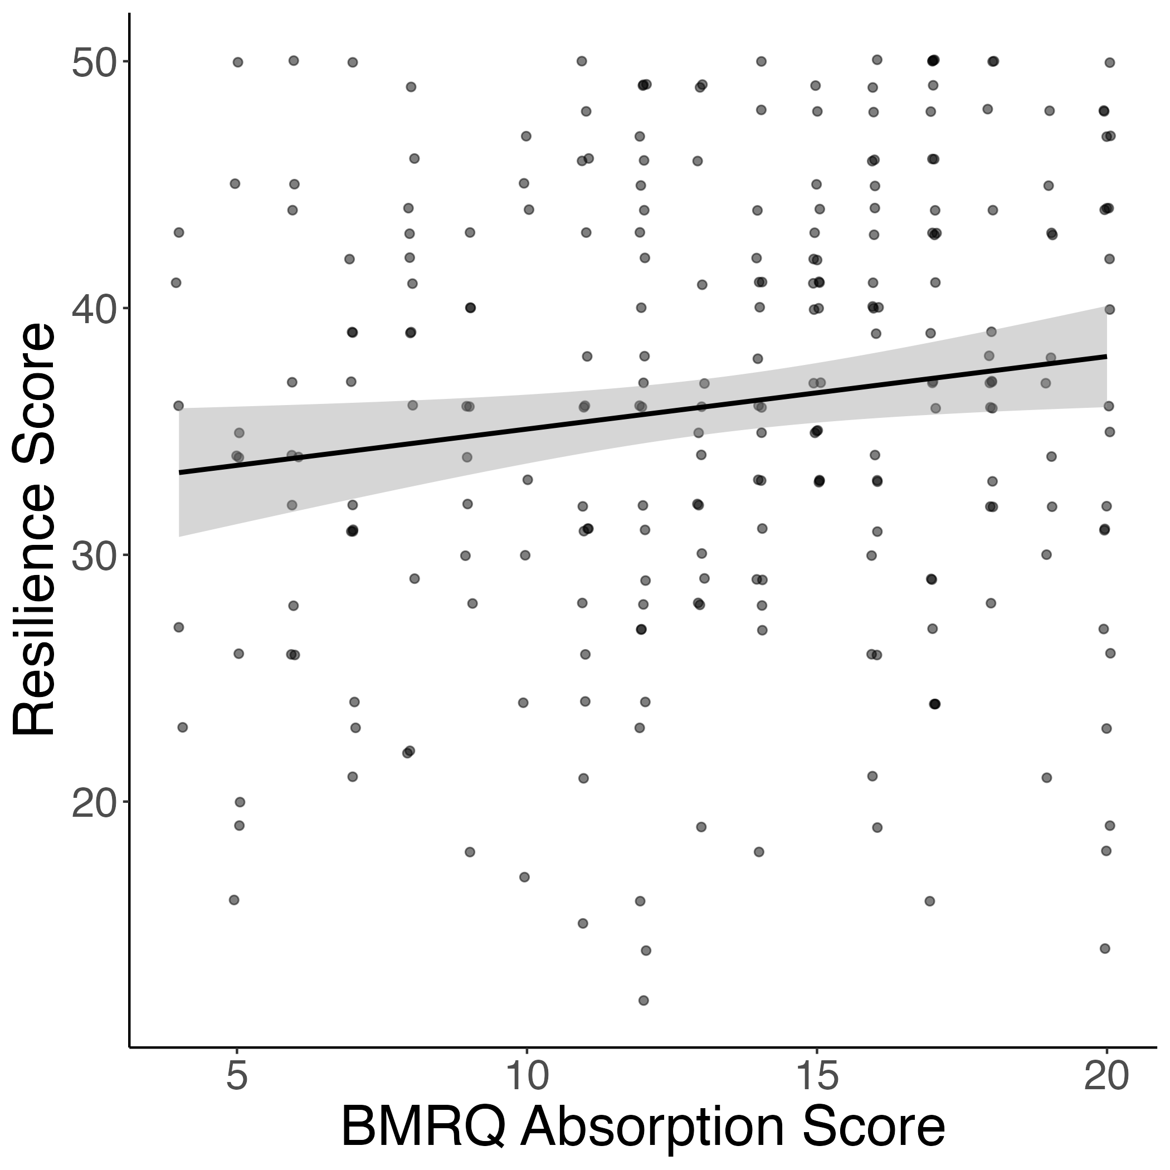
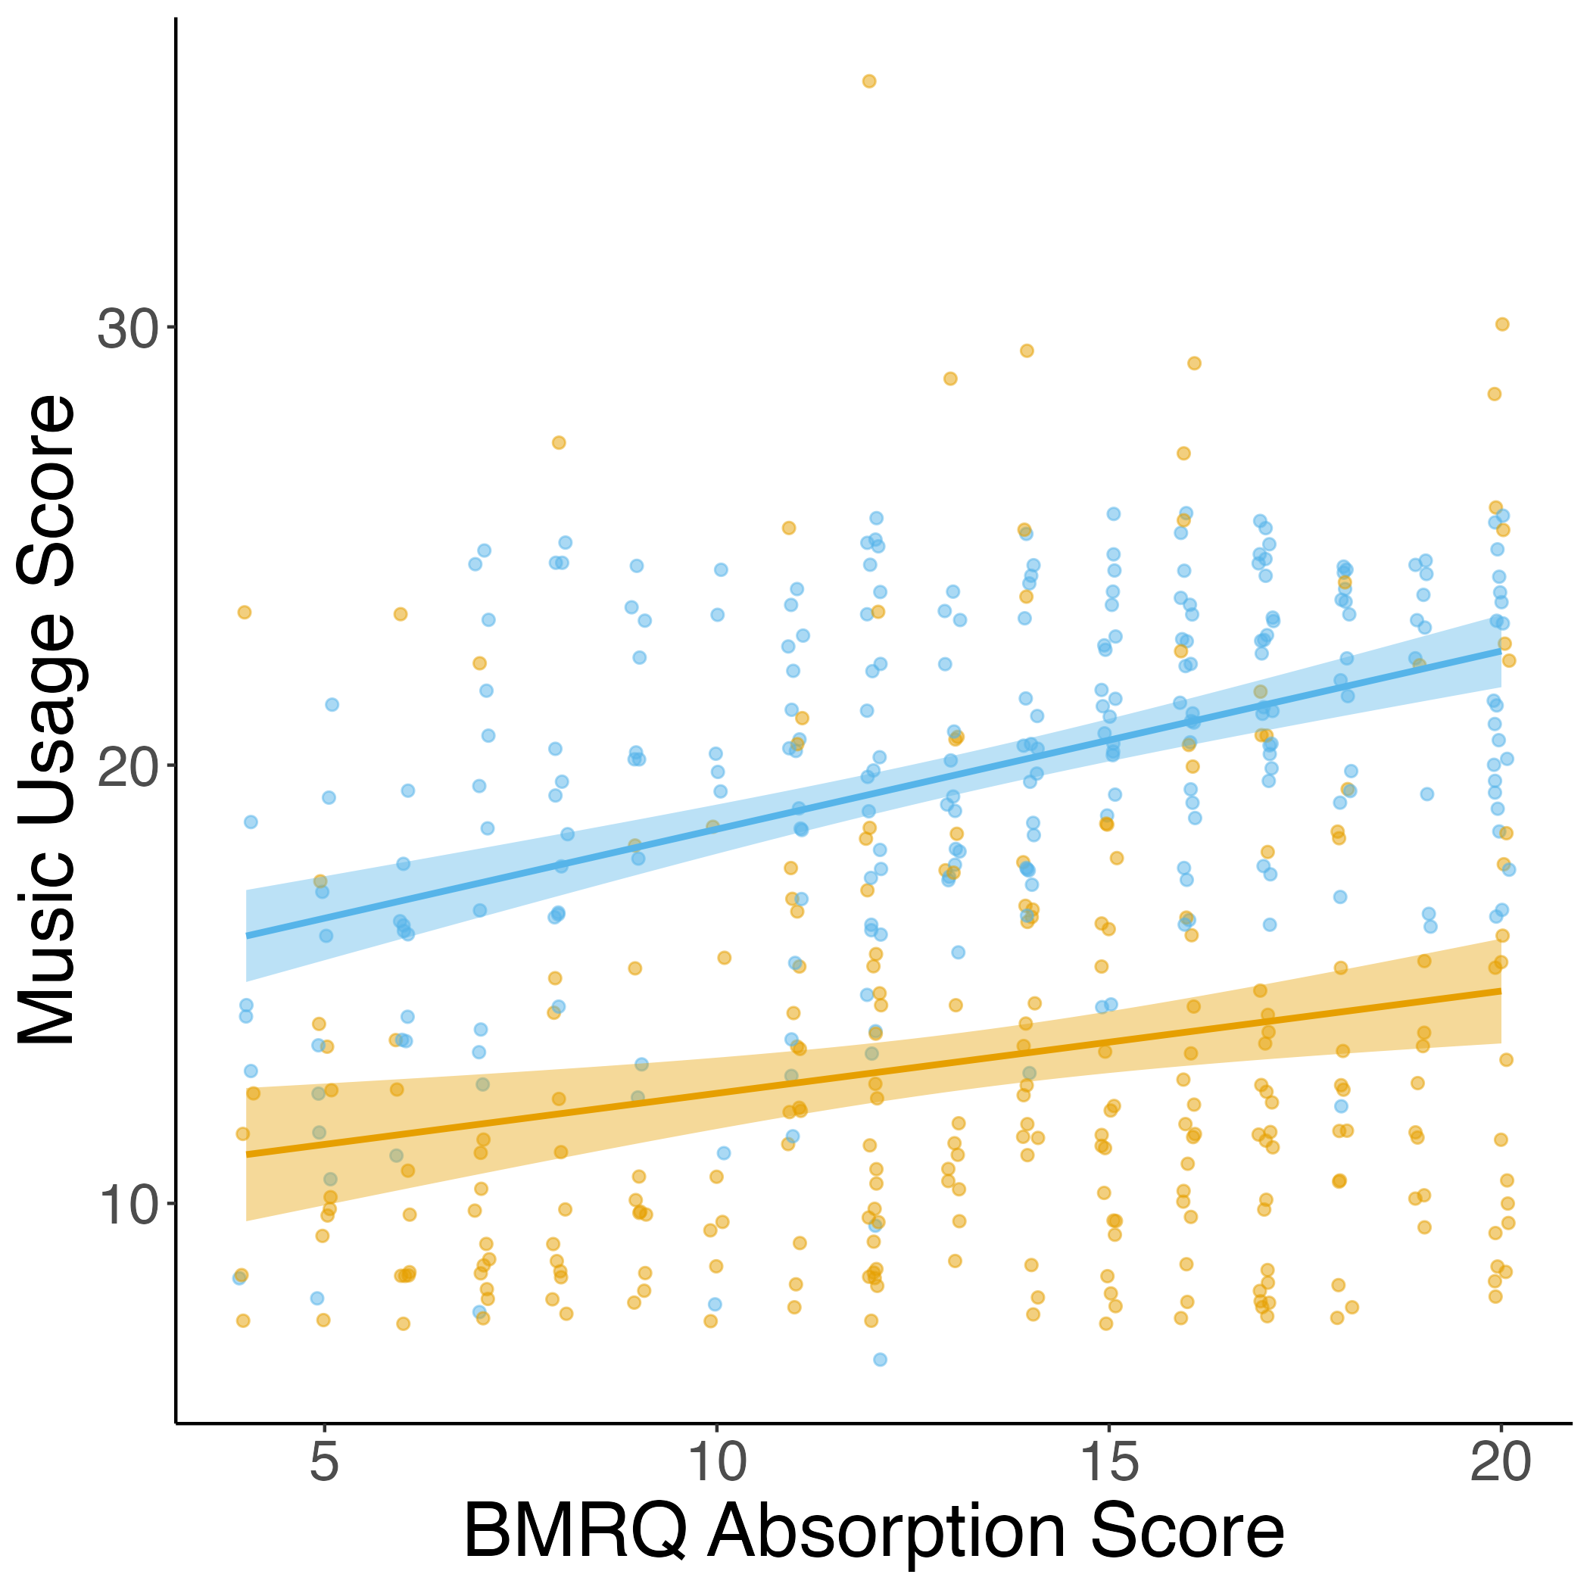
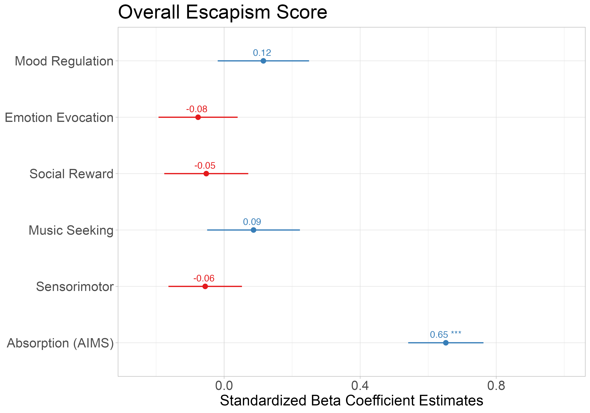




Early Life Adversity Reveals Adaptive Use of Absorption in Music
Nicholas Kathios, Kelsie L. Lopez, Psyche Loui, Laurel Gabard-Durnam
Northeastern University, Boston, MA
Introduction
Absorption is also positively related to resilience & both healthy and unhealthy music usage
Absorption relates to reports of escapism above effects of other facets of music reward
Music accrues implicit reward value by exploiting reward-prediction mechanisms: listeners tend to prefer music with predictable acoustic and structural features¹
Pleasurable music listening experiences involve interactions between the auditory and reward systems²
Experiences of early life adversity (ELA) is associated with higher levels of adult depression³ and blunted responsivity of the reward system during reward anticipation⁴
Exposure to ELA may blunt music-reward responsivity and enjoyment of music
254 participants (140F) recruited from a previous experiment
Participants completed the Questionnaire of Unpredictability in Childhood⁵ (QUIC), the short-form Confusion, Hubbub, and Order Scale⁶ (CHAOS), McLaughlin Deprivation & Threat Scales⁷, Healthy-Unhealthy Music Scale⁸ (HUMS), the State/Trait Anxiety Inventory⁹ (STAI), the Connor-Davidson Resilience Scale¹⁰ (CD-RISC-10)
All retrospective adversity measures were reported for both childhood (6-12) and adolescence (13-18)
Participants also completed the Extended Barcelona Music Reward Questionnaire¹¹ (eBMRQ) in the previous study
Hypothesis: Individuals who have experienced higher levels of early life adversity (across all dimensions) will demonstrate lower music-reward sensitivity.
Study 1 Methods
Interim Conclusion
Absorption mediates the relationship between CHAOS & resilience
Absorption positively correlated with resilience and healthy music usage, suggesting it can serve an adaptive purpose
Items on the unhealthy music usage scale index music listening as a form of escapism (e.g. “I hide in my music because nobody understands me, and it blocks people out)
In adverse contexts, such escapism might be adaptive, explaining why absorption in music is positively related to experiences of adversity
288 participants (141F) recruited through Prolific from another previous experiment
Participants completed the QUIC, the full CHAOS, McLaughlin Deprivation & Threat Scales, the STAI, the CD-RISC-10, the Escapism Scale¹² adapted for music, and the Absorption in Music Scale¹³ (AIMS)
Participants also completed the Barcelona Music Reward Questionnaire¹⁴ (BMRQ) in the previous study
All dimensions of ELA are positively associated with reports of absorption into music
Follow-up Hypothesis: The degree to which individuals report absorption into music will be related to how much they report using music as a form of escapism
Study 2 Methods
AIMS scores did not mediate this relationship for overall exposure to threat (indirect effect: B = 0.02 [-0.0006, 0.05]) or childhood CHAOS scores (indirect effect: B = 0.02 [-0.001, 0.05]), but it did for adolescent CHAOS scores (indirect effect: B = 0.02 [0.001, 0.05]).
“Escaping” adverse contexts is one way individuals with ELA develop resilience
AIMS did not mediate the relationship between exposure to threat and resilience because it is likely not advantageous to psychologically escape these contexts
CHAOS – AIMS – Resilience mediation driven by adolescent CHAOS scores, likely due to increased agency in music listening during this time (citation)
[Anything else?]
AIMS scores positively associated with CHAOS and Threat Scores
Discussion
References
kathios.n@northeastern.edu
@nickkathios

