Slide 1

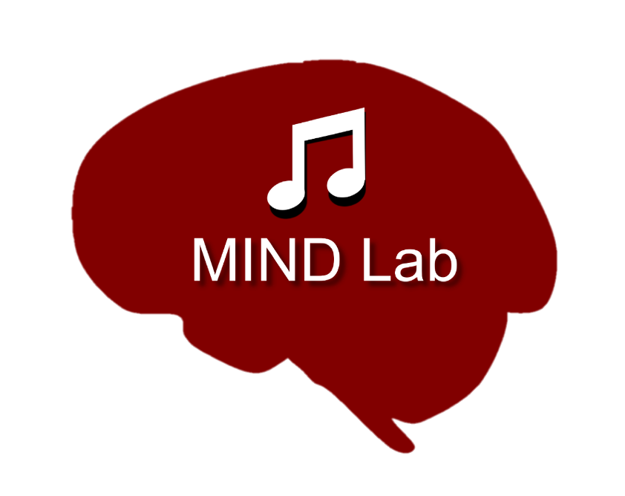

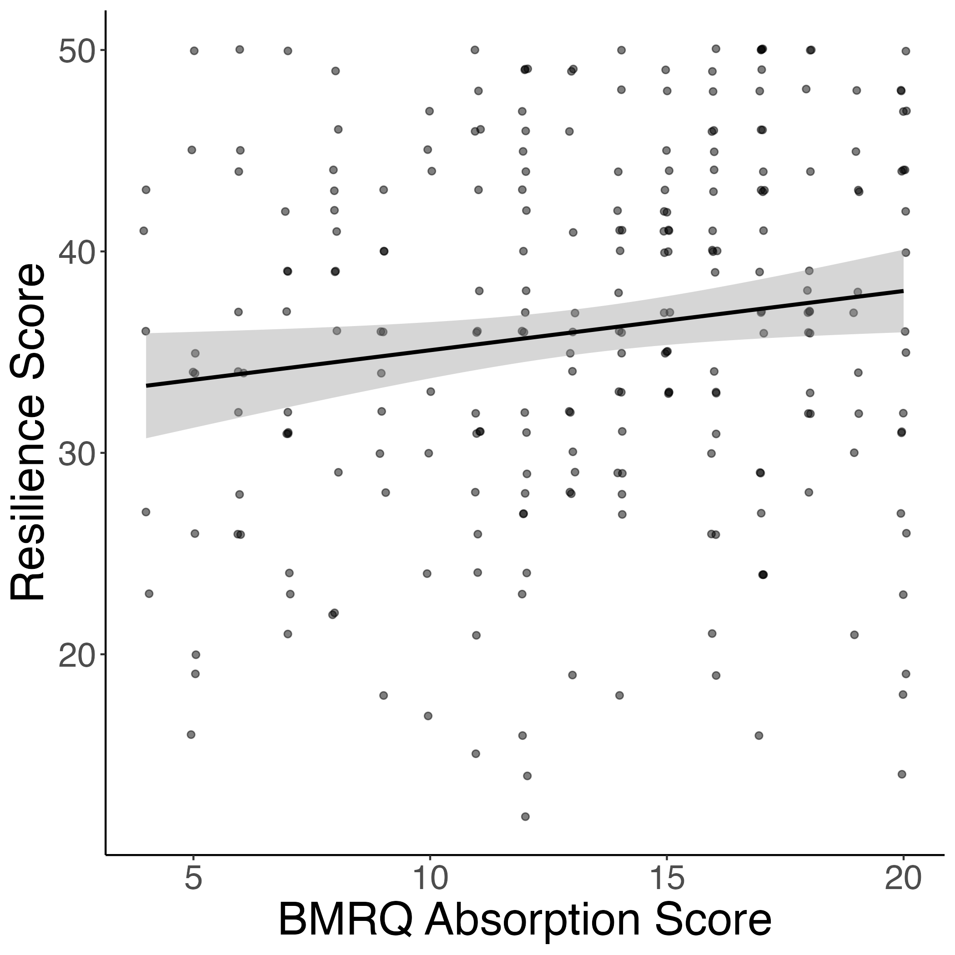
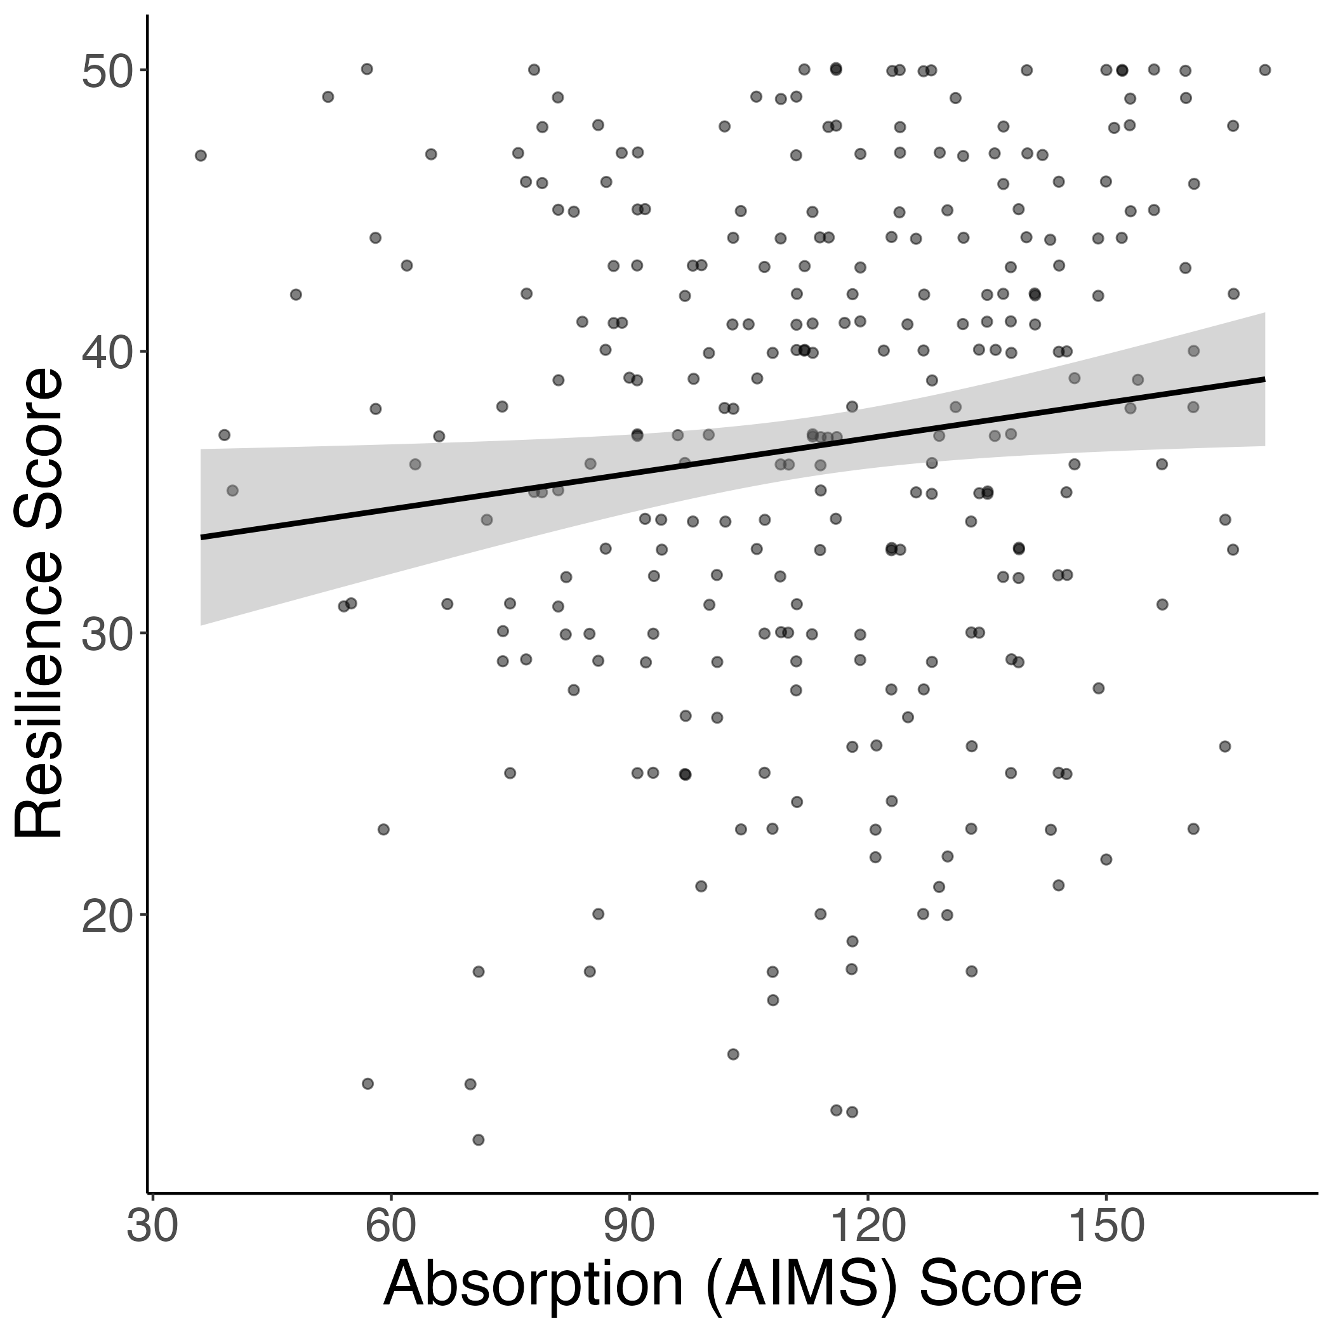
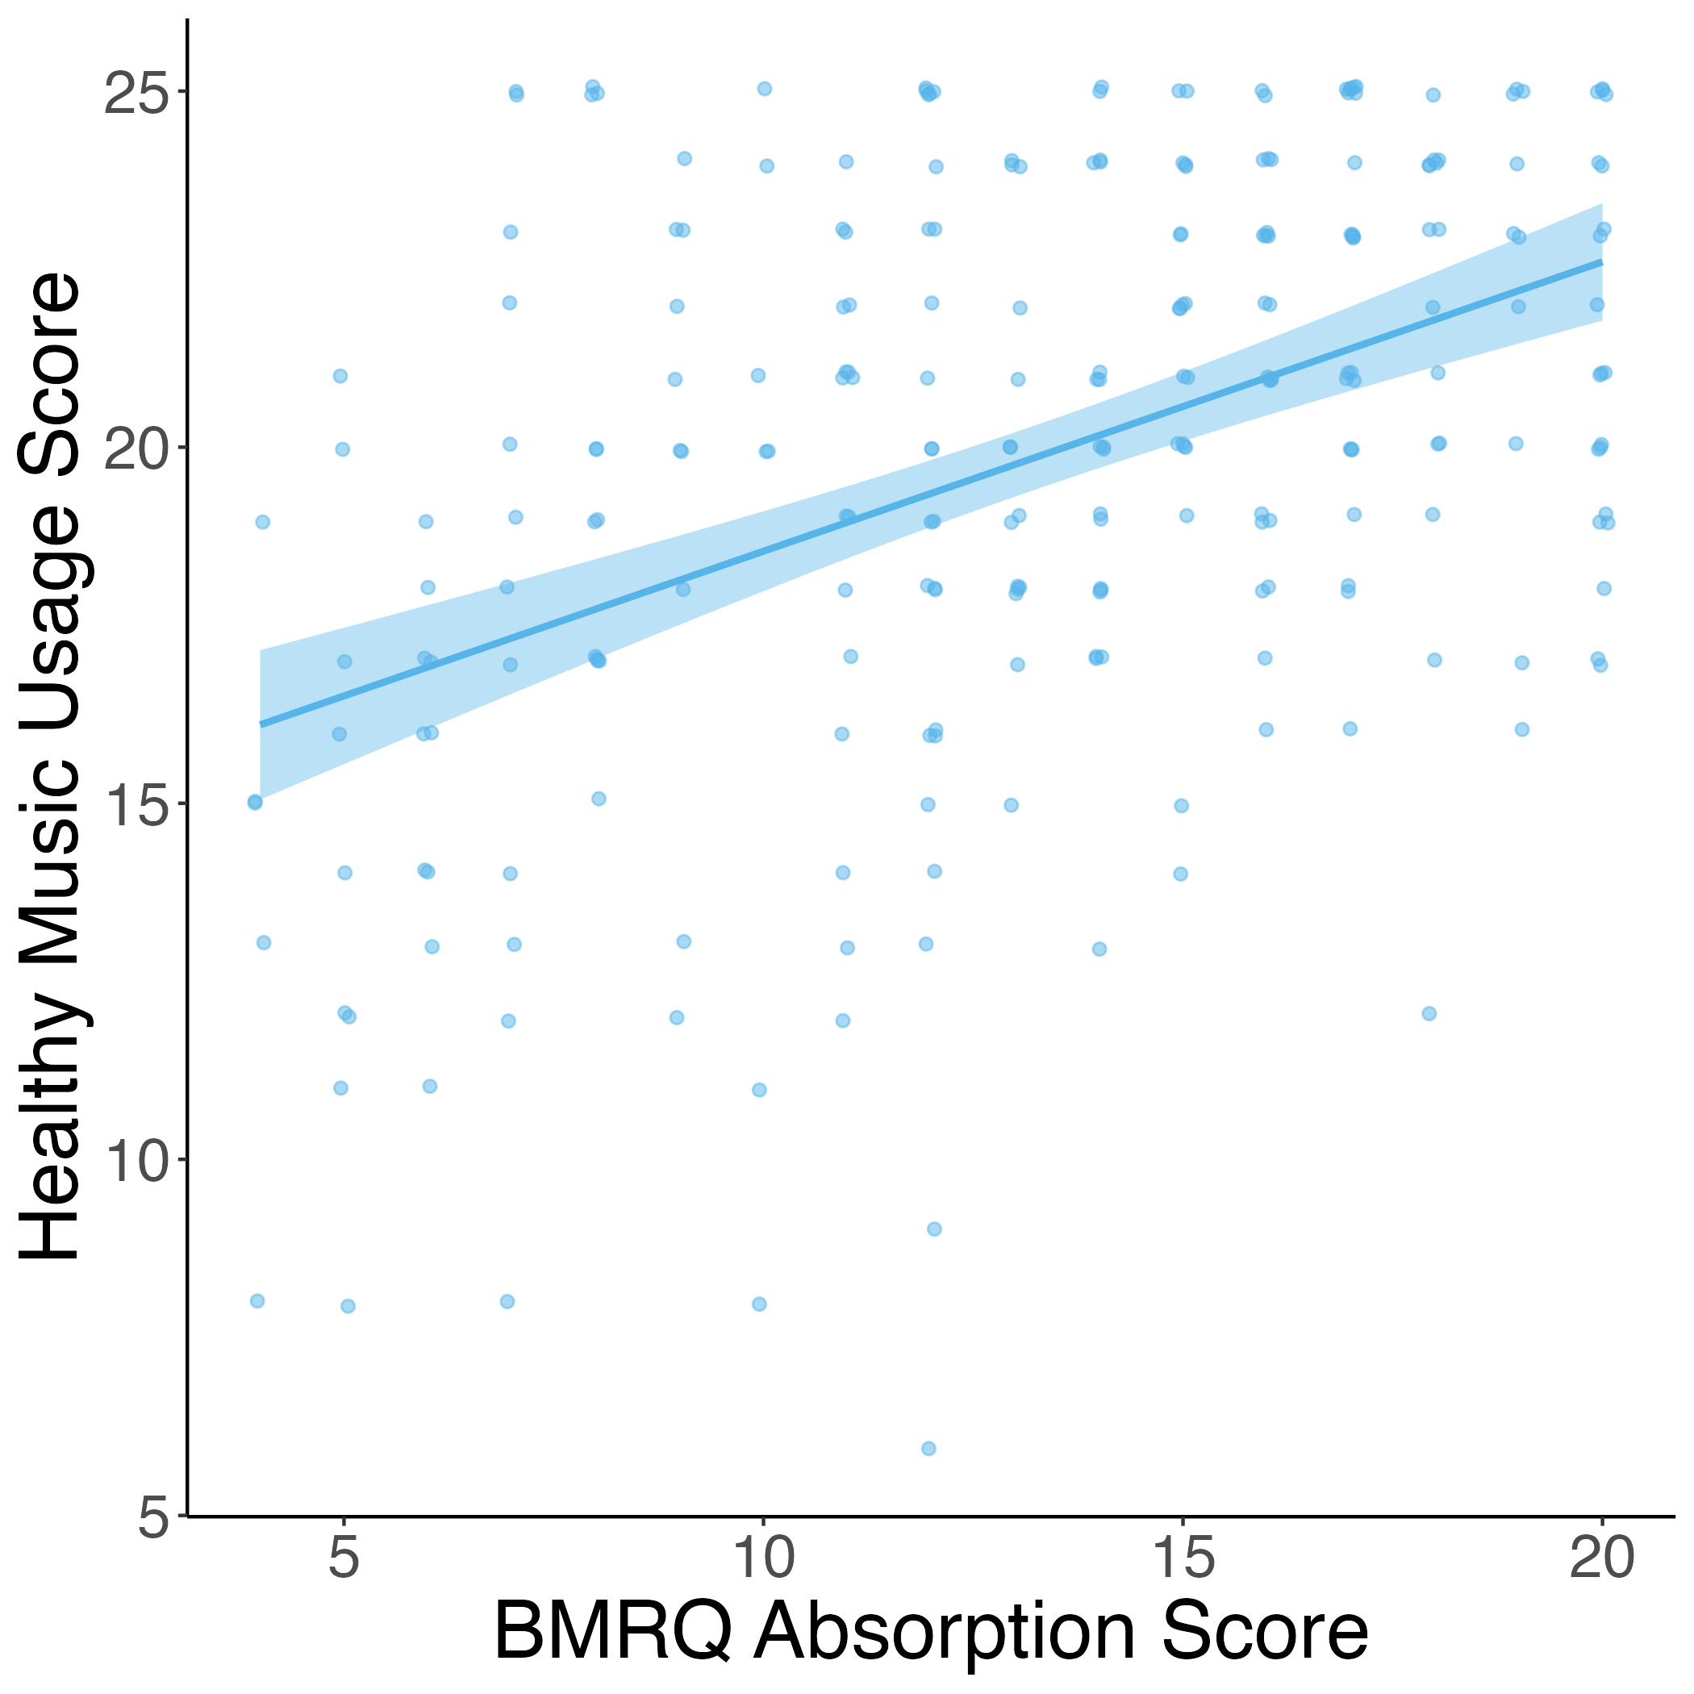
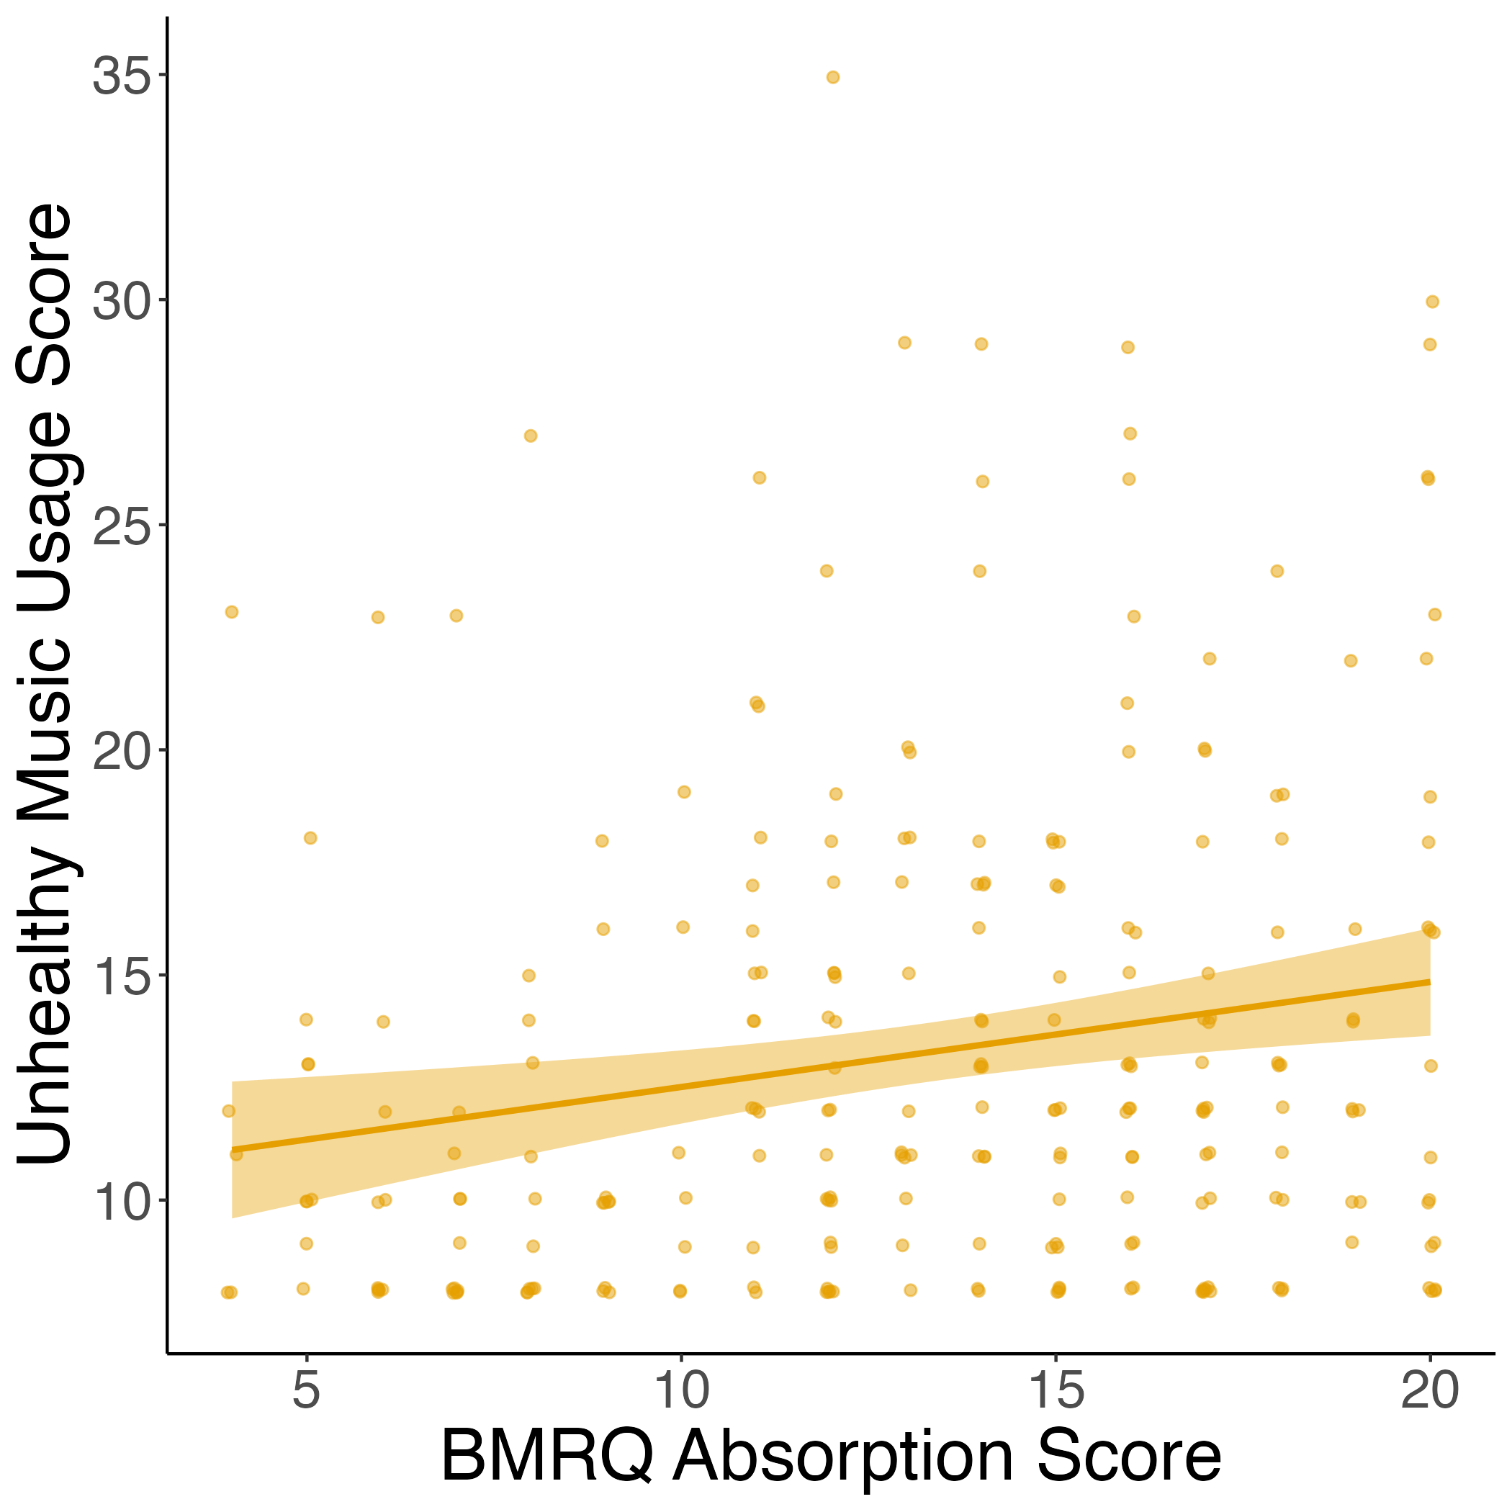
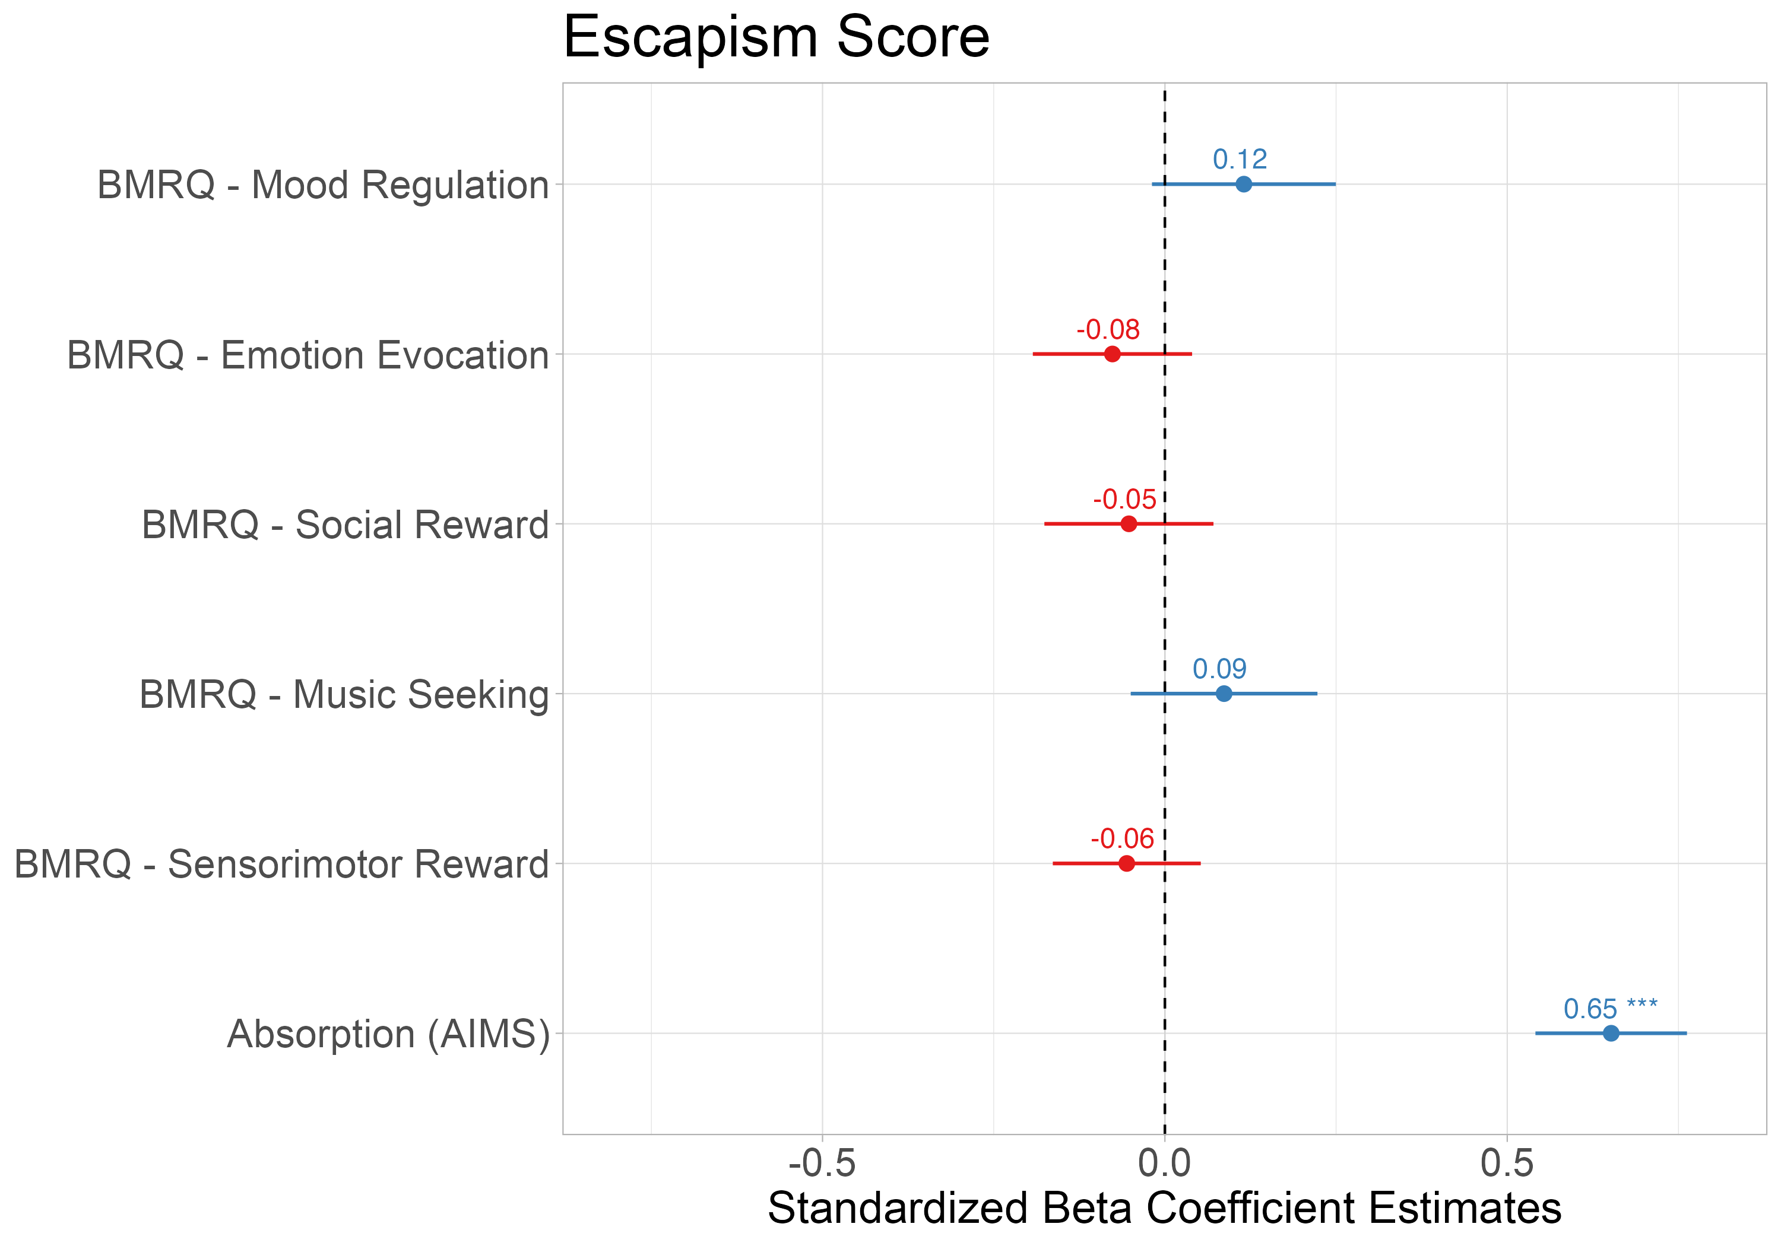


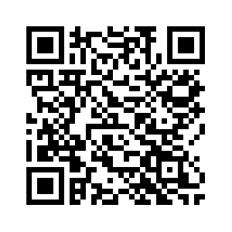
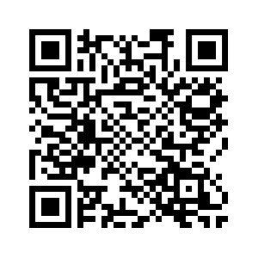
Early Life Adversity Reveals Adaptive Use of Absorption in Music
Kelsie L. Lopez*, Nicholas Kathios*, Psyche Loui, Laurel Gabard-Durnam
Northeastern University, Boston, MA
*shared first authors
Introduction
Study 2: Conceptual replication of associations for CHAOS and Threat Scores with absorption (via AIMS)
Is absorption into music adaptive?
Music listening is often identified as a pleasurable experience that individuals use to regulate emotions and behavior in every day life¹
Early life adversity (ELA) encompasses experiences across dimensions of threat, deprivation, and unpredictability and is associated with higher levels of mental health difficulties over the lifespan²
Exposure to ELA may change how adults engage with and use music to regulate themselves
STUDY 1:
254 participants (140F; mean age = 38) recruited from a previous experiment
Participants completed the Questionnaire of Unpredictability in Childhood³ (QUIC), the short-form Confusion, Hubbub, and Order Scale⁴ (CHAOS), McLaughlin Deprivation & Threat Scales⁵, Healthy-Unhealthy Music Scale⁶ (HUMS), and the Connor-Davidson Resilience Scale⁷ (CD-RISC-10)
All retrospective adversity measures were reported for both childhood (6-12 years) and adolescence (13-18 years)
Participants also completed the Extended Barcelona Music Reward Questionnaire⁸ (eBMRQ) in the previous study
STUDY 2:
288 participants (141F; mean age = 38) recruited from another previous experiment
Participants completed the QUIC, the full CHAOS, McLaughlin Deprivation & Threat Scales, the CD-RISC-10, and the Escapism Scale⁹ adapted for music
For a more sensitive measure of absorption into music, participants also completed the Absorption in Music Scale¹⁰ (AIMS)
Participants also completed the Barcelona Music Reward Questionnaire¹¹ (BMRQ) in the previous study
Absorption: “an individual’s ability and willingness to allow music to draw them into an emotional experience”¹⁰
“While listening to music, I may become so involved that I may forget
about myself and my surroundings.”
Study 1:
Study 2:
Research Questions:
A) How does early life adversity, with respect to developmental timing and dimension of adversity, impact adult music engagement?
B) How do differences in music engagement relate to mental health and resilience in adulthood?
Methods
r = 0.14, p = 0.02
r = 0.13, p = 0.03
Study 2: Absorption mediates the relationship between CHAOS & resilience
Study 1: Absorption into music relates to adult music usage
Study 1: All dimensions of ELA are positively associated with reports of absorption into music
DEVELOPMENTAL TIMING:
AIMS scores did not mediate this relationship for childhood CHAOS scores (indirect effect: B = 0.02 [-0.001, 0.05]), but it did for adolescent CHAOS scores (indirect effect: B = 0.02 [0.001, 0.05]).
Individuals who report experiencing early life adversity also report being highly absorbed by music.
This relationship is observed in retrospective reports of both childhood and adolescence experiences.
“Escaping” adverse contexts into music is one way individuals with ELA develop resilience.
AIMS did not mediate the relationship between exposure to threat and resilience because it is likely not advantageous to psychologically escape these contexts.
CHAOS – AIMS – Resilience mediation driven by adolescent CHAOS scores, likely due to increased agency in music listening during this time.¹²
Thoma, M. V., Ryf, S., Mohiyeddini, C., Ehlert, U., & Nater, U. M. (2012). Emotion regulation through listening to music in everyday situations. Cognition and Emotion, 26(3), 550–560. https://doi.org/10.1080/02699931.2011.595390
Taylor, S. E., Way, B. M., & Seeman, T. E. (2011). Early adversity and adult health outcomes. Development and Psychopathology, 23(3), 939–954. https://doi.org/10.1017/S0954579411000411
Glynn, L. M., Stern, H. S., Howland, M. A., Risbrough, V. B., Baker, D. G., Nievergelt, C. M., Baram, T. Z., & Davis, E. P. (2019). Measuring novel antecedents of mental illness: The Questionnaire of Unpredictability in Childhood. Neuropsychopharmacology, 44(5), Article 5. https://doi.org/10.1038/s41386-018-0280-9
Matheny, A. P., Wachs, T. D., Ludwig, J. L., & Phillips, K. (1995). Bringing order out of chaos: Psychometric characteristics of the confusion, hubbub, and order scale. Journal of Applied Developmental Psychology, 16(3), 429–444. https://doi.org/10.1016/0193-3973(95)90028-4
Sheridan, M. A., & McLaughlin, K. A. (2014). Dimensions of early experience and neural development: Deprivation and threat. Trends in Cognitive Sciences, 18(11), 580–585. https://doi.org/10.1016/j.tics.2014.09.001
Saarikallio, S., Gold, C., & McFerran, K. (2015). Development and validation of the Healthy-Unhealthy Music Scale. Child and Adolescent Mental Health, 20(4), 210–217. https://doi.org/10.1111/camh.12109
Connor, K. M., & Davidson, J. R. T. (2003). Development of a new resilience scale: The Connor-Davidson Resilience Scale (CD-RISC). Depression and Anxiety, 18(2), 76–82. https://doi.org/10.1002/da.10113
Cardona, G., Ferreri, L., Lorenzo-Seva, U., Russo, F. A., & Rodriguez-Fornells, A. (2022). The forgotten role of absorption in music reward. Annals of the New York Academy of Sciences, 1514(1), 142–154. https://doi.org/10.1111/nyas.14790
Stenseng, F., Rise, J., & Kraft, P. (2012). Activity Engagement as Escape from Self: The Role of Self-Suppression and Self-Expansion. Leisure Sciences, 34(1), 19–38. https://doi.org/10.1080/01490400.2012.633849
Sandstrom, G. M., & Russo, F. A. (2013). Absorption in music: Development of a scale to identify individuals with strong emotional responses to music. Psychology of Music, 41(2), 216–228. https://doi.org/10.1177/0305735611422508
Mas-Herrero, E., Marco-Pallares, J., Lorenzo-Seva, U., Zatorre, R. J., & Rodriguez-Fornells, A. (2013). Individual Differences in Music Reward Experiences. Music Perception: An Interdisciplinary Journal, 31(2), 118–138. https://doi.org/10.1525/mp.2013.31.2.118
12. Saarikallio, S. H., Randall, W. M., & Baltazar, M. (2020). Music Listening for Supporting Adolescents’ Sense of Agency in Daily Life. Frontiers in Psychology, 10. https://www.frontiersin.org/articles/10.3389/fpsyg.2019.02911
We acknowledge support from NSF-CAREER 1945436 to PL.
r = 0.44, p < 0.001
r = 0.19, p = 0.002
Items on the HUMS scale indicate music listening as a form of escapism: “I hide in my music because nobody understands me, and it blocks people out”
Discussion
Study 2: Absorption into music associated with using music for escapism
References
Colors indicate r value; asterisks denote significance level p < .05, ** p <.01, *** p <.001
Model: Escapism ~ Mood Regulation + Emotion Evocation + Social Reward + Music Seeking + Sensorimotor Reward + Absorption
kathios.n@northeastern.edu
lopez.ke@northeastern.edu
Study 1
Study 2

