Slide 1
AIMS Paper Figures

Slide 2
Study 1

Slide 3
All dimensions of ELA are positively associated with reports of absorption into music

Slide 4
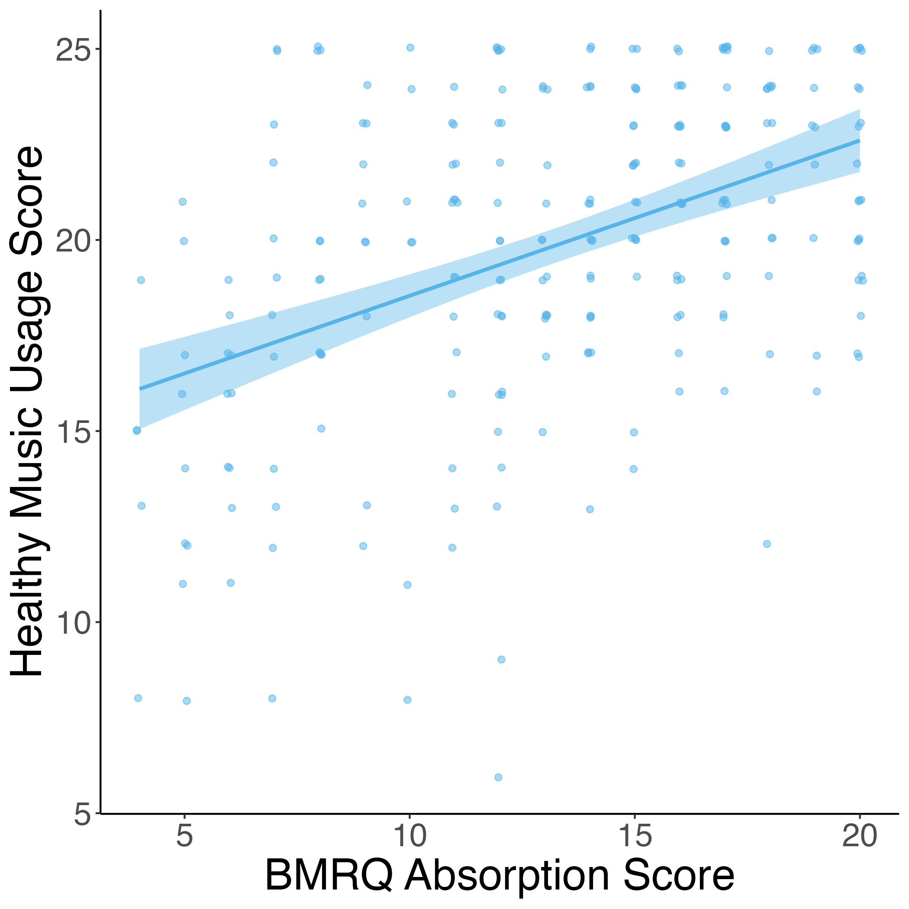
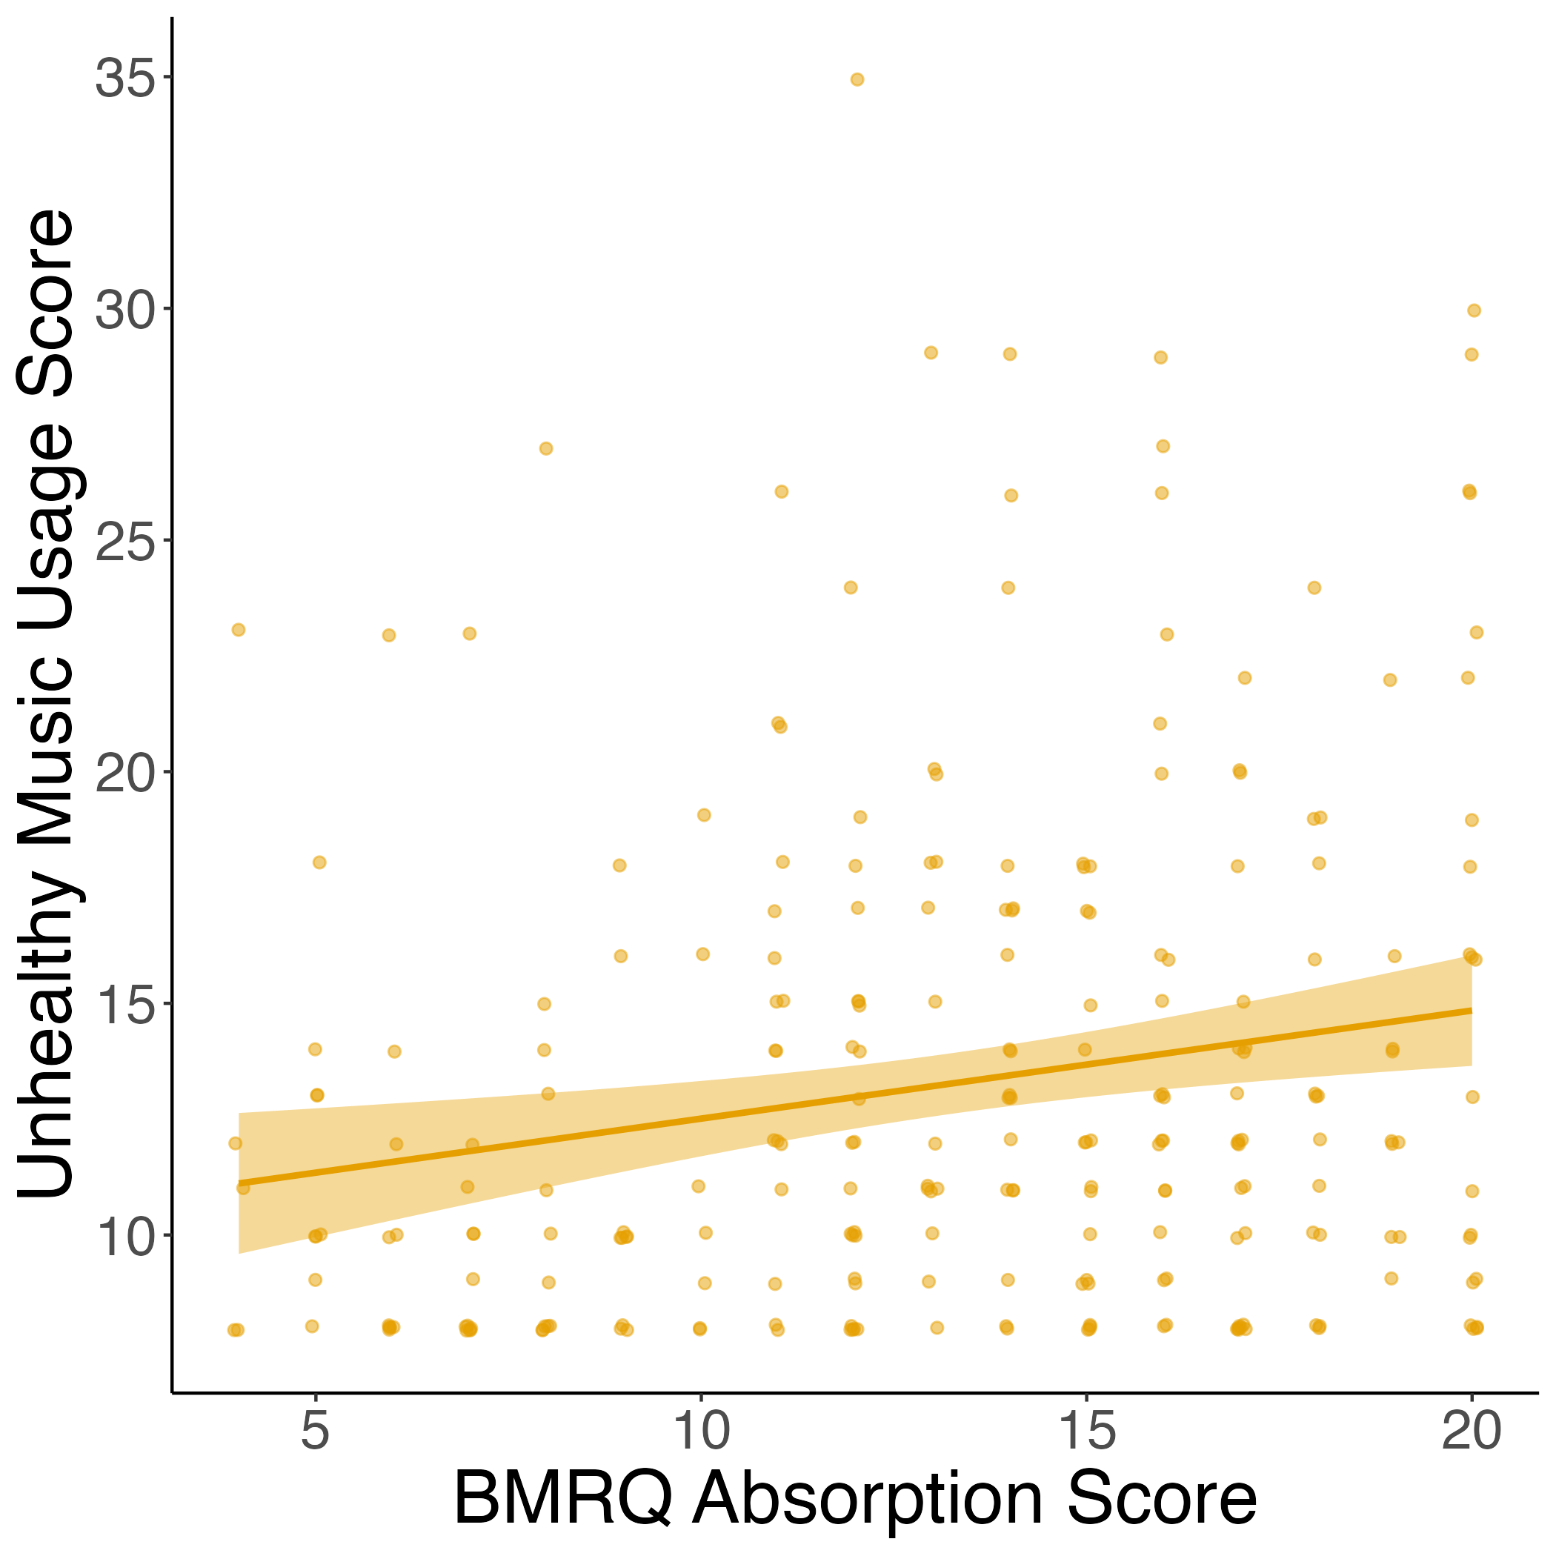
Absorption into music positively related to both healthy & unhealthy music usage

Slide 5
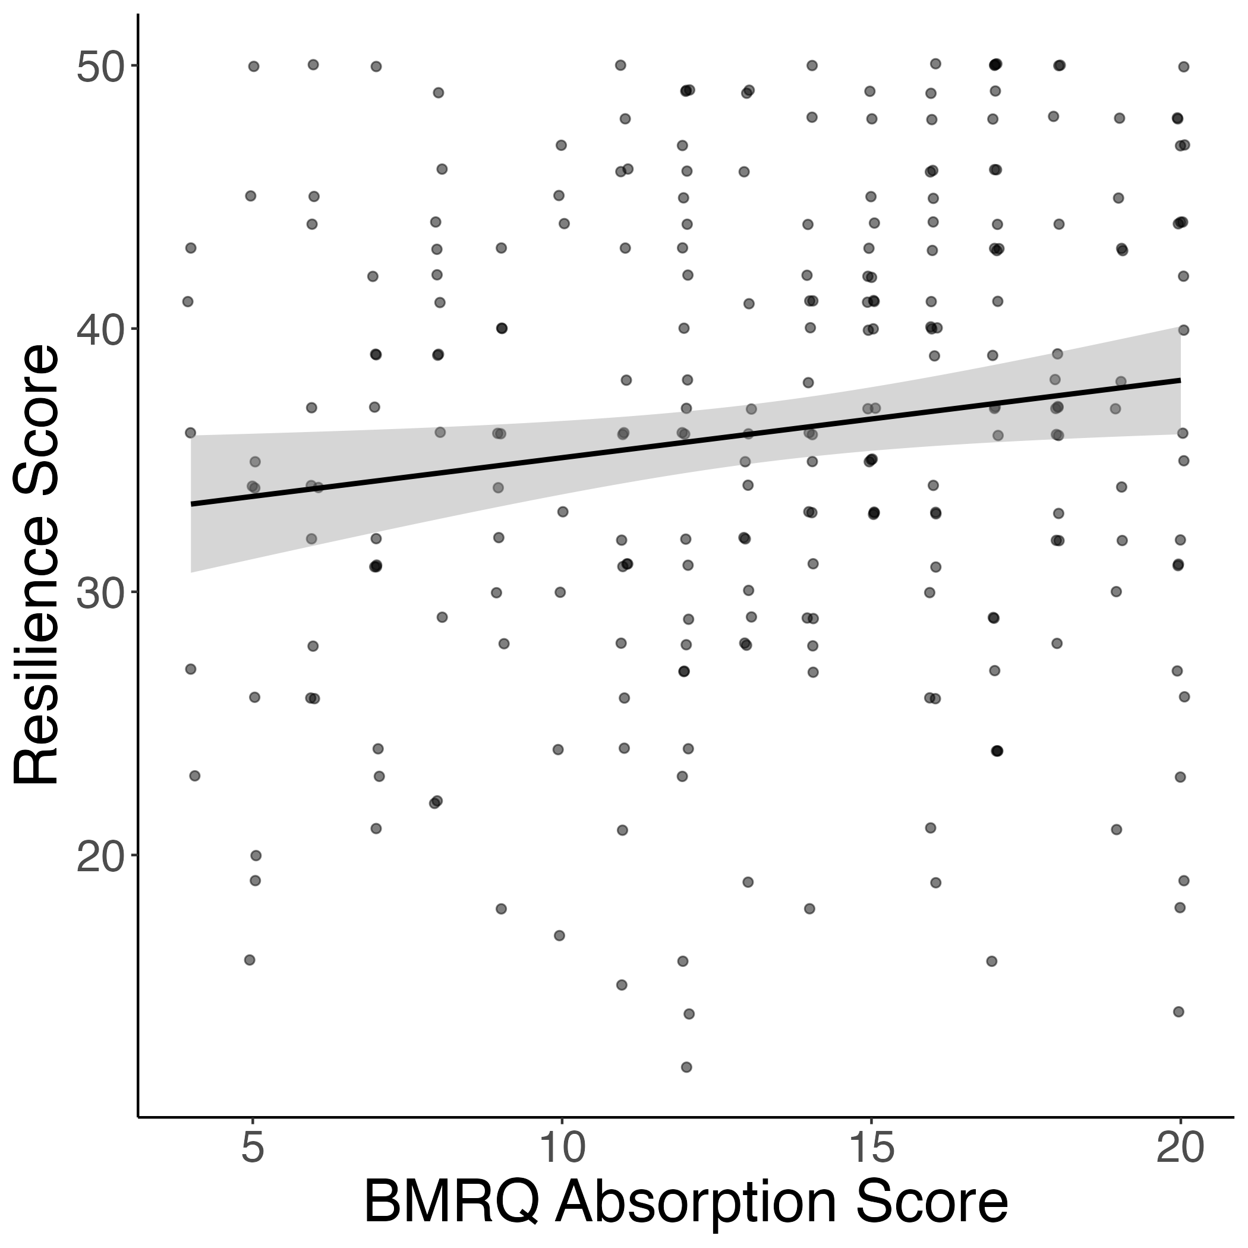
Absorption also positively related to resilience

Slide 6
Study 2

Slide 7
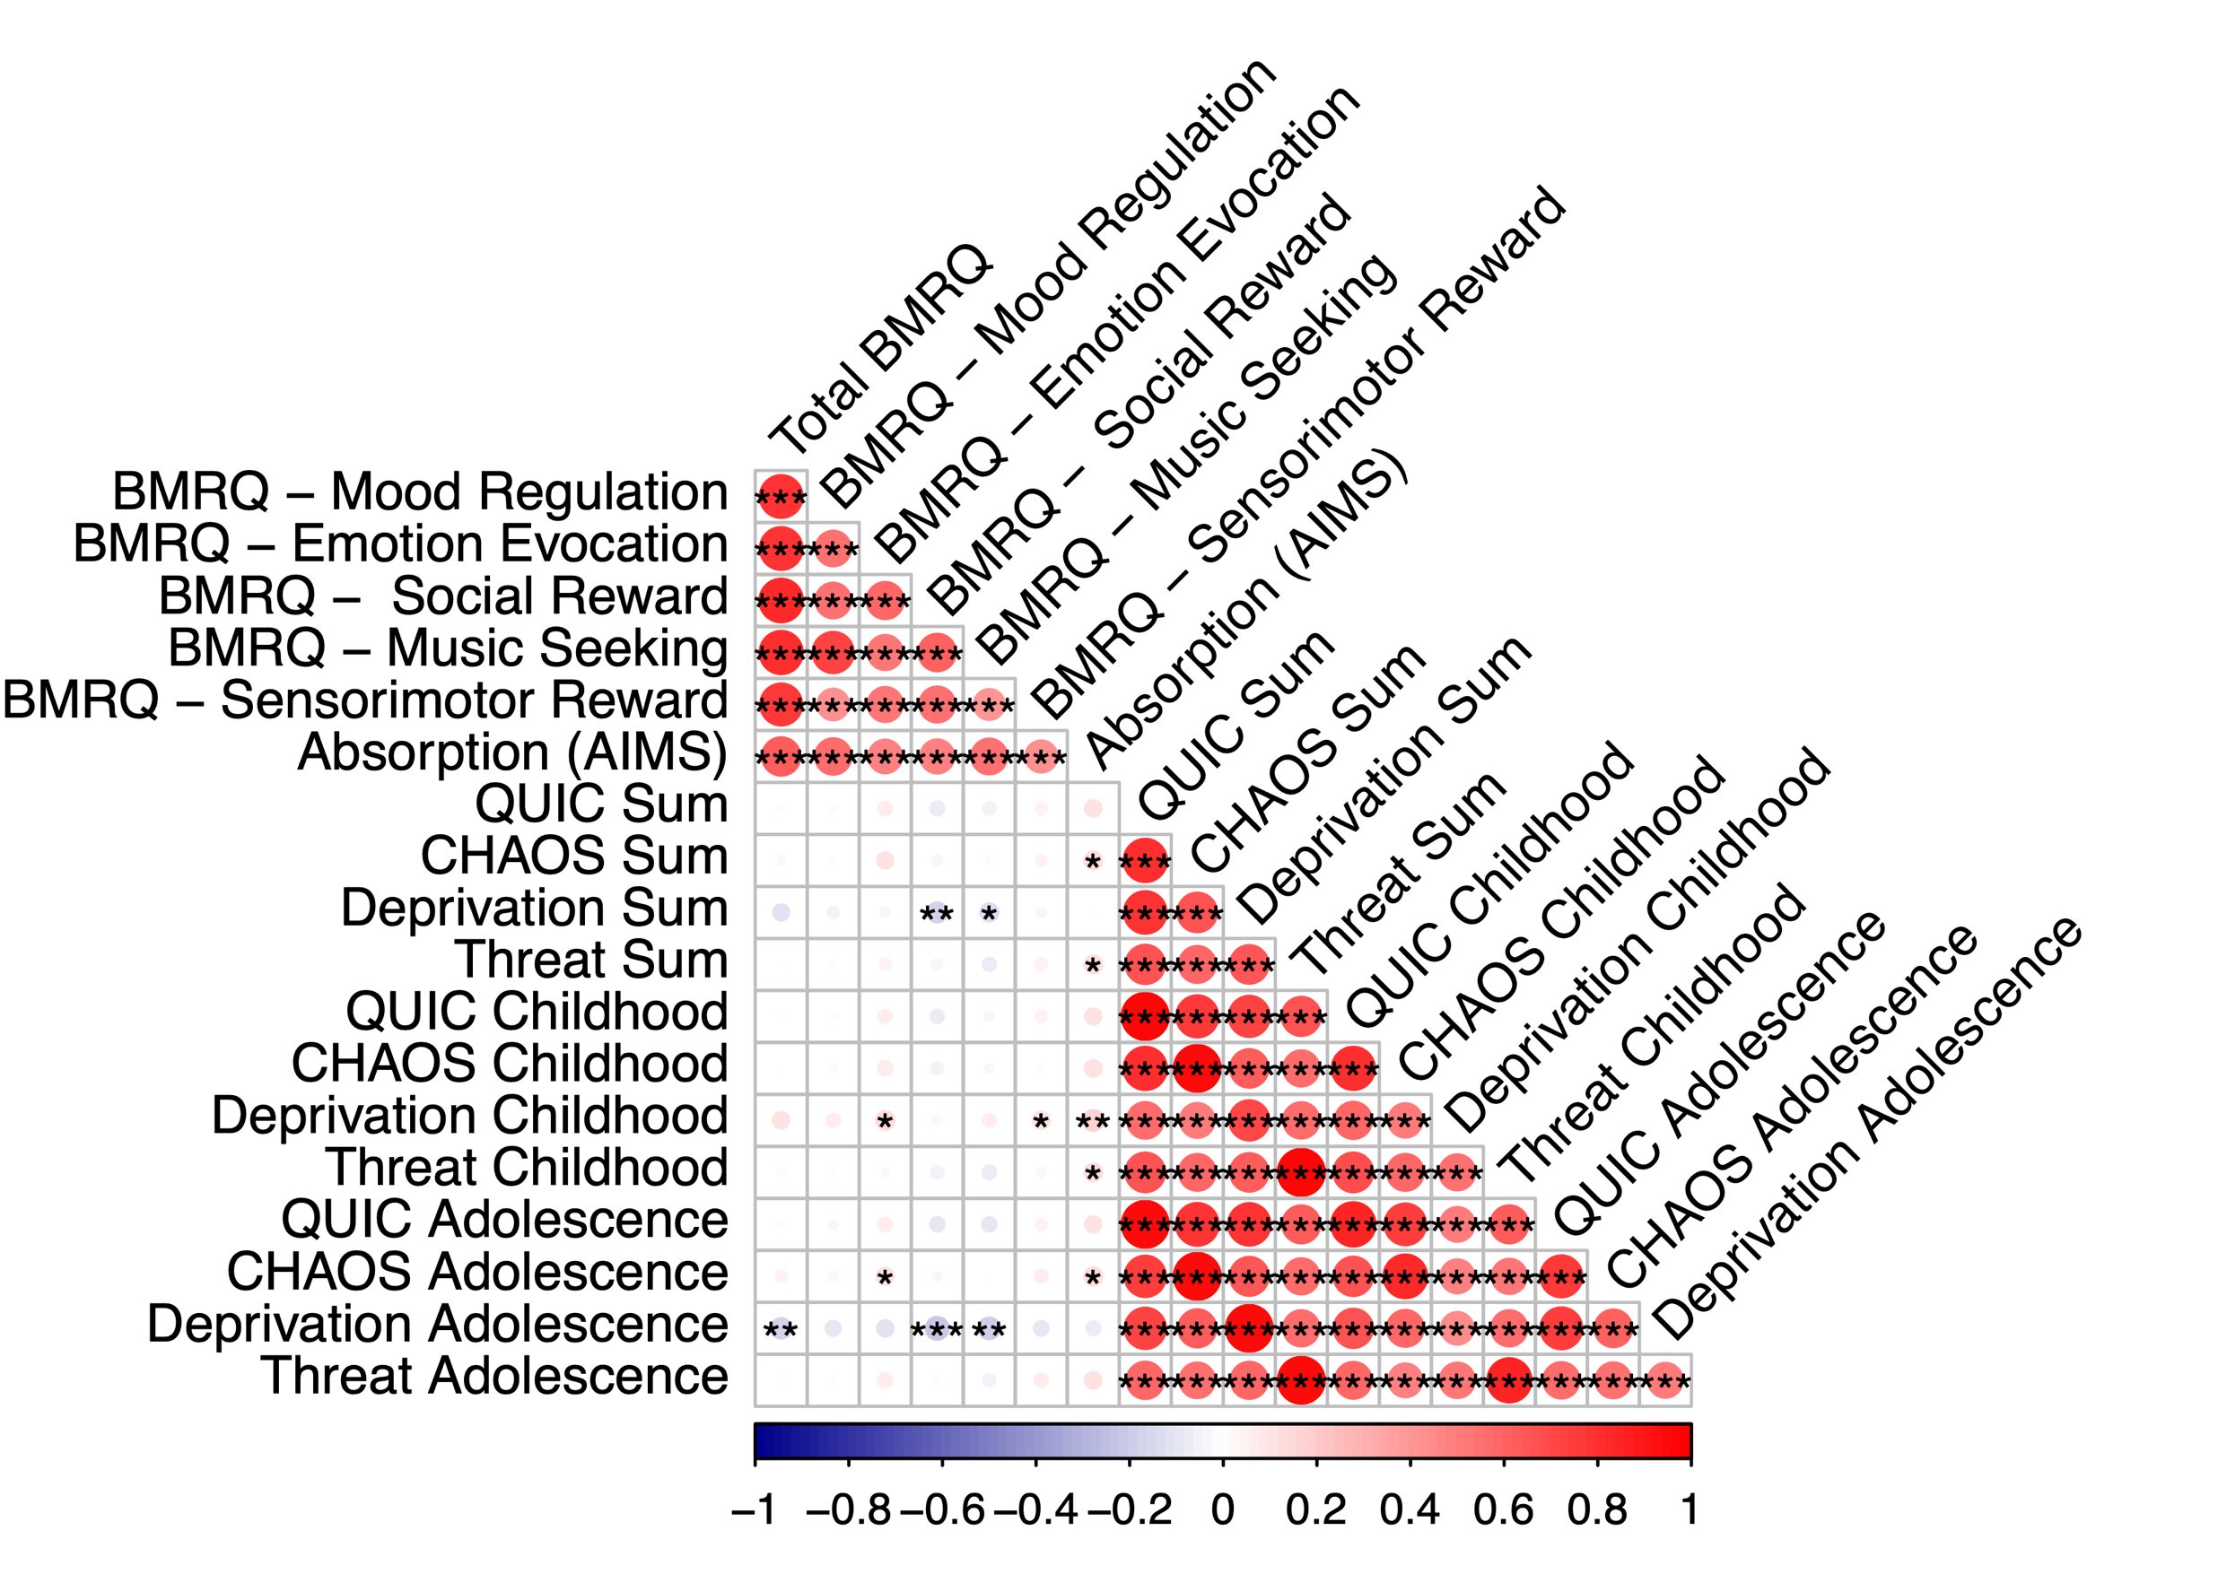
Conceptual replication of CHAOS & threat associations with absorption (via AIMS)

Slide 8
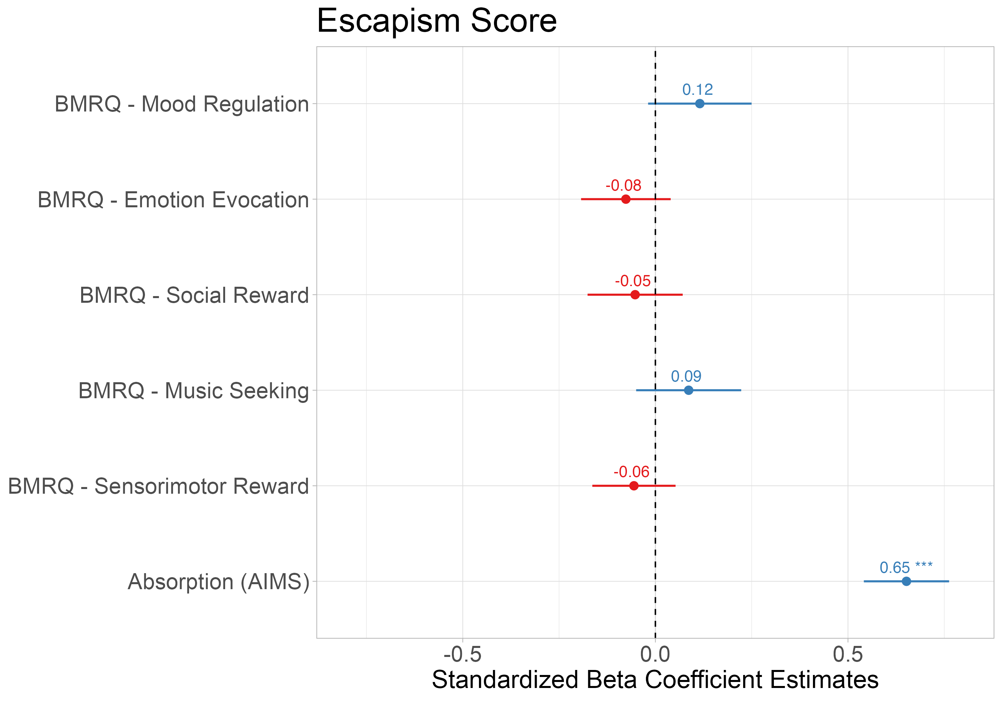
Absorption into music associated with using music for escapism

Slide 9
Absorption mediates the relationship between CHAOS and resilience

