Slide 1

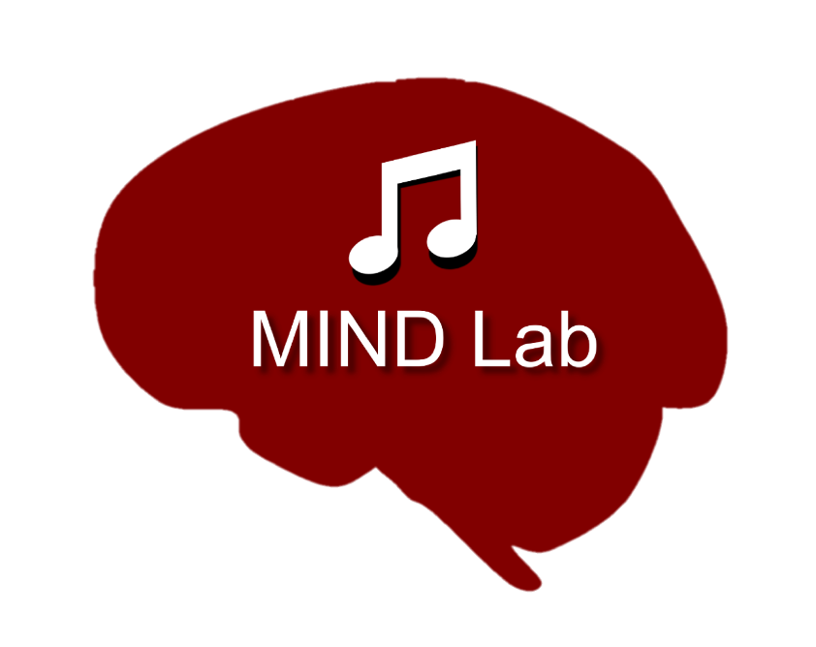




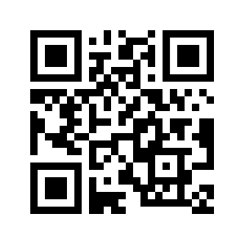
Early Life Adversity Reveals Adaptive Use of Absorption in Music
Nicholas Kathios, Kelsie L. Lopez, Psyche Loui, Laurel Gabard-Durnam
Northeastern University, Boston, MA
Background
Study 1 Results
ROI-ROI Connectivity
Right NAcc Activation Time Series
Study 1 Methods
NAcc Seed-Based Connectivity
Study 1 Results
Discussion
References
kathios.n@northeastern.edu
@nickkathios

