Slide 1
AIMS Paper Figures

Slide 2
Results Outline
More ELA → lower resilience + higher trait anxiety
eBMRQ + ELA: four block figure (AIMS + threat/CHAOS for both studies)
HUMS ~ absorption [both studies; AIMS more related to positive music usage] (what is AIMS? This and next result)
Escapism ~ BMRQ + AIMS subscales (only sig. ‘Predictor’ is AIMS; use full score.
interaction with pos+neg but with just AIMS
Secondary analyses of using subscales of escapism [pos & neg]
Absorption → resilience [both studies]
Mediation model (CHAOS - AIMS - resilience) / (check STAI)
N.s. for just childhood
Significant for adolescence
CHAOS mediation remained sig w/ age as a covariate (cite music reward decreasing of age/retrospective reporting could be confound)
- could weave in temporally specific measures
-consider goldMSI measures for specificity of AIMS effects (correlations w/ AIMS – explore w/ ELA/STAI/resilience)
-was age related to any outcomes of interest outside of mediation model? (correlations w/ AIMS, eBMRQ[abs], STAI, resilience, escapism, HUMS)

Slide 3
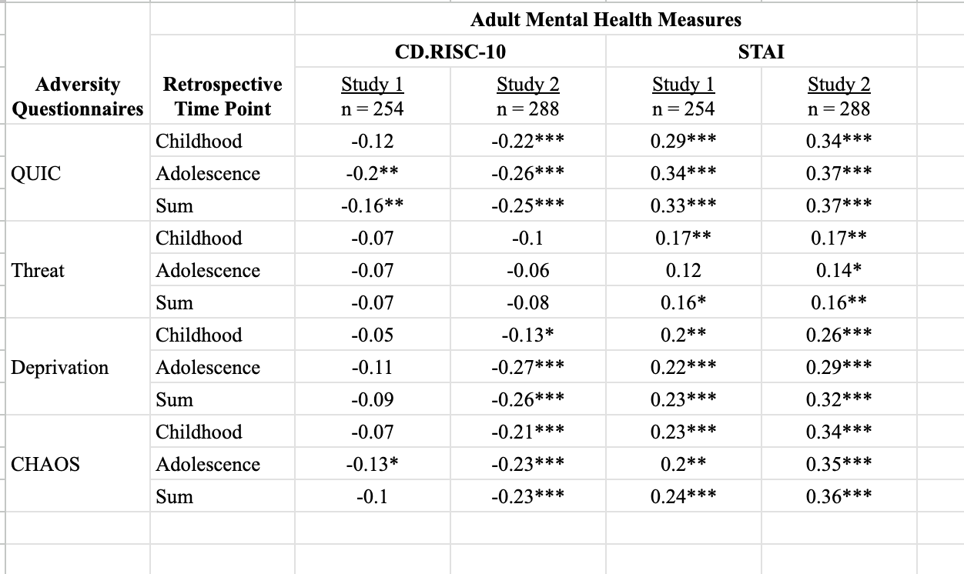
ELA & Mental Health Outcomes Table

Slide 4
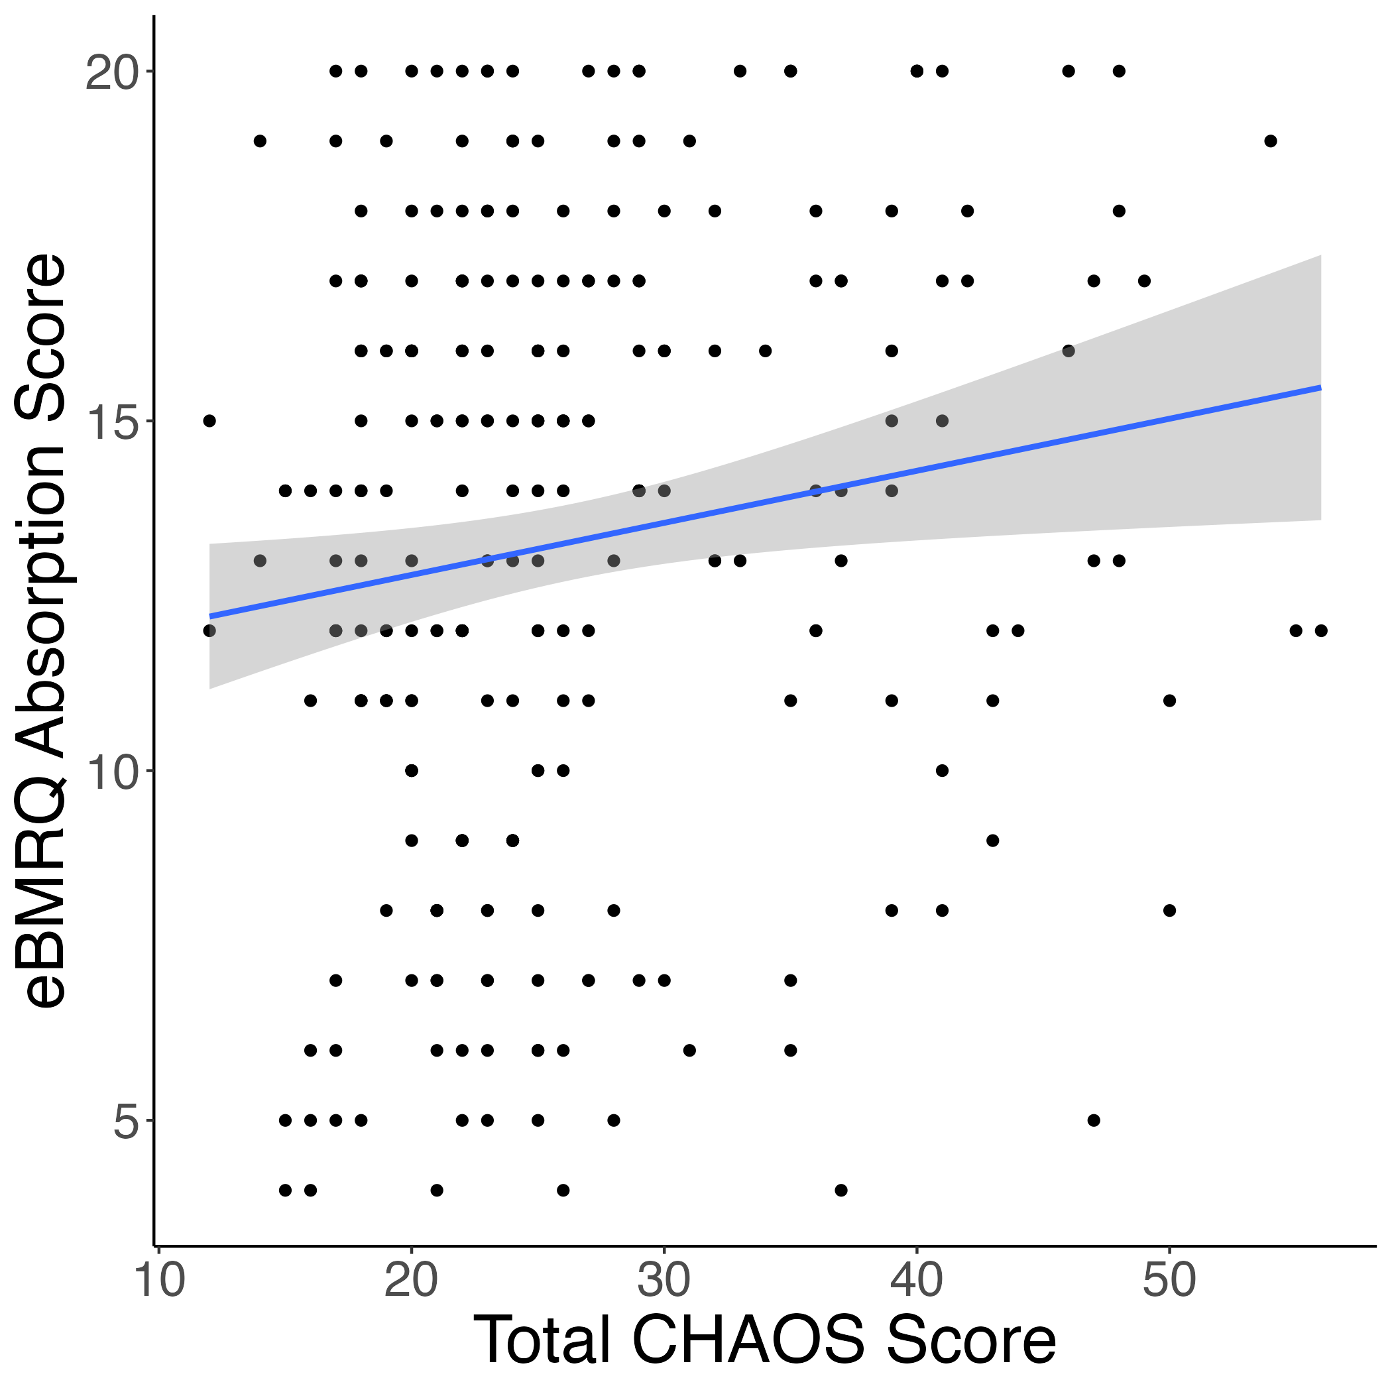
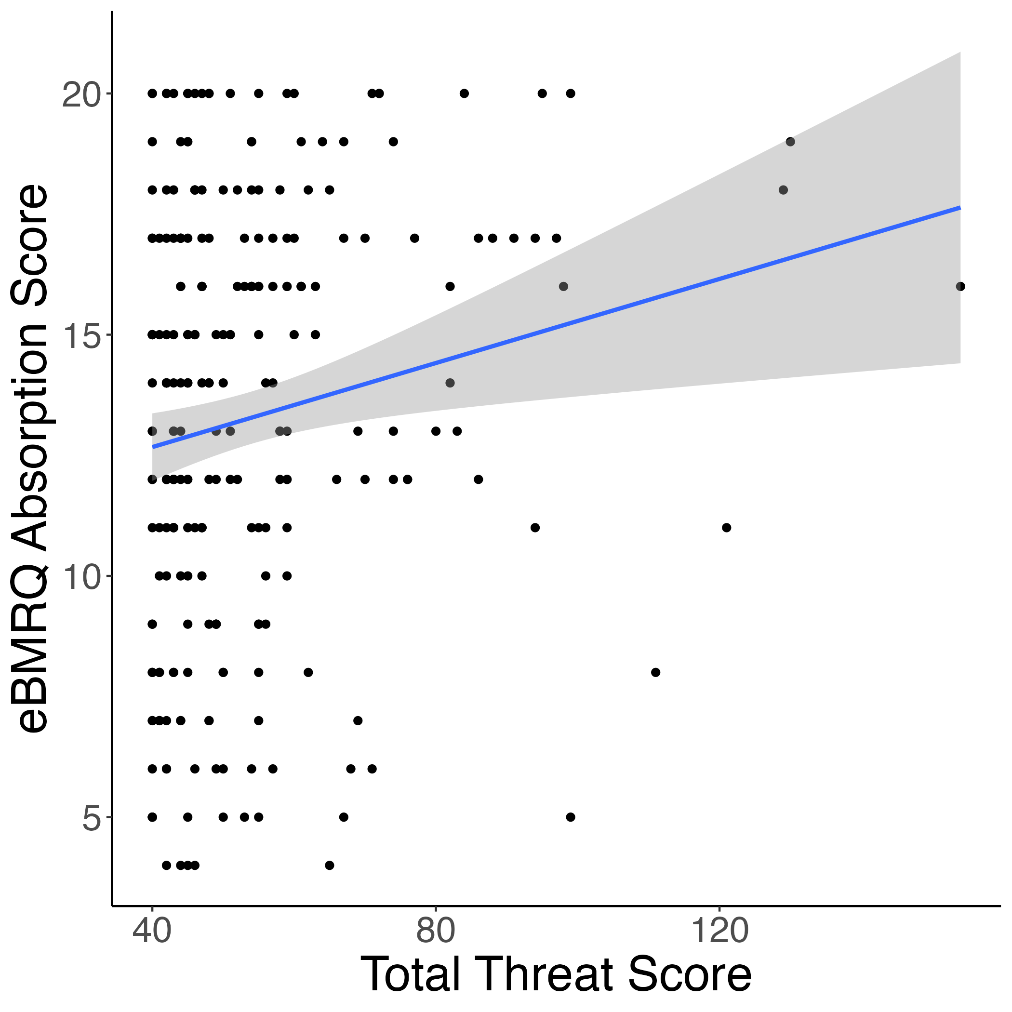
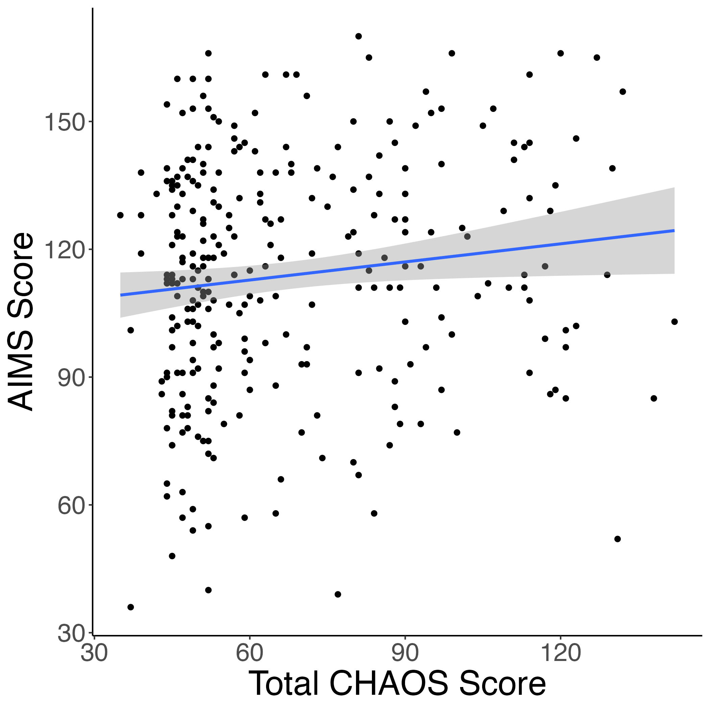
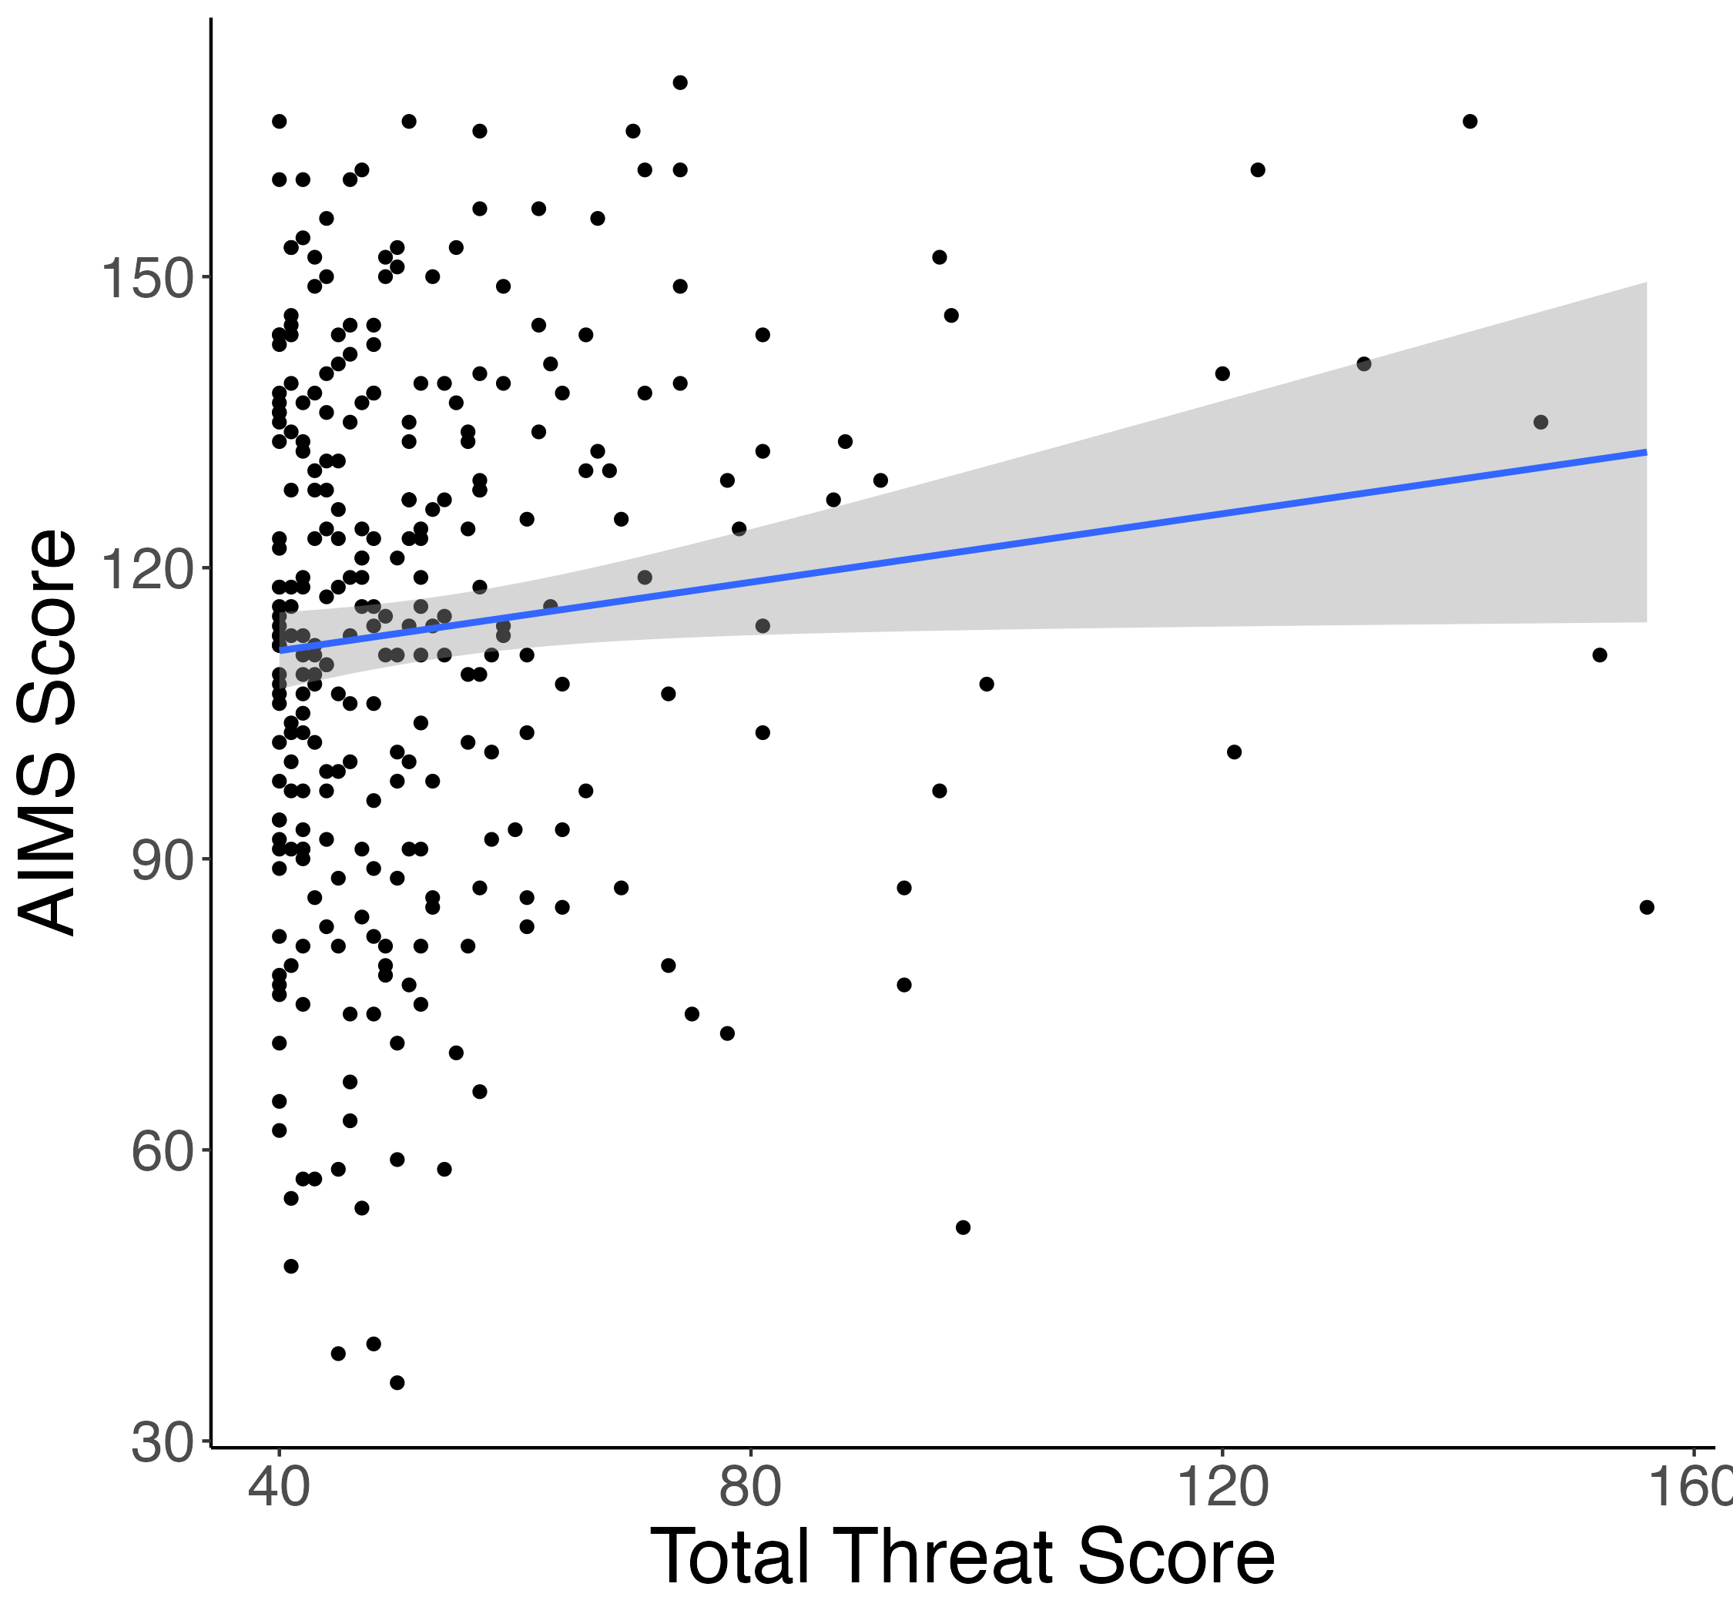
ELA & Absorption Correlations
Study 1
r = 0.15*
r = 0.17**
Study 2
r = 0.13*
r = 0.12*

Slide 5
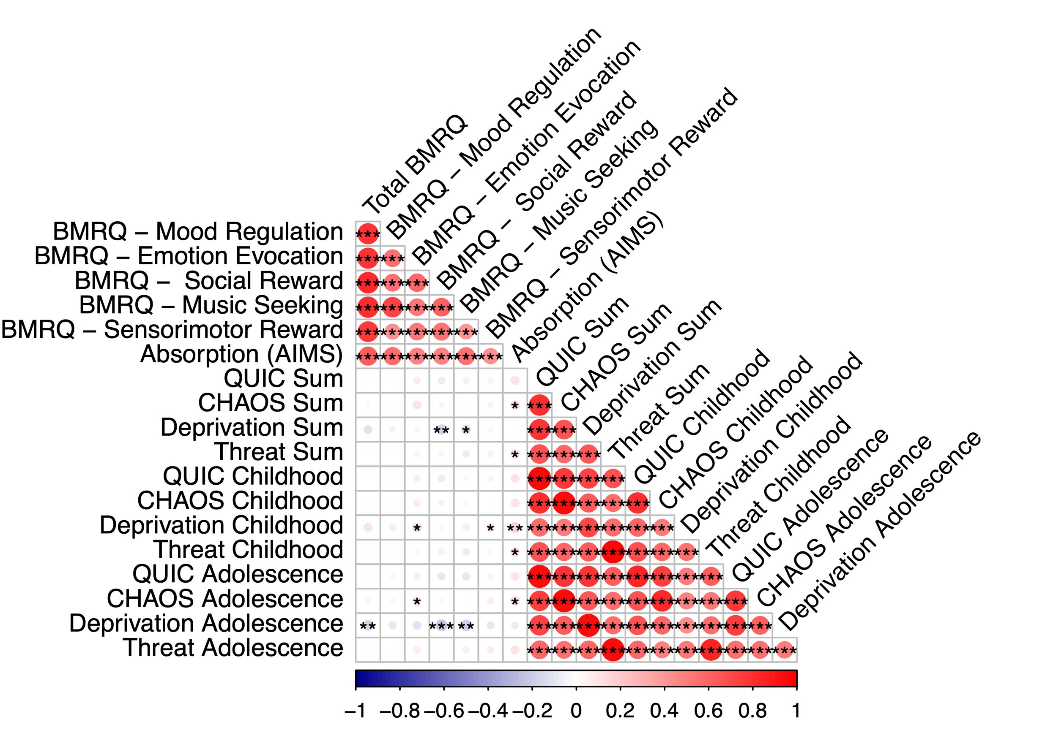
Correlation matrices for ELA + music measures
Study 1
Study 2

Slide 6
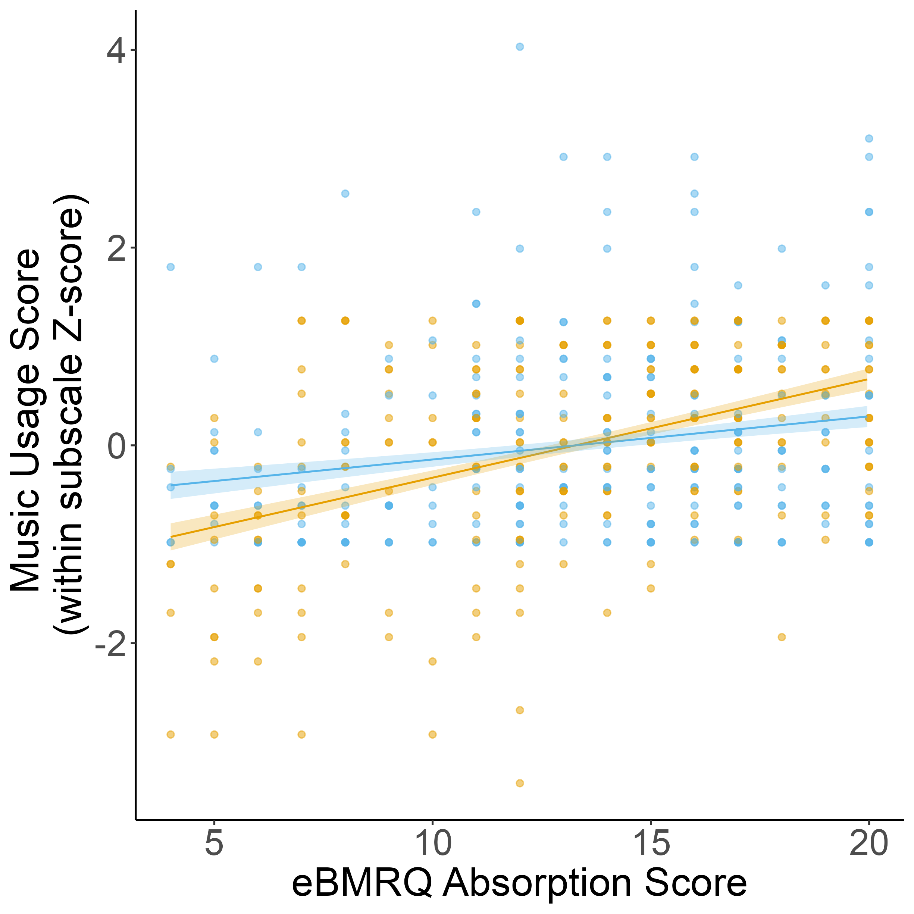
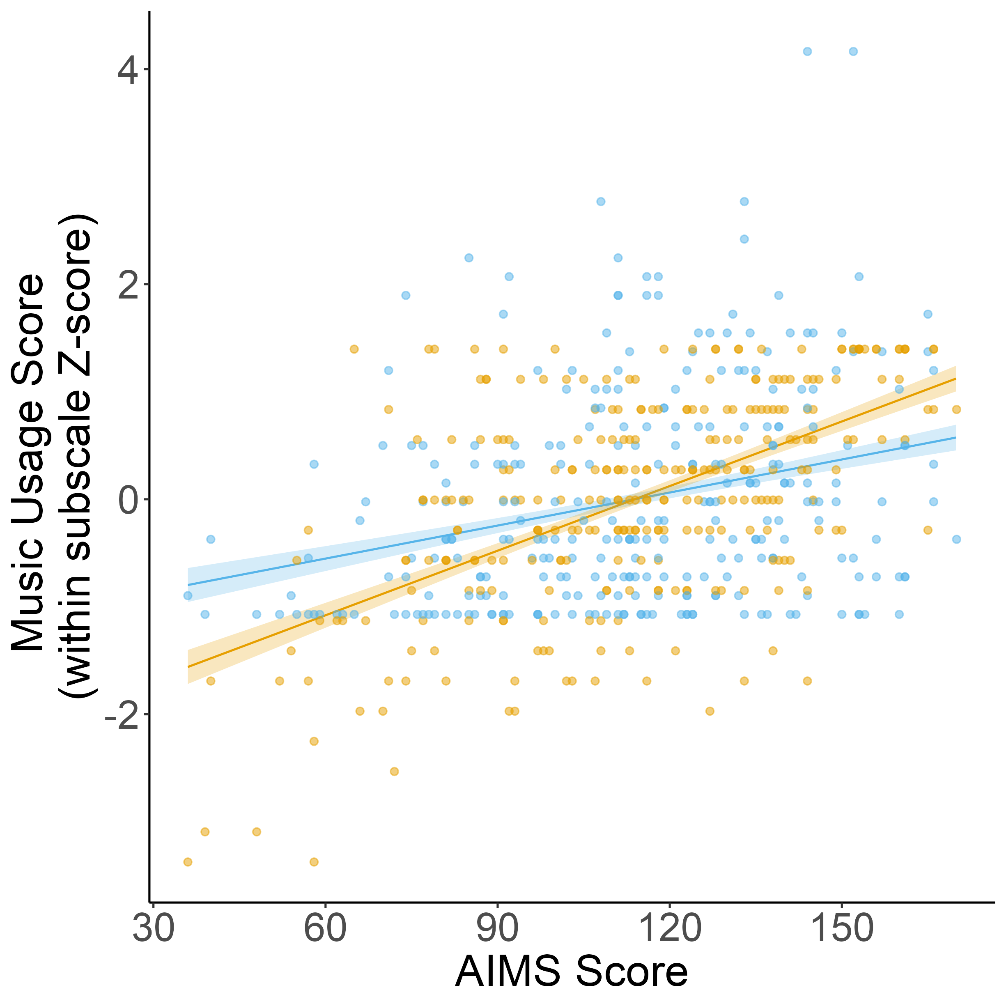
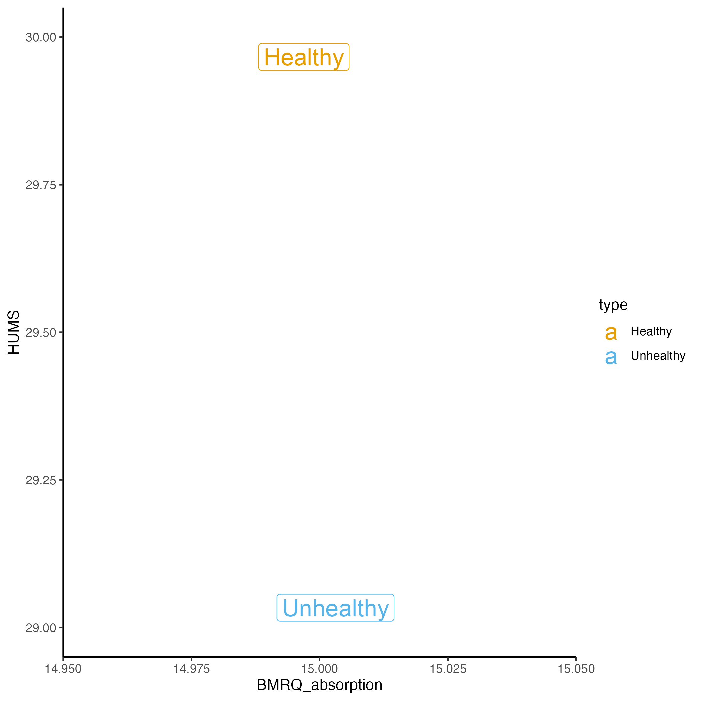
Absorption related to both healthy + unhealthy music usage, but more strongly associated with healthy music usage across both studies
Study 1
Study 2
Notes:
How do we account for the fact that there are more questions on Unhealthy compared to Healthy?

Slide 7
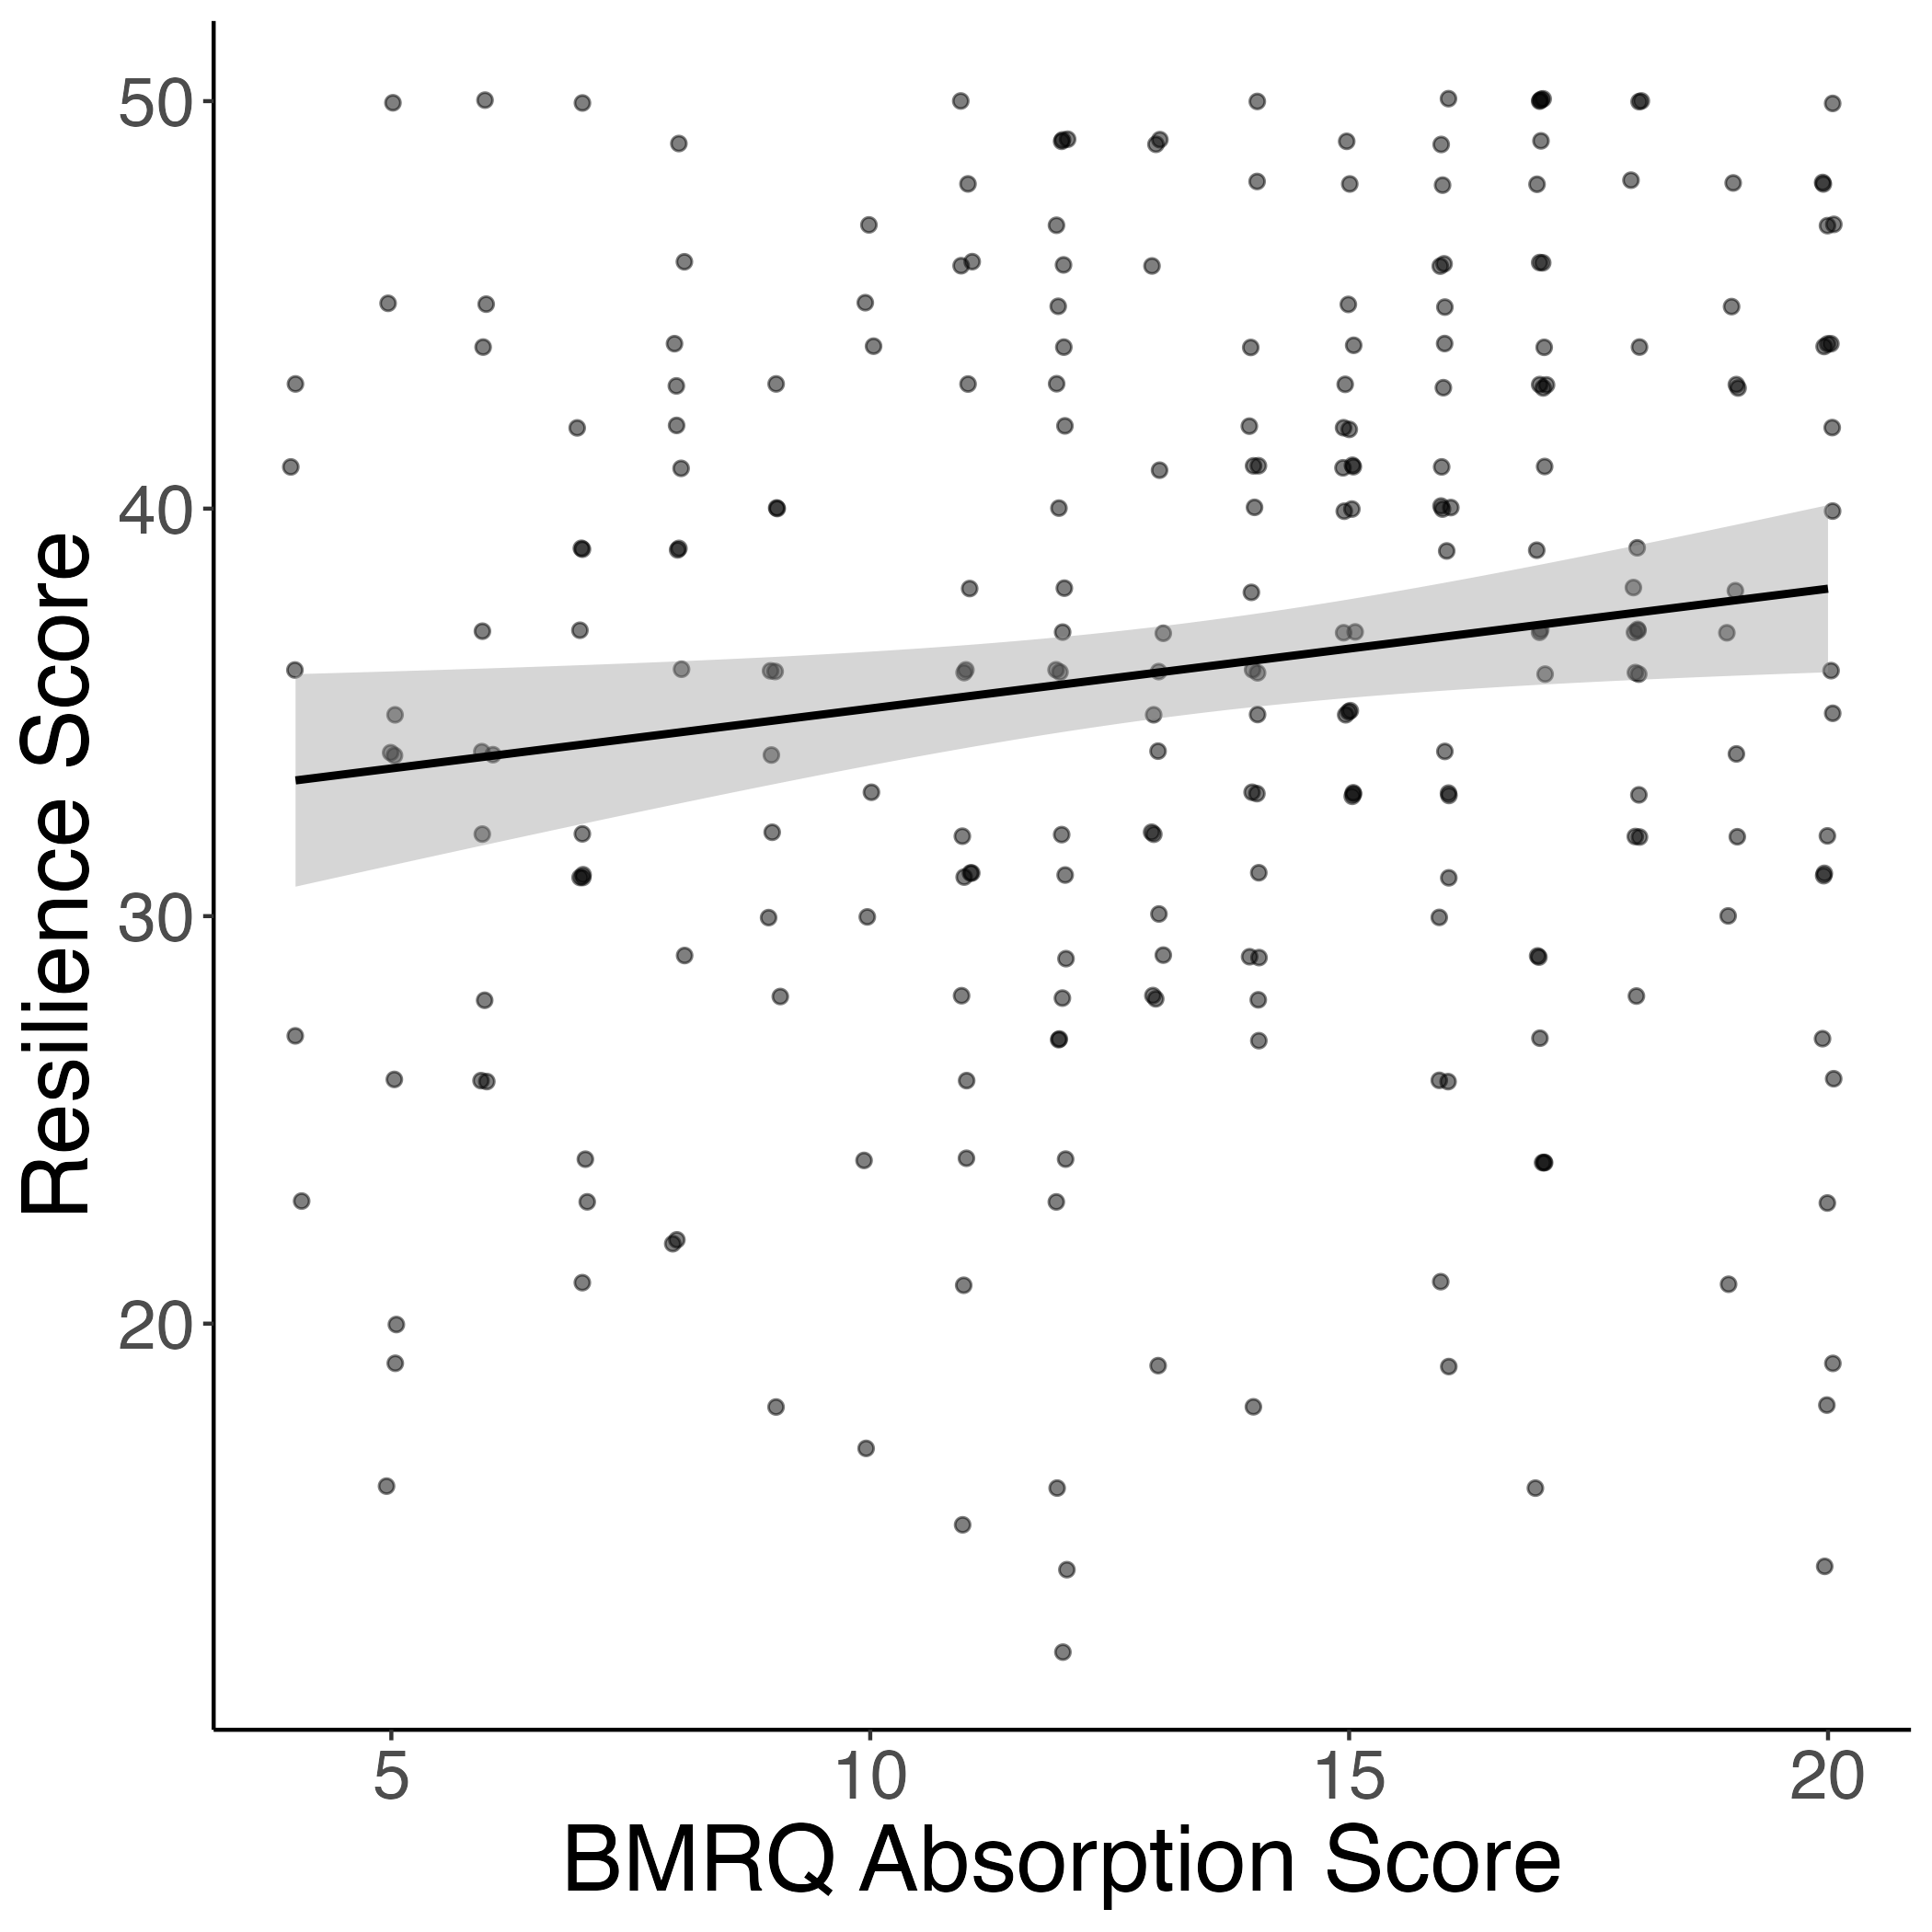
Absorption also positively related to resilience
Study 1

Slide 8
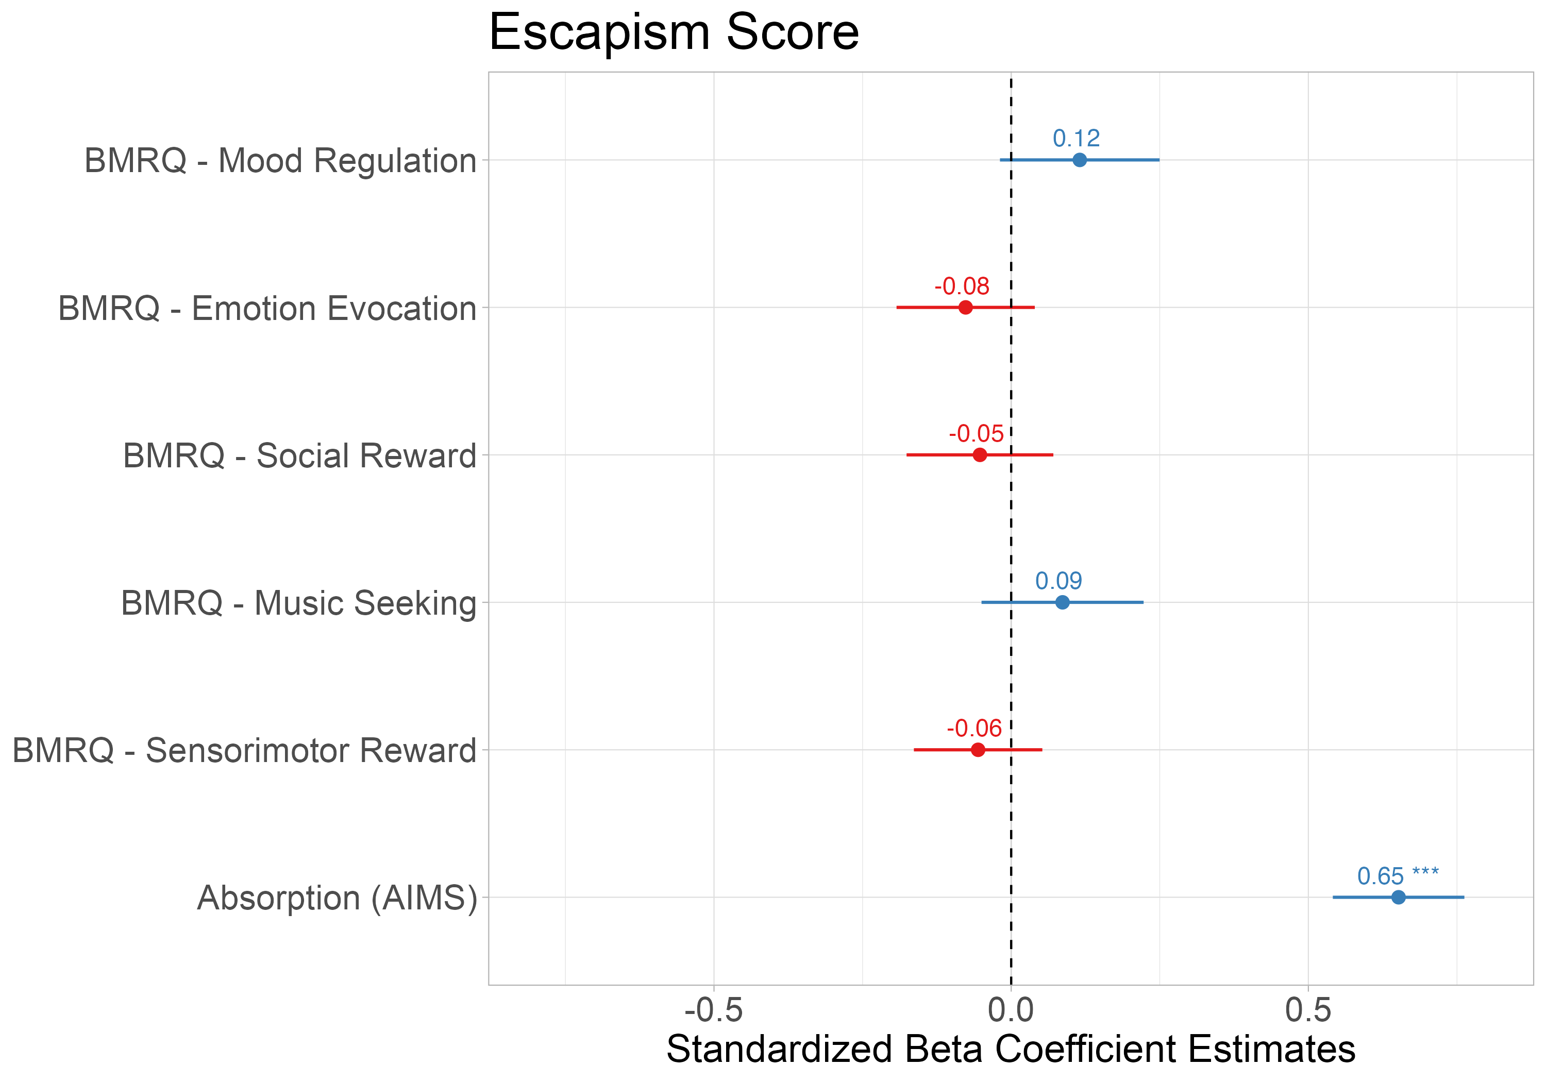
Absorption into music associated with using music for escapism
Notes:
Secondary analyses of using subscales of escapism [pos & neg]; interaction with pos+neg but with just AIMS

Slide 9
Absorption mediates the relationship between CHAOS and resilience

