Slide 1



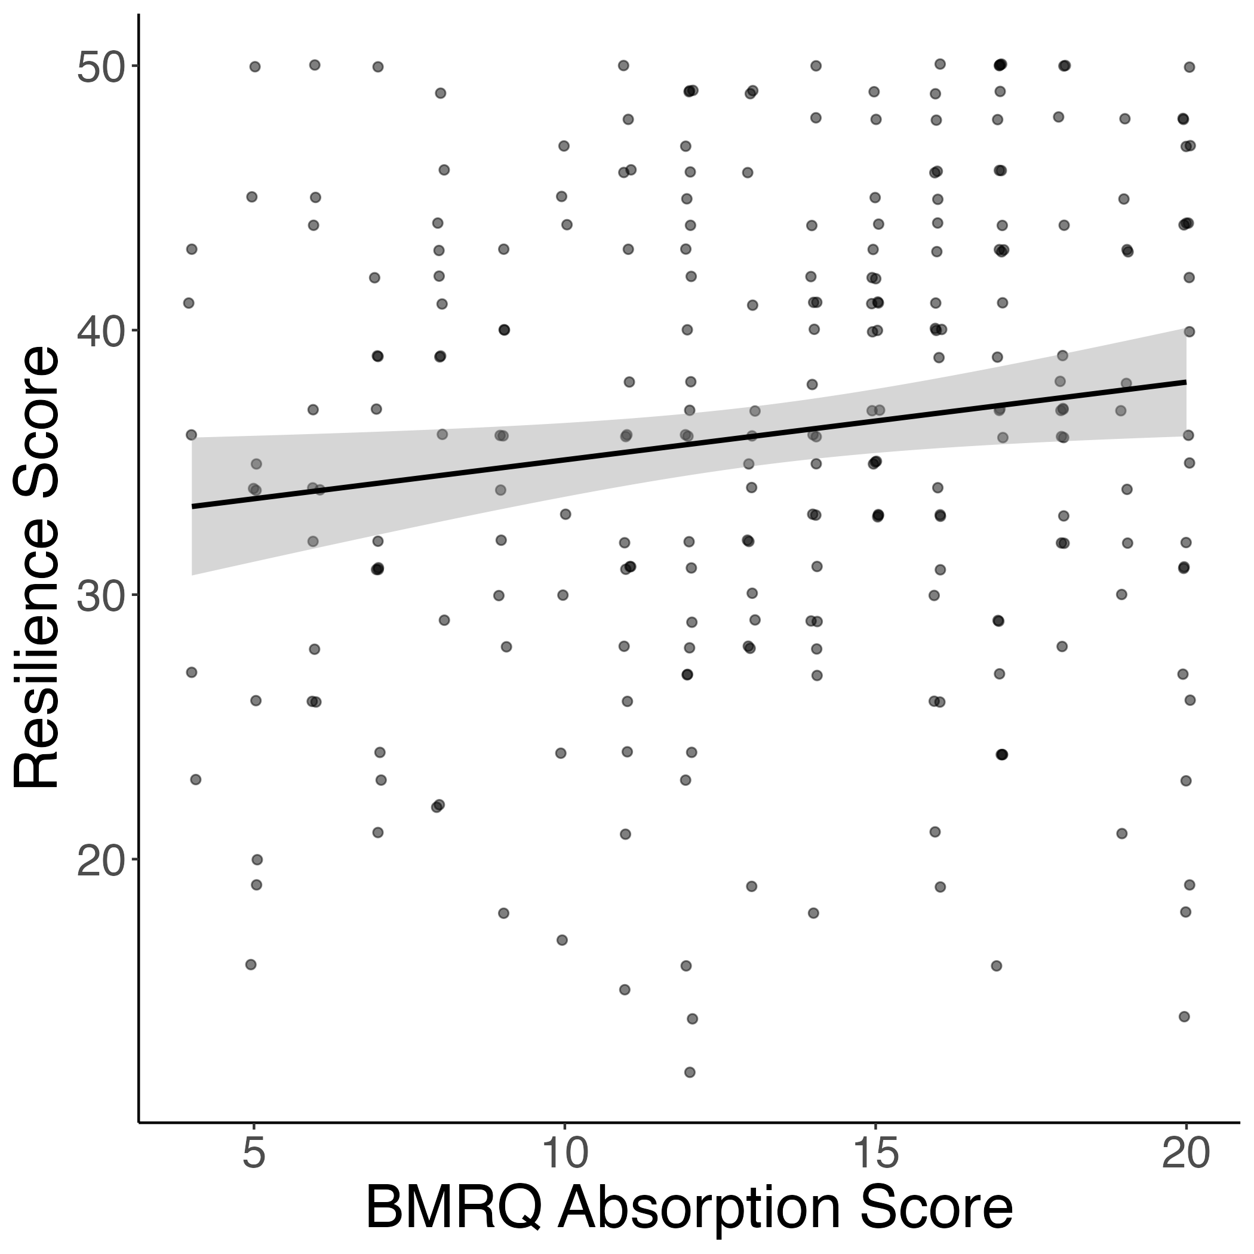
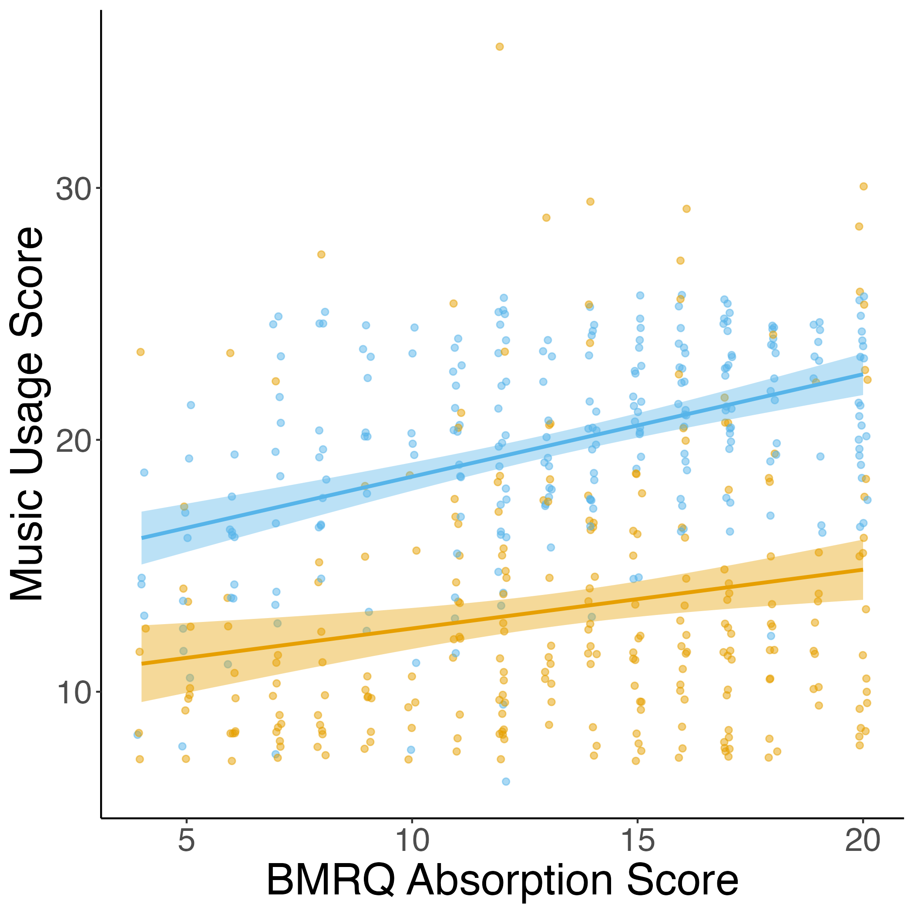
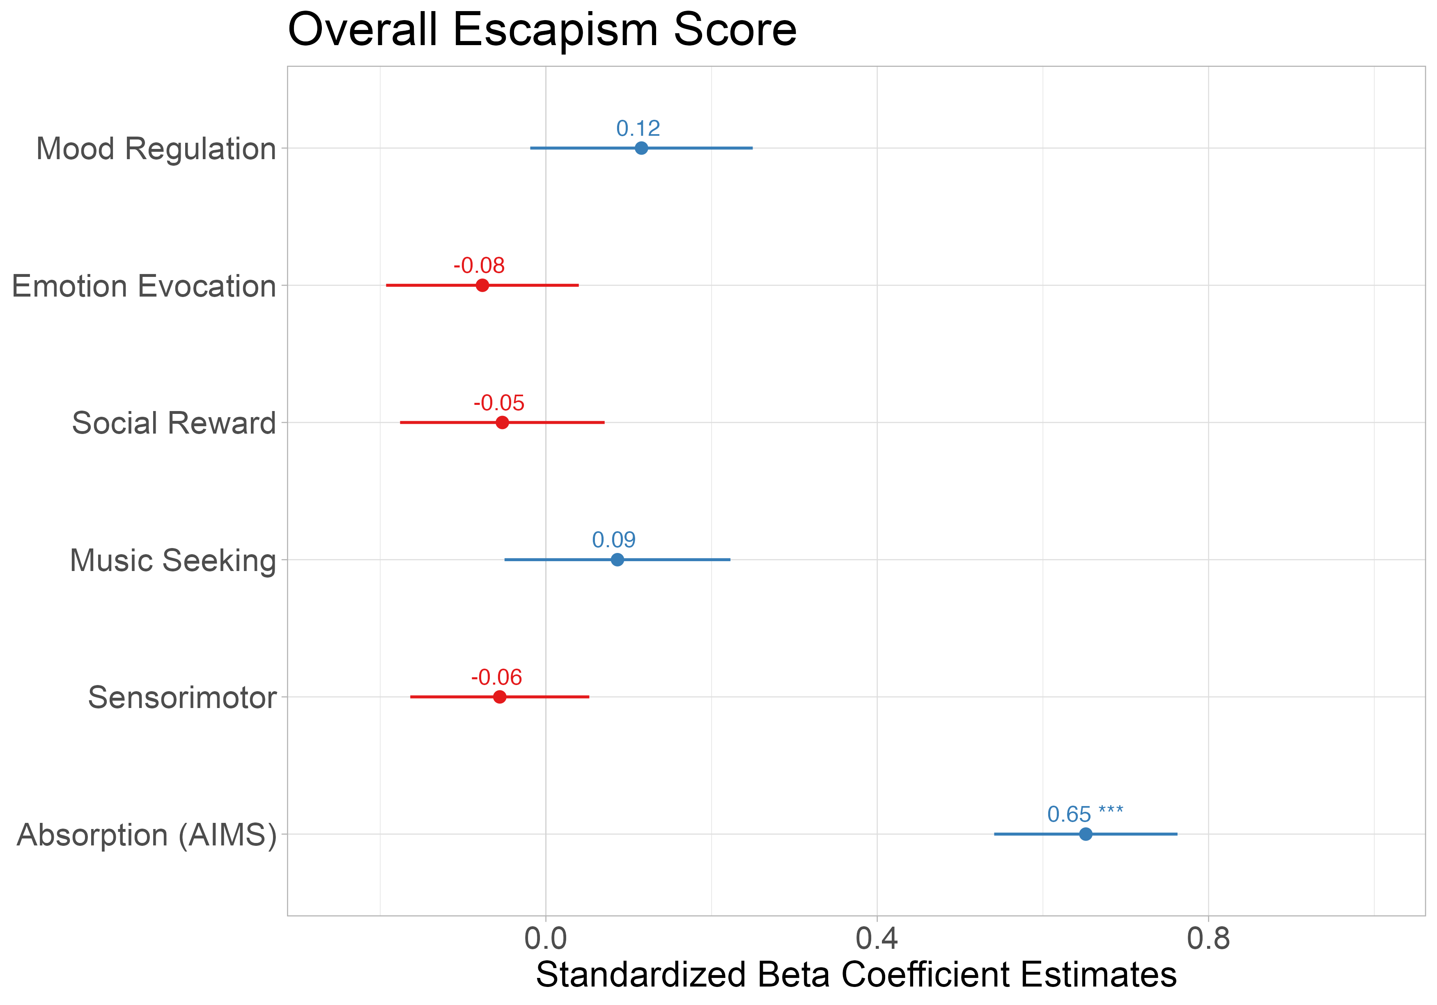




Early Life Adversity Reveals Adaptive Use of Absorption in Music
Nicholas Kathios, Kelsie L. Lopez, Psyche Loui, Laurel Gabard-Durnam
Northeastern University, Boston, MA
Introduction
Absorption is also positively related to resilience & both healthy and unhealthy music usage
Absorption related to reports of escapism above effects of other facets of music reward
Music accrues implicit reward value by exploiting reward-prediction mechanisms: listeners tend to prefer music with predictable acoustic and structural features
Pleasurable music listening experiences involve interactions between the auditory and reward systems
ELA depression/structural brain changes
Connection
254 participants (140F) recruited through Prolific from a previous experiment in our lab completed the study on Qualtrics
Survey included Questionnaire of Unpredictability in Childhood (QUIC; cite), the short-form Confusion, Hubbub, and Order Scale (CHAOS; cite), McLaughlin Deprivation & Threat Scales (cite), Healthy-Unhealthy Music Scale (HUMS; cite), the State/Trait Anxiety Inventory (STAI; cite), the Connor-Davidson Resilience Scale (CD-RISC-10; cite)
All retrospective adversity measures were reported for both childhood (6-12) and adolescence (13-18)
Participants also completed the Extended Barcelona Music Reward Questionnaire (eBMRQ; cite) and the Revised Physical Anhedonia Scale (PAS, cite) in the previous study
Hypothesis: Individuals who have experienced higher levels of early life adversity (across all dimensions) will demonstrate lower music-reward sensitivity.
Interim Conclusion
Study 1 Methods
Early life adversity is associated with more reported absorption in music cross all dimensions
Absorption positively correlated with resilience and healthy music usage, suggesting it can serve an adaptive purpose
Items on the unhealthy music usage scale index music listening as a form of escapism (e.g. “I hide in my music because nobody understands me, and it blocks people out),
In adverse contexts, such escapism might be adaptive, explaining why absorption in music is positively related to experiences of adversity
288 participants (141F) recruited through Prolific from another previous experiment in our lab completed the study on Qualtrics
Survey included Questionnaire of Unpredictability in Childhood (QUIC; cite), the full Confusion, Hubbub, and Order Scale (CHAOS; cite), McLaughlin Deprivation & Threat Scales (cite), the State/Trait Anxiety Inventory (STAI; cite), the Connor-Davidson Resilience Scale (CD-RISC-10; cite), the Escapsim Scale (cite) adapted for music, and the Absorption in Music Scale (cite)
Participants also completed the Barcelona Music Reward Questionnaire (BMRQ; cite) and the Revised Physical Anhedonia Scale (PAS, cite) in the previous study
Follow-up Hypothesis: The degree to which individuals report absorption into music will be related to how much they report using music as a form of escapism
Discussion
Study 2 Methods
All dimensions of ELA (sum-scored) are positively associated with reports of absorption into music
Absorption in music again positively associated with CHAOS and Threat Scores
References
kathios.n@northeastern.edu
@nickkathios

