Slide 1
Music@Home Figures

Slide 2
Study 1 Validity
eBMRQ
GoldMSI

Slide 3
Study 2 Validity
GoldMSI
BMRQ

Slide 4
Study 2 Validity
Adversity

Slide 5
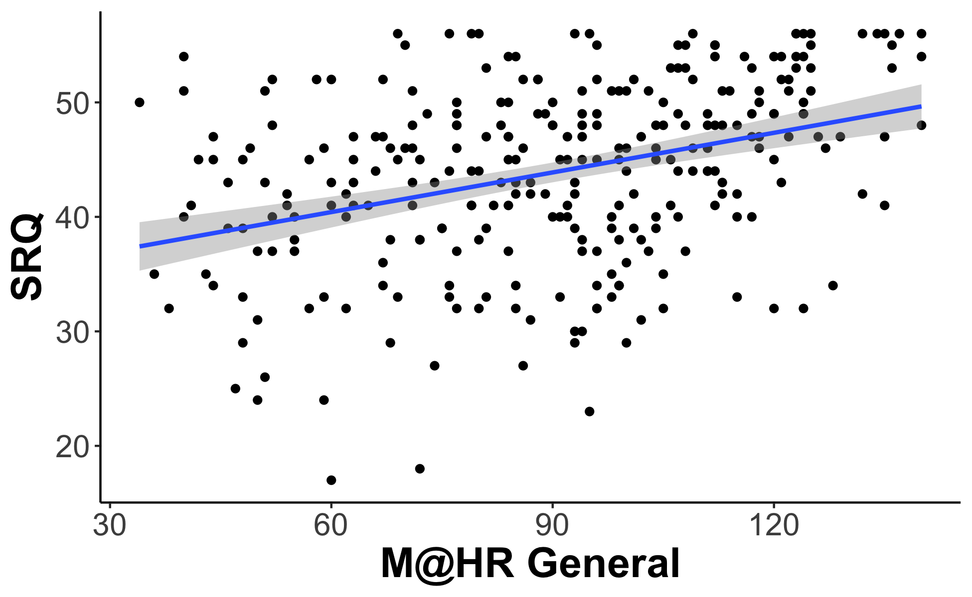
Study 2 Validity
SRQ

Slide 6
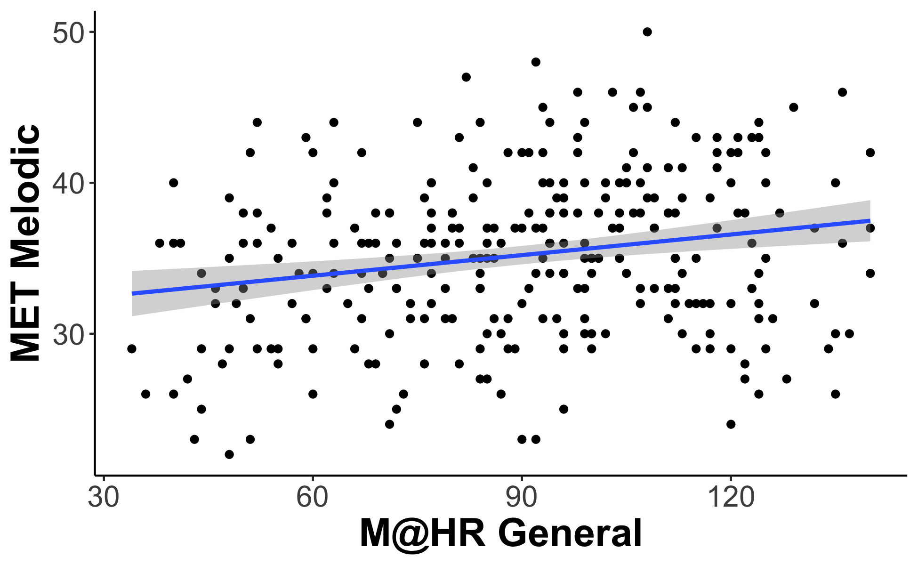
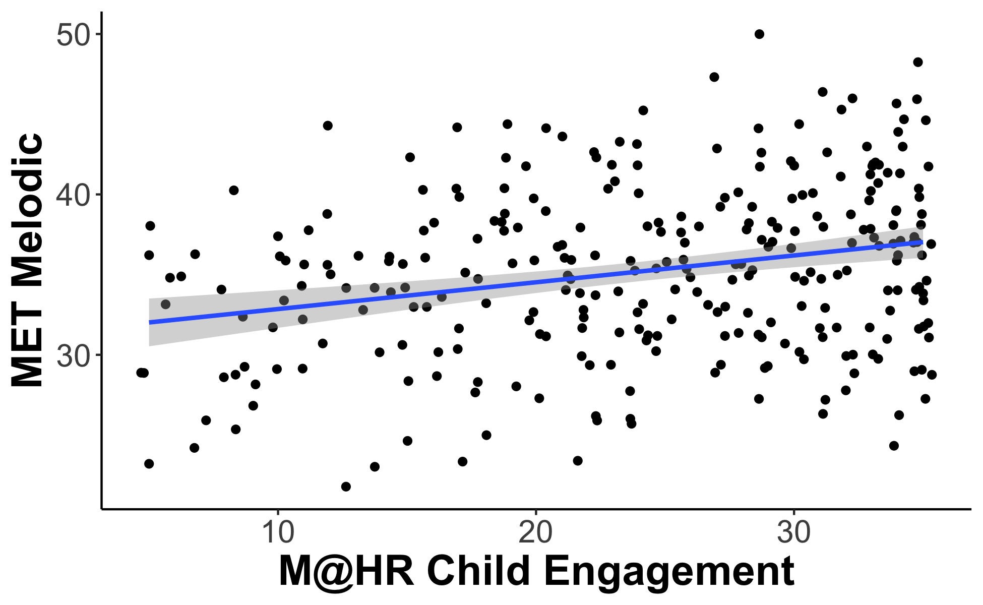
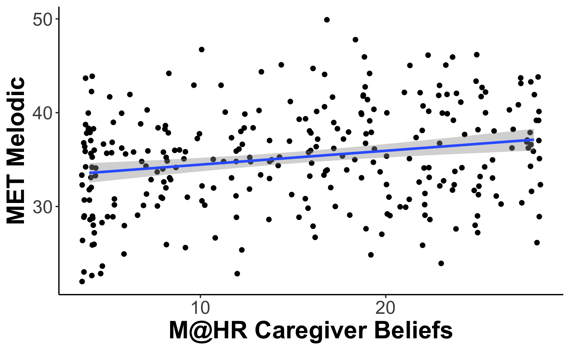
Utility of Scale: MET

Slide 7
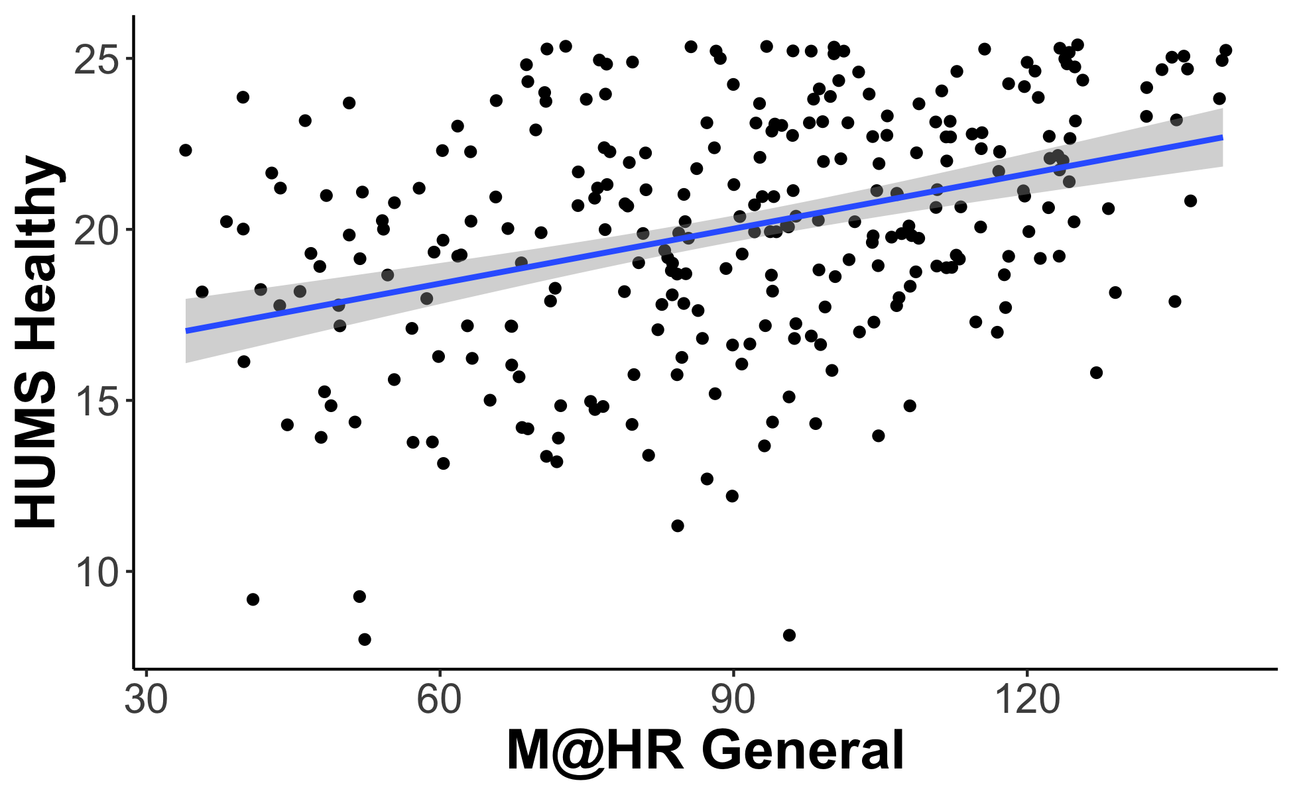
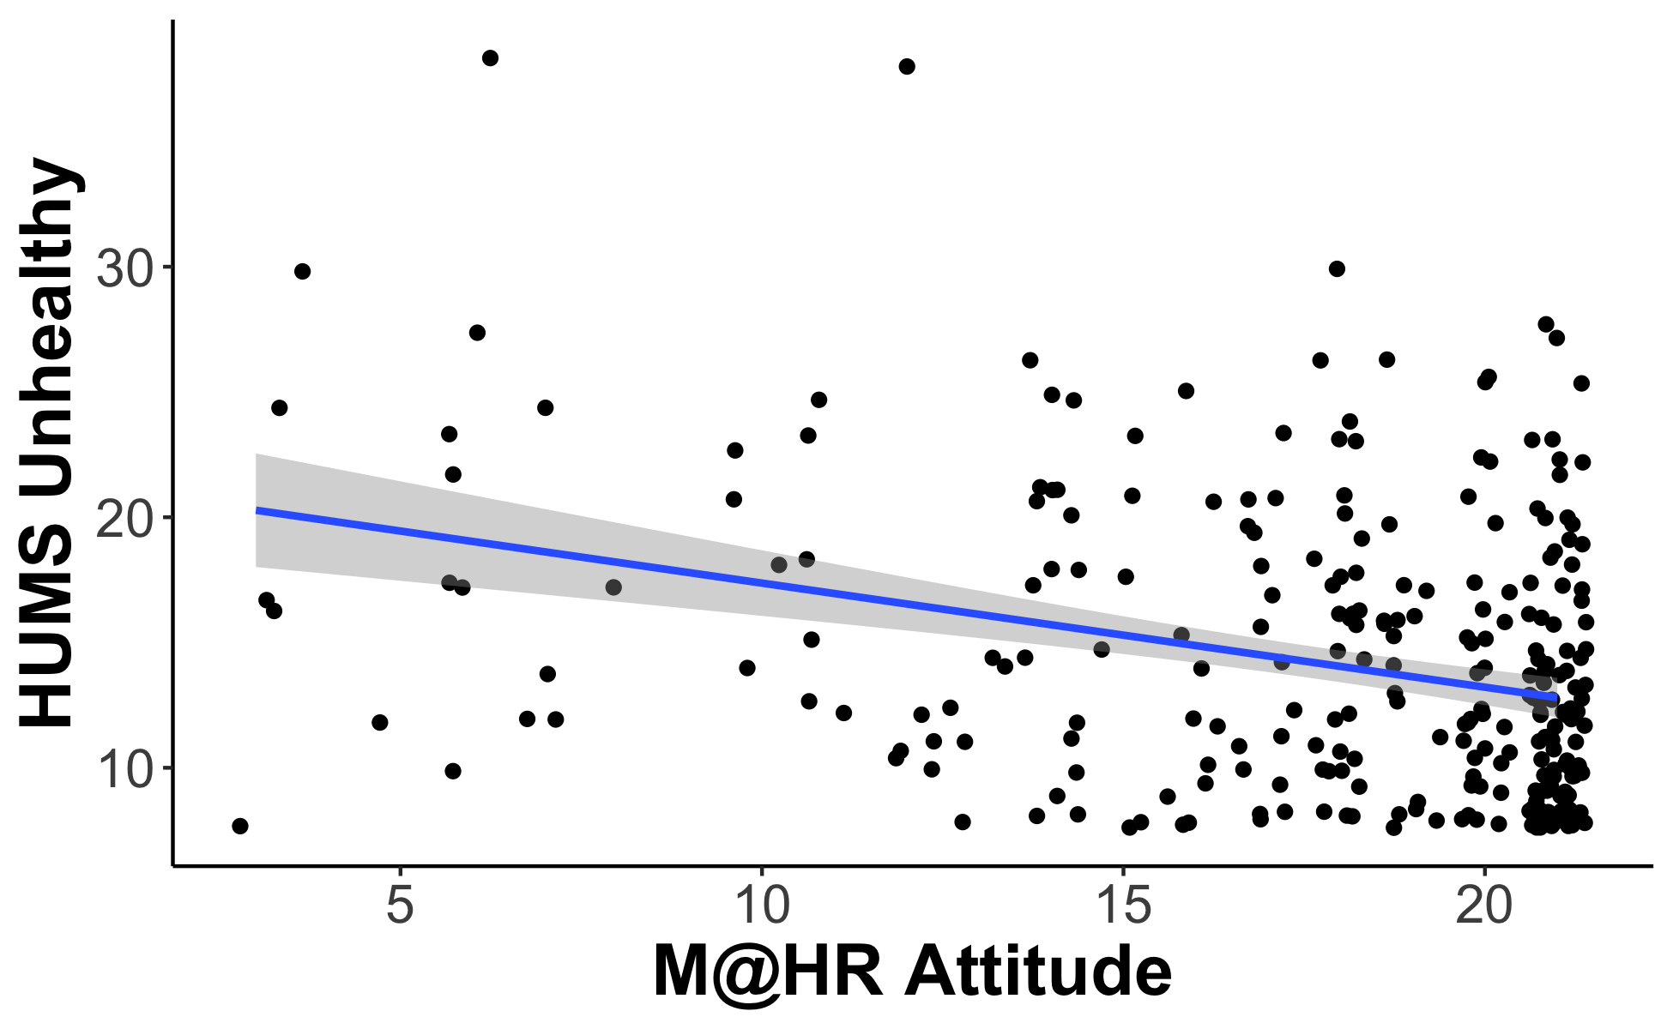
Utility of Scale: HUMS

Slide 8
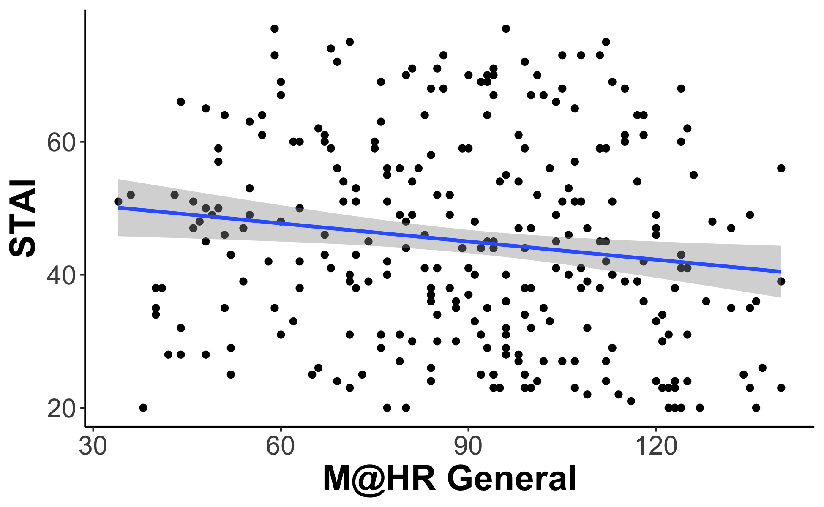
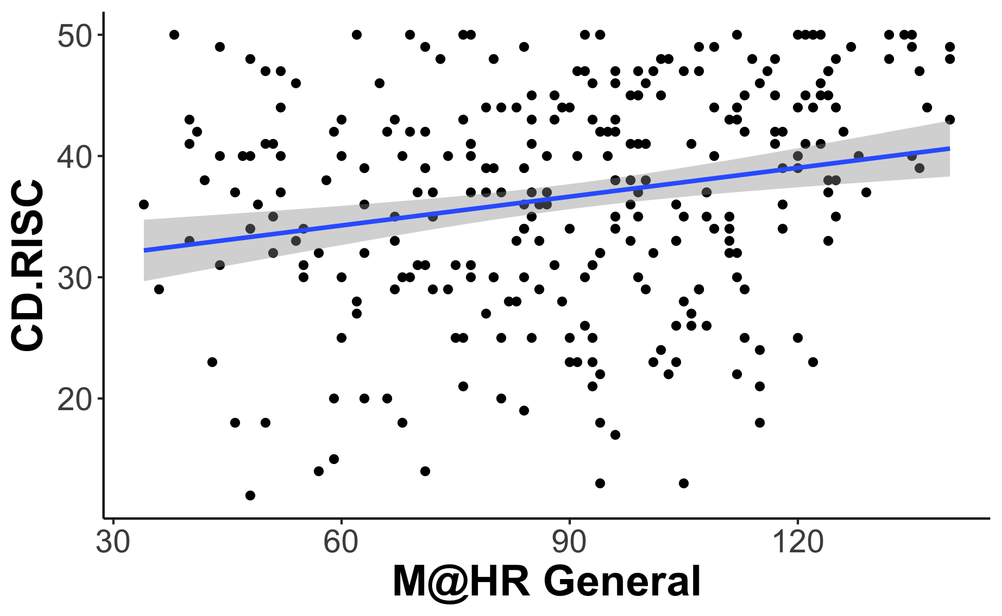
Utility of Scale: Mental Health

