Slide 1


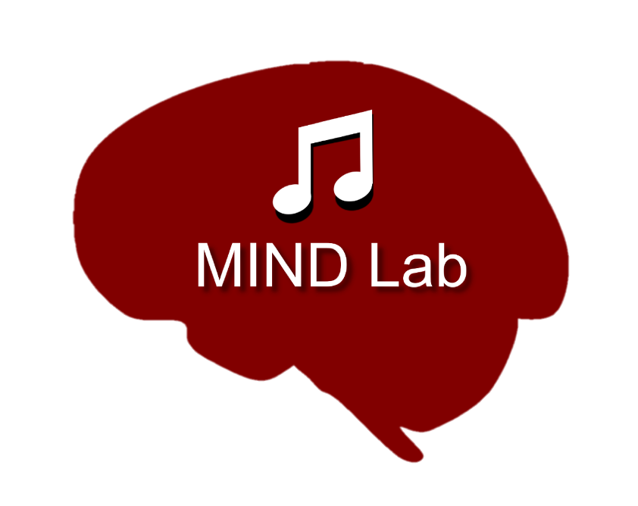
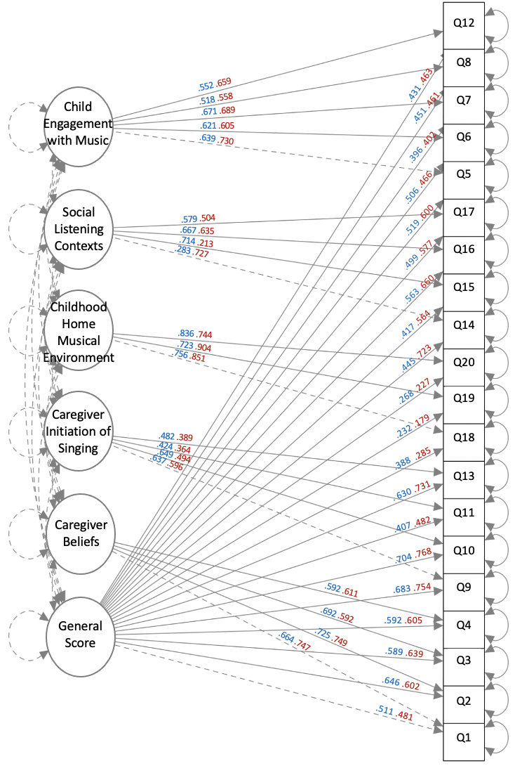
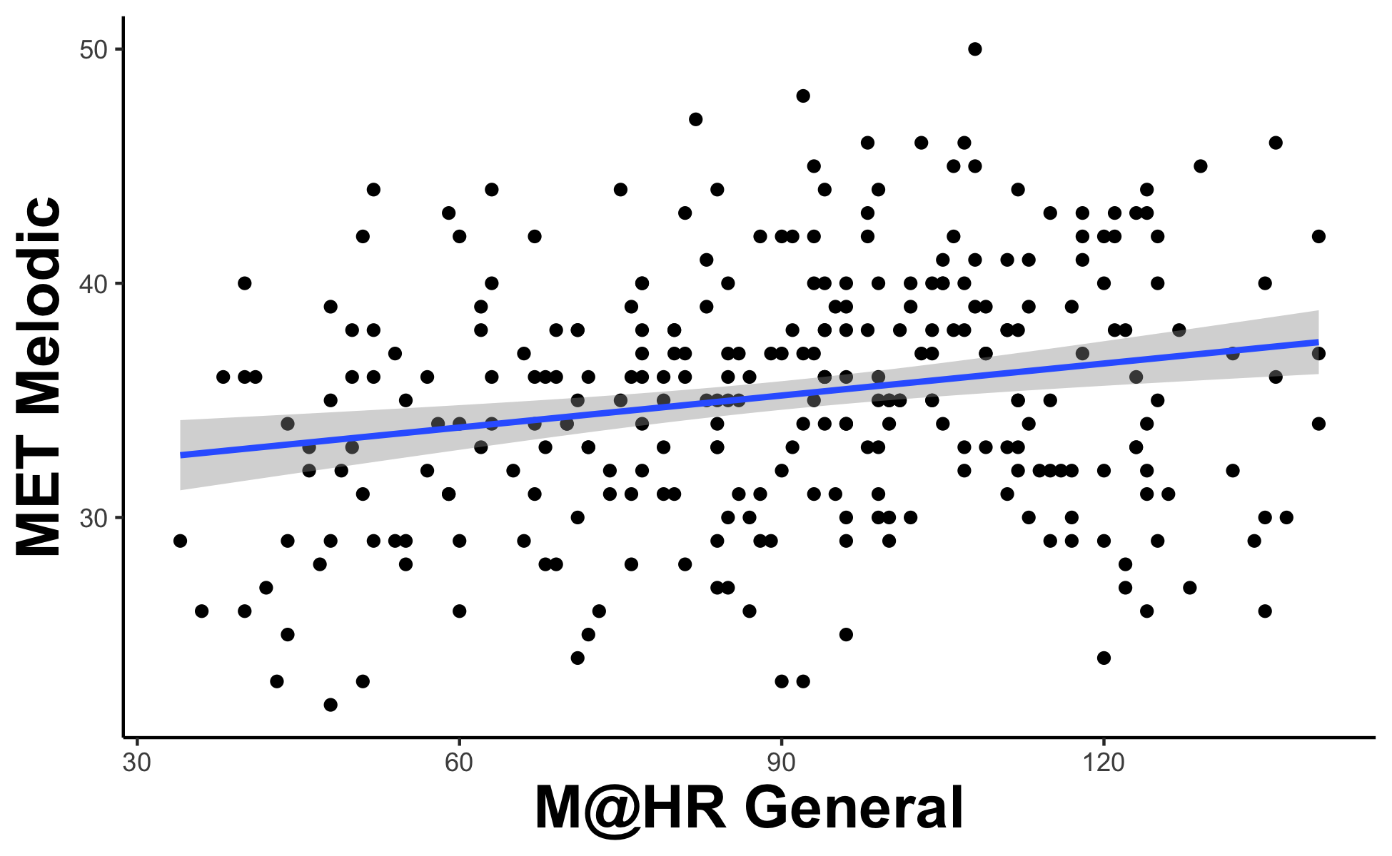
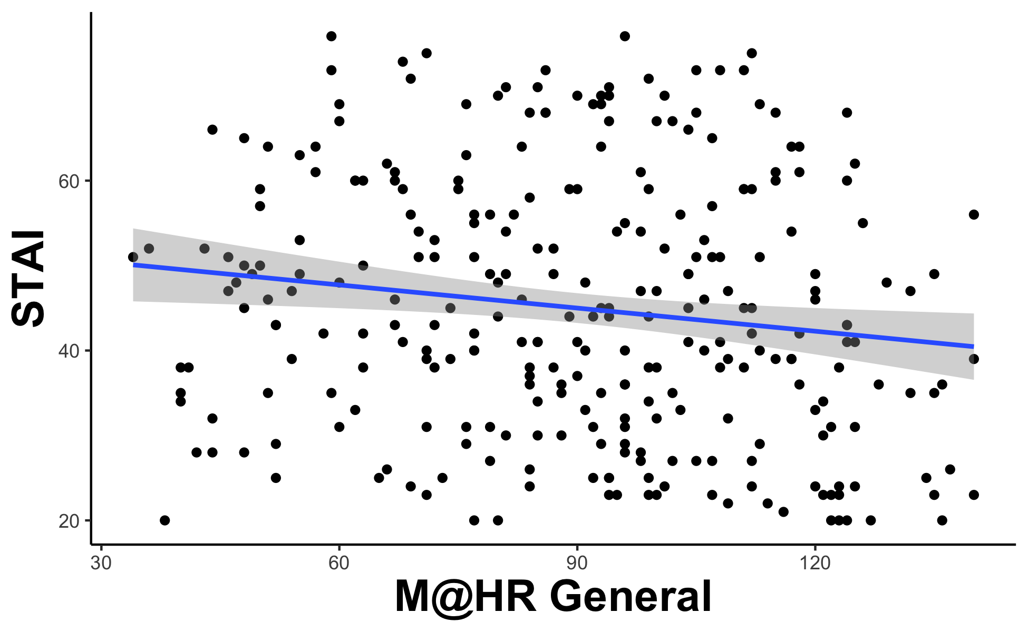
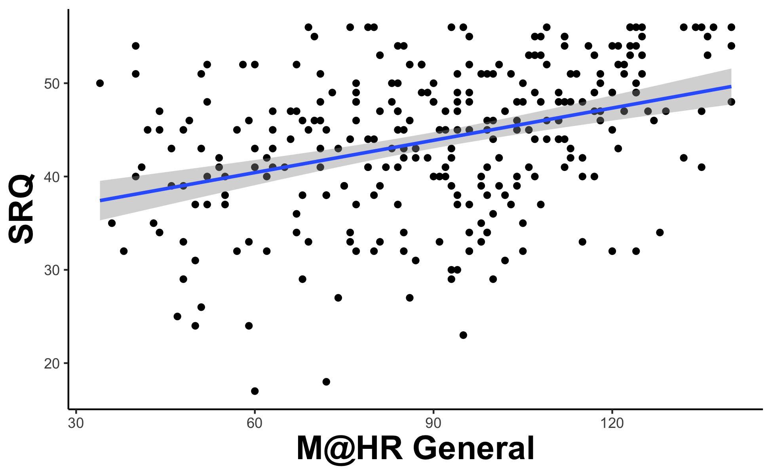
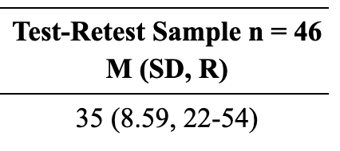
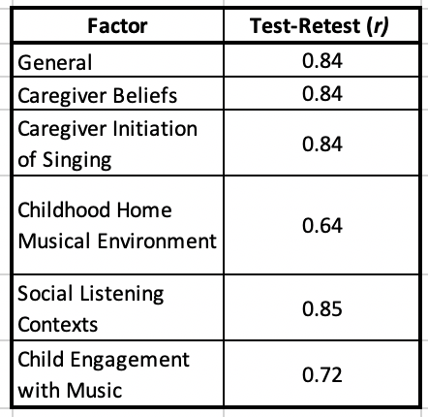
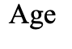
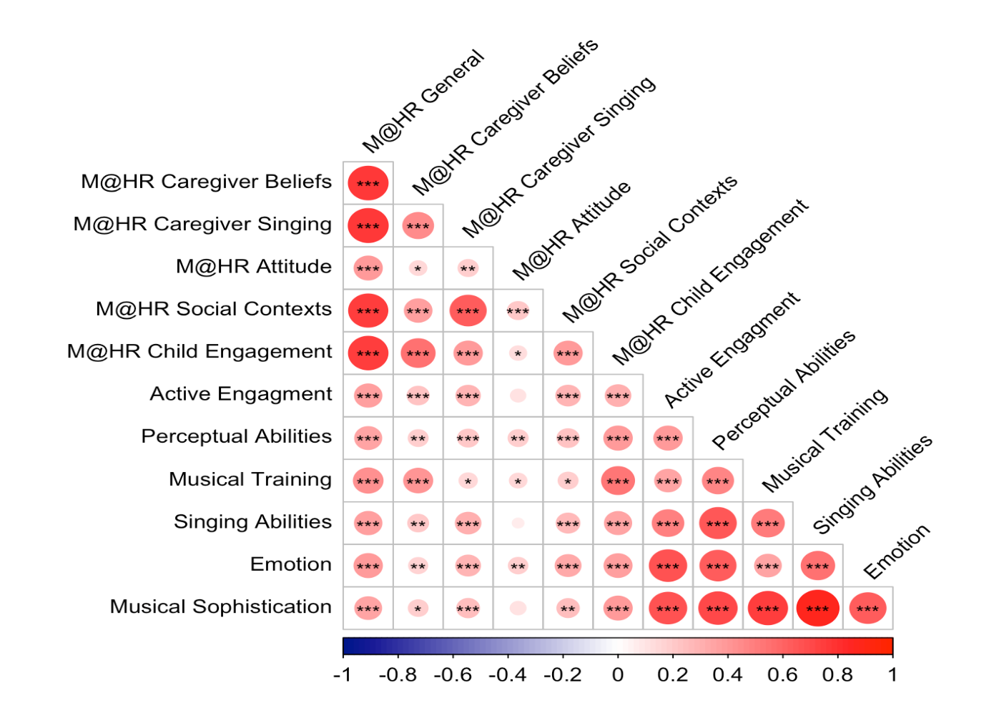
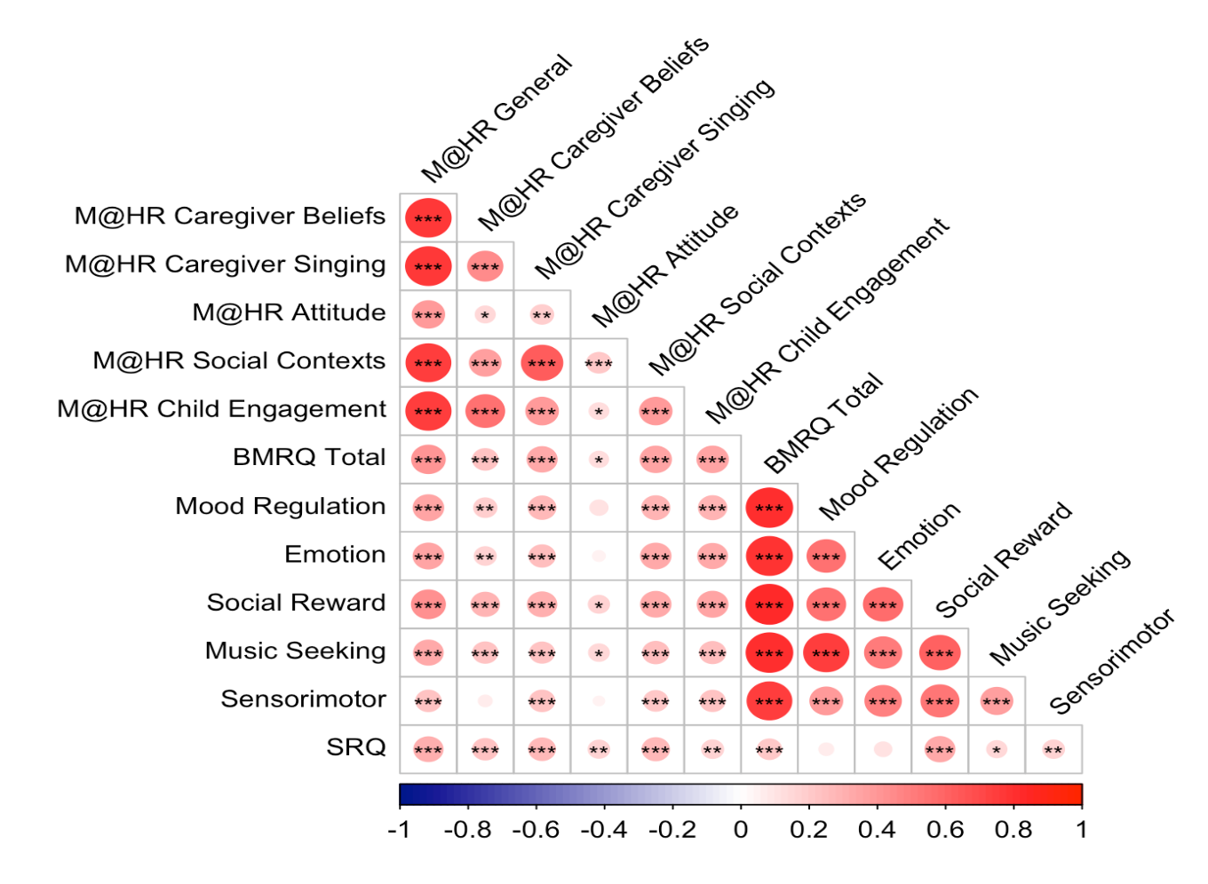
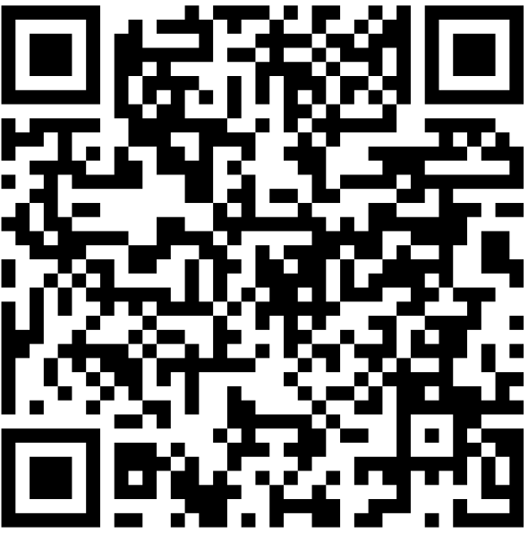
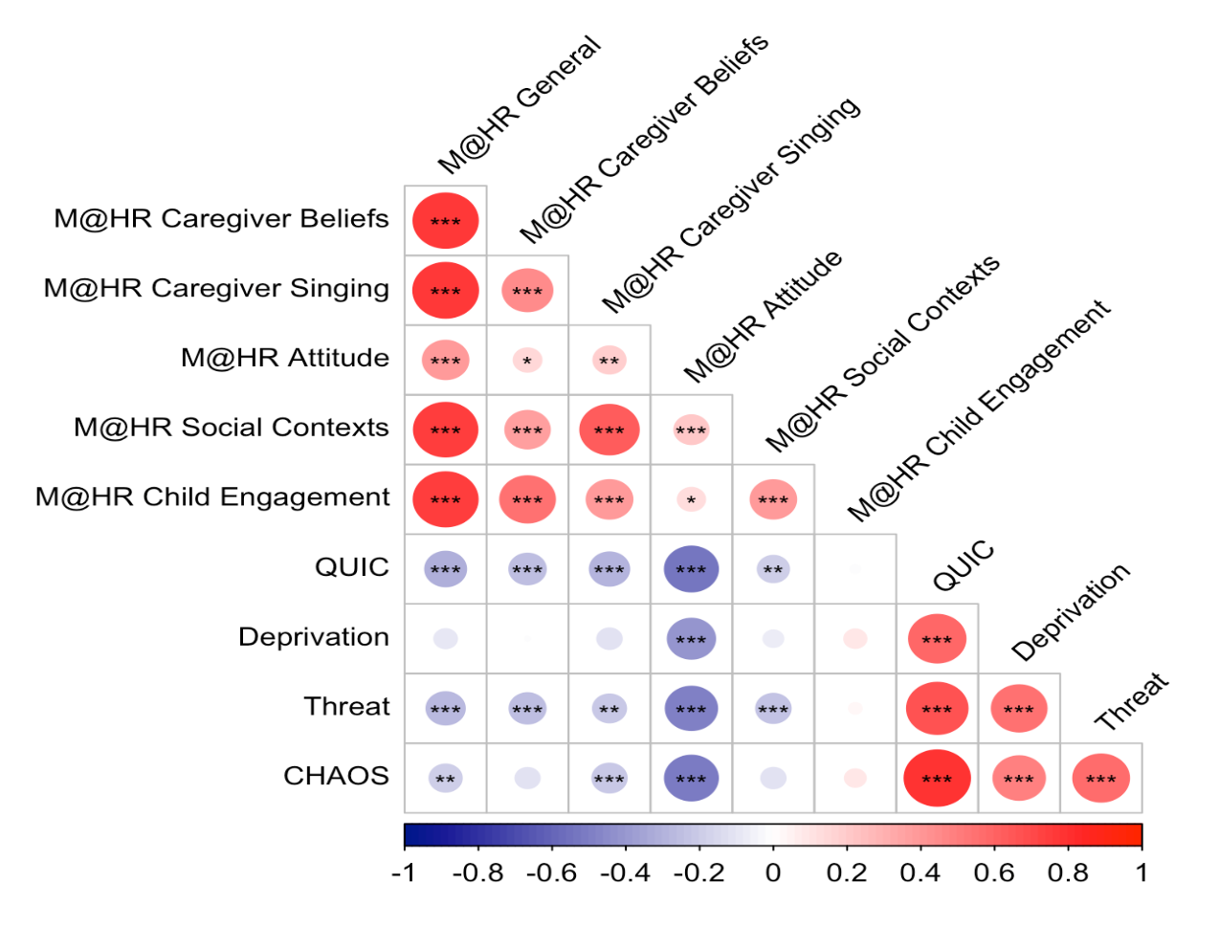



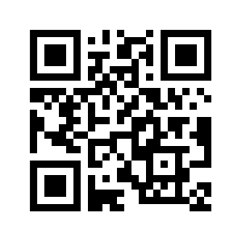
Music@Home Retrospective:
A New Measure to Retrospectively Assess Early Home Music Environments
Kelsie Lopez,* Nicholas Kathios,* Laurel Gabard-Durnam,^ Psyche Loui^
Northeastern University, Boston, MA
Background
Factor Analyses
Relevance to Adult Behavior
Heightened brain plasticity during early childhood facilitates experiences that impart lasting effects on individuals¹
Survey and in-home recording studies have shown that many children engage in informal musical activities (such as spontaneous singing, being sung to, and playing with musical toys) starting in infancy and extending throughout childhood^{2,3}
Both early passive music exposure & formal musical training have lasting effects on music perception, cognition, and brain structure^{4,5}
The only existing measure of the home musical environment, the Music@Home scale⁶ is a caregiver report intended for infants and preschoolers, limiting its applicability in understanding downstream effects of such music exposure
Here, we present the Music@Home-Retrospective scale, a measure aimed at capturing adult self-reports of their informal musical engagement at home during development, as a tool to probe the long-term effects of early music engagement on brain and cognitive health and socioemotional well-being.
r = 0.21,
p < .001
r = -0.15,
p = .01
*
*
r = 0.36,
p < .001
*
Test-Retest Reliability
Methods
STUDY 1:
• 299 participants (167F; mean age = 36) recruited from a previous experiment⁷
• Participants completed the 34-item Music@Home – Retrospective, the Questionnaire of Unpredictability in Childhood⁸ (QUIC), the short-form Confusion, Hubbub, and Order Scale⁹ (CHAOS), McLaughlin Deprivation & Threat Scales¹⁰
• All retrospective adversity measures were reported for both childhood (6-12 years) and adolescence (13-18 years)
• Participants also completed the Extended Barcelona Music Reward Questionnaire¹¹ (eBMRQ) and the Goldsmith Musical Sophistication Index¹² (GoldMSI) from the previous study
STUDY 2:
• 288 participants (141F) recruited from another previous experiment¹³
• Participants completed the 20-item Music@Home – Retrospective, the QUIC, the full CHAOS, McLaughlin Deprivation & Threat Scales, Social Reward Questionnaire¹⁴ (SRQ), the Musical Ear Test¹⁵ (MET), the State-Trait Anxiety Inventory¹⁶ (STAI)
• Participants also completed the Barcelona Music Reward Questionnaire¹⁷ (BMRQ) and the Goldsmith Musical Sophistication Index (GoldMSI) in the previous study
Time to Retest = 4 months
Blue loadings correspond to Study 1 (EFA) whereas Red loadings correspond to Study 2 (CFA).
Music@Home – Retrospective Scale Example Items
Discussion
Caregiver Beliefs:
My caregivers believed that I should learn to play an instrument.
Caregiver Initiation of Singing:
My caregivers sang to/with me in many different situations (e.g. during playtime, with friends and family, in the car).
Childhood Home Musical Environment:
I have negative memories of the music I heard in the home as a child. (Reverse scored)
Social Listening Contexts:
I associate music I heard as a child with social contexts (listening with caregivers, siblings, friends).
Child Engagement with Music:
I enjoyed making sounds/interacting with musical instruments (including toy ones).
Exploratory and confirmatory analyses revealed a five-factor solution to the Music@Home – Retrospective, with three factors maintained from the original Music@Home scale: Caregiver Beliefs, Caregiver Initiation of Singing, and Child Engagement with Music, and two novel factors: Attitude towards Childhood Home Musical Environment and Social Listening Contexts.
Multiple M@HR factors correlate with Social Reward Questionnaire, suggesting a relationship between home musical environment and social reward sensitivity.
Caregiver Beliefs and Child Engagement with Music scores were significantly positively correlated with MET – Melodic scores, suggesting that early musical engagement imparts lasting improvements in auditory perception.
Caregiver Initiation of Singing scores were significantly negatively correlated with levels of adult anxiety, suggesting caregiver singing during this time might result in lower baseline levels of anxiety or improved emotion regulation abilities in adulthood.
Developing Music@Home – Retrospective Items
Music@Home - Retrospective Validity
GoldMSI
BMRQ and SRQ
31 Items:
17 from M@H Preschool + 14 new items
Music@Home – Retrospective Scale
1.
The childhood home musical environment
References
Gabard-Durnam, L., & McLaughlin, K. A. (2020). Sensitive periods in human development: Charting a course for the future. Current Opinion in Behavioral Sciences, 36, 120–128.
Fancourt, D., & Perkins, R. (2018). Maternal engagement with music up to nine months post-birth: Findings from a cross-sectional study in England. Psychology of Music, 46(2), 238–251.
Mendoza, J. K., & Fausey, C. M. (2021). Everyday music in infancy. Developmental Science, 24(6), e13122.
Bailey, J. A., & Penhune, V. B. (2010). Rhythm synchronization performance and auditory working memory in early- and late-trained musicians. Experimental Brain Research, 204(1), 91–101.
Papadimitriou, A., Smyth, C., Politimou, N., Franco, F., & Stewart, L. (2021). The impact of the home musical environment on infants’ language development. Infant Behavior and Development, 65, 101651.
Politimou, N., Stewart, L., Müllensiefen, D., & Franco, F. (2018). Music@Home: A novel instrument to assess the home musical environment in the early years. PLOS ONE, 13(4), e0193819.
Kathios, N., Patel, A. D., & Loui, P. (2023). Musical Anhedonia, timbre, and the rewards of musical listening. Timbre, and the Rewards of Musical Listening.
Glynn, L. M., Stern, H. S., Howland, M. A., Risbrough, V. B., Baker, D. G., Nievergelt, C. M., Baram, T. Z., & Davis, E. P. (2019). Measuring novel antecedents of mental illness: The Questionnaire of Unpredictability in Childhood. Neuropsychopharmacology, 44(5), Article 5.
Matheny, A. P., Wachs, T. D., Ludwig, J. L., & Phillips, K. (1995). Bringing order out of chaos: Psychometric characteristics of the confusion, hubbub, and order scale. Journal of Applied Developmental Psychology, 16(3), 429–444.
McLaughlin, K. A., Sheridan, M. A., & Lambert, H. K. (2014). Childhood adversity and neural development: Deprivation and threat as distinct dimensions of early experience. Neuroscience & Biobehavioral Reviews, 47, 578–591.
Cardona, G., Ferreri, L., Lorenzo-Seva, U., Russo, F. A., & Rodriguez-Fornells, A. (2022). The forgotten role of absorption in music reward. Annals of the New York Academy of Sciences, 1514(1), 142–154.
Müllensiefen, D., Gingras, B., Musil, J., & Stewart, L. (2014). The Musicality of Non-Musicians: An Index for Assessing Musical Sophistication in the General Population. PLOS ONE, 9(2), e89642.
Kathios, N., Sachs, M. E., Zhang, E., Ou, Y., & Loui, P. (2022). Generating New Musical Preferences from Multi-level Mapping of Predictions to Reward. bioRxiv, 2022-06.
Foulkes, L., Viding, E., McCrory, E., & Neumann, C. (2014). Social Reward Questionnaire (SRQ): Development and validation. Frontiers in Psychology, 5.
Wallentin, M., Nielsen, A. H., Friis-Olivarius, M., Vuust, C., & Vuust, P. (2010). The Musical Ear Test, a new reliable test for measuring musical competence. Learning and Individual Differences, 20(3), 188–196.
Spielberger, C. D., Gorsuch, R. L., Lushene, R., Vagg, P. R., & Jacobs, L. (1970). Manual for the state-trait anxiety inventory. Consult. Psychol.
Mas-Herrero, E., Marco-Pallares, J., Lorenzo-Seva, U., Zatorre, R. J., & Rodriguez-Fornells, A. (2013). Individual Differences in Music Reward Experiences. Music Perception: An Interdisciplinary Journal, 31(2), 118–138.
2.
Adolescent attitudes toward childhood home musical environment
Adversity
3.
Current attitudes toward childhood home musical environment
lopez.ke@northeastern.edu
@KelsieLLopez
kathios.n@northeastern.edu
@nickkathios

