Slide 1
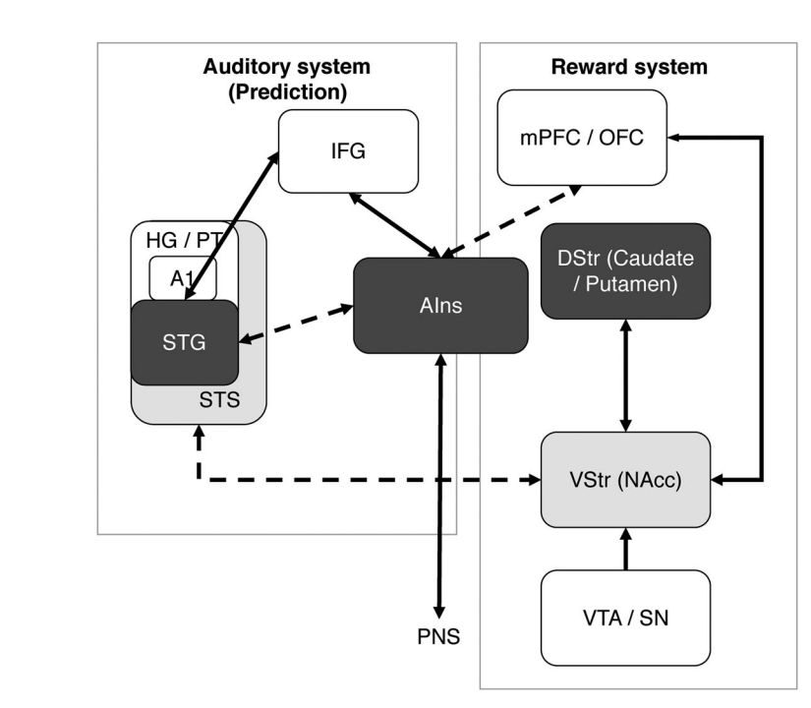
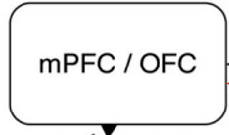
Known functional connections during pleasurable music listening experiences
DStr (Caudate / Putamen)
AIns
STG
Hypothesized increased functional connectivity during adolescence
STS
VS (NAcc)
Hippocampus

