Slide 1
//Developers_Institute_ Coding Bootcamp
EarningsSentiment
Does how a CEO speaks on an earnings call predict what the stock does next?
Real-time AI platform · earnings call NLP · post-call price correlation
~10,000
5
730
90%
companies searchable
AI signals per call
days of history per CEO
token cost cut via caching
Natanel Karp · 2026

Slide 2
THE PROBLEM
3,000
Every quarter,
~3,000 US companies hold earnings calls.
Billions of dollars of trading
decisions follow.
None of it is systematically
measured.
EarningsSentiment builds the measurement layer.

Slide 3
How It Works
Four steps from filing to insight
01
02
03
04
INGEST
SCORE
CORRELATE
SURFACE
SEC EDGAR & FMP transcripts arrive within seconds of filing
Claude AI extracts 5 signals from every CEO's language
1d, 3d, 7d stock returns fetched automatically via yfinance
Feed, leaderboard, company pages, calendar, and portfolio watchlist
→
→
→
Self-validating by design — every prediction is automatically back-tested against real post-call returns

Slide 4
The Scoring Engine
What Claude extracts from every earnings call — the differentiating feature
TRANSCRIPT EXCERPT — AAPL Q1 2026
Confidence Score
82 / 100
Overall CEO language confidence — graded from crisis (0) to exceptional (100)
"Our guidance for fiscal year 2026 reflects our confidence in continued strong demand across our product lines. We are raising full-year EPS guidance to $7.20, up from our prior range. During Q&A, when pressed on supply constraints, management responded: 'We have robust supply chain visibility and remain confident our commitments will be met on schedule.'"
Guidance Flag
RAISED ↑
Management raised, maintained, lowered, or withdrew forward guidance
→
Q&A Defensiveness
2 / 10
How evasive management became during analyst questions vs. prepared remarks
Key Phrases
Top 3
The 3 verbatim phrases that moved the score most — direct from the transcript
Sent to Claude with cached system prompt →
Trade Brief
2 sentences
Plain-English signal for a short-term trader: tone + most important fwd statement
System prompt cached → ~80% latency reduction · ~90% token-cost saving on cache hits

Slide 5
Architecture
Event-driven microservices — 5 containerised services, Kafka backbone
Ingestor
Scoring Service
Correlation Service
BFF REST API
Frontend
Python
Python
Python
Node.js
Next.js 14
SEC EDGAR FMP / Alpha Vantage Polls every 2 h seeds ~10k companies
Consumes raw-transcripts Claude AI → 5 signals → scored-transcripts
Consumes scored-transcripts yfinance returns → MongoDB
Express + JWT auth 15+ endpoints Reads MongoDB production-hardened
6 product views Recharts charts SSE streaming Tailwind CSS
→
→
→
→
Apache Kafka | raw-transcripts · raw-prices · scored-transcripts
MongoDB | price_reactions · scores · users
Production : AWS ECS Fargate · Amazon MSK · MongoDB Atlas · ECR · ALB x2 · Terraform · GitHub Actions CI/CD

Slide 6
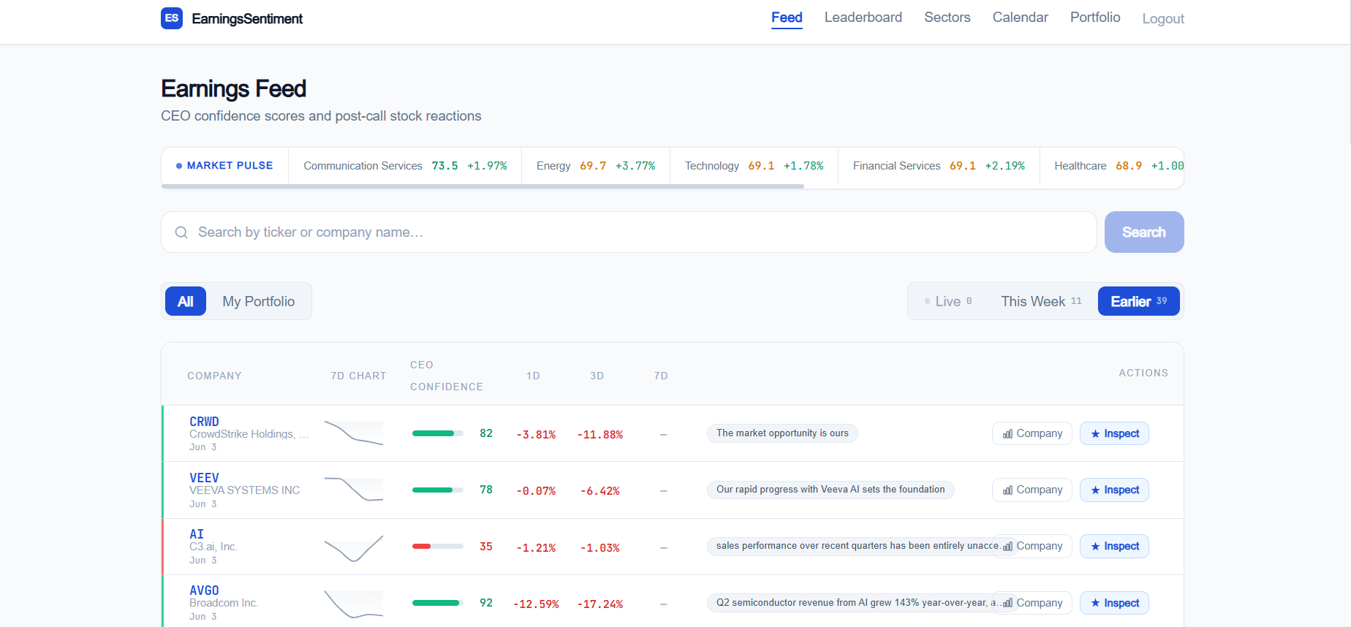
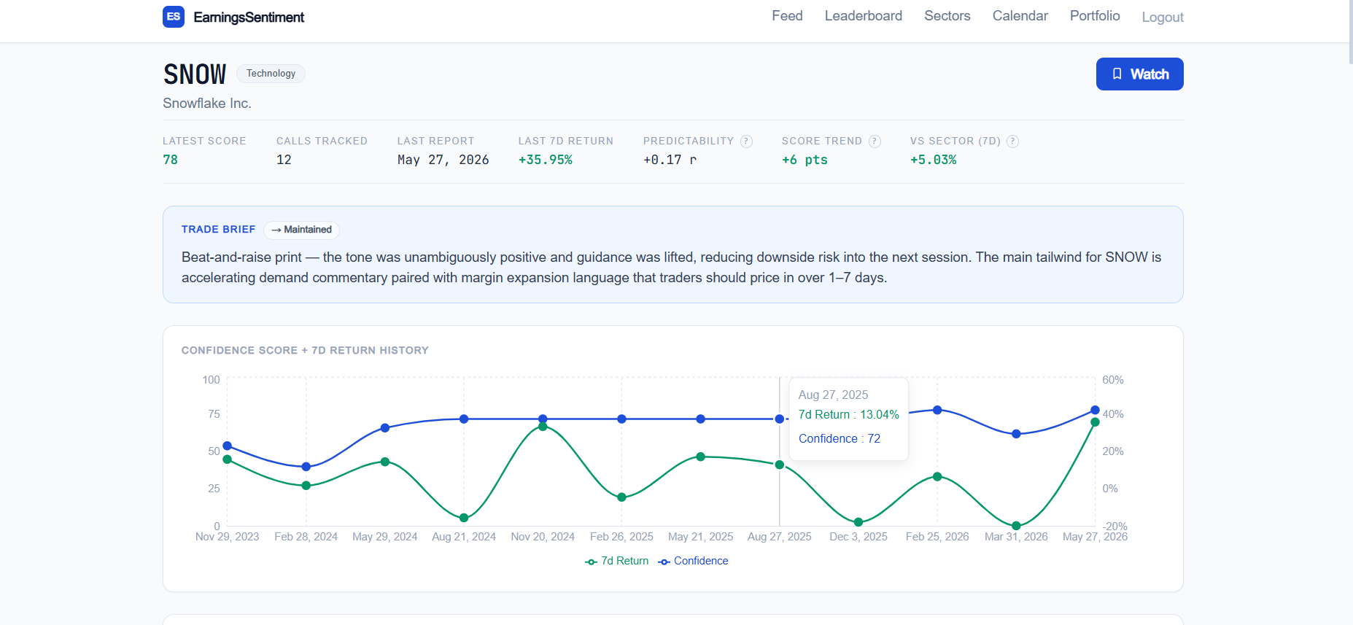
The Product — Live
Real data. Real companies. Running now.
Earnings Feed — live CEO confidence scores, key phrases, 1d / 3d / 7d returns
Company deep-dive — SNOW: 12 calls tracked, +35.95% last 7D

Slide 7
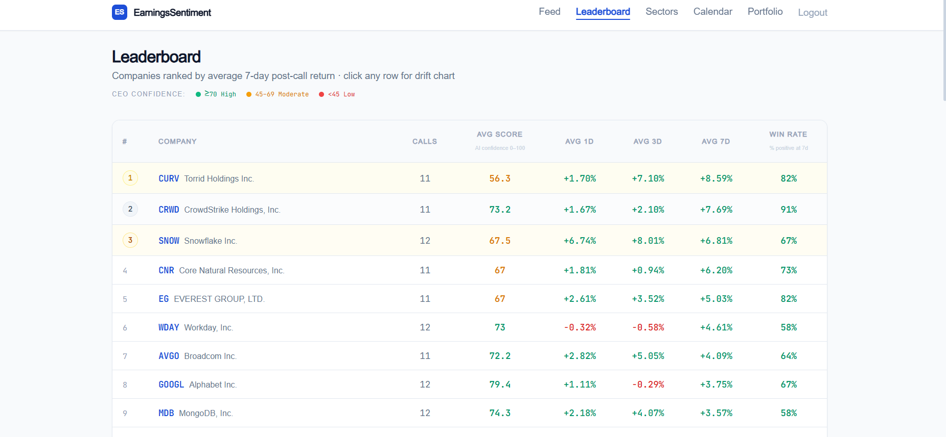
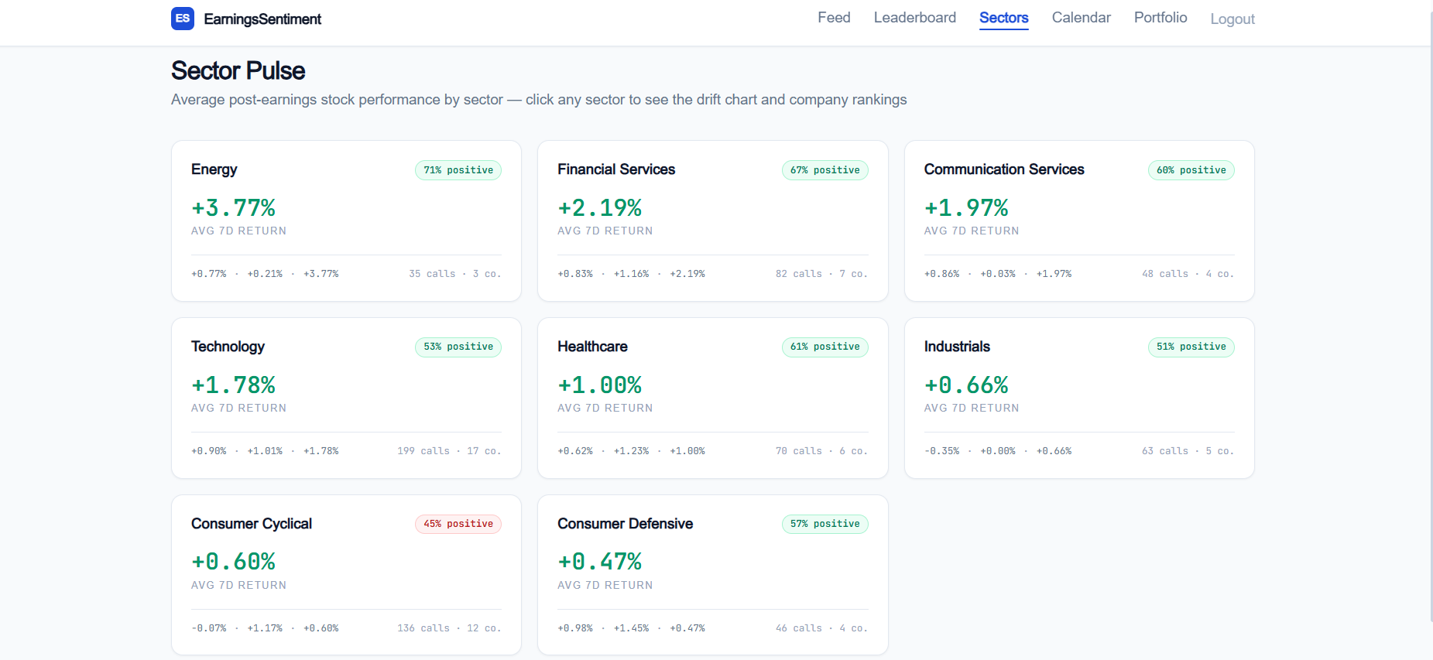
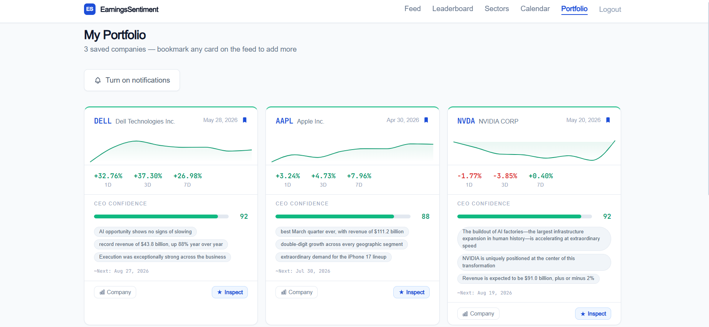
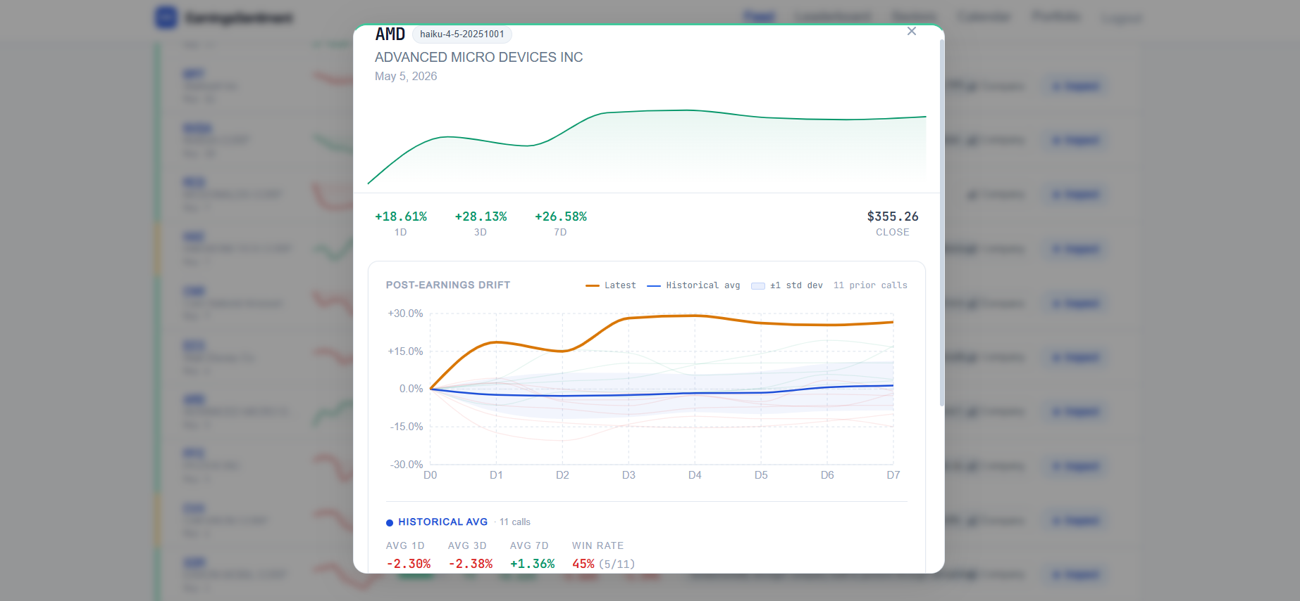
The Product — All Views
Six views built, all running on AWS
Leaderboard — CRWD 91% win rate · ranked by avg 7D return
Sector Pulse — Energy +3.77% · Technology 199 calls
Portfolio — DELL +32.76% 1D, AAPL +7.96% 7D
Call Inspect — AMD post-earnings drift · 11 prior calls

Slide 8
By the Numbers
The scale of what was built
~10,000
5
199
90%
companies searchable from EDGAR
AI signals extracted from every call
Technology sector calls across 17 companies
token-cost reduction via prompt caching
91%
5
+35.95%
15+
CRWD win rate — highest on leaderboard
microservices deployed on AWS
SNOW last 7D return after high-score call
REST API endpoints with JWT auth

Slide 9
Tech Stack
Tools, languages, and services — grouped by layer
Data & AI Layer
Application Layer
Frontend & Infra Layer
Python 3.12
Node.js / Express
Next.js 14 (App Router)
Apache Kafka (3 topics)
MongoDB + Mongoose
React 18 + Tailwind CSS
SEC EDGAR API
JWT authentication
Recharts (data visualisation)
FMP / Alpha Vantage
bcryptjs (password hashing)
AWS ECS Fargate (5 services)
Claude claude-sonnet-4-6
Resend (email alerts)
Amazon MSK (managed Kafka)
Anthropic SDK + prompt caching
REST API (15+ endpoints)
MongoDB Atlas (cloud DB)
yfinance (price data)
Flask sidecar (ingest trigger)
ECR + ALB x2
APScheduler (ingest schedule)
Docker / Docker Compose
Terraform + GitHub Actions
Kafka chosen for decoupled stream processing · Prompt caching chosen for cost/latency · Terraform for reproducible AWS infra

Slide 10
Roadmap
Next 4 priorities — ordered by impact
1 FMP Data Depth
Wk 1-3
Upgrade tier · forced re-backfill endpoint · full 5-year history per ticker
2 Predictability Score
Wk 3-6
Score-to-return scatter · Pearson r regression · CEO Predictability badge
3 UX Clarity
Wk 6-8
Tooltips for % win, Avg Score, thresholds, and pending return badges
4 Score Trend + Sector
Wk 8-10
Confidence trend over 4-6 quarters · returns vs. sector benchmark
W0
W2
W4
W6
W8
W10

Slide 11
My Next Step
Fix FMP Data Depth
1
Upgrade FMP tier and ship a forced re-backfill endpoint. Data quality is the foundation — without a full 5-year call history the predictability model is built on sand.
Ship the CEO Predictability Score
2
Build the per-company score-to-return scatter with a Pearson r regression line and surface the Predictability Score prominently. This is the single most differentiated feature on the platform.
UX Clarity
3
Add inline tooltips for every metric — % win, Avg Score, score thresholds, pending return badges. Low-lift, high-impact: makes the platform accessible to non-quant users without dumbing it down.
Score Trend + Sector-Relative Returns
4
Show confidence score trend over the last 4-6 quarters and post-call returns adjusted for sector movement. Adds the analytical depth expected by sophisticated users and portfolio managers.

Slide 12
Links
GitHub
github.com/njkarp06-design/earnings_sentiment_project
Demo Video
loom.com/share/f538f79d328f420aac248f0383ebb3ee
Deployed App
njkarp06-design.github.io/earnings_sentiment_project

Slide 13
Career Prep
Natanel Karp
Junior full-stack developer who treats AI tooling as part of the stack. Built this project end-to-end. Hackathon Winner 2026.
Full-Stack Dev Intern — Horizon Trade Tech (May-Jun 2026)
AI Data Analyst Intern — Elevata Ventures / Brevan Howard
In-memory LRU cache: ~700x speedup (97ms to 0.14ms p50). Solved 502 errors traced to cold EBS snapshot reads on Fargate.
Built AI-driven investment evaluation system with Claude Code. Applied to 45+ startups. Briefed Brevan Howard on AI strategy.
Education — Developers Institute + Hasmonean A-Levels
Achievements
AI & Full-Stack Diploma (2026). A-Levels: Mathematics 96%, Further Mathematics, Economics, Psychology.
Author: 'Rumination' (60,000-word manuscript). Gold, UKMT Senior Maths Challenge 2024. Competitive distance runner.
CV
LinkedIn
drive.google.com/file/d/1xvYOBGgMApOvlOSh_a2i1uAQ64rfpEqE/view
linkedin.com/in/natanel-karp-6890aa3b3

