Slide 1
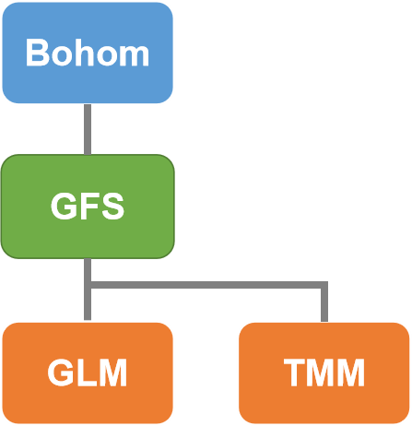
Bohom
GFS
GLM
TMM

Slide 2









Host
192.168.3.16
Container
Python + Django
GFS.GLM.WEB
./clweb/dev:/home
0.0.0.0:8899->80
image-overview
&
image
image index
Container
GFS.GLM.DB
./db:/db
0.0.0.0:27016->27017
image data
Container
Python +
Process
GFS.GLM.IMGSRV
./clweb/static/assert/image/glm:/db
Raspberry
PI
192.168.3.34
CC
save.py
Connect to DB
./img/
cc.py
USB Camera

Slide 3
Host
192.168.3.16
Container
Python + Django
GFS.GLM.WEB
./clweb/dev:/home
0.0.0.0:8899->80
image-overview
&
image
image index
Container
GFS.GLM.DB
./db:/db
0.0.0.0:27016->27017
image data
Container
Python +
Process
GFS.GLM.IMGSRV
./clweb/static/assert/image/glm:/db
Raspberry
PI
192.168.3.34
CC
save.py
Connect to DB
./img/
cc.py
USB Camera

