Slide 1


Predictive Modeling with Feed Forward Neural Network
Presenter: James Folk
Course: DATA 527 – Predictive Modeling | Project Deadline: May 6, 2024 | Semester: Spring 2024

Slide 2

Overview
The purpose of this exercise is to implement a feed forward neural network to predict the pitch of an airplane based on previous values of altitude, indicated airspeed, and roll. The main goal is to work on data exploration and preparation beside the network model implementation. I am using a dataset that contains 3 columns with 5404 entries. I leveraged the Tensor SDK to implement the feed forward neural network.
Notes:
The purpose of this exercise is to implement a feed forward neural network to predict the pitch of an airplane based on previous values of altitude, indicated airspeed, and roll. The main goal is to work on data exploration and preparation beside the network model implementation. I am using a dataset that contains 3 columns with 5404 entries. I leveraged the Tensor SDK to implement the feed forward neural network.
Create the neural network using the Tensor SDK
Clean the dataset.
Determine which data is relevant

Slide 3
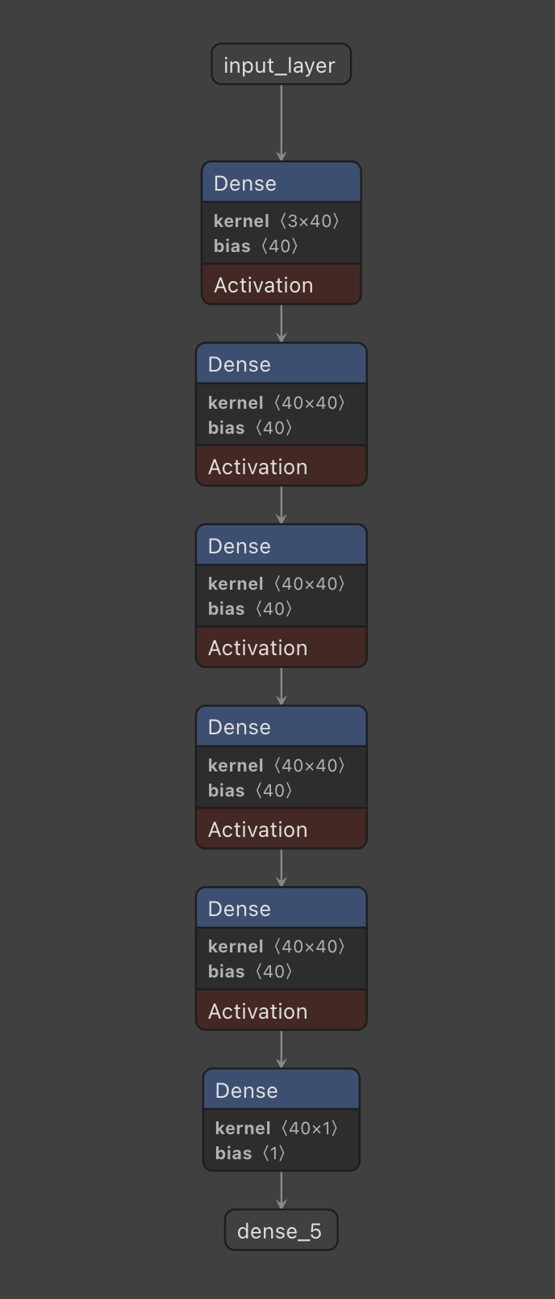
Methodology
Create the Neural Network:
- Keras sequential model.
- Architecture: Input layer, five hidden layers, and output layer.
- Neurons per Hidden Layer: 20 with ReLU activation function.
Normalize the Dataset:
- Applied min-max scaling normalization for effective anomaly handling.
Notes:
The neural network architecture was established with a Keras sequential model, comprising an input layer, five hidden layers, and an output layer. Each hidden layer is composed of 20 neurons employing a Rectified Linear Unit (ReLU) activation function, chosen due to the positive nature of all inputs. The input layer accommodates the number of input neurons corresponding to the dimensions utilized in training the model. Conversely, the output layer consists of a single neuron, as the objective is solely to predict the airplane pitch based on their attributes.

Slide 4

Implementation
Learning Rate: 0.001
Number of Iterations: 500
Final Correlation Coefficient: 0.7293365435980965
Structure:
- 3 input nodes
- 5 hidden layers with 40 nodes each
- 1 output node

Slide 5
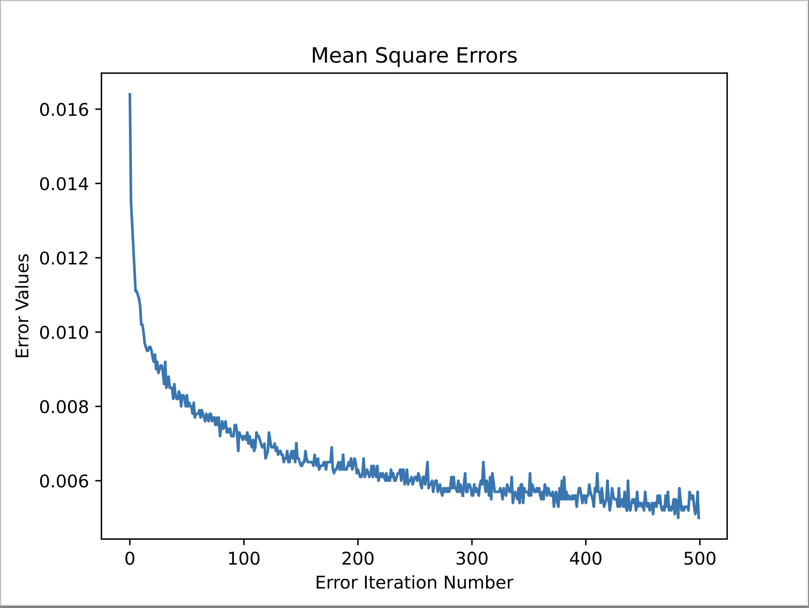
Mean Square Errors
Discussion of error metrics and model evaluation.

Slide 6

Challenges Faced and Solutions
Challenge: Determining Hidden Layer Structure.
Solution: Iterative adjustment to achieve optimal configuration.
- Initially: 1 layer with 3 nodes, resulting in R-squared of 0.4.
- Refinement: 3 layers with 20 nodes, R-squared increased to 0.6.
Notes:
Determining the Hidden Layer Structure: Analyzing the neural network’s optimal setup was the major issue encountered, specifically in determining the number of nodes and hidden layers in the model. This configuration consisted of 5 hidden layers, each with 40 nodes. The process was iterative which showed that increasing the number of layers and nodes had an improved accuracy in prediction. R-squared value of 0.4 was obtained when a single layer with 3 nodes was used which was very low. This structure was then adjusted to have 3 layers with each having 20 nodes resulting in R-squared equal to 0.6.

Slide 7
Conclusion
Summary of refinement efforts and achieved results.
Notable enhancements in predictive accuracy with a configured neural network.
Potential for further optimization to meet diverse demands.
Notes:
To enable the neural network to accurately determine pitch based on the provided data, this represents the culmination of extensive refinement efforts. Initially, structuring the model effectively posed a significant challenge, necessitating iterative adjustments, particularly concerning the allocation of hidden layers and their nodes. Progress was incremental, ultimately leading to the adoption of a configuration featuring five hidden layers, each comprising 40 nodes, resulting in a substantial enhancement in predictive accuracy. This is evidenced by the achieved final correlation coefficient of 0.729. Considering the potential for further optimization, it becomes imperative to continually enhance our models, as varied inquiries demand tailored solutions.

