Slide 1
Classification of Jets in nuclear collisions
Nolan Luppino

Slide 2
Background
Collisions of atomic nuclei and subatomic particles sometimes produce a stream of high energy and momentum particles called jets
If there are jets in a collision then equations need to account for that

Slide 3
Initial Goals/Questions
Determine which method of normalization yields the best accuracy
Modify neural network parameters to improve accuracy
Does the number of hidden layers also have a diminishing returns effect?
Increase/decrease learning rate
Modify batch size
Determine where the cutoff point is for increasing the dataset size
Does dataset size have diminishing returns effect?

Slide 4
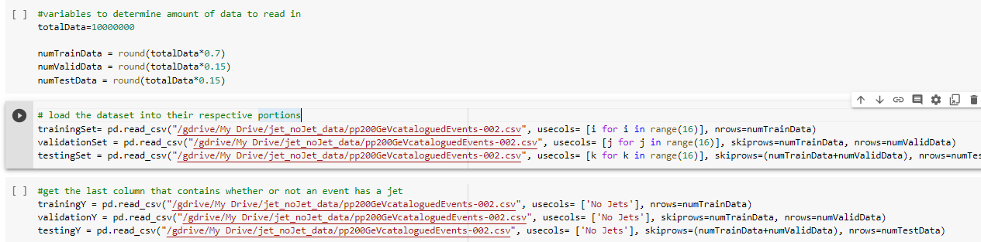
Loading data
Use loadtxt and pandas to create numpy arrays from a given .csv file
can import specifc columns and skip a number of rows

Slide 5
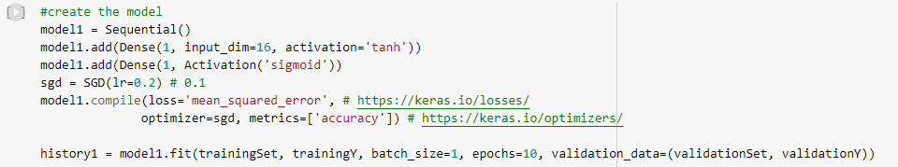
Normalization: Overview
Keeping the dataset size and neural network setup constant but change how the data is normalized
Using small dataset of 10,000 nuclear collisions. (70% training, 15% validation and testing)
Used XOR example code as a base.

Slide 6
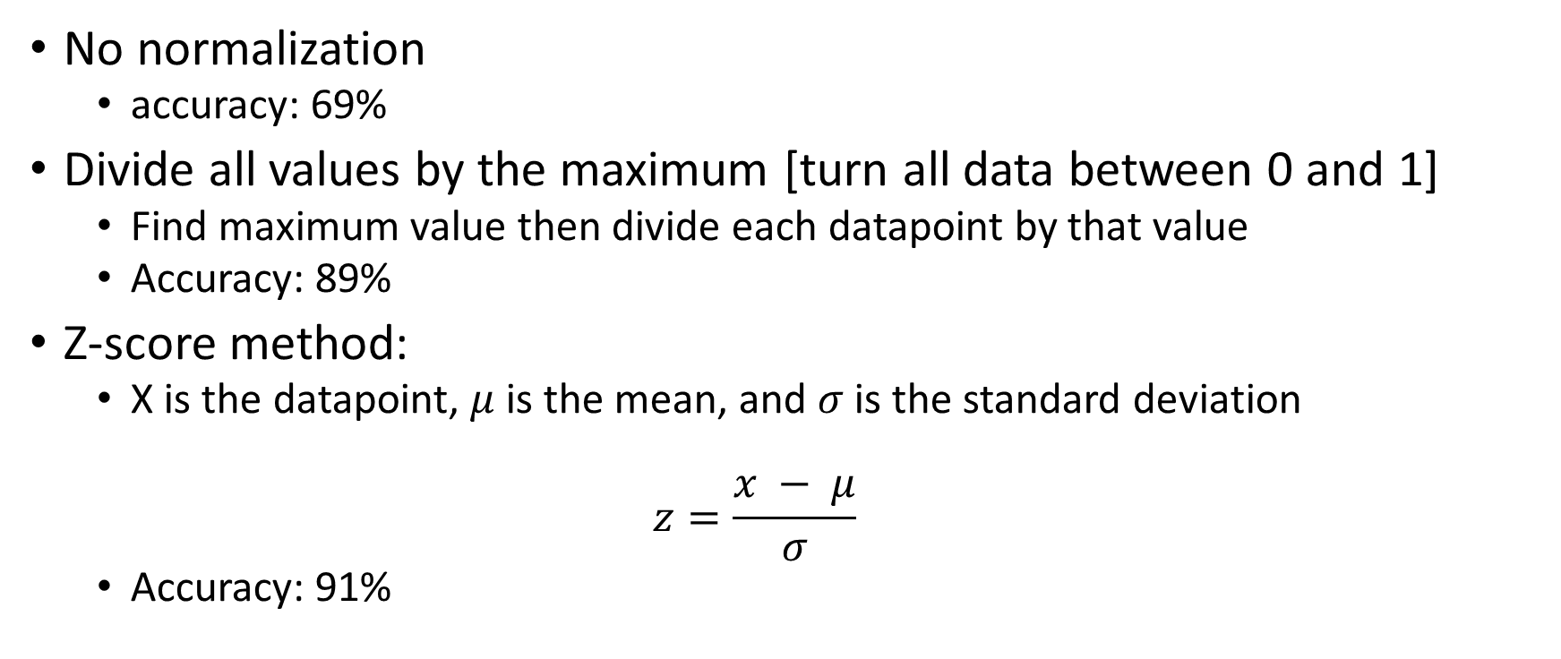
Normalization: Methods
No normalization
accuracy: 69%
Divide all values by the maximum [turn all data between 0 and 1]
Find maximum value then divide each datapoint by that value
Accuracy: 89%
Z-score method:
X is the datapoint, $μ$ is the mean, and $σ$ is the standard deviation
$$z=\frac{x − μ}{σ}$$
Accuracy: 91%

Slide 7
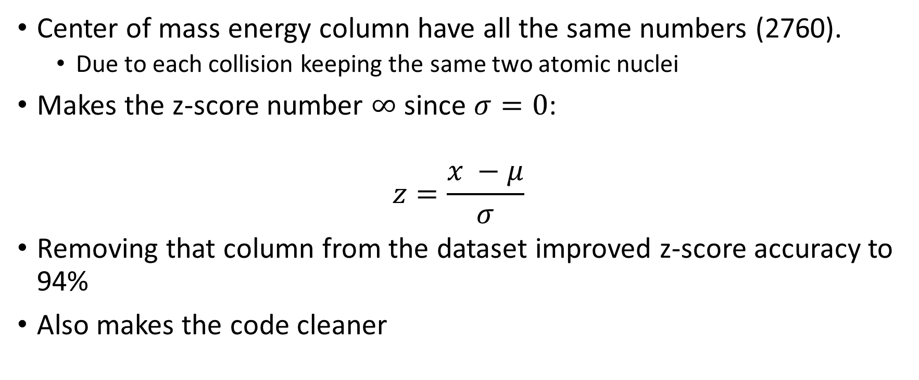
Normalization: methods (cont.)
Center of mass energy column have all the same numbers (2760).
Due to each collision keeping the same two atomic nuclei
Makes the z-score number $∞$ since $σ=0$:
$$z=\frac{x −μ}{σ}$$
Removing that column from the dataset improved z-score accuracy to 94%
Also makes the code cleaner

Slide 8
Network parameters
Number of hidden neurons:
Tested at 32, 64, and 128
Increasing network from 32 to 64 improved accuracy about 1%
No major change (~0.01% increase) from 64 to 128
Activation functions:
Tested with ReLU, tanh, sigmoid and using them in combinations
Using tanh then sigmoid gives the best accuracy
Learning rate:
Increased and decreased learning rate by 0.01 and 0.05
0.2 learning rate still gave the best accuracy

Slide 9
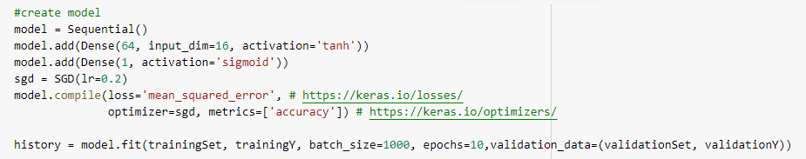
Final Network

Slide 10
Larger Data Sets
Given two larger data sets:
3 million lead-lead nuclei collisions
30 million proton-proton collisions
Lead-lead collisions:
tested with 1 million, 2 million, 3 million
accuracy increased to 96% from 1-2 million events
No change when increasing size from 2-3 million

Slide 11
Larger Data Sets: proton-proton collisions
Tested at 10, 20, and 30 million
Google colab crashes when trying to read through 480 million data points (30 million rows X 16 columns)
At 20 million model.evaluate() gives 0.01%
Accuracy and loss graphs also flatline
Same behavior at 10 million

Slide 12
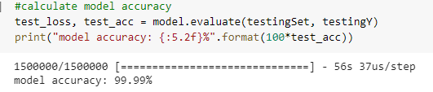
Larger Data Sets: No normalization
Using a 10 million row dataset without normalizing gives 99.99% accuracy

Slide 13
Future work/Questions that remain
Why does no normalization have more accuracy than z-score on larger data sets?
Could the way z-score is calculated have a negative effect and compounds when the dataset size increases?
Could the difference in training on lead-lead vs. proton-proton have an effect?

Slide 14
Questions?

