Slide 1
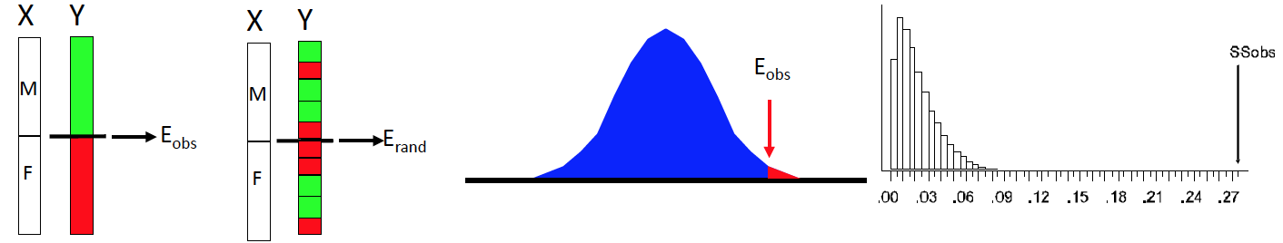
Permutation Process

Slide 2

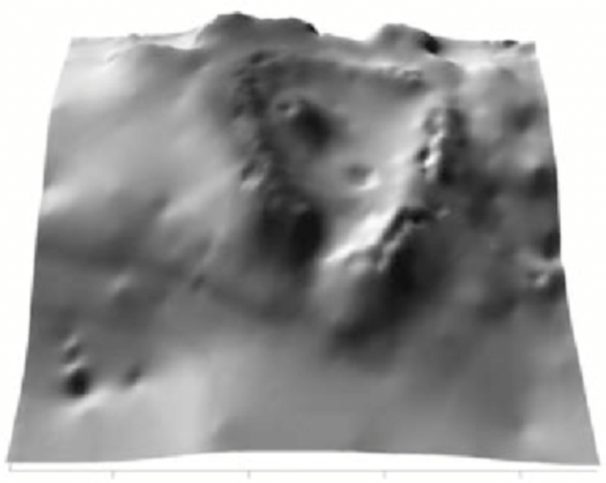
NMS Helicopter Analogy
One starting configuration of the data
Hypothetical Stress Landscape

