Slide 1
Multivariate Statistical methods in R
Nick Lyon

Slide 2
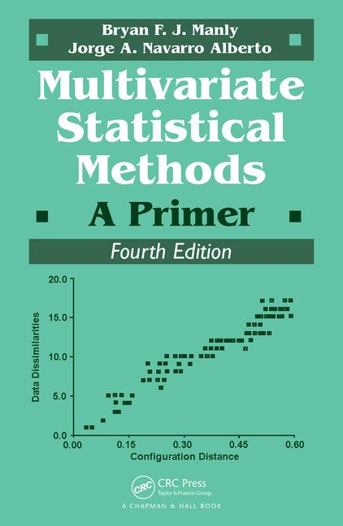
Caveat before we begin
Read this book ->
Has complete R appendix for:
Every example
Every figure
Every operation
Essentially written in R Markdown
Is actually pretty engaging to read

Slide 3
Outline
Background
Resampling/Permutation
Multivariate Data Visualization
Principal Components Analysis (PCA)
Nonmetric Multidimensional Scaling (NMS)

Slide 4
Multivariate Background
Background
Multivariate definition:
Any dataset with more variables (p) than observations (n)
I.e. more columns than rows
Basically every ecology/evolution dataset
Difference from (improvement on) univariate
Univariate explores variation in one variable
Multivariate explores variation in many variables
And their potential inter-relationships

Slide 5
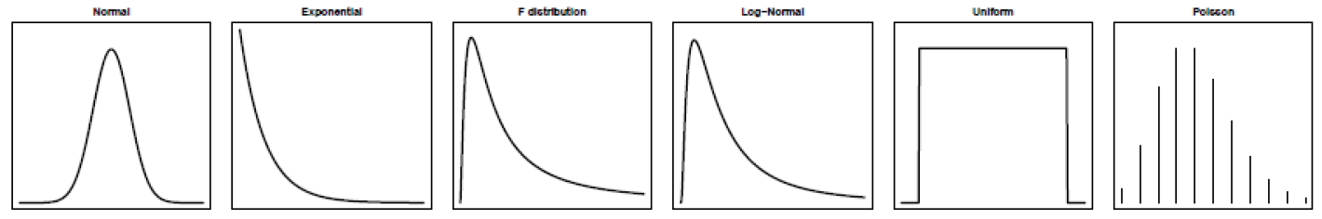
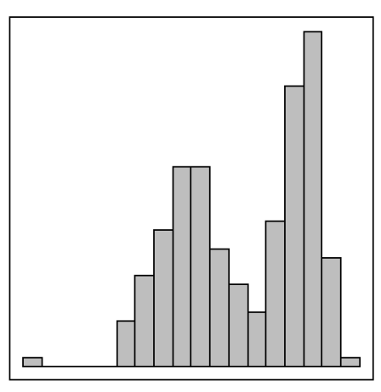
Permutation/Resampling Methods
Permutation
Frequentist Statistics
Theoretical distributions from theory
Resampling Statistics
Theoretical distributions from the data
Slide modified from:
Dean Adams’ Biostats course

Slide 6
Permutation Theoretical Process
Permutation
Process
Take samples from data (i.e. “re-sample” data)
Evaluate significance based on the re-sampled group
Resampling/permutation methods are:
Nonparametric
I.e. no theoretical distribution
Flexible
Can assess both standard and non-standard designs
High-dimensional data (p > n)
Slide modified from:
Dean Adams’ Biostats course

Slide 7
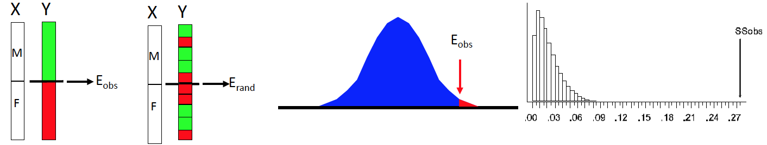
Two Major Types of Permutation
Permutation
”Full” Permutation
Residual Permutation
Permute the whole dataset
Fit the preferred model
Permute the residuals
E_{resid}

Slide 8
Multivariate Visualization
Viz
Can be used as synonymous with “ordination”
Frequently uses “multidimensional scaling”
Condense many dimensions of data into two or three
Requires distances between objects in multivar. space
Couple main flavors:
PCA
Nonmetric Multidimensional Scaling (NMS)
Principal Coordinates Analysis (PCoA)
Related to PCA
Aka Metric Multidimensional Scaling
Not covered here, but cool if you really want metric

Slide 9
Principal Components Analysis
PCA
Goal: reduce the number of variables
Mechanism: create combinations of existing variables to summarize variation
Want each combination to contain max variation possible
Such that you approach 100% variation summarized in only a few indexes
PC # = observation # (n)

Slide 10
PCA Theoretical Process
PCA
For variables (X_{i}) you want to create indexes (I_{k})
I₁ = X₁ + X₂ + X₃ + X₄ + X₅
Then:
I₂ = X₁ + X₂ + X₃ – X₄ – X₅
…
…
…
Eventually:
I_{k} = X₁ – X₂ – X₃ – X₄ – X₅

Slide 11
Special Considerations of PCA
PCA
Axis orthogonality
Due to the variation maximization, axes are ”constrained to orthogonality”
Plain English: they are all perpendicular
This means PC3 through PC_{n} are defined as soon as PC1 & PC2 are
Focus on early PCs to avoid this problem
Not a hypothesis test
Good for visualizing patterns in data
Not good for statistical evaluation

Slide 12
Nonmetric Multidimensional Scaling
NMS
Sometimes aka NMDS or NMMDS
Nonmetric means it uses dissimilarities
Dissimilarity ≠ distance
Get to choose the number of dimensions
Then scale to that number
Aims to reduce “stress” between objects
Stress indicates how much tension there is between the distances among points and their spatial configuration
Want stress to be small (i.e. have high goodness of fit)

Slide 13
NMS Process
NMS
Choose starting configuration of points
Move them around and measure stress at each configuration
Keep moving until stress minimizes
Start again with a different position
Rinse and repeat
Multiple starting configurations help avoid local stress minima

Slide 14

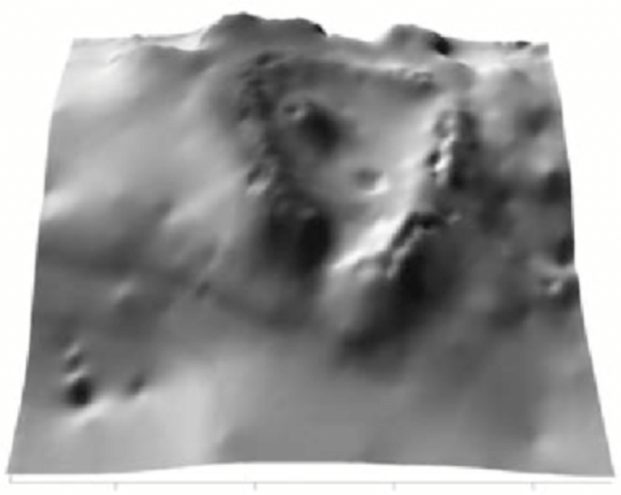
NMS Helicopter Analogy
NMS
One starting configuration of the data
Hypothetical Stress Landscape

